Slide 1
Basic principles of RF Superconductivity
Tobias Junginger

Slide 2



Particle Acceleration with cavities
1. Acceleration with radiofrequency cavities requires synchronization of particles and RF field. Outside of the cavity the approaching particle bunch does not experience the RF field
In this lecture we will address these questions:
Superconductivity means no resistance. Why can’t we reduce the losses zero?
Why is niobium the material choice which requires costly helium cooling?
What are the fundamental and technical limitations of niobium SRF cavities?
  Highest Energy Gain → Maximum Accelerating Gradient?
  Lowest cryogenic losses → Maximum Quality Factor?
What are possible future materials and what are the challenges?
beam direction
Particle bunch
E
H
2. The particle bunch enters the cavity. The electric field is pointing in the direction of the beam axis → The particle is accelerated
beam direction
Particle bunch
E
H
3. The particle bunch leaves the cavity. The field direction has changed again
beam direction
Cavities are used to accelerate particles by an alternating electric field
An oscillating electric field causes an oscillating magnetic field
The cavity confines the electromagnetic fields by surface shielding currents
These currents create losses (heating), which can be reduced by using superconducting materials
E
H
Particle bunch
Free space: $∇×H=ε_{0}\frac{∂E}{∂t}$
$$\text{P}\text{erfect} \text{conductor}: ∇×H=J$$
Ohm‘s law: $J$=σE

Slide 3
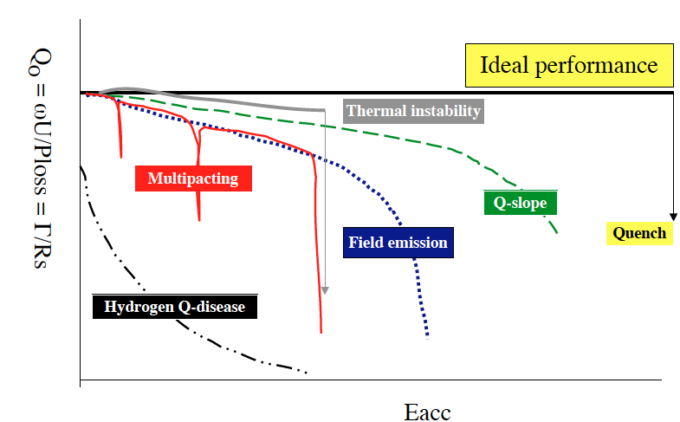
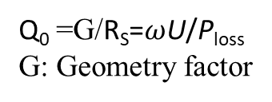

Performance of SRF cavities
There are two parameters which define the performance of an SRF cavity: Quality factor and the accelerating gradient
The quality factor:
Q₀ =G/R_{S}=$ω$U/P_{loss}
G: Geometry factor
The accelerating gradient can be limited by the peak surface electric field (field emission) or the peak surface magnetic field (quench)
Quality FactorQ₀ =G/R_{S}=$ω$U/P_{loss}
Accelerating Gradient E_{acc} ∝ B_{peak}
E
B
There are two ways to increase performance: Shape and material optimization
In this lecture the focus is on material optimization. What are the intrinsic limitations to R_{s} and B_{peak}
Shape optimization and extrinsic limitations, i.e Multipacting, field emission and thermal breakdown are covered in Bob’s lecture

Slide 4
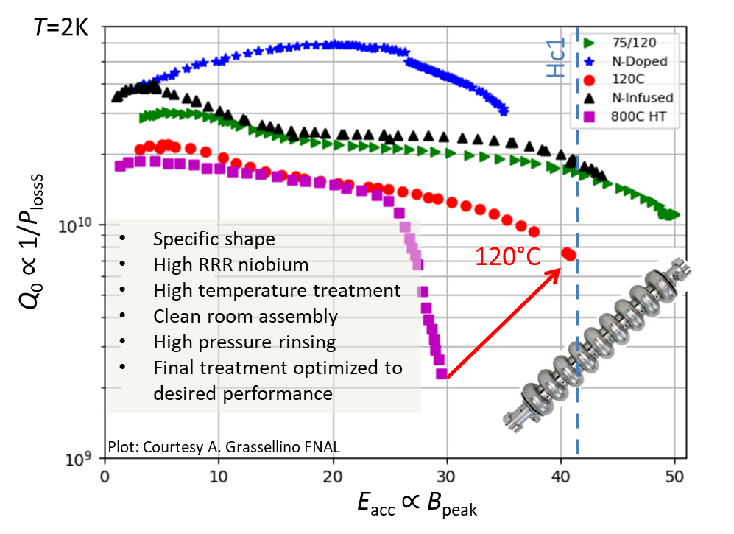
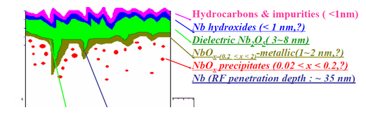
Surface treatments for State of the art SRF cavities
SRF is highly efficient but complex technology
Supercurrents only flow within a few tens of nanometres
  Performance is very sensitive to near surface material properties which can be engineered by heat treatments in vacuum or low pressure gas atmosphere
Maximum quality factor and accelerating gradient depend on surface treatment but also on RF frequency, cavity shape (surface field configuration), ambient magnetic flux in a correlated and not fully understood way

Slide 5
Superconducting Materials

Slide 6
Outline
Quick recap of London theory and demonstration of the Meissner effect
Surface Resistance
  Electrodynamics of normal conductors
    Normal and anomalous skin effect
  Electrodynamics of superconductors
    Surface impedance of superconductors in the two fluid model and the BCS theory
    Residual resistance
    Field dependence of surface resistance
Maximum RF field
  DC critical fields, Hc, Hc1, Hc2, Hsh
  Critical field under RF
Materials for SRF
  Why niobium
  Materials beyond niobium
  Multilayers

Slide 7
Outline
Quick recap of London theory and demonstration of the Meissner effect
Surface Resistance
  Electrodynamics of normal conductors
    Normal and anomalous skin effect
  Electrodynamics of superconductors
    Surface impedance of superconductors in the two fluid model and the BCS theory
    Residual resistance
    Field dependence of surface resistance
Maximum RF field
  DC critical fields, Hc, Hc1, Hc2, Hsh
  Critical field under RF
Materials for SRF
  Why niobium
  Materials beyond niobium
  Multilayers

Slide 8
Overview of theories
London Theory
  Based on Maxwell´s equations. Phenomenological theory that can describe zero resistance and the Meissner effect
  Best applicable to Type-II superconductors
Ginzburg Landau Theory
  Can describe non-local effects
  Applicable to Type-I and II superconductors
BCS Theory
  First microscopic theory of superconductivity
  Published 46 years after the discovery of superconductivity

Slide 9


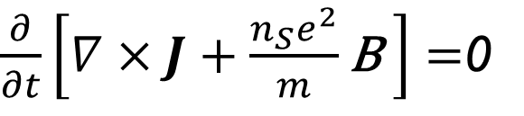
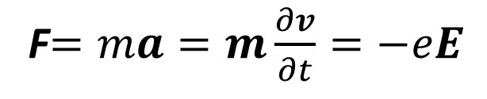
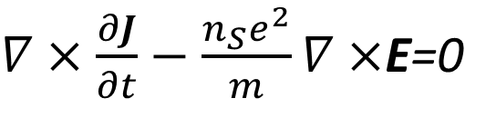
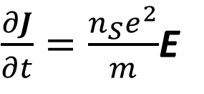
The London Theory
Assume an electron which is freely accelerated by an electric field
Lorentz force acting on the particle:
F$=ma=m\frac{∂v}{∂t}=−eE$
$\frac{∂J}{∂t}=\frac{n_{S}e^{2}}{m}$E
J$=−en_{S}v$
1st London Equation
Definition of the current density
To explain the Meissner effect we want to derive an equation that relates J to B
Maxwell equation:
$$∇×E=−\frac{∂B}{∂t}$$
$∇×\frac{∂J}{∂t}−\frac{n_{S}e^{2}}{m}∇×$E=0
$\frac{∂}{∂t}\left[∇×J+\frac{n_{S}e^{2}}{m}\text{B} \right]=$0
The goal is to obtain a differential equation for B

Slide 10
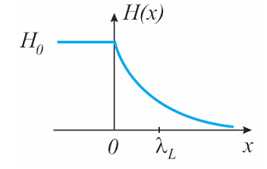


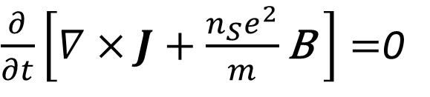
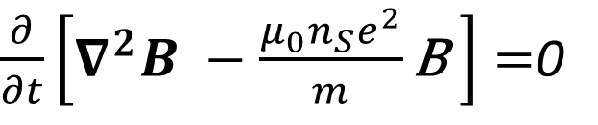


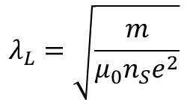




The London Theory
Ampere´s law relates the current density J and the magnetic flux density B
$$∇×B=μ_{0}J$$
$\frac{∂}{∂t}\left[∇×J+\frac{n_{S}e^{2}}{m}\text{B} \right]=$0
$$μ_{0}∇×J=−∇^{2}B$$
$\frac{∂}{∂t}\left[∇^{2}B −\frac{{μ_{0}n}_{S}e^{2}}{m}\text{B} \right]=$0
$$∇×B=μ_{0}J$$
B(x)
B₀
$$∇×∇×B=μ_{0}∇×J$$
$$∇×∇×B=∇\left(∇B\right)−∇^{2}B$$
Maxwell equation
$$∇B=0$$
2 possible solutions:
$$1. B=const$$
London penetration depth
$$λ_{L}=\sqrt{\frac{m}{μ_{0}n_{S}e^{2}}}$$
2. B(x)$=B_{0}exp⁡(−\frac{x}{λ_{L}})$
with
Let us check which solution is physically meaningful

Slide 11
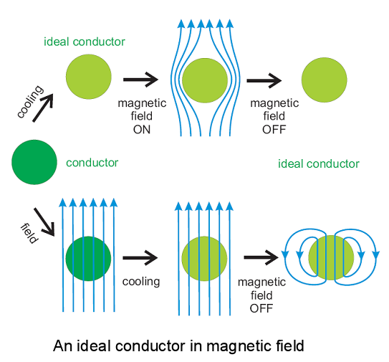

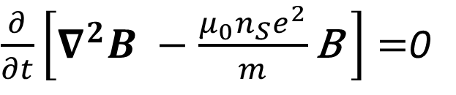

Perfect Conductor
$\frac{∂}{∂t}\left[∇^{2}B −\frac{{μ_{0}n}_{S}e^{2}}{m}\text{B} \right]=$0
Consider a conductor which fulfills these solutions when cooled below its critical temperature
$$1. B=const$$
2. B(x)$=B_{0}exp⁡(−\frac{x}{λ_{L}})$
This is not what we observe in superconductors

Slide 12
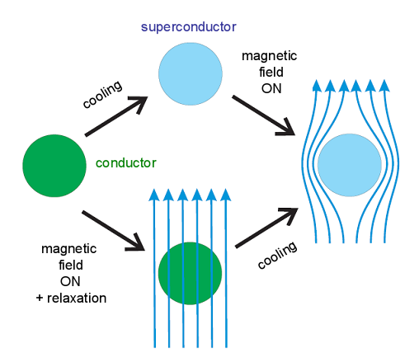


Superconductor - Meissner Effect
$$1. B=const$$
2. B(x)$=B_{0}exp⁡(−\frac{x}{λ_{L}})$
Superconductivity is a phase transition
The final state does not depend on the order of cooling and applying field
The constant solution is not physically meaningful

Slide 13

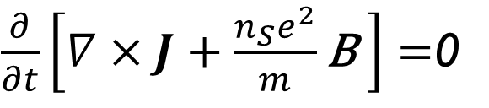
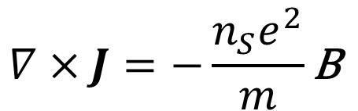


London Theory and Meissner Effect
Only exponential decaying fields are observed
$$1. B=const$$
2. B(x)$=B_{0}exp⁡(−\frac{x}{λ_{L}})$
To explain the Meissner effect the Londons postulated:
$\frac{∂}{∂t}\left[∇×J+\frac{n_{S}e^{2}}{m}\text{B} \right]=$0
Finally we have derived the two London equations:
$$∇×J=−\frac{n_{S}e^{2}}{m}\text{B}$$
$\frac{∂J}{∂t}=\frac{n_{S}e^{2}}{m}$E
Zero Resistance
Meissner Effect

Slide 14




Pippards extension of London´s Theory
Pippard found that λ_{L} depends on the purity of the material and therefore on the electron mean free path l
He introduced of the new parameter coherence length ξ in analogy to the anomalous skin effect in normal conductors
$$λ\left(l\right)=λ_{L}\sqrt{1−{ξ0}/l}$$
Non-local relation between current density and vector potential:
$$\frac{1}{ξ}=\frac{1}{ξ_{0}}+\frac{1}{l}$$
$$\vec{R}=\vec{r}−\vec{r^{′}}$$
Pippard introduced ξ as a phenomenological parameter. Later explained by the microscopic BCS theory
A.B Pippard - Proceedings of the Royal Society of London. A Vol. 216, No. 1127 (1953)
Notes:
Which material?

Slide 15
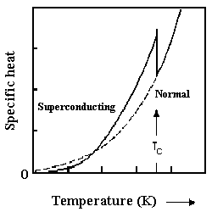
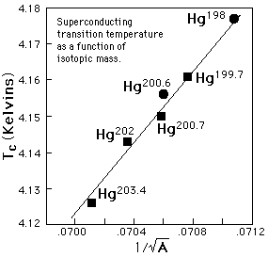


The microscopic BCS theory
What needed to be explained?
Zero Resistance and Meissner Effect
Coherence (Non-local relation between current density and E-field)
Energy Gap (exponential specific heat)
  Suggests a Bose-Einstein condensation like process
The isotope effect
  The transition temperature of mercury depends on the isotopic mass
  This suggests that the lattice is important for superconductivity
$$∝T3$$
$$∝exp⁡(−Δ/kbT)$$

Slide 16
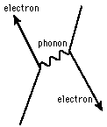
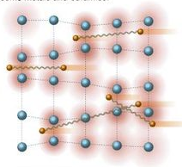

The microscopic BCS theory
Pairing of electrons close to the Fermi level into Cooper pairs through interaction with the crystal lattice
  Boson (no Pauli exclusion principle)
  All cooper pairs condense to the same ground state
  Coherent wave functions → no scattering → zero resistance
Size of a cooper pair is large compared to the lattice constant and is related to the coherence length ξ
Estimated size of a cooper pair:
Relaxation time of the lattice: 2π/ω_{D}≈10⁻¹³s
Electrons move with v_{F}≈10⁶m/s
Distance between electrons forming a cooper pair:
$ξ≈\text{(}\text{2}\text{π}\text{/}\text{ω}\text{D}\text{)}$ v_{F}≈10⁻⁷m

Slide 17
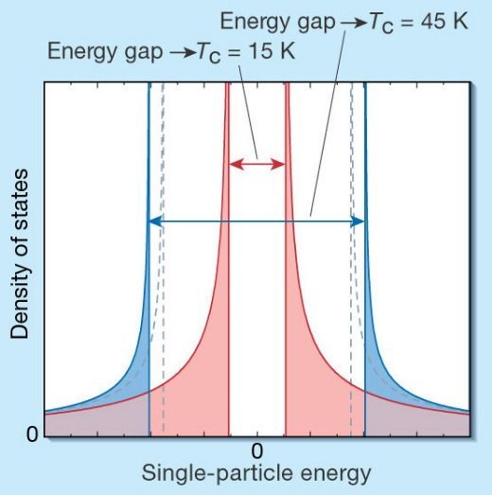
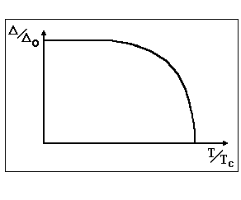
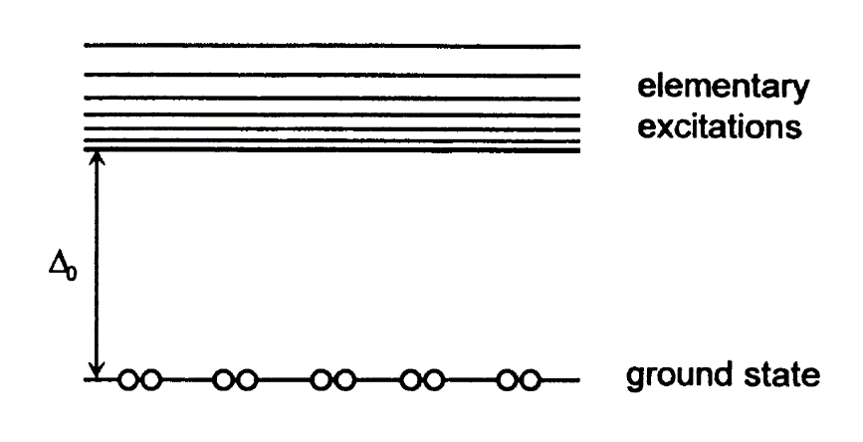
The microscopic BCS theory
The superconducting state consists of electron pairs and elementary excitations, quasiparticles, behaving almost like free electrons
BCS theory
GL theory
The energy gap Δ separates the energy levels of elementary excitations from the ground state level. At 0K only the ground state is occupied
Density of elementary excitations. There are no states within the energy gap Δ
Temperature dependence of Δ:
The gap has its full value Δ₀ at 0K and vansishes at T_{C}
The BCS theory has been derived from perturbation theory – valid only close to 0 K
Close to T_{C} the Ginzburg-Landau theory is valid

Slide 18


Ginzburg-Landau Theory
Based on Landau's previously-established theory of second-order phase transitions
Free energy, F, of a superconductor near the superconducting transition can be expressed in terms of a complex order parameter
Assuming |ψ| and A and their gradients to be small, the free energy can be expressed in a Taylor series
Extension to include magnetic fields
$$ψ\left(\vec{r}\right)=\left|ψ\left(\vec{r}\right)\right|e^{iφ\left(\vec{r}\right)}$$
$gS=gN+α{\left|ψ \right|}^{2}$ $+β{\left|ψ \right|}^{4}$
$gS(B)=gN+α{\left|ψ \right|}^{2}$ $+β{\left|ψ \right|}^{4}+\frac{1}{2μ_{0}}{\left|B_{a}−B_{i}\right|}^{2}+\frac{1}{2m}{\left|\frac{ℏ}{i}(Δ−qA)ψ\right|}^{2}$
Energy needed to reduce the external field B_{a} inside the SC to B_{i}
Energy change from currents necessary to cause a spatial variation of ψ

Slide 19




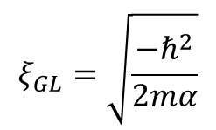
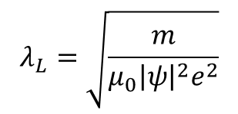

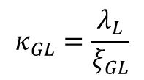
Ginzburg-Landau Theory
$gS(B)=gN+α{\left|ψ \right|}^{2}$ $+β{\left|ψ \right|}^{4}+\frac{1}{2μ_{0}}{\left|B_{a}−B_{i}\right|}^{2}+\frac{1}{2m}{\left|\frac{ℏ}{i}(Δ−qA)ψ\right|}^{2}$
Minimizing g_{S} wrt to Δψ and ΔA (variational method) yields the Ginzburg-Landau equations:
$J=\frac{qℏ}{2m}(ψ^{∗}Δψ−ψΔψ^{∗})+\frac{q^{2}}{m}{\left|ψ\right|}^{2}$ A
$$\left(ψ^{∗}Δψ−ψΔψ^{∗}\right)=0$$
London equation:
$${ns=\left|ψ\right|}^{2}$$
$$∇×J=−\frac{n_{S}e^{2}}{m}\text{B}$$
$αψ{+β\left|ψ \right|}^{2}ψ$ $+\frac{1}{2m}{\left|\frac{ℏ}{i}(Δ−qA)ψ\right|}^{2}=0$
Characteristic lengths:
Penetration depth is the length scale for the variation of the magnetic field
Coherence length is the length scale for the variation of the order parameter
Ginzburg-Landau parameter
$$λ_{L}=\sqrt{\frac{m}{μ_{0}{\left|ψ\right|}^{2}e^{2}}}$$
$$ξ_{GL}=\sqrt{\frac{{−ℏ}^{2}}{2mα}}$$
$$κ_{GL}=\frac{λ_{L}}{ξ_{GL}}$$

Slide 20
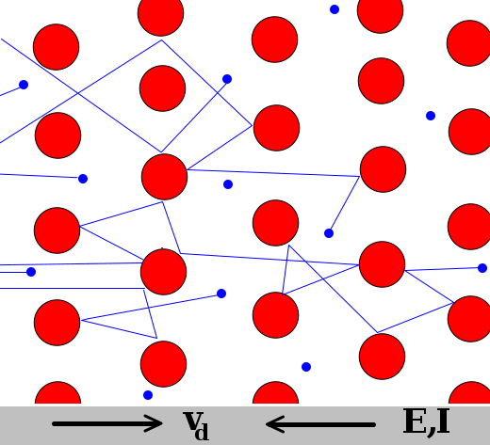
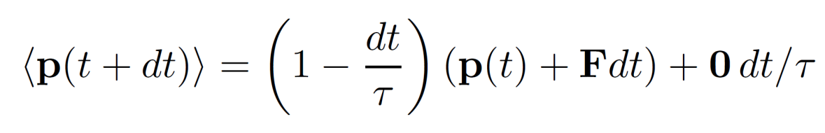

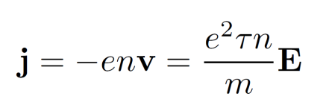
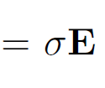

DC electrical conduction: resistance
DRUDE MODEL
Kinetic Theory of Gases
Electron scattering time τ. Probability of scattering within time interval dt is dt/τ
After scattering p=0.
+ Free Acceleration between collisions
Average momentum
Probability for scattering within dt
Probability for no scattering within dt
Momentum gain of unscattered electrons
Drude model electrons (shown here in blue) constantly bounce between heavier, stationary crystal ions (shown in red).
Only E fields:
$$\frac{dp}{dt}=−eE−\frac{p}{τ}$$
The Drude model provides an understanding what conductivity is.
The steady state solution is useful for RF application, where the RF period is much longer than the scattering time.
Steady state:
Ohm´s law:
Scattering time τ = l/v_{F} ≈ 10⁻¹⁴s
Notes:
Scattering to zero makes sense when a large number of particles is considered. The average momentum is zero if it is treated as a vector.

Slide 21
Outline
Quick recap of London theory and demonstration of the Meissner effect
Surface Resistance
  Electrodynamics of normal conductors
    Normal and anomalous skin effect
  Electrodynamics of superconductors
    Surface impedance of superconductors in the two fluid model and the BCS theory
    Residual resistance
    Field dependence of surface resistance
Maximum RF field
  DC critical fields, Hc, Hc1, Hc2, Hsh
  Critical field under RF
Materials for SRF
  Why niobium
  Materials beyond niobium
  Multilayers

Slide 22
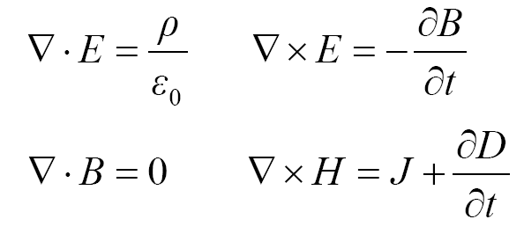
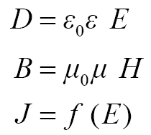

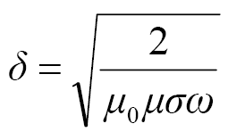
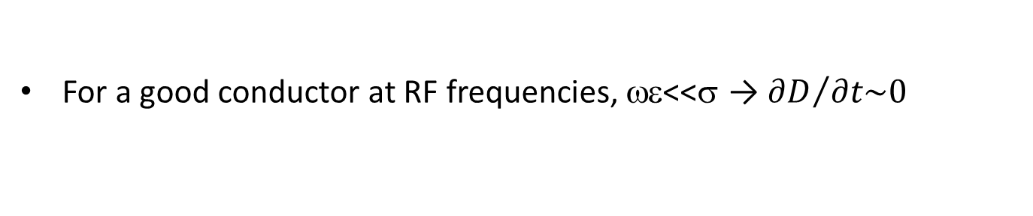
Electrodynamics of normal conductors
j=σE
(linear and isotropic) material’s equations
Maxwell’s equations
For a good conductor at RF frequencies, ωε<<σ → ${∂D}/{∂t\sim 0}$
$$∇×∇×H=∇\left(∇∙H\right)−∇^{2}H=σ∇×E=−iμ_{0}μσωH$$
Solution (semi-infinite slab):
E_{z}(x,t)
H_{y}(x,t)
z
y
x

Slide 23
Surface Impedance
The surface impedance is defined as:
surface reactance
E_{z}(x,t)
surface resistance
H_{y}(x,t)
z
y
x
For the semi-infinite plane conductor:
Notes:
Ratio of electric field at the surface to the total current flowing across a unit line in the surface.
The surface resistance of the semi-infinite plane conductor is the same as the dc resistance of a plane conductor of depth \delta

Slide 24
Surface resistance: intuitive meaning
Since we will deal a lot with the surface resistance R_{s} in the following, here is a simple DC model that gives a rough idea of what it means:
Consider a square sheet of metal with resistivity ρ and calculate its resistance to a transverse current flow:
In this model the surface resistance R_{s} is the resistance that a square piece of conductor opposes to the flow of the currents induced by the RF wave, within a layer δ
a
Resistance of a square metal sheet of thickness d:
a
current
δ
Surface Resistance of a square metal sheet with penetration depth δ:
d
Courtesy: S. Calatroni

Slide 25
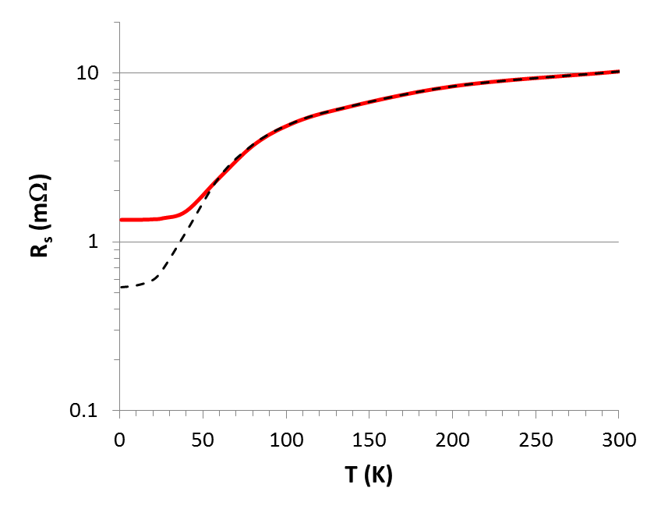
What happens at low temperature?
Surface resistance of Cu at 1.5 GHz as a function of temperature with conductivity σ=1/ρ
Anomalous skin effect l>δ
At room temperature the conductivity is dominated by phonon scattering
At low temperature phonons “freeze out” and the conductivity depends on impurity concentration.
The residual resistivity ratio RRR = σ(0K)/σ(300K) is a measure of material purity
R_{s}=1/σδ
Courtesy: G. Ciovati
R_{s}(4.2 K) ≅ 1.3 mΩ
…in spite of the resistivity decreasing by a factor 300 from 300 K to 4.2 K, R_{s} only decreases by a factor of ~8!
To reduce R_{S} below the mΩ range for RF application we need superconductivity!
Notes:
Less numbers. Better explanation of anomalous skin effect. Some numbers

Slide 26
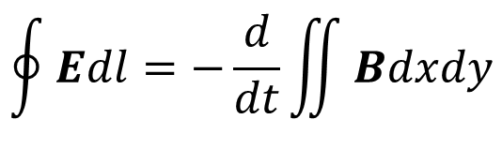
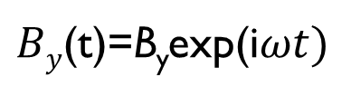
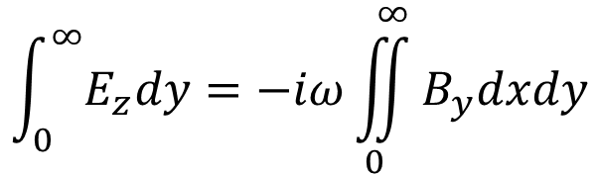
The RF surface resistance (intuitive approach)
Consider an alternating magnetic field at the surface of a semi-infinite superconductor
Consider Faraday's law of induction
$By$(t)=B_{y}exp(i$ωt)$
$$\oint{Edl=−\frac{d}{dt}\iint{Bdxdy}}$$
Vacuum
Superconductor
B
Integration area
J,E
$$\int_{0}^{∞}{E_{z}dy}=−iω\iint_{0}^{∞}{B_{y}dxdy}$$
y
x

Slide 27
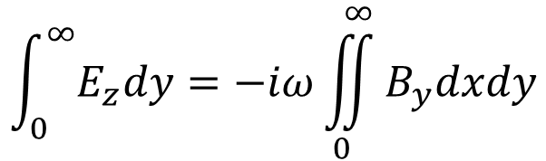
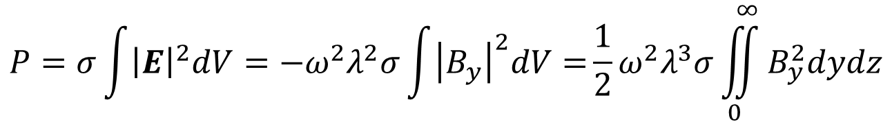

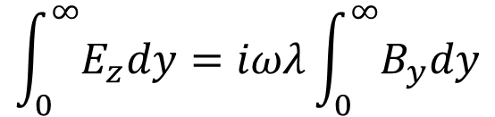

The RF surface resistance (intuitive approach)
$$\int_{0}^{∞}{E_{z}dy}=−iω\iint_{0}^{∞}{B_{y}dxdy}$$
B(x)$=B_{y}exp⁡(−\frac{x}{λ_{L}})$
Vacuum
Superconductor
$$\int_{0}^{∞}{E_{z}dy}=iωλ\int_{0}^{∞}{B_{y}dy}$$
B
J,E
E_{z} and B_{y} are both independent of y
$$E_{z}=iωλB_{y}$$
y
Ohms law:
x
$$P=σ\int{{\left|E\right|}^{2}dV}=−ω^{2}λ^{2}σ\int{{\left|B_{y}\right|}^{2}dV=}{\frac{1}{2}ω}^{2}λ^{3}σ\iint_{0}^{∞}{B_{y}^{2}dydz}$$

Slide 28
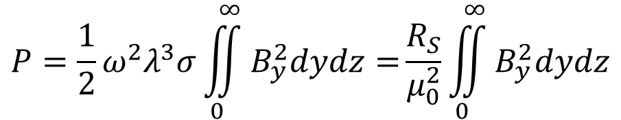
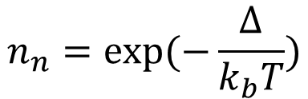
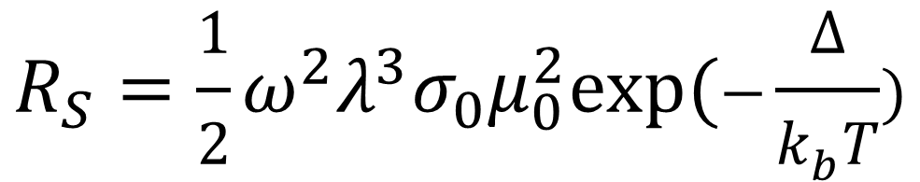
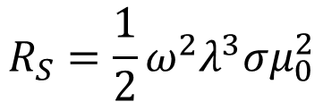

The RF surface resistance (intuitive approach)
$$P={\frac{1}{2}ω}^{2}λ^{3}σ\iint_{0}^{∞}{B_{y}^{2}dydz=}\frac{R_{S}}{μ_{0}^{2}}\iint_{0}^{∞}{B_{y}^{2}dydz}$$
n
electron density
n_{s}
$$R_{S}={\frac{1}{2}ω}^{2}λ^{3}σμ_{0}^{2}$$
Definition of the
Surface resistance
T_{c}
temperature (K)
$$σ=σ_{0}n_{n}=σ_{0}exp⁡(−\frac{Δ}{k_{b}T})$$
$$R_{S}={\frac{1}{2}ω}^{2}λ^{3}σ_{0}μ_{0}^{2}exp⁡(−\frac{Δ}{k_{b}T})$$
Close to 0 K:
$$n_{n}=exp⁡(−\frac{Δ}{k_{b}T})$$

Slide 29
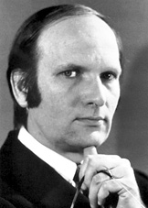
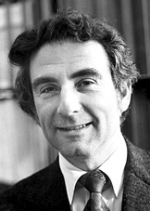






Historical Overview
1908 Liquefaction of helium (4.2 K)
1911 Zero resistance
1933 Meissner effect
1935 Phenomenological theory of H. & F. London
1950 Ginzburg – Landau theory
1951 – 2 types of superconductors (Abrikosov)
1957 Bardeen – Cooper – Schrieffer microscopic theory
1960 Magnetic flux quantisation
1962 Josephson effect
1986 High temperature superconductors (Bednorz – Müller)
Bardeen – Cooper – Schrieffer (BCS)
Ginzburg
Landau
Abrikosov
Bednorz
Müller

Slide 30


Surface Resistance of Superconductors
Superconducting currents are transported by Cooper pairs formed of two electrons
  flow without friction → DC supercurrents are lossless
For temperatures above 0 K not all electrons form Cooper pairs
Cooper pairs have a finite inertia. Under RF fields a time-varying E-field is induced in the material. Normal electrons see this field, move and dissipate
$$n_{n}(T)∝e^{−∆/k_{B}T}$$
+
+
j=σE
R_{s} > 0

Slide 31

Surface Resistance in the two fluid model
Basic ingredients for RF superconductivity
  Two fluid model (Gorter-Casimir)
  Maxwell electrodynamics
  London equations
n
electron density
n_{s}
T_{c}
temperature (K)
Basic assumptions of two fluid model
  all free electrons of the superconductor are divided into two groups:
    superconducting electrons of density n_{s}
    normal electrons of density n_{n}
  The total density of the free electrons is
  n = n_{s} + n_{n}
  As the temperature increases from 0 to T_{c}, the density n_{s} decreases from n to 0.
$$n_{n}=exp⁡(−\frac{Δ}{k_{b}T})$$

Slide 32

Surface Resistance in the two fluid model
London equation:
Two fluid model:
= σ₂
σ
Electrodynamics of sc is the same as nc, only that we have to change σ → σ₁ – i σ₂
Penetration depth:
σ₁ << σ₂ for sc at T<<T_{c}
Scattering time τ = l/v_{F} ≈ 10⁻¹⁴s
Interesting to note here: -We have derived λ_{L} from DC arguments before
- Now we find δ=λ_{L} for T<<T_{c}
Notes:
E=Eeiwt… Rework!!!

Slide 33


Surface Resistance in the two fluid model
Electrodynamics of sc is the same as nc, only that we have to change σ → σ₁ + i σ₂
Recall the definition of the surface impedance:
For σ₁<< σ₂ we obtain:
E_{z}(x,t)
H_{y}(x,t)
$σ=σ_{1}$+i$σ_{2}$
z
y
x
L_{s}: kinetic inductance

Slide 34

Rs within BCS theory
Mattis and Bardeen (1958) used time dependent perturbation theory to derive R_{S} for weak RF fields
Within this theory no simple formula can be derived. Several approximate formula can be found in the literature for some limits. For example for the dirty limit
There are numerical codes (Halbritter (1970) to calculate R_{BCS} as a function of ω, T and material parameters (ξ₀, λ_{L}, T_{c}, Δ, l)
For example, http://www.lepp.cornell.edu/~liepe/webpage/researchsrimp.html
$R_{S}={\frac{1}{2}ω}^{2}λ^{3}σ_{1}μ_{0}^{2}ln\left(\frac{Δ}{ℏω}\right)exp\left(⁡−\frac{Δ}{k_{b}T}\right)$/T

Slide 35


Rs within BCS theory
Be carefureful here. The website suggests 40nm. The input required is πξ₀/2, while ξ₀≈40nm for Nb

Slide 36

BCS vs two fluid model
The treatment within BCS theory and two-fluid model give qualitatively similar results
Quantitatively they can differ by an order of magnitude
  The BCS treatment gives qualitatively correct results for low field
To treat experimental data approximate formulae are useful, e.g.
Here A accounts for all material parameters
$$R_{S}=\frac{ω^{2}A}{T}\exp\left(−\frac{Δ}{k_{b}T}\right)$$

Slide 37


The RF surface resistance
$$R_{BCS}=ω^{2}λ^{3}σ_{1}μ_{0}^{2}exp⁡\left(−\frac{Δ}{k_{b}T}\right)$$
This equation implies R_{S}:
Has a minimum for medium purity
Is proportional to $ω^{2 }$
Decreases exponentially with temperature
Vanishes as T→0 K
Is independent of RF field strength
In the following we will compare these assumptions to experimental data and modify the formula if necessary

Slide 38



Material purity dependence of R_{s}
$$R_{BCS}=ω^{2}λ^{3}σ_{1}μ_{0}^{2}exp⁡\left(−\frac{Δ}{k_{b}T}\right)$$
The dependence of the penetration depth on l is approximated as
σ₁ ∝ l
$$RS∝{\left(1+\frac{πξ0}{l}\right)}^{3/2}l$$
if l >> ξ₀ (“clean” limit)
if l << ξ₀ (“dirty” limit)
Nb on Cu,1.5 GHz, 4.2 K
R_{s} has a minimum for l = πξ₀/4
C. Benvenuti et al., Physica C 316 (1999) 153.
Example: Nb films sputtered on Cu substrate
By changing the sputtering species, the mean free path was varied
RRR of niobium on copper cavities can be tuned for lowest R_{S}.
“clean”
“dirty”

Slide 39



CERN – Nb on Cu cavities
352 MHz
CERN first started to use Nb on Cu technology for LEP-II cavities.
Du to the low frequency and optimal mean free path economical operation at 4.5K was possible
400 MHz
The technology was then adopted for the 400 MHz LHC cavities
100 MHz
LHC cavities
Hie-Isolde Quarter Wave Resonator commissioned in 2015
Hie-Isolde cavities

Slide 40


The RF surface resistance
$$R_{BCS}=ω^{2}λ^{3}σ_{1}μ_{0}^{2}exp⁡\left(−\frac{Δ}{k_{b}T}\right)$$
This equation implies R_{S}:
Has a minimum for medium purity
Is proportional to $ω^{2 }$
Decreases exponentially with temperature
Vanishes as T→0 K
Is independent of RF field strength
In the following we will compare these assumptions to experimental data

Slide 41




The RF surface resistance
$$R_{BCS}=ω^{2}λ^{3}σ_{1}μ_{0}^{2}exp⁡\left(−\frac{Δ}{k_{b}T}\right)$$
Normal Conducting
Superconducting
1200MHz
800MHz
$$R_{S}(0K)≠0$$
400MHz
$R_{S}=R_{BCS}$(T)+R_{res}
Measurement of the surface resistance at low field of niobium at three frequencies with the Quadrupole Resonator

Slide 42



The RF surface resistance
$R_{S}=ω^{2}λ^{3}σ_{1}μ_{0}^{2}exp⁡\left(−\frac{Δ}{k_{b}T}\right)$+R_{res}
This equation implies R_{S}:
Has a minimum for medium purity
Is proportional to $ω^{2 }$ ( )
Decreases exponentially with temperature
Vanishes as T→0 K
Is independent of RF field strength

Slide 43


The residual resistance
According to the BCS theory there are no quasiparticle states within the energy gap Δ
Smearing of Density of States leads to a residual resistance
T. Proslier et at Appl Phys Lett 92 212505 2008
Point contact tunneling experiments on Nb and Nb₃Sn have found finite density of states (DOS) inside the energy gap
Subgap states will yield a finite R_{S}(0K) irrespective of physical mechanism

Slide 44
The residual resistance
DoS smearing is not the only cause of residual resistance
Other contributions to R_{res}:
Trapped magnetic flux and thermal currents
Lossy oxides, metallic hydrides
Normal conducting precipitates
Grain Boundaries
Interface Losses
Magnetic Impurities

Slide 45
Trapped Magnetic Flux
Well understood contribution to R_{res}
When a cavity is cooled down in an ambient DC magnetic field not all flux is expelled – Incomplete Meissner effect
In fact fields of a few µT (order earth magnetic field) can be completely trapped
In cryomodules thermal currents can cause additional magnetic fields which can be trapped

Slide 46


Trapped Magnetic Flux
Simple model with these assumptions:
  Fluxoids are perpendicular to the cavity surface
  Fluxoids are static, no displacement due to RF fields
  RF currents flow around them
  Flux completely trapped
  Losses are independent on RF field
H. Padamsee et al. RF Superconductivity for Accelerators
Additional residual resistance=Ratio nc/sc area$×$Normal conducting surface resistance
for RRR=300

Slide 47
The RF surface resistance
$R_{S}=ω^{2}λ^{3}σ_{1}μ_{0}^{2}exp⁡\left(−\frac{Δ}{k_{b}T}\right)$+R_{res}
This equation implies R_{S}:
Has a minimum for medium purity
Is proportional to $ω^{2 }$ ( )
Decreases exponentially with temperature
Vanishes as T→0 K
Is independent of RF field strength

Slide 48
Surface treatments for State of the art SRF cavities
Maximum quality factor and accelerating gradient depend on surface treatment but also on RF frequency, cavity shape (surface field configuration), ambient magnetic flux in a correlated and not fully understood way

Slide 49
The RF surface resistance
$R_{S}=ω^{2}λ^{3}σ_{1}μ_{0}^{2}exp⁡\left(−\frac{Δ}{k_{b}T}\right)$+R_{res}
This equation implies R_{S}:
Has a minimum for medium purity
Is proportional to $ω^{2 }$ ( )
Decreases exponentially with temperature
Vanishes as T→0 K
Is independent of RF field strength
Not only do R_{BCS} and R_{res} depend on the RF field strength there can also be additional extrinsic losses limiting the cavity performance

Slide 50

Field emission
Under high RF fields electrons can be released from the surface and accelerated.
Released electrons will impact on the cavity wall creating x-rays and heating → Reduced Q-value
Field emitters found on dissected cavities (size 0.5-10μm with sharp edges)

Slide 51

Field emission
Solution to field emission – high pressure water rinsing (100 atm), and an ultra-clean assembly => remove field emitters and preserve cleanliness
A lot more on this in Ari’s lecture tomorrow

Slide 52
Thermal Breakdown
Quench is the final limitation set by the critical field of the material
A quench can however occur at much lower fields if the magnetic field locally exceeds the critical field or the temperature exceeds the critical temperature at sub mm size defects of high resistivity
At high fields these defects will heat up its surrounding area above T_{c} and a normal conducting area will spread causing a quench
Avoiding thermal breakdown
Use material with high thermal conductivity: high purity niobium or niobium on copper cavities
Careful electron beam welding
Post processing
In production usually the cavity is chemically etched again
Big defects with sizes of 1 mm can be mechanically grinded away. This requires knowledge of the quench position from online diagnostics during cold test and optical inspection afterwards.

Slide 53




Quench localization and visualization
Quench sites can be located with temperature mapping
Alternative approaches to temperature mapping are
Second sound – Y. Tamashevich
Transition Edge Sensors – H. Furci (both talks on Thursady)
Afterwards the location can be visualized with an optical inspection system

Slide 54


Performance of SRF cavities
There are two parameters which define the performance of an SRF cavity: Quality factor and the accelerating gradient
The quality factor. Remember:
Q₀ =G/R_{S}=$ω$U/P_{loss}
$${R_{S} \text{∝} n}_{n}\text{∝}\text{(−}\text{∆}k_{B}/T)$$
The accelerating gradient can be limited by the peak surface electric field (field emission) or the peak surface magnetic field (quench)
E
E_{acc} ∝ B_{peak}
B
Intrinsic limitations: Q-disease and Q-slope

Slide 55



The hydrogen Q-disease
If a cavity is cooled down slowly around 50-150K Q decreases
Effect correlated to hydrides
Some cavities recover after warm up to RT
800$°$C baking is always effective

Slide 56

Performance of SRF cavities
There are two parameters which define the performance of an SRF cavity: Quality factor and the accelerating gradient
The quality factor. Remember:
Q₀ =G/ R_{S}=$ω$U/P_{loss}
$${R_{S} \text{∝} n}_{n}\text{∝}\text{(−}\text{∆}k_{B}/T)$$
The accelerating gradient can be limited by the peak surface electric field (field emission) or the peak surface magnetic field (quench)
E
E_{acc} ∝ B_{peak}
B
lntrinsic limitations: Q-disease and Q-slope

Slide 57

The high field Q-slope
Observations:
    Strong decrease of Q₀ above E_{acc} > 20 MV/m
    Tesla cavities( B_{p} > 85 mT )
    Field emission not involved ( no e ⁻, no X rays )
    T map : global heating in the area of max B-field
    Limitation by RF power supply or quench
    Seemingly a typical feature of BCP cavities
“European Headache”
superiority of EP
without Q-slope
( L. Lilje et al. - SRF ’99 - Santa Fe )
K. Saito et al.
SRF ’97
( Abano Terme )
( Nb 1-cell cavity )
( E. Kako et al. - SRF ’99 - Santa Fe )

Slide 58
Baking Effect on BCP Cavities
    “in-situ” baking discovered on BCP cavity
  slope improvement ( 90 < T < 120°C ) - degradation ( T > 150°C )
Baking reduces R_{BCS} but increases R_{res}:
( B. Visentin et al. – EPAC ’1998 - Stockholm )

Slide 59
Baking Effect on EP Cavities
Courtesy B. Visentin
  Same phenomenon on E.P. cavities
  before baking: Q-slope identical to BCP
      after baking : Q-slope improvement
P. Kneisel. – TUP 044
K. Saïto. – TUP 031
L. Lilje et al. – TUA 001
B. Visentin et al. – TUP 015
SRF ’ 99
Santa Fe
apparent superiority of EP reported before ?
cleaning procedure at KEK
wet cavities ( High Power Rinsing )
directly pumped out and baked at 85°C/20h
to accelerate pumping speed
( Saclay cavity – EP & tested @ KEK )

Slide 60



Field dependence of Rs
Strong RF currents affect superconducting properties, in particular the DOS
Observed normal ΔR_{S}/ΔB>0 mainly due to external sources and dependent on material preparation
Inversed ΔR_{S}/ΔB <0 is thought to be intrinsic
A theory of non-linear R_{S} at high field [A. Gurevich, Phys. Rev. Lett. 113, 087001 (2014)]
R_{s}(H) was re-derived from first principles (BCS) taking into account oscillations of N(ε, t) due to RF current pairbreaking and non-equilibrium distribution function of quasiparticles in the dirty limit
$$R_{BCS}=ω^{2}λ^{3}σ_{1}μ_{0}^{2}exp⁡\left(−\frac{Δ}{k_{b}T}\right)$$
Left: σ₁ calculated for different levels of quasiparticle overheating parametrized by α. Right: Nb cavity at 1.75 GHz fitted with α=0.91

Slide 61
Surface treatments for State of the art SRF cavities
Are these fundamental limit?
Nb is reaching fundamental limits in quality factor and accelerating gradient.
Unfortunately so far we can have only one or the other and only for elliptical niobium cavities.
There is still margin for improvement of non-elliptical cavities.
For performance far beyond the state of the art of elliptical cavities materials other than Nb need to considered
Maximum quality factor and accelerating gradient depend on surface treatment but also on RF frequency, cavity shape (surface field configuration), ambient magnetic flux in a correlated and not fully understood way

Slide 62


Slide 63
Outline
Quick recap of London theory and demonstration of the Meissner effect
Surface Resistance
  Electrodynamics of normal conductors
    Normal and anomalous skin effect
  Electrodynamics of superconductors
    Surface impedance of superconductors in the two fluid model and the BCS theory
    Residual resistance
    Field dependence of surface resistance
Maximum RF field
  DC critical fields, Hc, Hc1, Hc2, Hsh
  Critical field under RF
Materials for SRF
  Why niobium
  Materials beyond niobium
  Multilayers

Slide 64







Energy balance at a SC-NC interface
$ΔE$: Energy difference at a NC-SC boundary compared to the SC state
B_{c}: crtical thermodynamic field, above B_{c} the normal conducting state is energetically favorable
Vacuum/n.c
s.c
B
ψ
$ΔE$=0 and resolve wrt B
Energy loss:
The density of cooper pairs is suppressed over the distance $ξ$
Energy gain:
Field does not need to be expelled over the distance $λ$
$$B_{c1}= \sqrt{ξ/λ}B_{c}^{}$$
z
ξ
λ
If $ξ<λ,$ it is energetically favourable to create normal-superconducting boundaries above the lower critical field B_{c1}
These superconductors are referred to as type-II
Exact result from GL theory
$$κ_{GL}=\frac{λ_{L}}{ξ_{GL}}>\frac{1}{\sqrt{2}}$$
Notes:
Give real GL result

Slide 65

Two types of superconductors
Type II Superconductors
  $κ>1/\sqrt{2}$
  Impure metals including high RRR niobium as used for SRF cavities
  All alloys
  For $κ$>>1 local electrodynamics (London theory) applicable
Type I Superconductors
  $κ<1/\sqrt{2}$
  All elements including very pure niobium Phys. Rev. B 106, L180505 (2022)
  Non-local electrodynamics needs to be considered

Slide 66


Flux Quantization
It is energetically favorable for Type-II superconductors to create normal superconducting boundaries
The energy is minimized if the boundary area is maximized
However quantum mechanics does not allow for infinite small domains
  This leads to flux quantization
Deaver und Fairbank
Magnetic flux
Applied Field

Slide 67


Flux Quantization
In Type-II superconductors flux tubes are created each carrying one flux quantum (the minimal flux allowed by quantum mechanics)
Flux tubes are repulsive creating therefore the vortex lattice
STM image of Vortex lattice, 1989
H. F. Hess et al. Phys. Rev. Lett. 62, 214 (1989)

Slide 68

The Magnetization Curve
Magnets
Cavities
Under DC fields flux tubes can be pinned – no dissipation
    SC magnets are operated between H_{c1} and H_{c2}
Under RF fields flux tubes oscillate – dissipation
  RF cavities are operated in the Meissner state
Can the Meissner state persist metastable beyond H_{c1}?

Slide 69

The superheating field
The superheating field H_{sh} is set by the competition between magnetic pressure (imposed by the external magnetic field), the energy cost to destroy superconductivity, and the attractive force due to the zero-current boundary condition at the interface.
H_{c1} is the field where it is energetically favourable for the flux to be in the superconductor
H_{sh} is the field where the Bean-Livingston barrier for flux entry disappears
Defects can serve as entry points for flux preventing superheating
Suggested further reading:
B. Liarte et al. - Supercond. Sci. Technol. 30 (2017) 033002

Slide 70
The superheating field
S. Posen et al. PRL 115, 047001 (2015)
Niobium:
  Close to T_{c} H_{entry}=H_{sh}
  T<<T_{c} usually H_{entry}<H_{sh}
Nb₃Sn:
  Close to T_{c} H_{entry}=H_{sh}
  T<<T_{c} H_{entry}<<H_{sh}
RF heating proportional to H². Close to T_{c} less power is dissipated. Flux entry less likely.
Coherence length of Nb₃Sn smaller than Nb. Flux entry at defects more likely.
The good news is H_{c1} is not a general limitation!

Slide 71
Outline
Quick recap of London theory and demonstration of the Meissner effect
Surface Resistance
  Electrodynamics of normal conductors
    Normal and anomalous skin effect
  Electrodynamics of superconductors
    Surface impedance of superconductors in the two fluid model and the BCS theory
    Residual resistance
    Field dependence of surface resistance
Maximum RF field
  DC critical fields, Hc, Hc1, Hc2, Hsh
  Critical field under RF
Materials for SRF
  Why niobium
  Materials beyond niobium
  Multilayers

Slide 72



Nb₃Sn
Nb3Sn can have the same Rs at 4.2K as Nb 2K as Δ$∝$T_{c}
$$R_{BCS}=ω^{2}λ^{3}σ_{0}μ_{0}^{2}exp⁡\left(−\frac{Δ}{k_{b}T}\right)$$

Slide 73

Multilayer
A. Gurevich - Supercond. Sci. Technol. 30 (2017) 034004
To address the low-B_{c1} problem of high-B_{c} materials, it was proposed to coat the Nb cavities with multilayers of thin superconductors (S) separated by dielectric (I) layers
For d_{S}<λ no thermodynamically stable parallel vortices in decoupled S layers

Slide 74

SRF Material of the future

Slide 75
Recommanded Literature
General solid state physics
S.H Simon The Oxford Solid State BasicsGeneral, OUP Oxford, 2013
General Superconductivity
W. Buckel and R. Kleiner, « Superconductivity: Fundamentals and applications», Wiley-VCH 2004
V. V. Schmidt « The physics of superconductors », Springer 1997
M. Tinkham, « Introduction to superconductivity », McGraw-Hill 1996
Online lectures from Cambridge University: http://www.msm.cam.ac.uk/ascg/lectures/fundamentals/isotope.php
RF Superconductivity
R. Padamsee, J. Knobloch and T. Hays – « RF Superconductivity for Accelerators », Wiley-VCH, 2008
J. P. Turneaure, J. Halbritter, and H. A. Schwettman. « The surface impedance of superconductors and normal conductors: The Mattis-Bardeen theory. » Journal of Superconductivity 4.5 (1991): 341-355.
A. Gurevich « Theory of RF superconductivity for resonant cavities. » Superconductor Science and Technology, 30(3), 034004 (2017).
A. Gurevich «Tuning microwave losses in superconducting resonators. »
Supercond. Sci. Technol. 36 063002 (2023)
SRF23 Tutorial A. Miyazaki

Slide 76
Thank you
Questions?

