Slide 1

Accelerator Physics Primer
(mainly transverse plane)
H.Schmickler, ex-CERN
Presented by F.Tecker, CERN
Corresponds to the
expected Level of the “successful student” after the Introductory CAS

Slide 2
The original title has been:
Accelerator Physics Primer and Need for SC Technologies
The real need for SC technologies does not need two hours to be explained (and will be explained in other presentations).
In short:
Higher Fields in dipole magnets (2T → at least 9T)
Higher gradients and/or apertures in quadrupoles
Much higher Q-factor for accelerating cavities
Hence this presentation is a 2 hour recap of basic accelerator beam dynamics in order to understand the specifications of SC magnets.

Slide 3
Content
Basics (only 5 minutes):
Phenomenology of Special relativity
simple examples of E-fields and B-fields, multipole expansion of B-fields
Linear Optics:
Hamiltonian formalism→ derivative of Hill’s equation from Hamiltonian
Hamiltonian in different Coordinate Systems, weak focusing
- linear optics: motion of single particle in a lattice, phase space plots
- trajectory, closed orbit, dispersion, weak focusing
- strong focusing, tune, chromaticity
- linear Imperfections, feed-down, coupling
- “A taste” of non-linear dynamics
Some Slides partially
or fully taken from:
W. Herr
A. Wolski
R. Tomas
F. Tecker
A. Cianchi
Liouville’s Theorem:
Definition of emittance
emittance preservation in conservative systems
filamentation due to non-linearities
Phenomenology of Collective Effects:
- Space Charge
- Touschek and Intrabeam Scattering
- Wakefields

Slide 4
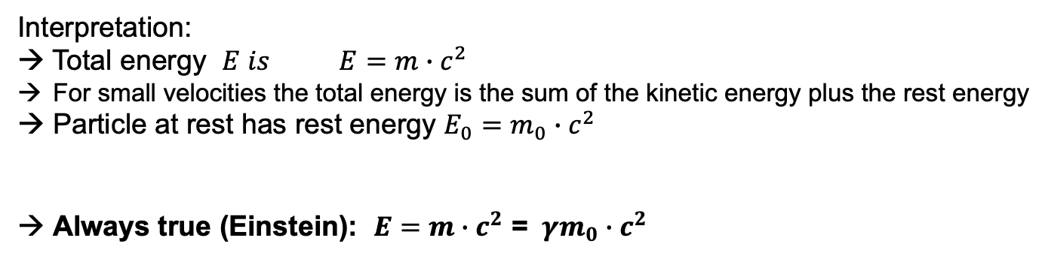
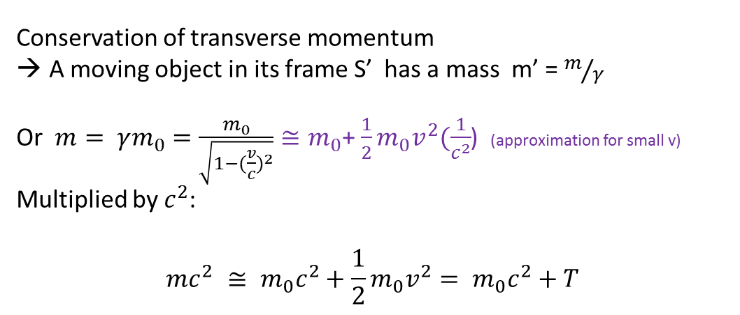
1: Relativistic particles
Conservation of transverse momentum
A moving object in its frame S’ has a mass m’ = $m/γ$
Or $m= γm_{0}$ $=\frac{m_{0}}{\sqrt{1−({\frac{v}{c})}^{2}}}≅m_{0}$+ $\frac{1}{2}m_{0}v^{2}(\frac{1}{c^{2}}$) (approximation for small v)
Multiplied by $c^{2}$:
$$mc^{2} ≅ m_{0}c^{2}+\frac{1}{2}m_{0}v^{2}= m_{0}c^{2}+T$$
Interpretation:
→ Total energy $E is E=m∙c^{2}$
For small velocities the total energy is the sum of the kinetic energy plus the rest energy
Particle at rest has rest energy $E_{0}=m_{0}∙c^{2}$
Always true (Einstein): $E=m∙c^{2}$ = $γm_{0}∙c^{2}$

Slide 5
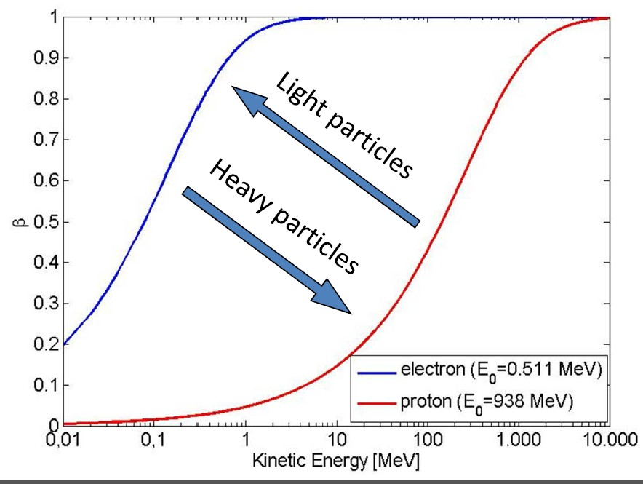




Relativistic momentum
$p=mv=γm_{0}v$ = $γm_{0}βc$
From page before (squared):
$E^{2}= m^{2}c^{4}= γ^{2}{m_{0}}^{2}c^{4}$ = ( $\frac{1}{1−β^{2}}){m_{0}}^{2}c^{4}$= ( $\frac{1−β^{2}+β^{2}}{1−β^{2}}){m_{0}}^{2}c^{4}$ = ($1+γ^{2}β^{2}){m_{0}}^{2}c^{4}$
$E^{2}= {(m_{0}c^{2})}^{2}$ + (${pc)}^{2}$
$$\frac{E}{c}= \sqrt{({m_{0}c)}^{2}+ p^{2}}$$
Or by introducing new units [E] = eV ; [p] =eV/c ; [m] = eV/c²
$E^{2}= {m_{0}}^{2}$ + $p^{2}$
Due to the small rest mass electrons reach already almost the speed of light with relatively low kinetic energy, but protons only in the GeV range

Slide 6
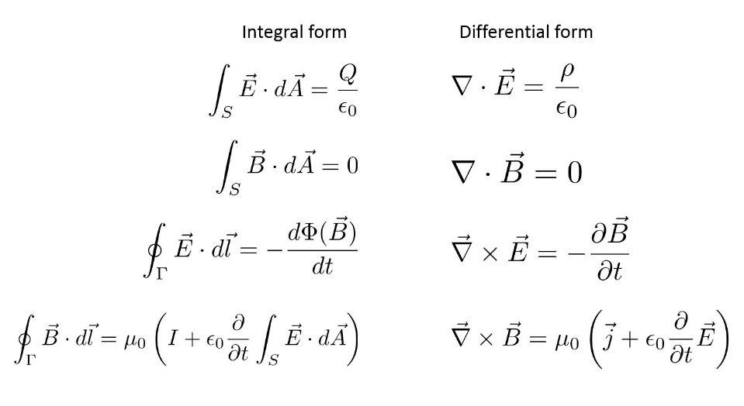
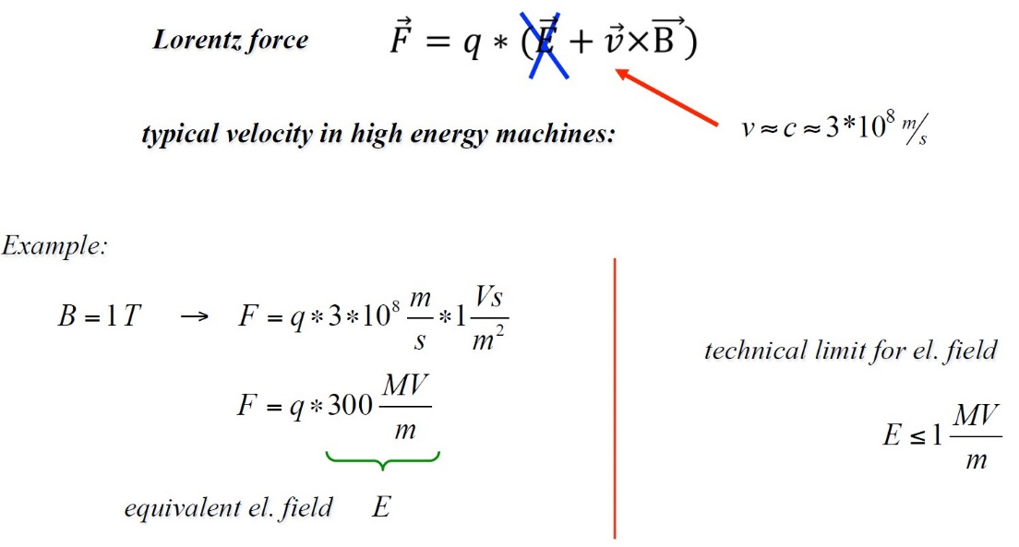
Electromagnetic Fields and forces onto charged particles
Described by Maxwell’s equations and by the Lorentz-force
Lots of mathematics, we will only “look” at the equations
Only electric fields can transfer momentum to charged particles
→ EM cavities for acceleration → F. Tecker
Magnetic fields are used to bend or focus the trajectory of charged particles
→ construction of different types of accelerator magnets
Also electrostatic forces can bend and focus beams; but since the forces are small we often neglect this part

Slide 7
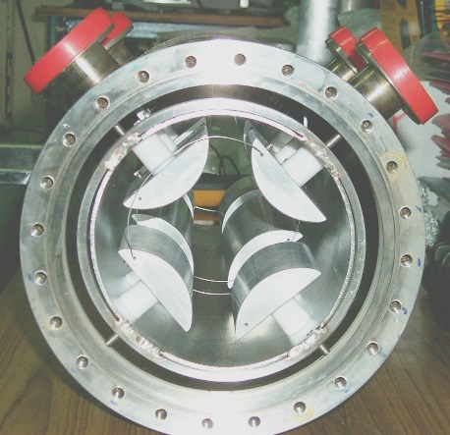
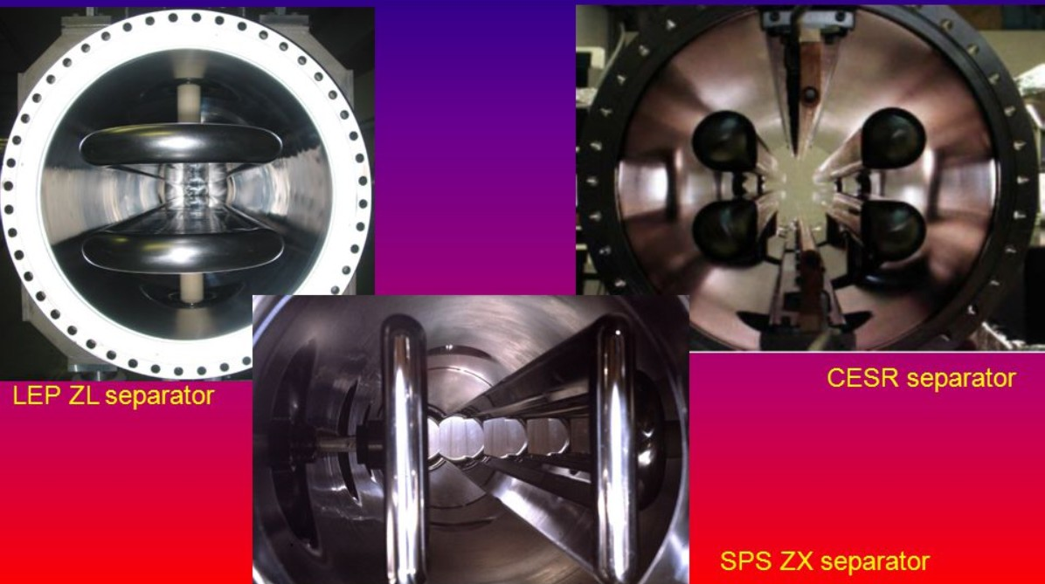
But: for specific cases we also use electrostatic elements
Separators for electron and positron beams in the same vacuum chamber
quadrupole

Slide 8
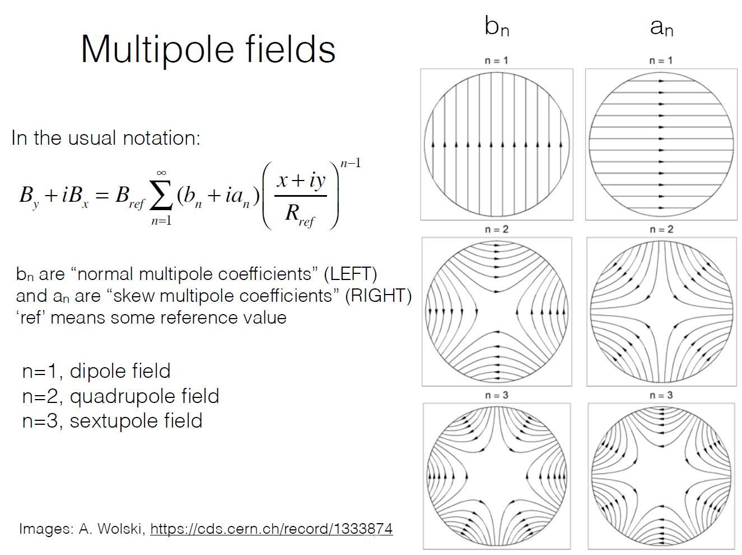
We need real magnets in an accelerator…not any arbitrary shapes of magnetic fields, but nicely classified field types by making reference to a multipole expansion of magnetic fields:

Slide 9
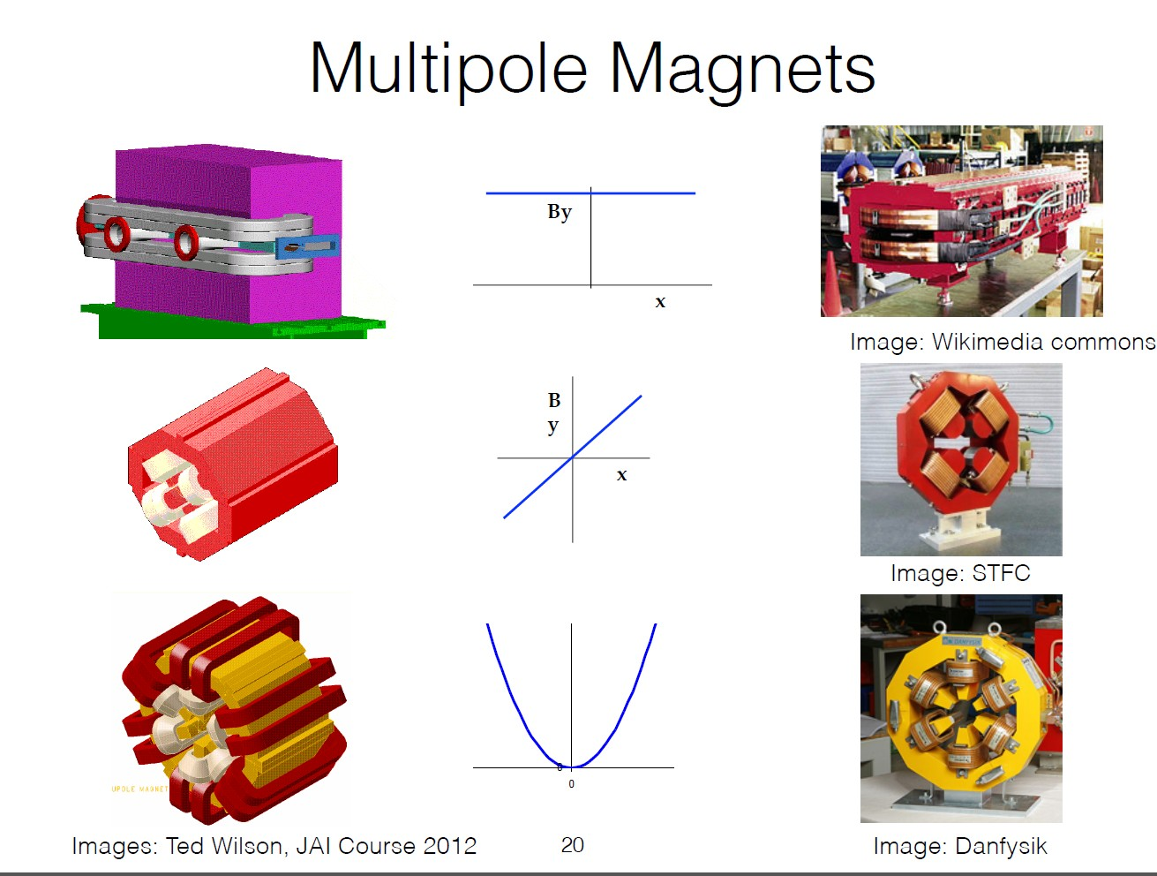

Slide 10
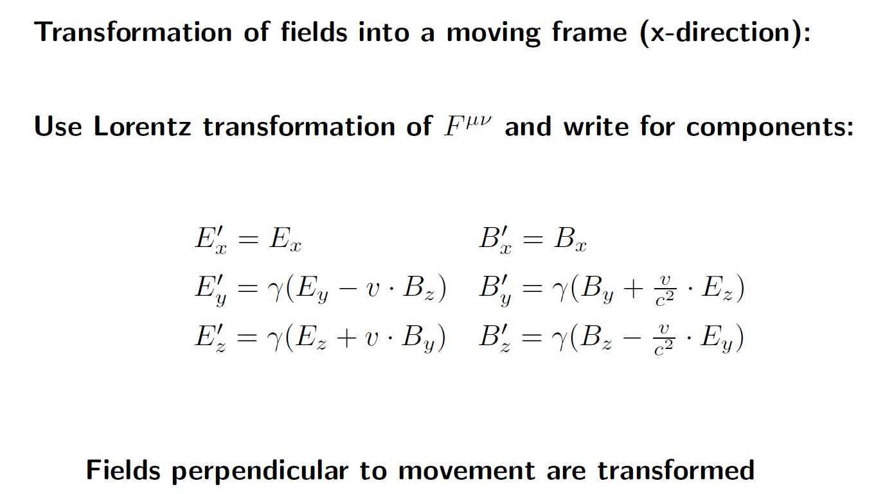
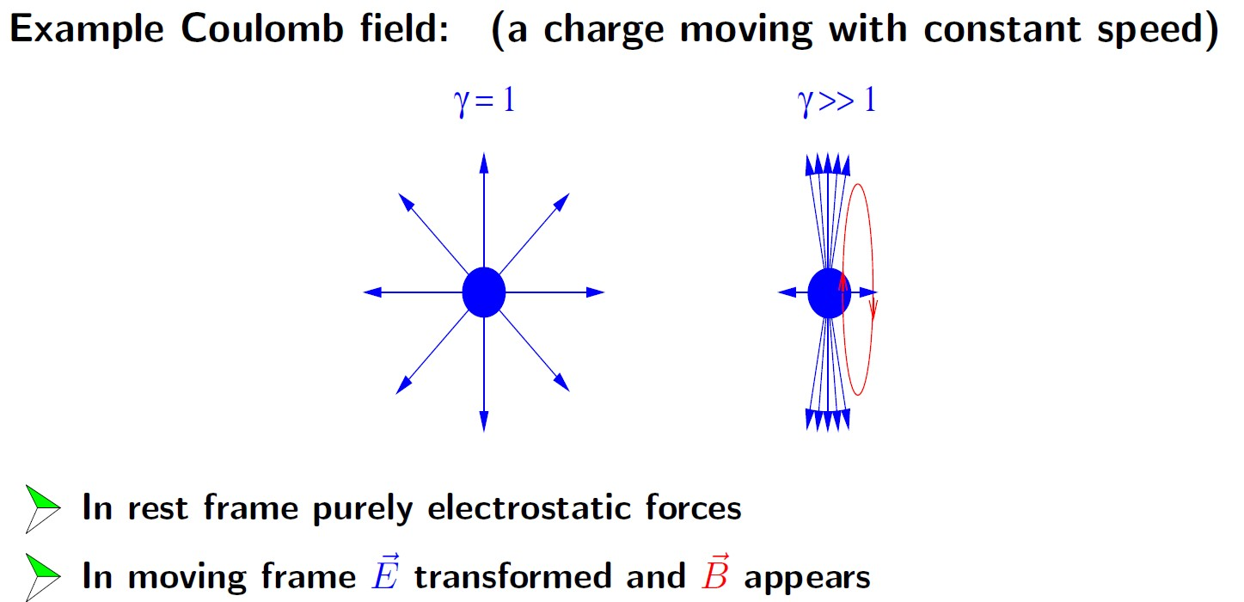
Back to relativity: transformation of fields into a moving frame
Essential to understand energy dependence of Space charge effects

Slide 11
Different Mathematical descriptions…a real pain?
We use differential equations, matrix – formalism, Hamiltonians, perturbation theory…
- Is there a right or wrong?
- Is it personal likings?
→ Depending on the problem to solve (or the phenomenon to describe)
one mathematical tool is more adequate than the other.
→ One should be aware of many of them in order to be able to choose the most adequate one.
In the following slides we will look at the very simple example of the classical spring-oscillator and describe it with a differential equation, with a matrix formalism and by using the Hamiltonian equations of motion.
But first: Definition of phase space and action functional

Slide 12
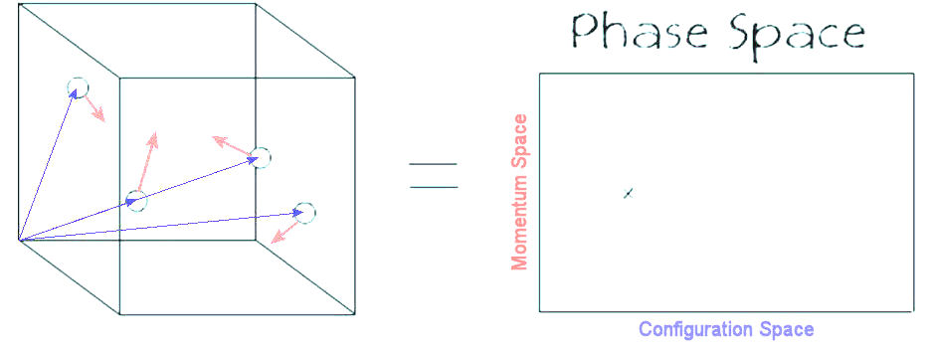
Phase Space
We are used to describe a particle by its 3D position (x,y,z in carth. Coordinates)
(blue arrows below)
In order to get the dynamics of the system, we need to know the momentum
(px, py, pz); red arrows below
In accelerators we describe a particle state as a 6D phase space point.
Below the projection into a 2 D phase space plot.
The points correspond to the x-position (q_{x}) and the x component of the p-vector (p_{x}).
p_{x}
q_{x}
This shows one of the three possible phase space projections

Slide 13
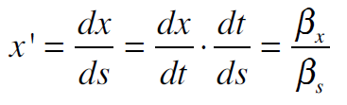

Warning: We often use the term phase space for the 6N dimensional space defined by
x, x’ (space, angle), but this the “trace space” of the particles.
At constant energy phase space and trace space have similar physical interpretation
Trace space
Phase space
x’
p_{x}
x
x
An important argument to use the trace space is that in praxis we can measure angles of particle trajectories, but it is very difficult to measure the momentum of a particle.

Slide 14
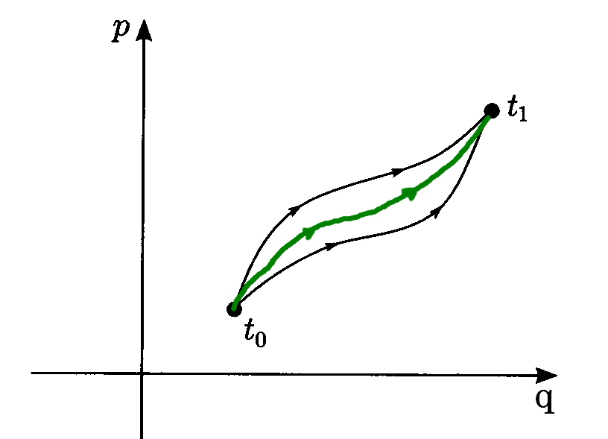
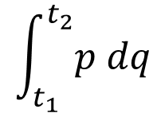
Action functional S
$$\int_{t_{1}}^{t_{2}}{p dq}$$
Define action S:=
No immediate physical interpretation of S
Much more important:
“Stationary” action principle:=
Nature chooses path from t₁ to t₂ such that the action integral is a minimum and stationary
→ we have a new invariant, which we can use to study the dynamics of the system

Slide 15
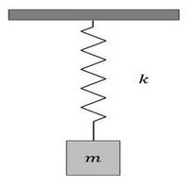



Harmonic oscillator (1/3)
Solved by using a Differential equation
Starting from:
Newton’s Kraftansatz (F = m * a) and
Hook’s law (F = - k * x)
As at school we “guess” the solution:
And we find that with the angular frequency
We have found a description of the motion of our system.

Slide 16

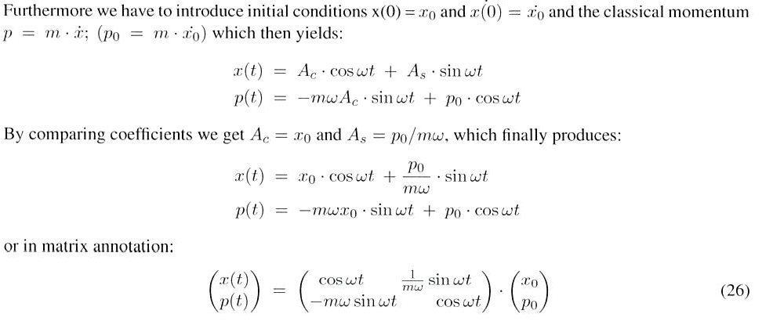
Harmonic oscillator (2/3)
Solved by using a matrix formalism
The general solution to the previous differential equation is a linear combination of a cosine- and a sine-term.
So after an additional differentiation we get:
So we can stepwise develop our solution from a starting point
x₀, p₀

Slide 17
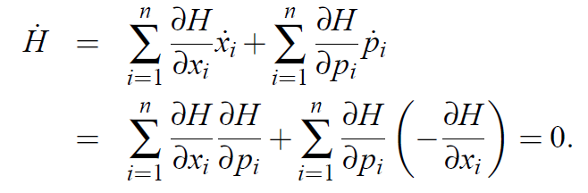


Harmonic oscillator (3a/3)
A little reminder of classical mechanics:
Take a set of “canonical conjugate variables” (q, p in a single one dimensional case)
q is called the generalized coordinate and p the generalized momentum
Construct a function H, which satisfies the dynamical equations of the system:
H “= the Hamiltonian “ of the system is a constant of motion
(= H does not explicitly depend on t) .
The Hamiltonian of a system is the total energy of the system: H = T +V
(sum of potential and kinetic energy)
$$\frac{∂q}{∂t}=\dot{q}=\frac{∂H}{∂p}$$
and
$$\frac{∂p}{∂t}=\dot{p}=−\frac{∂H}{∂q}$$
Proof:
Used x instead of q just to test your attention

Slide 18
Harmonic oscillator (3b/3)
This leads immediately to the question:
What are canonically conjugate variables?
Short answer:
Several combinations are possible, the most relevant for us are
- x (space) and p (momentum)
- E (energy) and t (time).
We can learn most of the physics, when we construct quantities from these canonical variables, which are constants of motion (energy, action…)
* Hint to a more complete answer:
Describe the particle motion by a Lagrange function of generalized coordinates and generalized velocities and time.
- define an action variable and assume that nature is made such that the action between any two points of particle motion is stationary
This is fulfilled for Lagrange functions satisfying the Euler-Lagrange equation
And this leads finally to the definition of generalized momenta instead of generalized velocities, the definition of the Hamiltonian function and then to the two equations of motion as shown on the last slide.

Slide 19
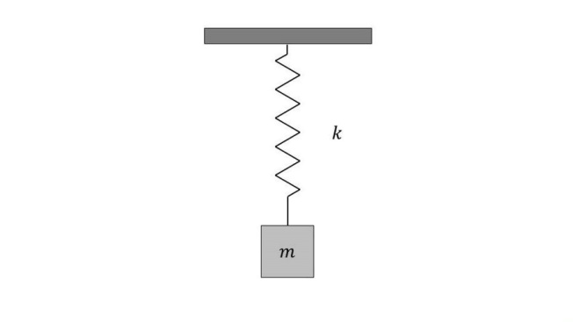
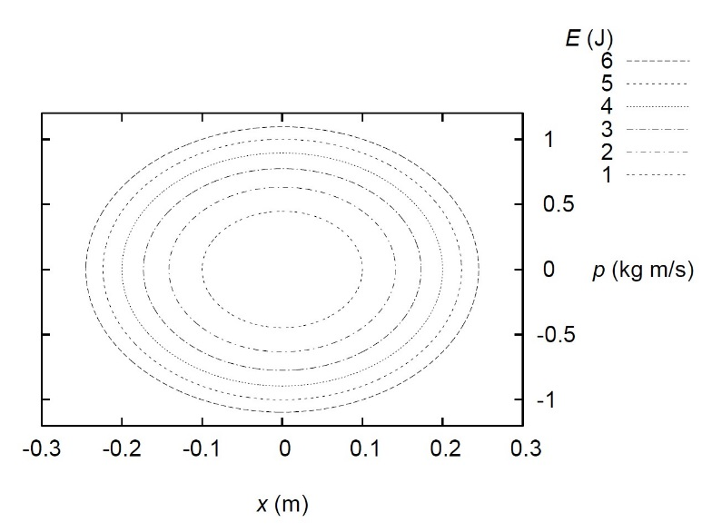
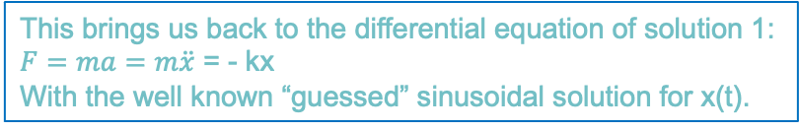



Harmonic oscillator (3c/3)
Back to our Example: Mass-spring system
$H=T+V= \frac{1}{2}$ k $x^{2}$+ $\frac{p^{2}}{2m}$= E
Hamiltonian formalism to obtain the equations of motion:
$\frac{δx}{δt}=\dot{x}=\frac{∂H}{∂p}$ =$\frac{p}{m}$ or p=m$\dot{x}$ = mv
$\frac{δp}{δt}=\dot{p}=−\frac{∂H}{∂x}$ = -kx
This brings us back to the differential equation of solution 1:
$F=ma=m\ddot{x}$ = - kx
With the well known “guessed” sinusoidal solution for x(t).
Instead of guessing a solution for x(t) we look at the trajectory of the system in phase space.
In this simple case the Hamiltonian itself is the equation of an ellipse.

Slide 20

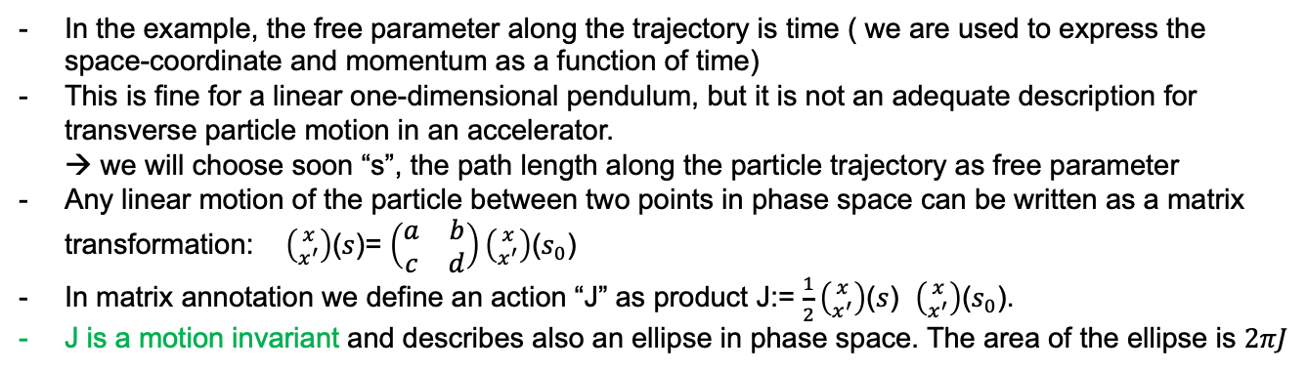
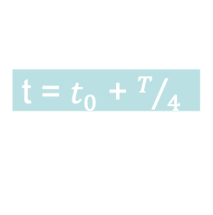
Outlook on Hamiltonian treatments
Increasing t
$$t=t_{0}$$
t = $t_{0}$ + $T/4$
In the example, the free parameter along the trajectory is time ( we are used to express the space-coordinate and momentum as a function of time)
This is fine for a linear one-dimensional pendulum, but it is not an adequate description for transverse particle motion in an accelerator.
→ we will choose soon “s”, the path length along the particle trajectory as free parameter
Any linear motion of the particle between two points in phase space can be written as a matrix transformation: $\left({x \atop x^{′}}\right)$($s$)= $\left(\begin{matrix}a & b \\ c & d\end{matrix}\right)\left({x \atop x^{′}}\right)$($s_{0}$)
In matrix annotation we define an action “J” as product J:= $\frac{1}{2}\left({x \atop x^{′}}\right)$($s$) $\left({x \atop x^{′}}\right)$($s_{0}$).
J is a motion invariant and describes also an ellipse in phase space. The area of the ellipse is $2πJ$
Why all this? This somewhat mathematically more complex approach allows us more complex systems.
The focus on motion invariants will give us access to important beam observables (ex: emittance)

Slide 21
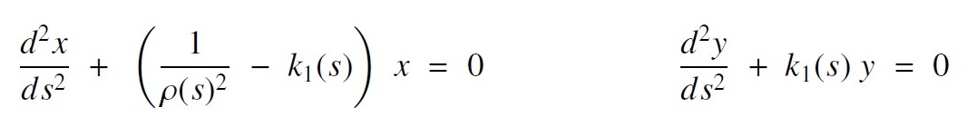
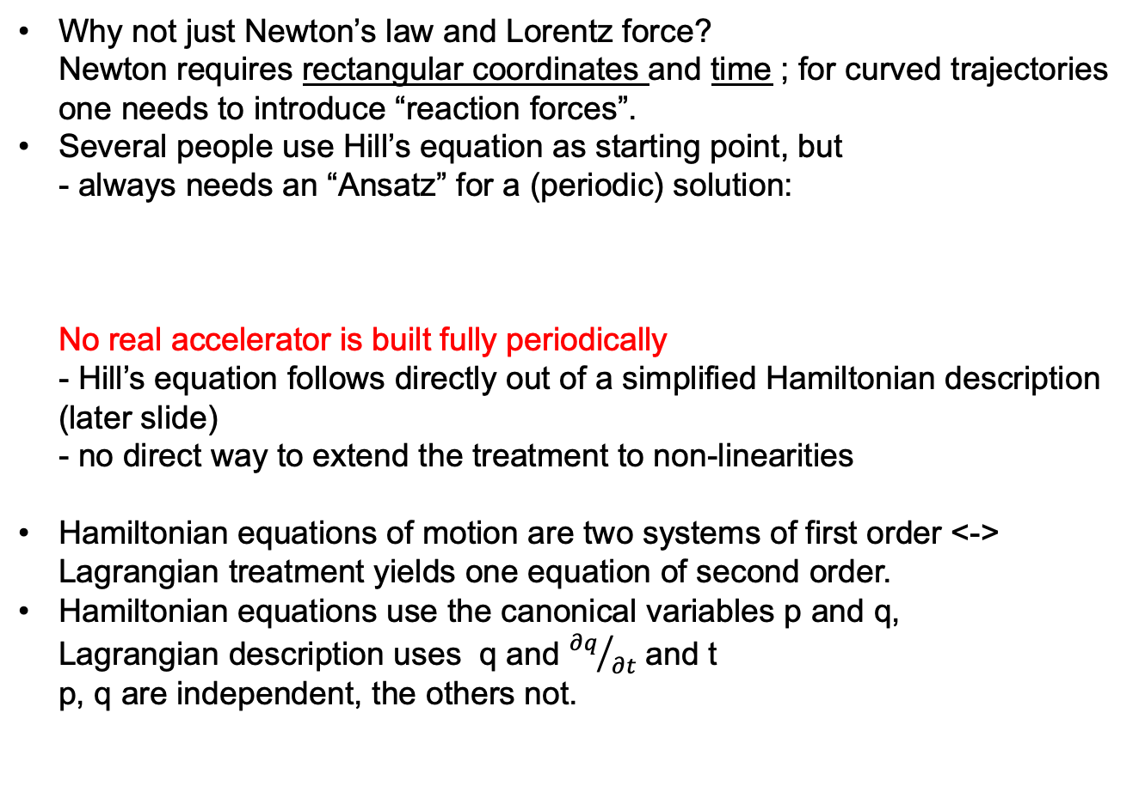
Why “Hamiltonian” treatment (1/2)?
Why not just Newton’s law and Lorentz force?
Newton requires rectangular coordinates and time ; for curved trajectories one needs to introduce “reaction forces”.
Several people use Hill’s equation as starting point, but
- always needs an “Ansatz” for a (periodic) solution:
No real accelerator is built fully periodically
- Hill’s equation follows directly out of a simplified Hamiltonian description
(later slide)
- no direct way to extend the treatment to non-linearities
Hamiltonian equations of motion are two systems of first order <->
Lagrangian treatment yields one equation of second order.
Hamiltonian equations use the canonical variables p and q,
Lagrangian description uses q and ${∂q}/{∂t}$ and t
p, q are independent, the others not.

Slide 22


More Outlook on Hamiltonian treatments
From each point in an accelerator we can come to the next point by applying a map (or in the linear case a matrix).
The map M must be symplectic ← energy conservation
The maps can be calculated from the Hamiltonian of the corresponding accelerator component.
We “know” the Hamiltonian for each individual accelerator component
(drift, dipole, quadrupole…)
This way we generate a piecewise description of the accelerator instead of trying to find a general continuous mathematical solution. This is ideal for implementation in a computer code.
Unfortunately it needs some complex mathematical framework to be able to derive the formalism on how to get symplectic maps from the Hamiltonian.
This is dealt with in some detail later in this course.
The next 2 slides show 2 examples.
$\left({x \atop x^{′}}\right)$($s$)= $M \left({x \atop x^{′}}\right)$($s_{0}$)
Linear case:
$\left({x \atop x^{′}}\right)$($s$)= $\left(\begin{matrix}a & b \\ c & d\end{matrix}\right)\left({x \atop x^{′}}\right)$($s_{0}$)

Slide 23
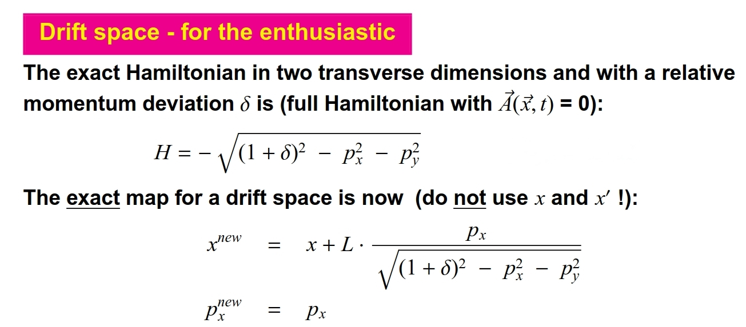
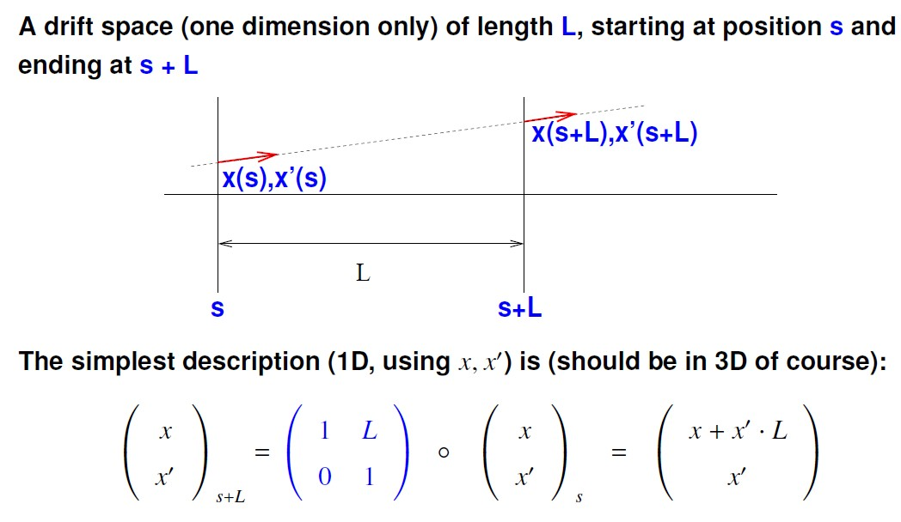
Particle Motion through accelerator components
Most of the time we use the linear approximation, which we get from simple geometry:

Slide 24
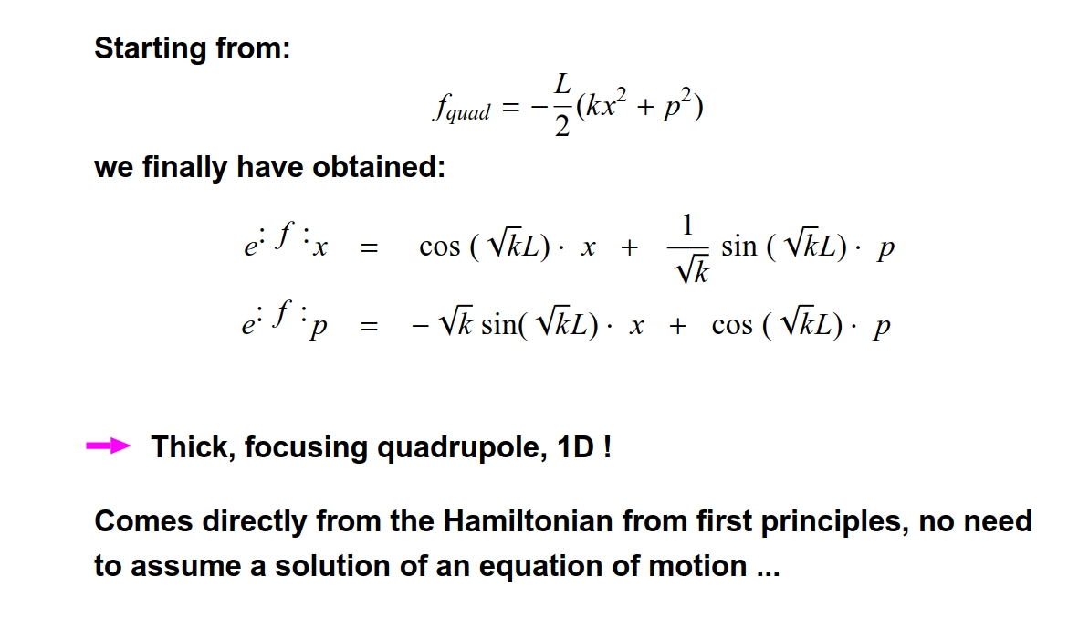
Map of a quadrupole
f is here the generator L * H
Much more on this: Werner Herr, Non linear Dynamics I- III,
advanced general CAS, for example Egham 2017

Slide 25
Transverse Beam Dynamics
??? high intensity beam described in 6D phase space??? No…
Starting point:
- Single particle in a single magnetic element
- complete decoupling of long., hor.& ver. motion
- particle with nominal momentum
But:
My first accelerator:
- Single particle in many magnetic elements
- circular structure: synchrotron
- twiss parameters, orbit, tune…
Off-momentum particle:
- Dispersion
- Momentum compaction
- Chromaticity…a taste of non-linearities
Finally a beam of many particles (not too many!)
- emittance
- Liouville’s theorem
- adiabatic damping and radiation damping

Slide 26
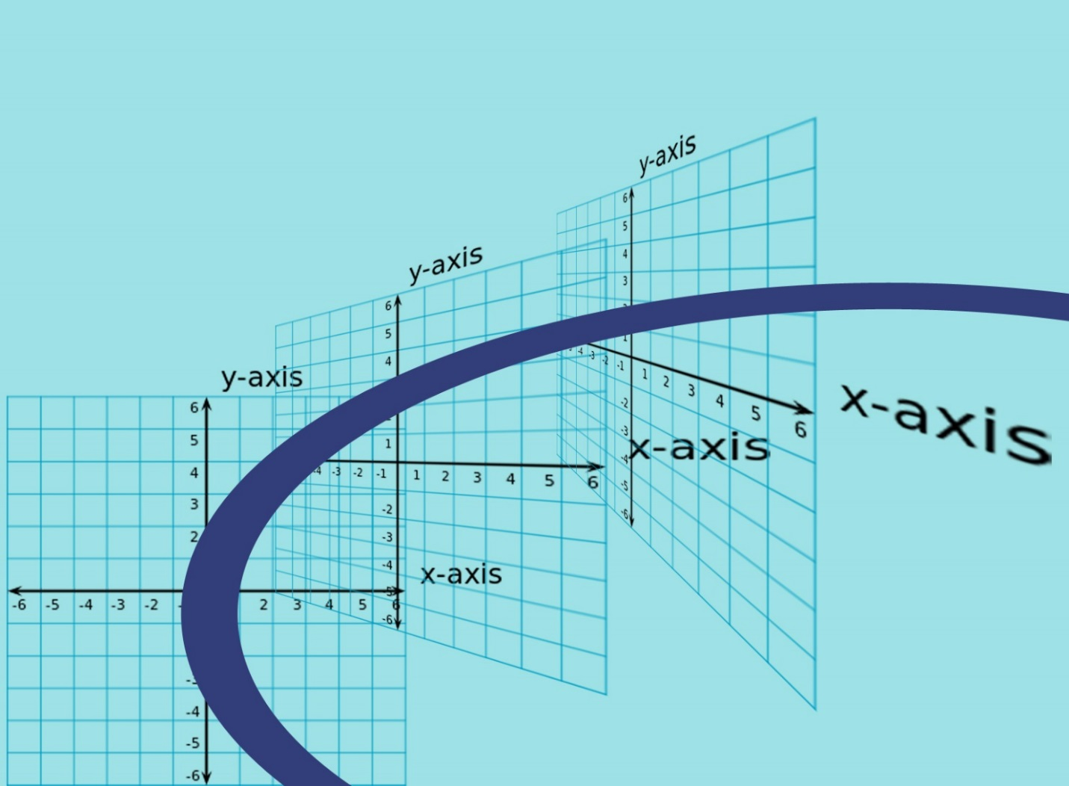
Another aspect of Hamiltonian treatment
So far we have been switching from time-dependent variables to s-dependent variables without paying attention to it: In a linear 1 D motion this is a equivalent since s= vt
But if we want to describe motion transverse to a curved reference line,
we are better off using “s” as independent variable. At every moment we have perpendicular to the tangent vector of the particle trajectory a transverse Cartesian coordinate system.

Slide 27
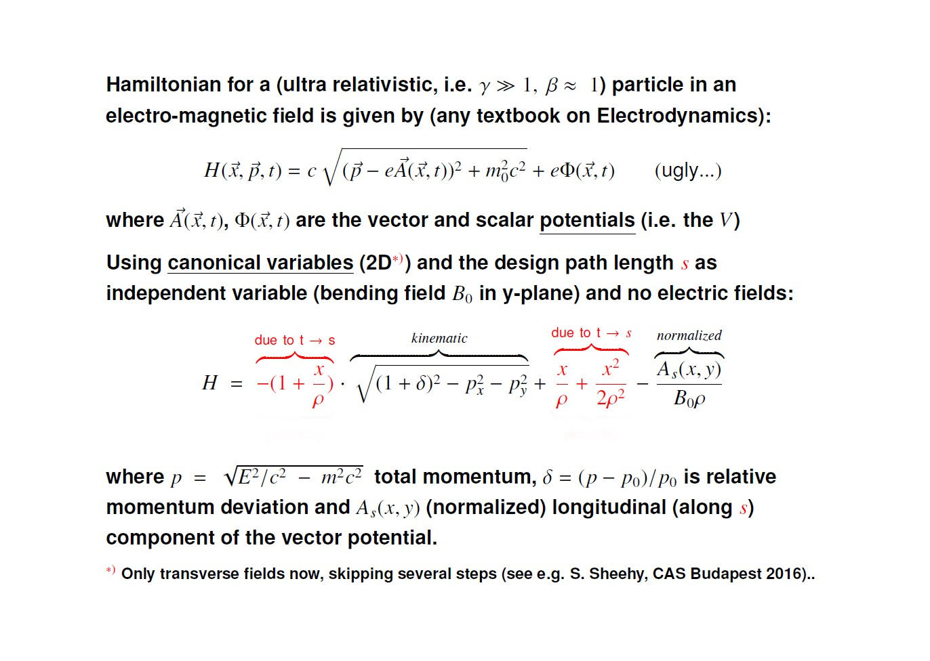

Slide 28
Where are we now?
- we describe every element in the trajectory of a particle with the corresponding Hamiltonian.
- we describe the particle motion through an element by a matrix (map) multiplication onto its phase-space vector.
- we generate more complex accelerator configurations by multiplying the maps of the induvial elements.
- we have changed the coordinate system and describe now the trajectory of a particle as a function of “s” and not of “t”.
- But: we are still treating single particles in a single passage through an accelerator component.
What comes next?
- We show that Hill’s equations come naturally out of the Hamiltonian formalism
- We look at transverse focusing…in particular a FODO lattice
- We look again and again at phase space diagrams.

Slide 29
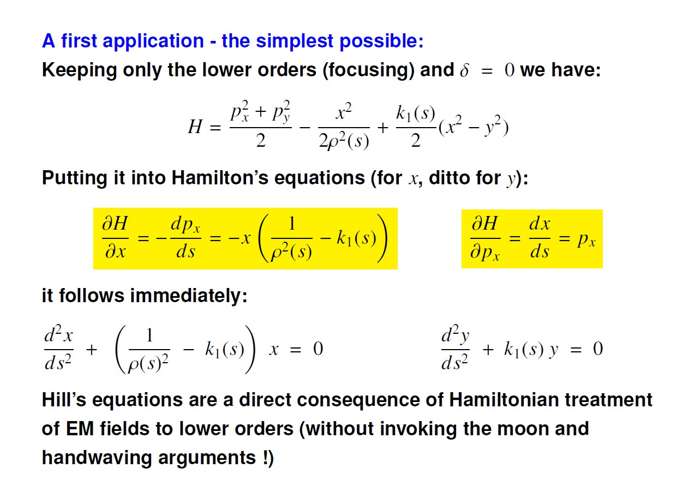

Slide 30
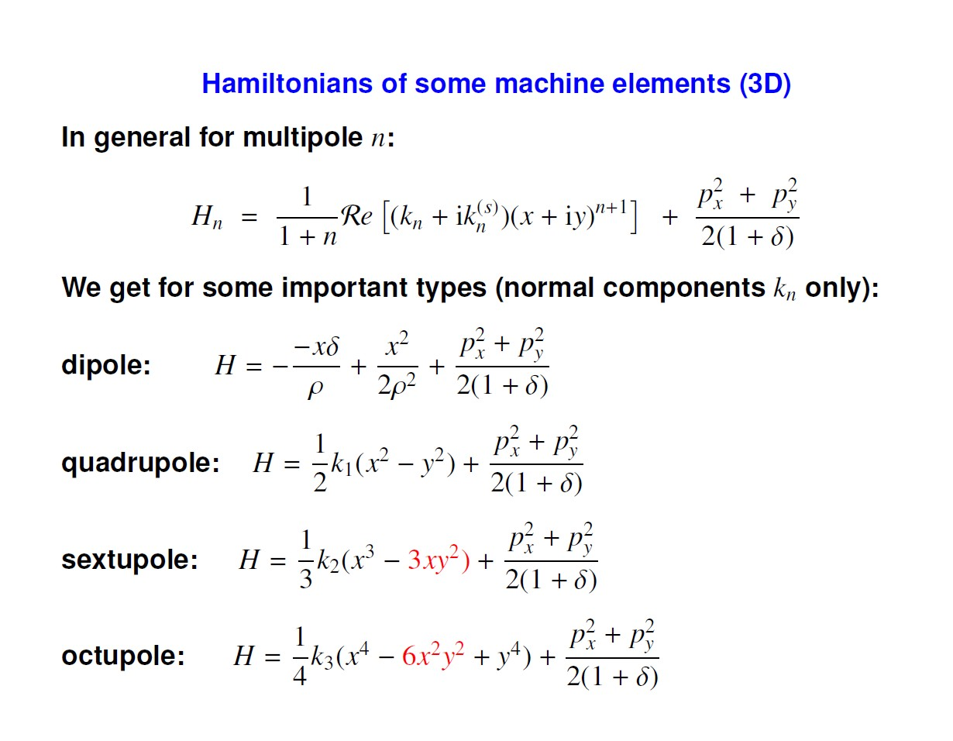
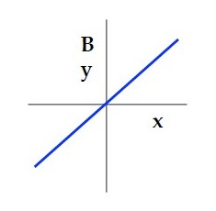
Such a field (force) we need for focusing

Slide 31
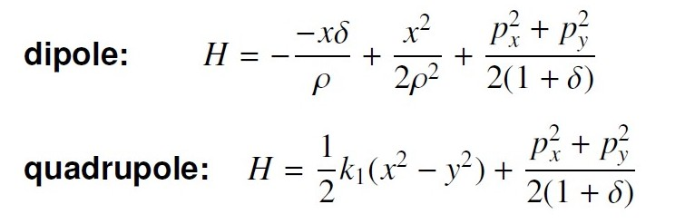
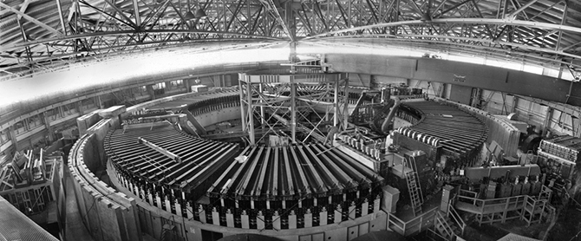
Weak focusing from dipoles
This means that we can construct a focusing circular accelerator based only on dipoles…
in particular when ρ is small.
This has been done in the 1950’s and it was called “ a weak focusing synchrotron”
How about the vertical plane? There are no dipoles. Or why do the particles not fall down?

Slide 32
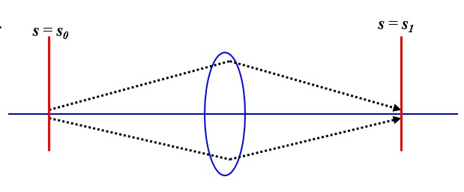
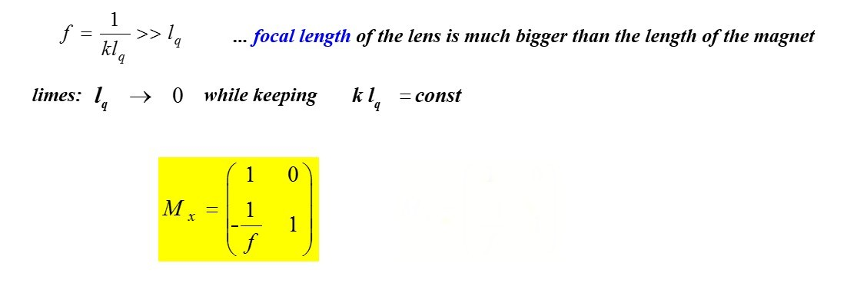
We need stronger focusing →quadrupoles
Negative = focusing

Slide 33
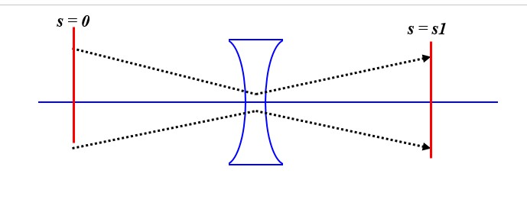

The negative sign in the Hamiltonian makes the same quadrupole defocusing in the other plane.
Positive = defocusing

Slide 34
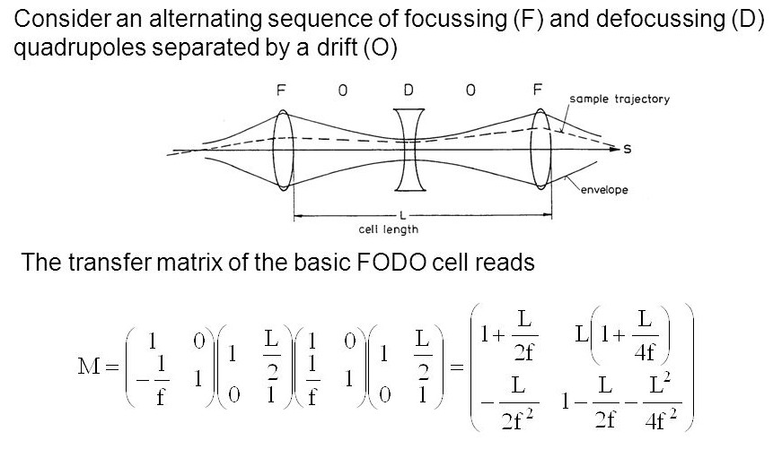

Slide 35
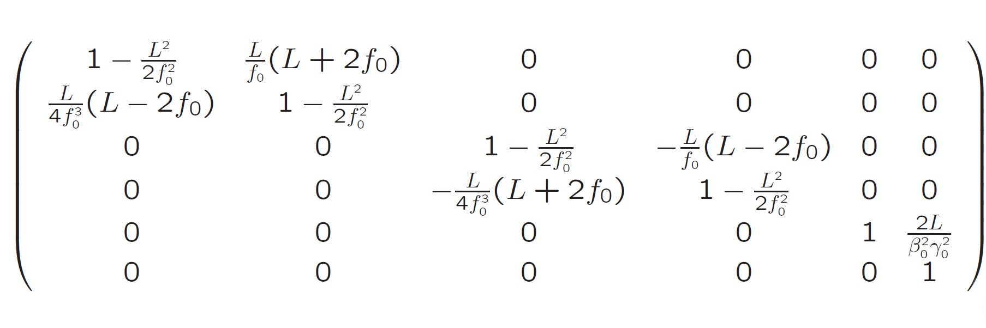
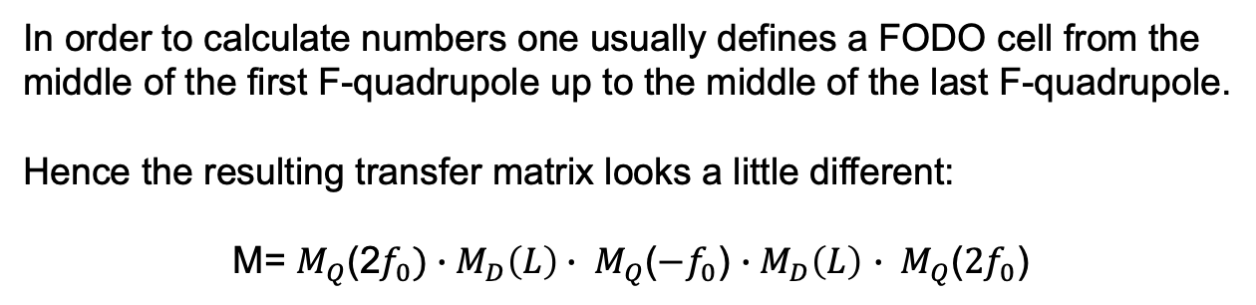
Transfer Matrix in 6-D
In order to calculate numbers one usually defines a FODO cell from the middle of the first F-quadrupole up to the middle of the last F-quadrupole.
Hence the resulting transfer matrix looks a little different:
M= $M_{Q}$(2$f_{0})∙M_{D}\left(L\right)∙ M_{Q}$(${−f}_{0}$) $∙M_{D}\left(L\right)$ $∙ M_{Q}$(${2f}_{0}$)

Slide 36
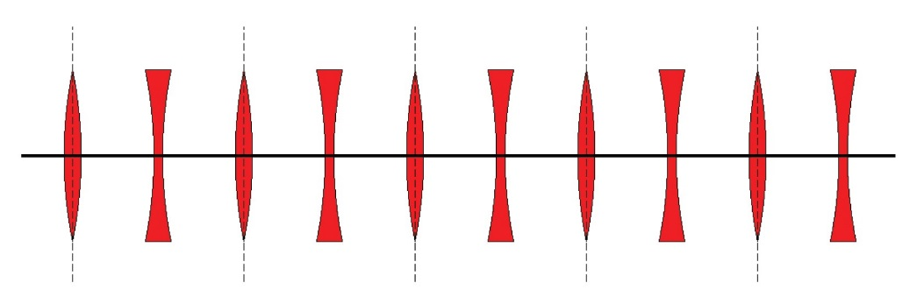
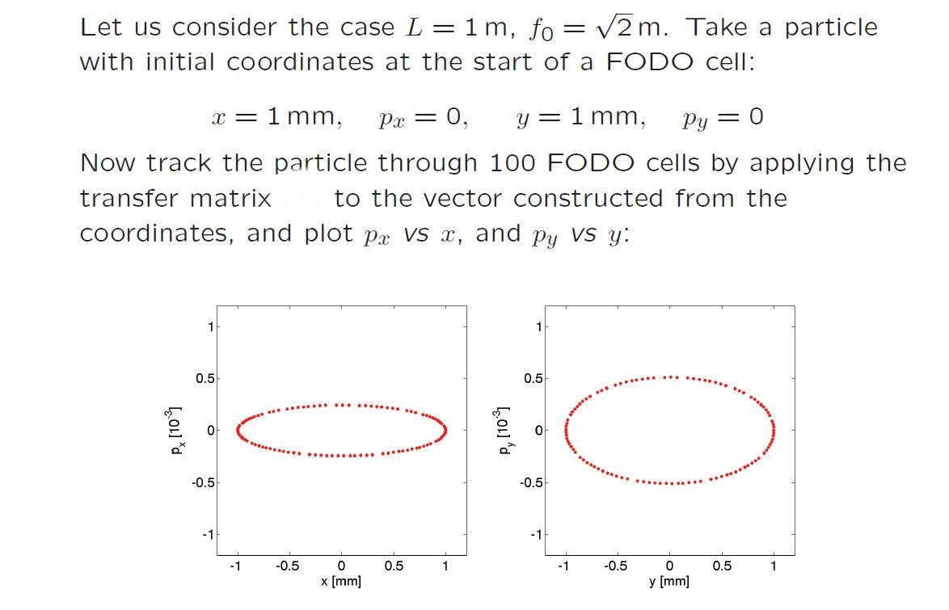

Slide 37
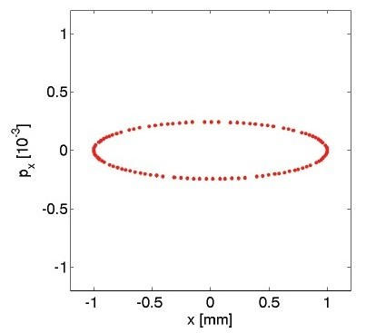
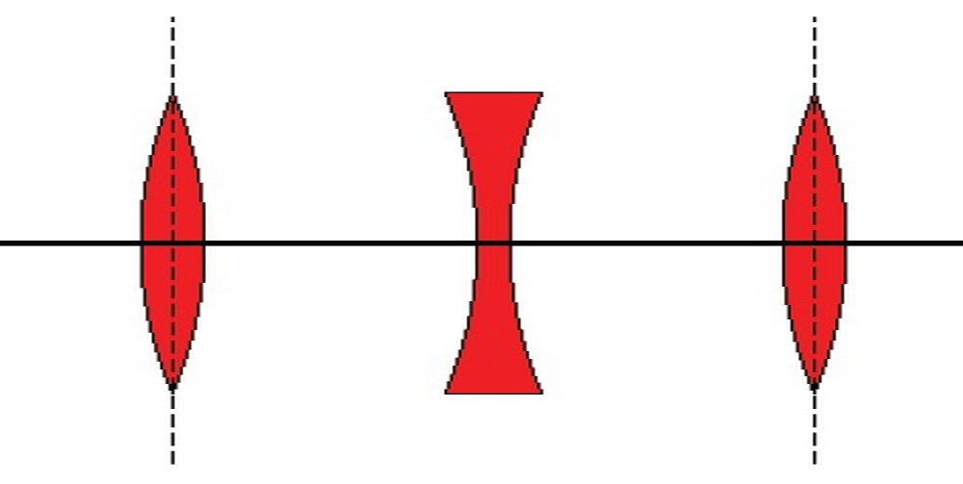
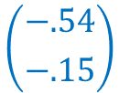
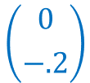


More details on the Illustrating Example
1mm
$$\left({1 \atop 0}\right)$$
$$\left({0.75 \atop 0.16}\right)$$
$$\left({0 \atop −.2}\right)$$
$$\left({−.54 \atop −.15}\right)$$

Slide 38
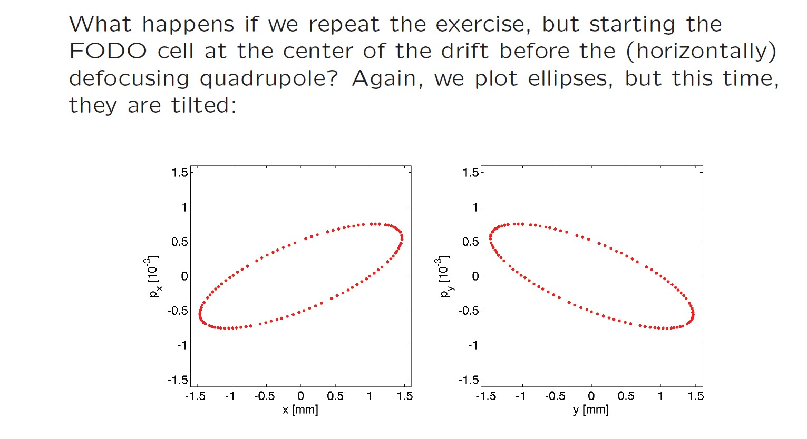

Slide 39
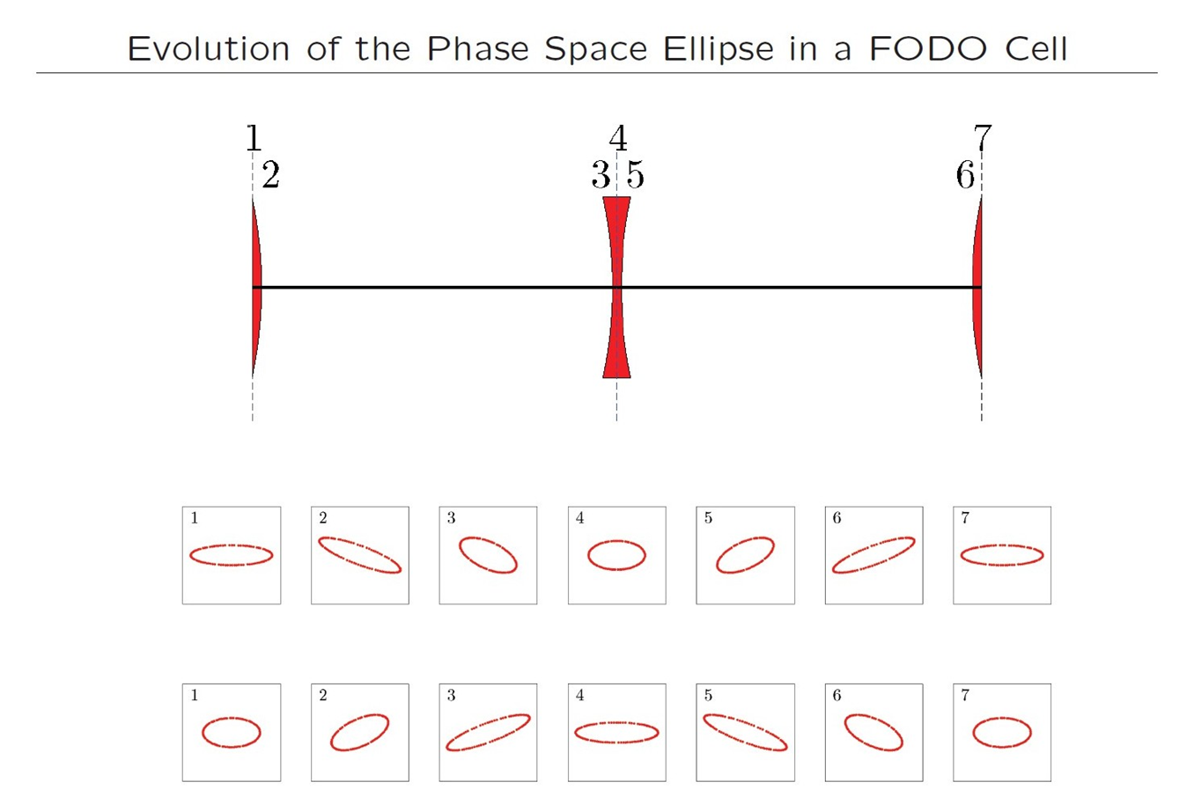

Slide 40
Our first synchrotron
The previous example of 100 consecutive FODO cells describes very well a regular transport line or a linac (in which we have switched off the cavities).
If we add dipoles into the driftspaces, the situation for the transverse particle motion does not change (neglecting the weak focusing part).
So actually with the previous description we also describe a very simple regular synchrotron.
The phase space ellipse we can compute provided we know the total transfer map (matrix) M_{tot}:
J= $\frac{1}{2}\left({x \atop x^{′}}\right)$($s_{0}$) $\left({x \atop x^{′}}\right)$($s_{0}+C) =\frac{1}{2}\left({x \atop x^{′}}\right)\text{(}s_{0}\text{)} \text{Mtot} \left({x \atop x^{′}}\right)\text{(}s_{0 }$)
The phase space plots will look qualitatively the same as in the previous case.
Definition: trajectory (single passage) or closed orbit (multiple passages):
(1)
Fix point of the transfer matrix…in our cases so far the “0” centre of all ellipses.

Slide 41

Orbit Acquisition
Horizontal
This orbit excursion
is too large!
Vertical

Slide 42

Orbit Correction (Operator Panel)

Slide 43

Orbit Correction (Detail)

Slide 44

Courant – Snyder formalism / Twiss parameters
Same beam dynamics
Introduced in the late 50’s
The classical way to parametrize the evolution of the phase space ellipse along the accelerator
Basic concept of this formalism:
1) Write the transfer matrix in this form (2 dimensional case):
$$M=I cosμ+S ∙A sinμ$$
I =$\left(\begin{matrix}1 & 0 \\ 0 & 1\end{matrix}\right); S= \left(\begin{matrix}0 & 1 \\ −1 & 0\end{matrix}\right)$; A= $\left(\begin{matrix}γ & α \\ α & β\end{matrix}\right)$
2) M must be symplectic → $βγ − α^{2}$ = 1
3) Four parameters: $α\left(s\right); β\left(s\right); γ\left(s\right)and μ\left(s\right)$, with one interrelation (2)
→ Three independent variables
4) Again, the preserved action variable J describes an ellipse in phase-space:
$J= \frac{1}{2}$ ( $γx^{2}$+ $2αx$p + $βp^{2}$)

Slide 45




Slide 46










Example: Propagation of Twiss parameters along s between two focusing quadrupoles
And in Matrix-Annotation:
${ A}_{s0}$= $\left(\begin{matrix}γ & α \\ α & β\end{matrix}\right)$
→
$A_{s}$= ${M^{T} A}_{s0}$ $M$
$β_{s}= C^{2}β_{0}$ - 2SC $α_{0}+ S^{2}γ_{0}=β_{0}$+${s^{2}}/{β_{0}}$
Example: Beta function between two strong focusing quadrupoles
Drift M =
$$\left(\begin{matrix}1 & s \\ 0 & 1\end{matrix}\right)$$
${ A}_{s0}$=$\left(\begin{matrix}γ_{0} & α_{0} \\ α_{0} & β_{0}\end{matrix}\right)$ = $\left(\begin{matrix}γ_{0} & 0 \\ 0 & β_{0}\end{matrix}\right)$ =$\left(\begin{matrix}1/{β_{0}} & 0 \\ 0 & β_{0}\end{matrix}\right)$
Starting from waist $α=0$
Using: $βγ − α^{2}$ = 1
$A_{s }$= $\left(\begin{matrix}1 & 0 \\ s & 1\end{matrix}\right)∙\left(\begin{matrix}1/{β_{0}} & 0 \\ 0 & β_{0}\end{matrix}\right)∙\left(\begin{matrix}1 & s \\ 0 & 1\end{matrix}\right)= \left(\begin{matrix}1/{β_{0}} & s/{β_{0}} \\ s/{β_{0}} & β_{0}+{s^{2}}/{β_{0}}\end{matrix}\right)$
$$β_{s}= β_{0}+{s^{2}}/{β_{0}}$$

Slide 47



Interpretation of the Twiss parameters (1/2)
1) Horizontal and vertical beta function $β_{H,V} \left(s\right):$
Proportional to the square of the projection of the phase space ellipse onto the space coordinate
Focusing quadrupole → decreasing beta values
Although the shape of phase space changes along s, the rotation of the particle on the phase space ellipse projected onto the space co-ordinate looks like an harmonic oscillation with variable amplitude: called BETATRON-Oscillation
$$x\left(s\right)=const ∙ \sqrt{β\left(s\right) }∙cos\left\{μ\left(s\right)+\left.φ\right\}\right.$$

Slide 48



Interpretation of the Twiss parameters (2/2)
2.)
$α=−\frac{1}{2}\frac{dβ}{ds}$
α indicates the rate of change of β along s
α zero at the extremes of beta (waist)
3.)
$μ= \int_{s1}^{s2}{\frac{1}{β}}$ ds
Phase Advance: Indication how much a particle rotates in phase space when advancing in s
Of particular importance: Phase advance around a complete turn of a circular accelerator, called the betatron tune Q (H,V) of this accelerator
$Q_{H,V}$ = $\frac{1}{2π}\int_{0}^{C}{\frac{1}{β_{H,V}} ds}$

Slide 49




The betatron tunes $Q_{H,V}$
Part of the most important parameters of a circular accelerator
The equivalent in a linac is called “phase advance per cell”
For a circular accelerator it is the phase advance over one turn in each respective plane.
In large accelerators the betatron tunes are large numbers (LHC ˜ 65), i.e. the phase space ellipse turns about 65 times in one machine turn.
We measure the tune by exciting transverse oscillations and by spectral analysis of the motion observed with one pickup.
This way we measure the fractional part of the tune; often called $q_{H,V}$
Integer tunes (fractional part= 0) lead to resonant infinite growth of particle motion even in case of only small disturbances.

Slide 50



Importance of betatron tunes
The couple (Q_{H} ,Q_{V} ) is called the working point of the accelerator.
Below: tune measurement example from LEP

Slide 51





Slides on “off-momentum” particles in a synchrotron
What happens: A particle with a momentum deviation $δ=\frac{δp}{p}$ > 0 gets bent less in a dipole.
In a weakly focusing synchrotron it would just settle to another circular orbit with a bigger diameter
In an alternate gradient synchrotron it is more complicated: The focusing/defocusing is also dependent on the momentum, so the resulting orbit follows the optics of the accelerator.
We describe the dispersion as a function of s as $D\left(s\right)$; the resulting position of a particle is thus simply:
$x_{δp}$= $x_{0}$+ $D\left(s\right)\frac{δp}{p}$
Typical values of D(s) are some meters, with$\frac{δp}{p}$ = ${10}^{−3}$ the orbit deviation becomes millimeters

Slide 52


Measurement example
HERA Standard Orbit
This gives also an example of an orbit measurement.
More on this: again R.Jones (BI)
HERA Dispersion Orbit
dedicated energy change of the stored beam
→ closed orbit is moved to a
dispersions trajectory

Slide 53




Momentum compaction factor
If a particle is slightly shifted in momentum it will have a different orbit and the orbit length is different.
The “momentum compaction factor” is defined as:
p
p+δp
$$α_{c}=\frac{{dL}/L}{{dp}/p}$$
$$α_{c}=\frac{p}{L}\frac{dL}{dp}$$
Typical numbers: $α_{c}≈ {10}^{−3}$… ${10}^{−4}$; ${∆p}/{p }$ $≈ {10}^{−3 }$→ ${∆L}/{L }$ $≈{10}^{−6}{…10}^{−7}$
→ Much more on this in long. dynamics (F. Tecker).

Slide 54


Finally: a beam
We focus on “bunched” beams, i.e. many (10 ¹¹) particles bunched together longitudinally (much more on this in the RF classes).
From the generation of the beams the particles have transversally a spread in their original position and momentum.
Source: ISODAR (Isotope at rest experiment)

Slide 55

A beam (bunch): Motion of individual particles (1/4)
Generate 10000 particle as a Gaussian distributionin x and p_{x}
For illustration mark 3 particle in colors red, magenta and yellow
The average (center of charge) is indicated as cyan cross
Make some turns (100 turns with 3 degrees phase advance par turn)

Slide 56





A beam (bunch): Motion of individual particles (2/4)
turn 0 turn 10 turn 53 turn 100
Trajectory in x over 100 turns
Individual particles perform betatron oscillations (incoherently!), the whole beam is “quiet”. No coherent betatron motion.

Slide 57

A beam (bunch): Motion of individual particles (3/4)
The whole bunch receives (at injection) a transverse kick (additional momentum q) of 2 units
Tracing over 100 turns as before

Slide 58





A beam (bunch): Motion of individual particles (4/4)
Turn 0 Turn 10 Turn 53 Turn 100
The incoherent motion of the particles remains the same, but this time the center of charge also moves (cyan curve). The beam beforms a betatron oscillation.

Slide 59

Liouville’s Theorem (1/2)
All particle rotate in phase space with the same angular velocity (in the linear case)
All particle advance on their ellipse of constant action
All constant action ellipses transform the same way by advancing in “s”
→ Since volumes in phase space are preserved, (1)-(3) means That the whole beam phase space density distribution transforms the same way as the individual constant action ellipses of individual particles.

Slide 60


Liouville’s Theorem (2/2)
We now define the emittance of a beam as the average action of all particles!
→ Since the action J of a particle is constant and the phase space area A covered by the action ellipse is $A=2πJ ,$we can represent the whole beam in phase space by an ellipse with a surface = $2π\left\langle J\right\rangle$ *
→ all equations for the propagation of the phase space ellipse apply equally
for the whole beam
!!! In case we talk about a single particle, the ellipse we draw is “empty” and any particle moves from one point to another; if we consider a beam, the ellipse is full of particles!!!
*
There are several different definitions of the emittance ε, also different normalization factors. This depends on the accelerator type, but the above definition describes best the physics.
Another often used definition is called RMS emittance
$ε=const∗[\left\langle x^{2}\right\rangle \left\langle p^{2}\right\rangle −{\left\langle xp\right\rangle }^{2}]$ or $ε=const∗[\left\langle x^{2}\right\rangle \left\langle {x^{′}}^{2}\right\rangle −{\left\langle xx^{′}\right\rangle }^{2}]$
attention: the first definition describes well the physics, the second describes what we eventually can measure

Slide 61
Remarks
We have already identified the action as a preserved quantity in a conservative system ← →
the emittance of a particle beam is preserved in a conservative beam line.
The sentence above is often quoted as Liouville’s theorem, but this is incorrect. Liouville’s theorem describes the preservation of phase space volumes, the preservation of the phase space of a beam is then just results from the Hamiltonian description.
We can identify the constant in the previous equation:
$$x\left(s\right)=\sqrt{ε} ∙ \sqrt{β\left(s\right) }∙cos\left\{μ\left(s\right)+\left.φ\right\}\right.$$

Slide 62


More on beam emittance
The reference momentum increases during acceleration
$P_{0}=β_{0}γ_{0}mc→P_{1}=β_{1}γ_{1}mc$ $\left(β,γ relativistic parameters\right)$
we can show: $β_{0}γ_{0}ε_{0}{=β}_{1}γ_{1}ε_{1}$
So the transverse emittances scale with the product $βγ$
For this reason we define:
normalized emittance $ε_{N}$: = $βγε$and we call $ε$ the geometric emittance
The “shrinking” of the transverse emittance during acceleration is called “adiabatic damping” (only $ε=const∗[\left\langle x^{2}\right\rangle \left\langle {x^{′}}^{2}\right\rangle −{\left\langle xx^{′}\right\rangle }^{2}]$ scales with energy)
Other ways to influence the emittance (advanced subjects):
- make it bigger by error (injection errors….)
- make it smaller by cooling (stochastic cooling; electron-cooling….)
Not to be confused with:
Radiation damping = Reduction in emittance due to the emission of photons as synchrotron radiation

Slide 63



What do we normally measure from the phase-space ellipse?
At a given location in the accelerator we can measure the position of the particles, normally it is difficult to measure the angle…so we measure the projection of the phase space ellipse onto the space dimension:
→called a profile monitor
Attention! The standard 2 D image of a synchrotron light based beam image is NOT a phase space measurement

Slide 64




Phase space mapping
Measurements
Simulations

Slide 65

Phase space evolution
A. Cianchi et al., “High brightness electron beam emittance evolution measurements in an rf photoinjector”, Physical Review Special Topics Accelerator and Beams 11, 032801,2008

Slide 66


A first taste of non-linearities (1/6)
So far we have completely neglected the longitudinal plane
Still, we will not couple the motion in the longitudinal and transverse plane (advanced course), but we need to consider
“off momentum particles” with a longitudinal momentum $\frac{∆p}{p_{0}}≠0$.
We already defined the Dispersion function, which describes the change in orbit
Now we look at what happens to the focusing in the quadrupoles:

Slide 67


A first taste of non-linearities (2/6)
Due to the change in focusing strength of the quadrupoles with varying momentum, particles have different betatron-tunes:
Definition: Chromaticity (H,V) := Dependence of tune on momentum
$∆Q=Q^{′}\frac{∆p}{p}$ or relative chromaticity $ξ=\frac{Q′}{Q}$
Is this bad? : Yes, the working point gets a “working blob”
We need to correct. How?
i) Inserting a magnetic element where we have dispersion (this separates in space particles with lower and higher momenta
ii) Having there a “quadrupole”, for which the strength grows for larger distances from the centre: a sextupole

Slide 68


A first taste of non-linearities (3/6)
We will have a high price to pay for this chromaticity correction!
→ we have introduced the first non-linear element into our accelerator
The map M (no longer a matrix) of a single sextupole represents a “kick” in the transverse momentum:
We choose a fixed value k₂L = - 600 m⁻² and we construct phase space portraits after repeated application of the map.
We vary the phase advance per turn (fractional part of the tune) from
$$0.2 ∙2π to 0.5 ∙2 π$$

Slide 69





A first taste of non-linearities (4/6)

Slide 70


A first taste of non-linearities (6/6)

Slide 71
Linear Imperfections
Up to now we have constructed an alternate –gradient focusing synchrotron
We have a well chosen working point
We have corrected chromaticity
(We still cannot accelerate! → see F. Tecker (long. Dynamics)
We assume:
- All magnetic elements have the calculated field strength and field quality
- All magnetic elements are in the right place and powered with the right polarity
Reality tells us:
- Magnets have field errors, have other multipole components, have time varying fields due to ripple in the connected power converter
- Magnets are wrongly mounted with horizontal and/or vertical offsets, rotations or tilts
These effects influence:
- the beta functions and phase advance around the ring (implicitly the tunes)
- the closed orbit
- the coupling between horizontal and vertical motion
…
We need to diagnose and correct: Strong interaction between beam measurements and corrections (see also R.Jones BDI talks)

Slide 72

Dipole Errors

Slide 73

Quadrupole Errors (1/2)

Slide 74

Quadrupole Errors 2/2

Slide 75

Beta-beating (1/2)

Slide 76

Beta-beating (2/2)

Slide 77


Quadrupole Errors 3/3
Any tilted quadrupole is seen as a normal quadrupole plus another quadrupole tilted by 45⁰. (skew quad)
Note that in a skew quad
F_{x} = k_{s}y and F_{y} = k_{s}x produce coupling between the x and y planes
Additional skew quads in an accelerator are used to compensate coupling

Slide 78

Last not least: Sextupole errors (1/2)

Slide 79

Last not least: Sextupole errors (2/2)
A horizontally (vertically) displaced sextupole is seen as a centred sextupole plus an offset quadrupole (skew quadrupole)

Slide 80
Last not least: Collective effects
Collective effects:
= Summary term for all effects when the coulomb force of the particles in a bunch can no longer be neglected; in other words when there are too many particles…
We distinguish:
i) self interaction of the particles within a bunch:
1) space charge effects
2) Intra beam scattering
3) Touschek scattering
leads to emittance growth and particle loss
ii) Interaction of the particles with the vacuum wall
→concept of impedance of vacuum system
leads to instabilities of single bunches and multiple bunches
iii) Interaction of with particles from other counter-rotating beam
→ beam-beam effects (→ more later this school)
Most is very advanced matter → here only concepts and buzz-words

Slide 81

Space-charge Forces

Slide 82



Space Charge: Scaling with energy
Recall from relativity
Electrical field : repulsive force between two charges of equal polarity
Magnetic field: attractive force between two parallel currents
after some work:
→ space charge diminishes with $1/{γ^{2}}$ scaling
→ each particle source immediately followed by a linac or RFQ for acceleration

Slide 83

Space Charge Tune Shift

Slide 84

“footprint” of particles with space charge tune shift.
The effect dramatically reduces at higher energies
Space charge always
defocusing

Slide 85

Intrabeam Scattering

Slide 86

Touscheck effect

Slide 87

Interaction of beam with vacuum chamber

Slide 88
Bunch in a conducting pipe with sudden change
v
+
+
+
+
+
+
+
+
v
v
+
+
+
+
+
+
+
+
v

Slide 89
All together
L
C
Accelerator
beam
R
beam

Slide 90


Slide 91
Impedance
Impedance
The real (resistive) part dissipates energy, the imaginary part creates instabilities

Slide 92


Consequences of impedances
Energy loss on pipes → heating (important in a superconducting accelerator)
Tune shift
narrow
resonances
Broad
Band
Model
short bunch
long bunch
Single bunch instabilities (head-tail)
Multibunch instabilities

Slide 93
Summary
1) Back to school: relativity, EM fields, magnets…
2) Hamiltonian and canonical variables → equations of motion + invariants; map-approach
3) Single particle in various magnetic elements…action as invariant
4) multiple elements; circular accelerator
5) Twiss parameters
6) Finally a beam: emittance and emittance preservation
7) A taste of non-linearities
8) Linear imperfections (and some corrections)
9) Collective effects

Slide 94

Recommended reading:
A. Wolski, Beam Dynamics in high energy particle accelerators,
Imperial College Press, ISBN 978-1-78326-277-9
CAS proceedings and references therein

