Slide 1
International Accelerator School 2023
Superconducting Science and Technology for Particle Accelerators
Linear Optics 2 (1h): Optics/Lattice Design
Todd Satogata (Jefferson Lab and Old Dominion University)
satogata@jlab.org
https://indico.lightsource.ca/event/6/timetable/#20230712
Additional material/courses: http://www.toddsatogata.net/
Happy Birthday to Willis Lamb (1955 Nobel), Buckminster Fuller, and the Australian Aboriginal Flag!
Happy Etch-a-Sketch Day (July 12 1960), New Conversations Day, and Paper Bag Day!

Slide 2
Outline
Brief review, digression on 2- and 3-bumps
  Connected to much of linear orbit correction
Quick review of linear optics, transport parameterization
Application: FODO optics
Application: Triplet focusing optics
Application: π/2 “insertion”
Symmetric doublet
(Emittance exchange, Mobius insertion)
Low-beta insertion
(Dispersion and dispersion suppressors)

Slide 3
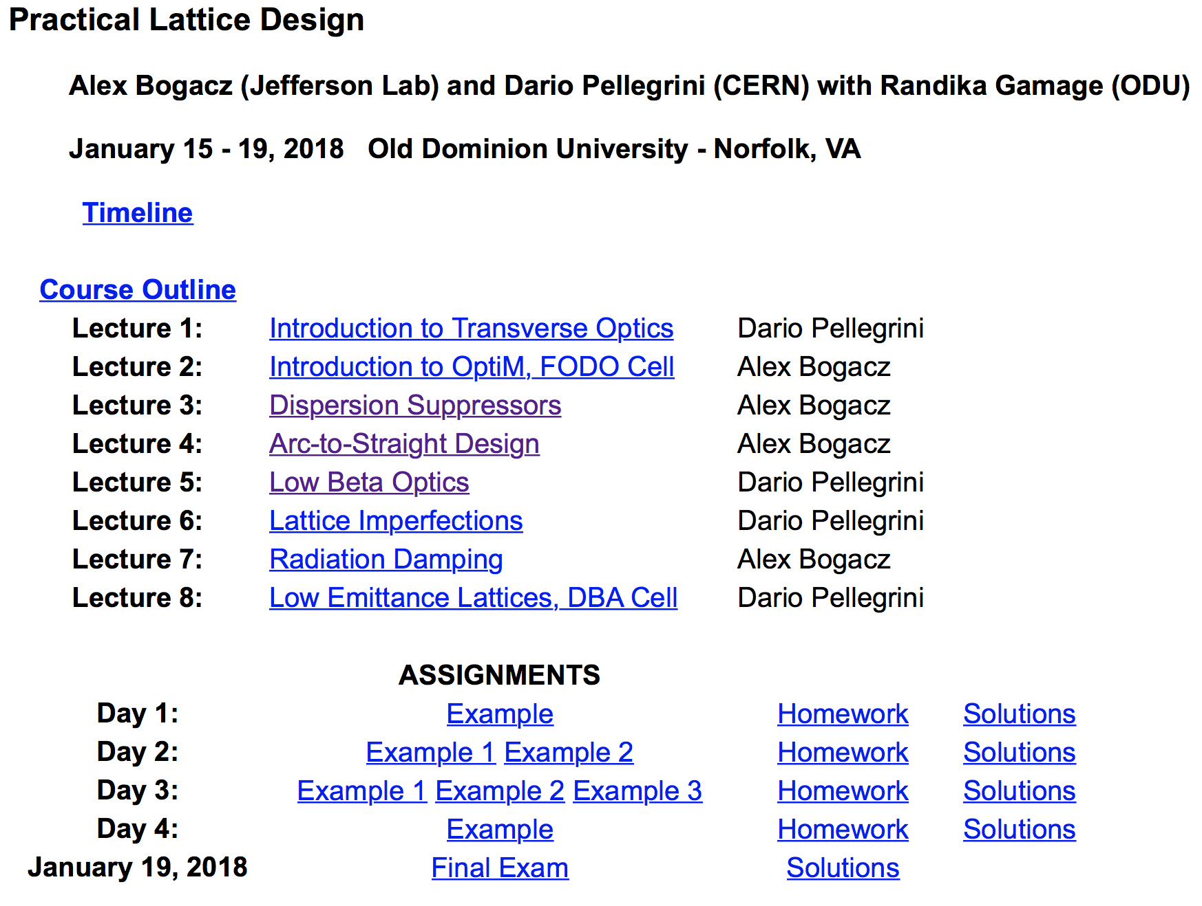
Entire Courses Also Taught On Lattice Design
https://casa.jlab.org/publications/USPAS_Jan_2018.html

Slide 4
Review: General Linear Transport Matrix
We can parameterize a general non-periodic transport matrix from s₁ to s₂ using lattice parameters and
This does not have a pretty form like the periodic matrix
  However both can be expressed as
  where the C and S terms are cosine-like and sine-like; the second row is the s-derivative of the first row!
  A common use of this matrix is the m₁₂ term:
Effect of angle kick
on downstream position

Slide 5
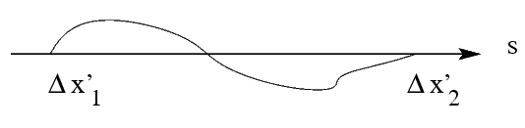
Orbit Control: Two-Bump
A single orbit error changes all later positions and angles
  Add another dipole corrector at a location where At this point the distortion from the original dipole corrector is all x’ that we can cancel with the second dipole corrector.
  Called a two-bump: localized orbit distortion from two correctors
  But requires between correctors

Slide 6
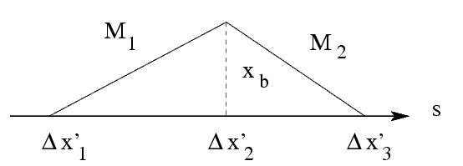
Orbit Control: Three-Bump (another view of homework)
A general local orbit distortion from three dipole correctors
  Constraint is that net orbit change from sum of all three kicks must be zero
  Bump amplitude
  Only three-bump requirement is that S₁₂, S₂₃ ≠ 0

Slide 7
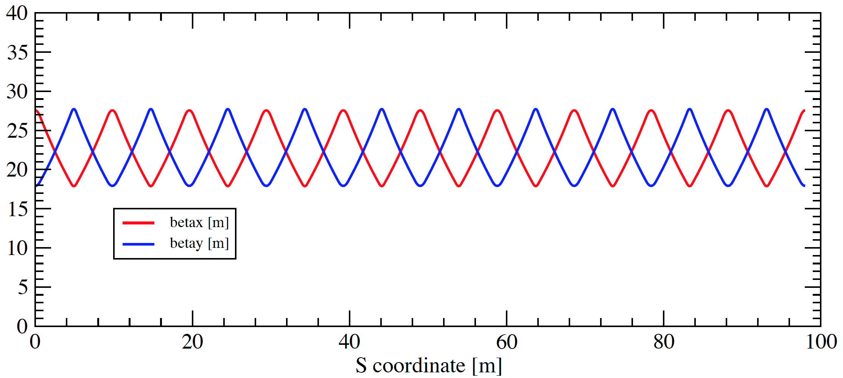
Review: Periodic Transport Matrix Parameterization
Periodic transport matrices can be parameterized as
  all depend on s location
  all have the periodicity of the system
FODO lattice

Slide 8
Review

Slide 9
Review: Matrices of Magnetic Elements
For our purposes this morning:
  All motion is linearized
  Linear transport matrices:
  (Sector) dipole includes constant fractional momentum offset
thin
quads

Slide 10
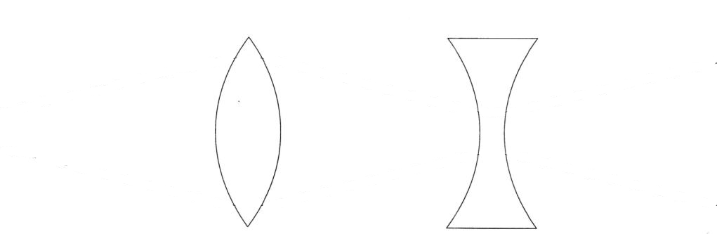
Lattice Optics: FODO Lives!
(Be very careful in comparisons to other sources!)
cell
Most accelerator lattices are designed in modular ways
  Design and operational clarity, separation of functions
One of the most common modules is a FODO module
  Alternating focusing and defocusing “strong” quadrupoles
  Spaces between are combinations of drifts and dipoles
  Strong quadrupoles dominate the focusing
  Periodicity is one FODO “cell” so we’ll investigate that motion
  Horizontal beam size largest at centers of focusing quads
  Vertical beam size largest at centers of defocusing quads

Slide 11
Periodic Example: FODO Cell Phase Advance
cell
Select periodicity between centers of focusing quads
  A natural periodicity if we want to calculate maximum β(s)
  only has real solutions (stability) if

Slide 12
Periodic Example: FODO Cell Beta Max/Min
cell
What is the maximum beta function, ?
  A natural periodicity if we want to calculate maximum β(s)
  Follow a similar strategy reversing F/D quadrupoles to find the minimum β(s) within a FODO cell (center of D quad)

Slide 13
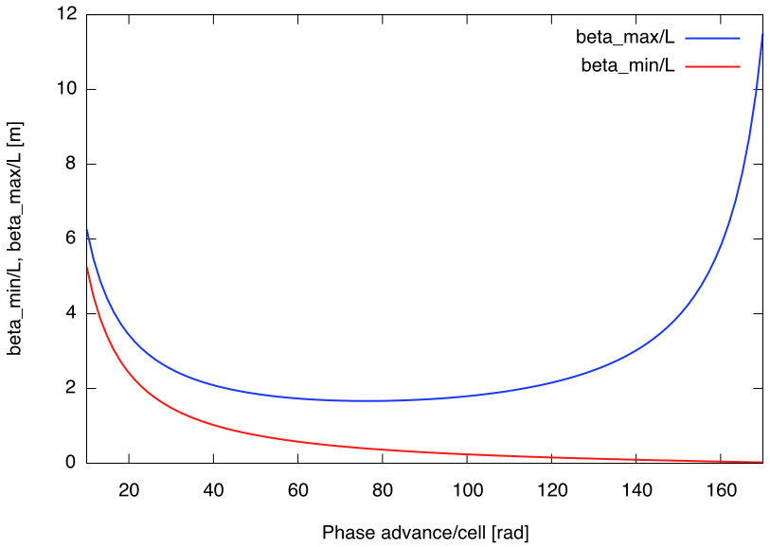
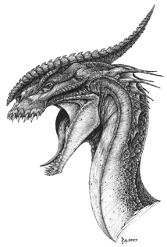
FODO Betatron Functions vs Phase Advance
Here there be dragons
Generally want /L small
Strong focusing
Smaller magnets
Less expensive accelerator
[deg]

Slide 14
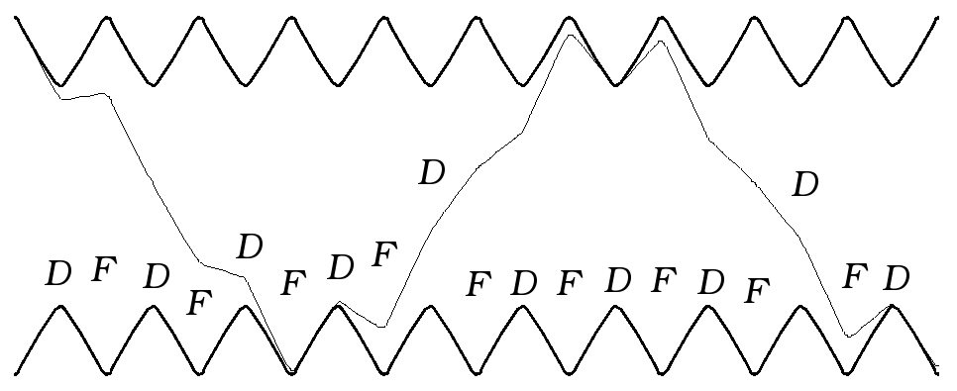
FODO Beta Function, Betatron Motion
Betatron motion
trajectory
design trajectory
This is a picture of a FODO lattice, showing contours of since the particle motion goes like
  This also shows a particle oscillating through the lattice
  Note that provides an “envelope” for particle oscillations
    is sometimes called the envelope function for the lattice
  Min beta is at defocusing quads, max beta is at focusing quads
  6.5 periodic FODO cells per betatron oscillation

Slide 15
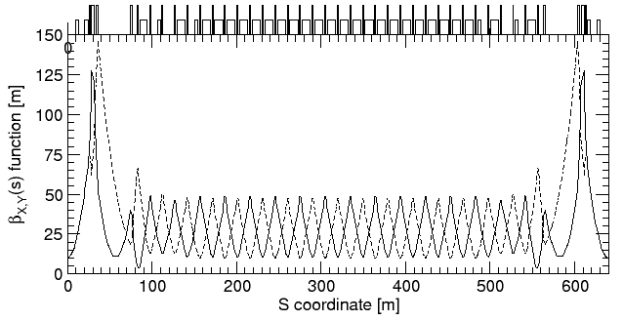
Example: RHIC FODO Lattice
quadrupoles
dipoles
low-beta insertion
low-beta insertion
Horizontal
Vertical
matching
FODO
1/6 of one of two RHIC synchrotron rings, injection lattice
  FODO cell length is about L=30 m
  Phase advance per FODO cell is about
☺

Slide 16
Stability Diagrams
Designers often want or need to change the focusing of the two transverse planes in a FODO structure
  What happens if the focusing/defocusing strengths differ?
  Recalculate the M matrix and use dimensionless quantities
  then take the trace for stability conditions to find
cell

Slide 17
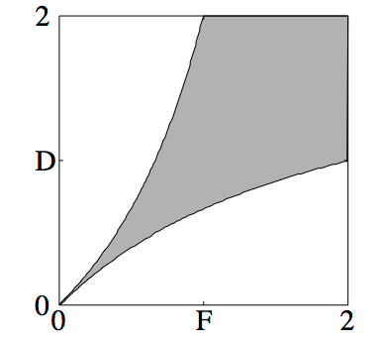
Stability Diagrams II
  For stability, we must have
  Using , stability limits are where
  These translate to a FODO “necktie” stability diagram

Slide 18
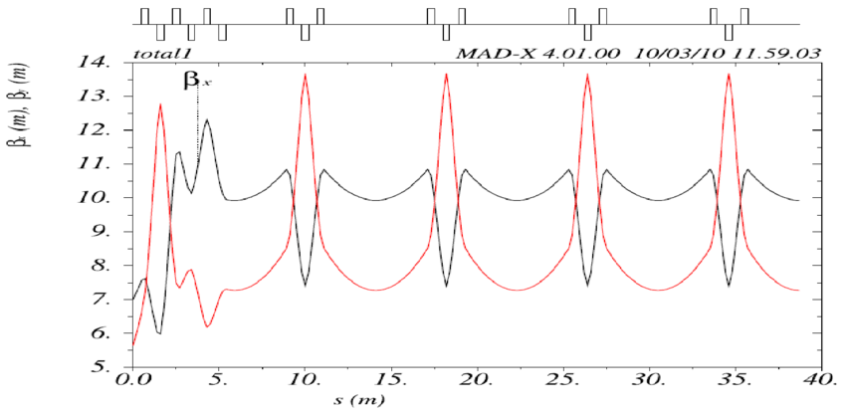
Triplet Optics: Extra Straight Space
cell
half quad!
half quad!
From R. Chehab et al., “The CLIC Positron Capture and Acceleration in the Injector Linac”, 2010.

Slide 19
Triplet Optics: Extra Straight Space
cell
long drift
full double strength quad!
symmetric beta
symmetric alpha
From R. Chehab et al., “The CLIC Positron Capture and Acceleration in the Injector Linac”, 2010.

Slide 20
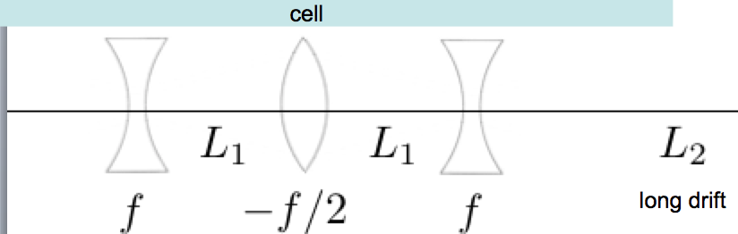
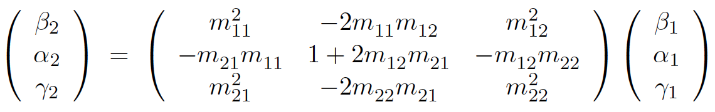
Triplet Cell Strategy: Not Exactly FODO
Calculate transport matrix in terms of L₁, L₂, f
  Three degrees of freedom
  Use general transport and find eigenvalues with α=0
Emphasis on periodic solutions for repeating cells

Slide 21
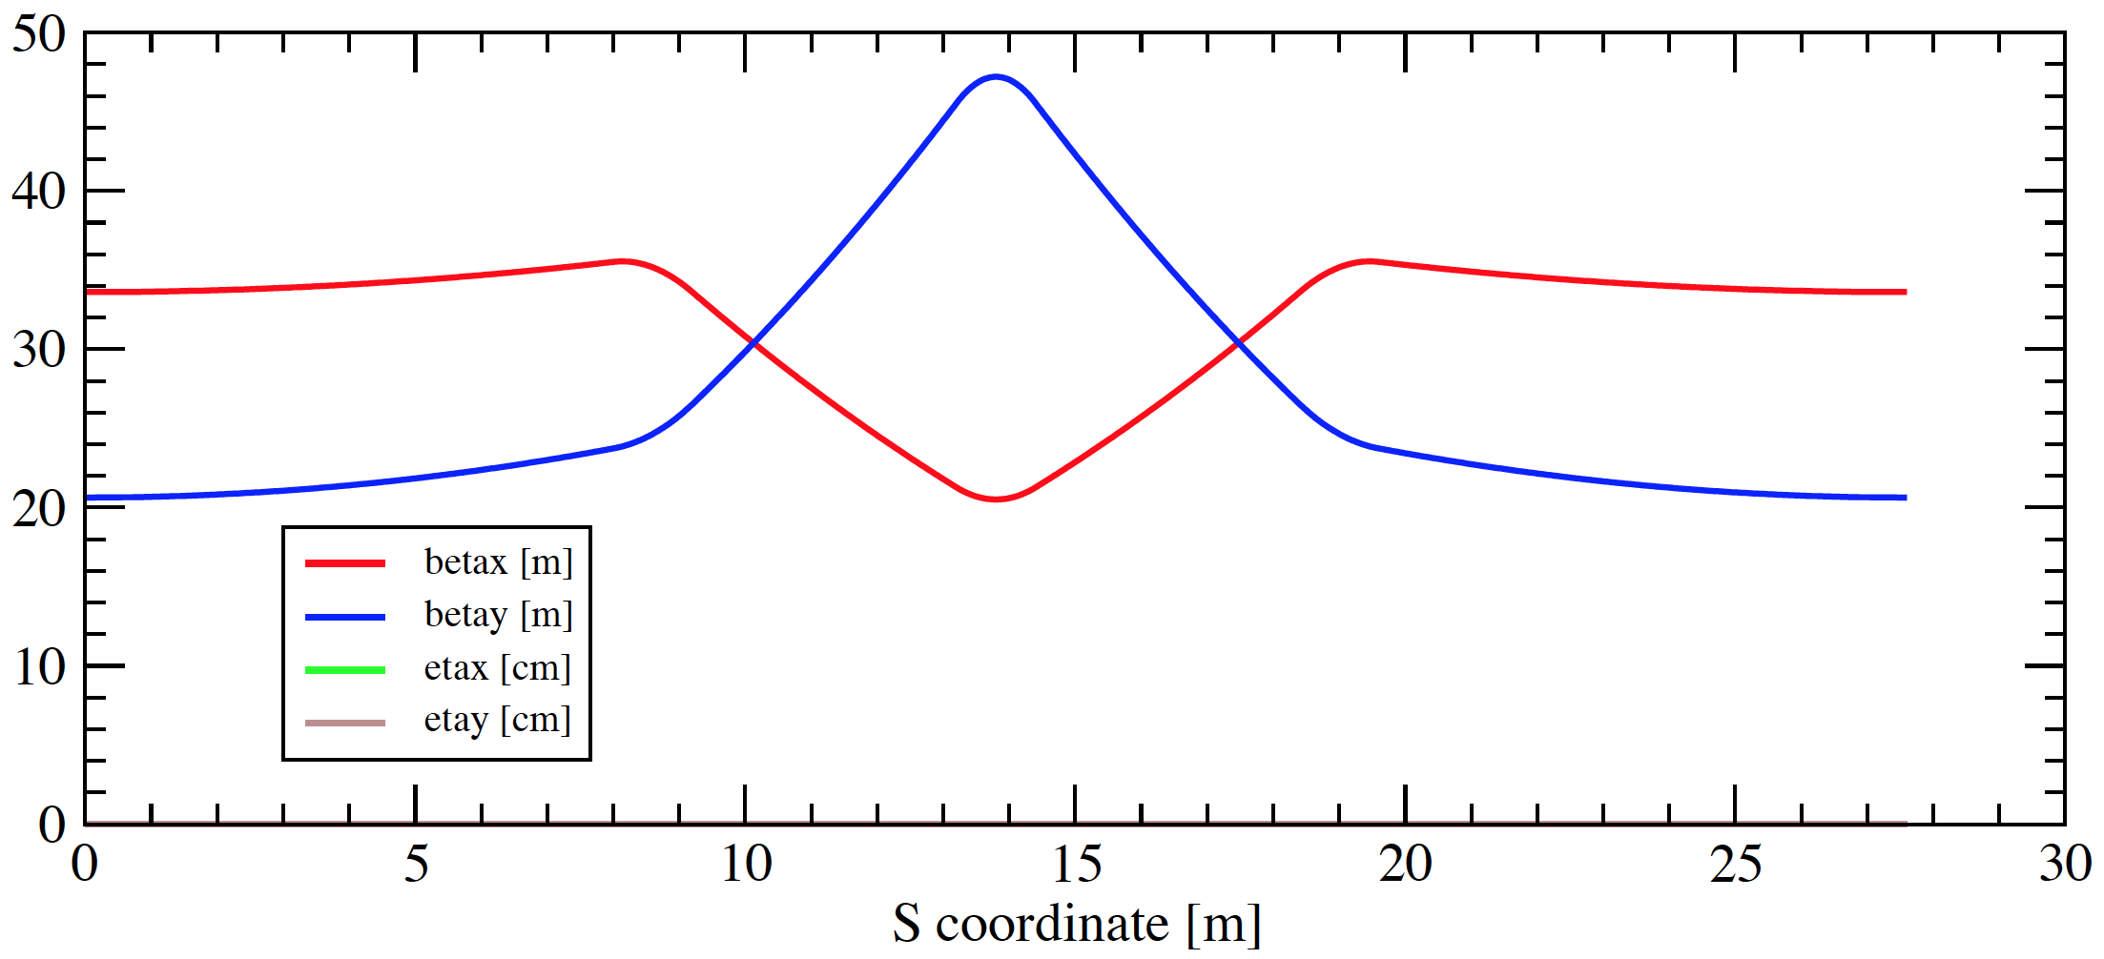
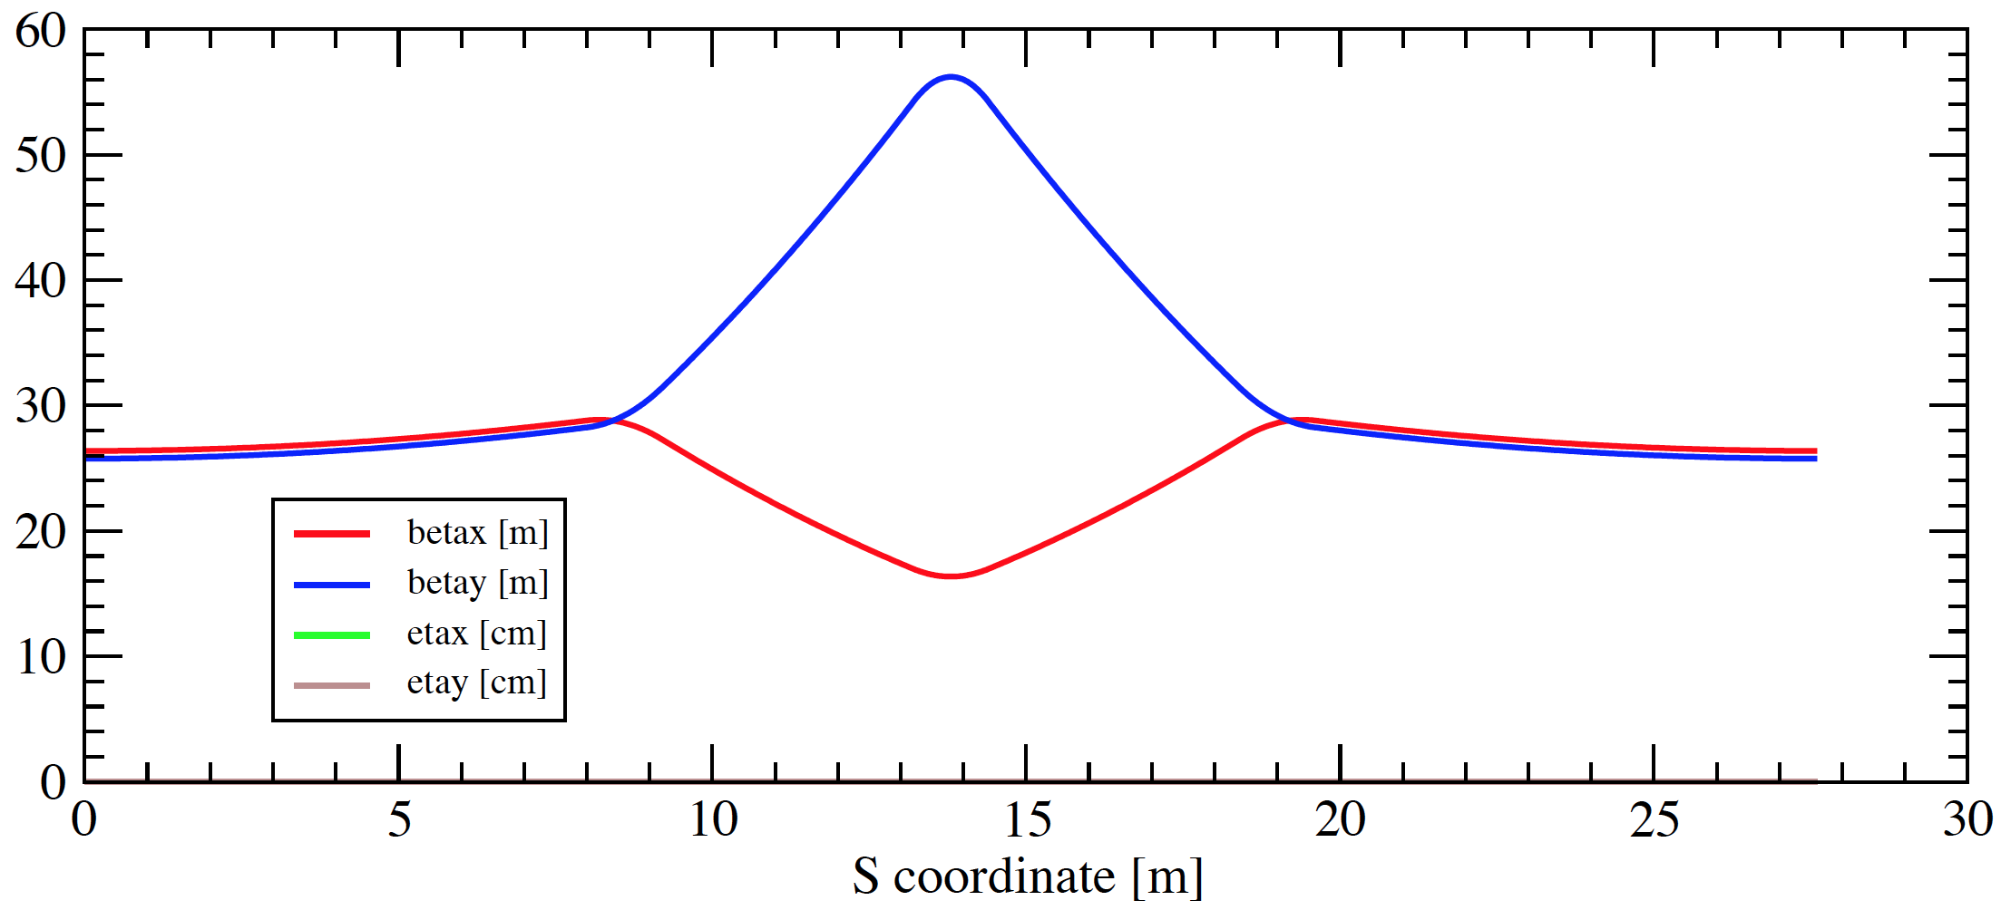
Triplet Focusing: Examples
2:1 quad strengths
round beam in
straight section L₂
2:1.12 quad strengths

Slide 22
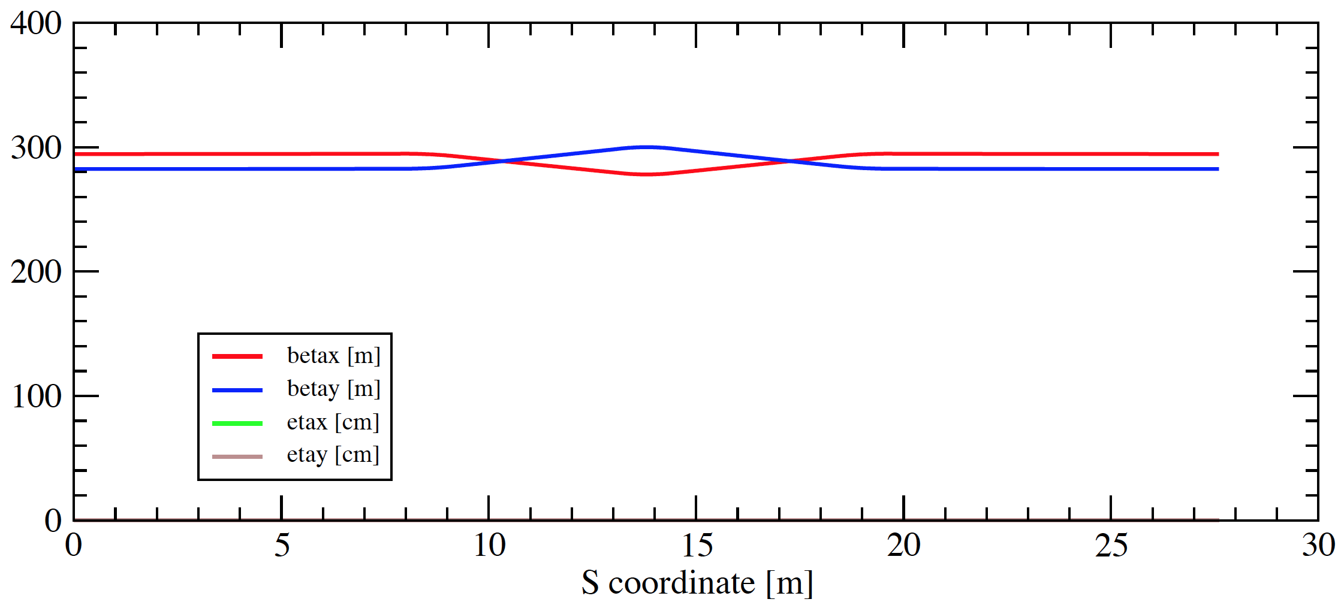
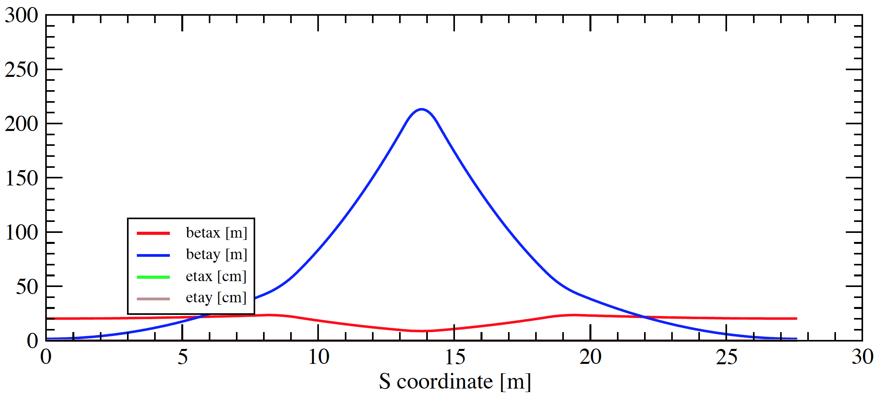
Triplet Focusing: Absurd Extremes
Very weak focusing
Beta functions arbitrarily large
Very strong focusing
Focal length close to
interquad spacing

Slide 23
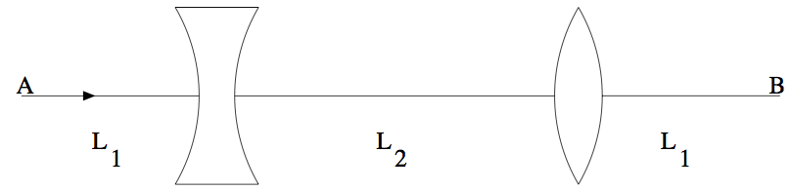
π/2 Insertion
Insertions and matching: modular accelerator design
FODO sections have very regular spacings of quads
  Periodicity of quadrupoles => periodicity of focusing
But we may need some long quadrupole-free sections
  RF, injections, extraction, experiments, long instruments
Can we design a periodic “module” that fits in a FODO lattice with a long straight section, and matches to FODO optics?
  Yes: the minimal periodic option is the π/2 insertion
  Matching lattice functions (β,α)_{x,y} at locations A,B

Slide 24
π/2 Insertion
periodic boundary conditions

Slide 25
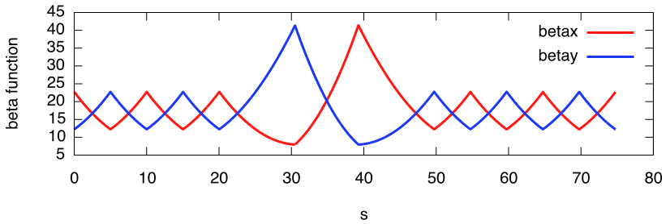
π/2 Insertion
π/2 insertion
5m FODO drifts
L₁=7.95m, L₂=8.75m

Slide 26
π/2 Insertion
π/2 insertion
Particles advance 90 degrees (π/2) in phase in this insertion but the
Twiss parameters are completely periodic
x’
x’
x
x
Play with equation 3.34
and components of M_{π/2}

Slide 27
π/2 Insertion
π/2 insertion
Q1: Why does this work for both planes even though we just
designed for one plane?
Hint:

Slide 28
π/2 Insertion
π/2 insertion
Q2: Can we set α=0 so this becomes an (x,x’) exchanger?
Hint:

Slide 29
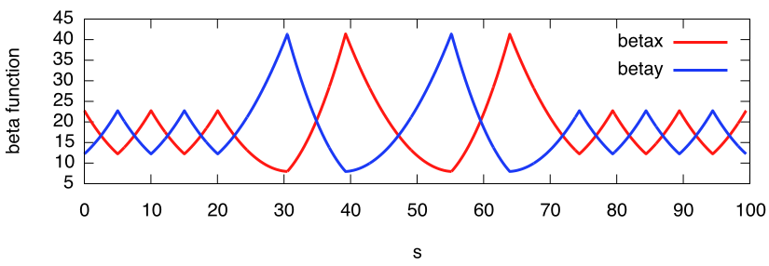
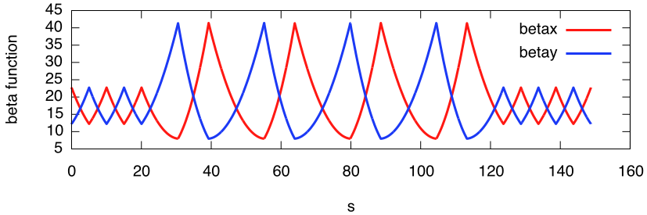
Multiple π/2 Insertions

Slide 30
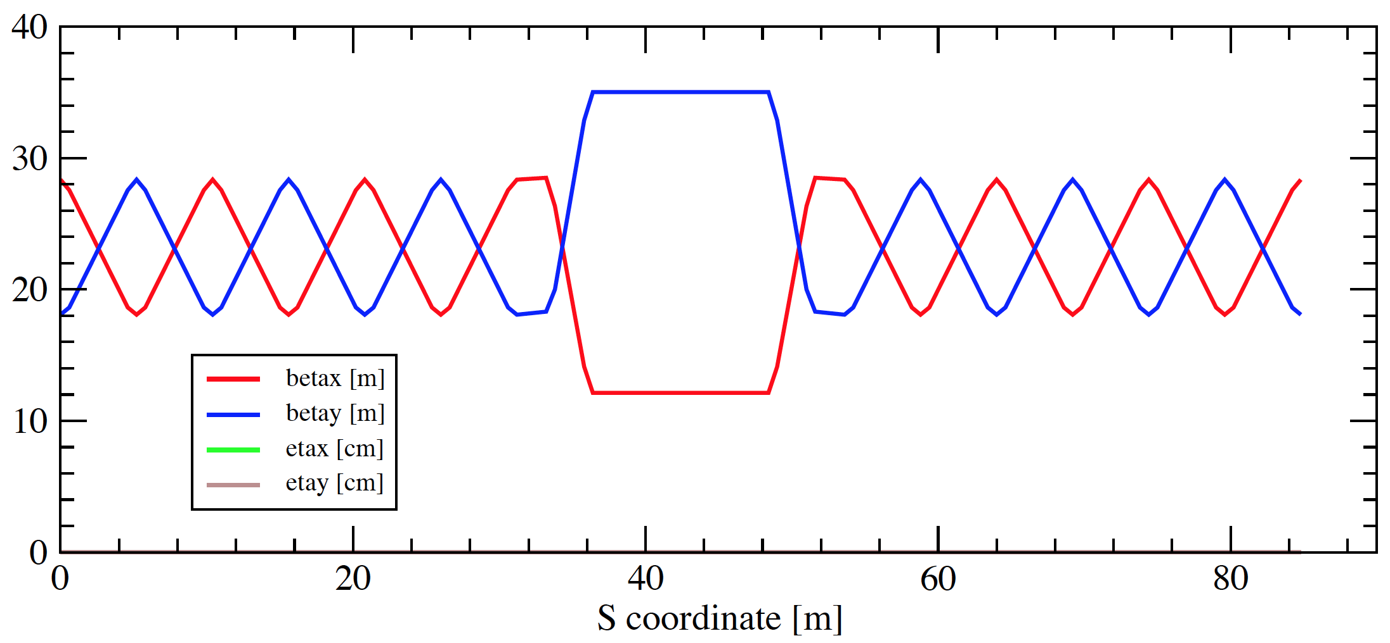
Symmetric Two-Doublet Insertion
insertion
FODO
FODO
Q2
Q2
Q1
Q1
Q: What does the symmetry imply for optics behavior?
Q: What about an antisymmetric two doublet insertion?

Slide 31
From (x,x’) Exchange to (x,y) Exchange
The π/2 solution prompted a question about (x,x’) exchange
Steve briefly discussed coupling from a theoretical and practical standpoint yesterday...
Q: is it possible to construct a lattice insertion that exchanges horizontal and vertical phase spaces?
A: Yes. This was developed in the 90s at Cornell and is called a Mobius insertion.
  Could “trivially” be implemented with a very long solenoid

Slide 32
Mobius Insertion
Fully coupled equal-emittance optics for e⁺e⁻ CESR collisions (round beam e⁺e⁻ collisions)
  Symmetrically exchange horizontal/vertical motion in insertion
  Horizontal/vertical motion are coupled
    Only one transverse tune degree of freedom!
  Match insertion to points where β_{x}=β_{y} and α_{x}=α_{y} with phase advances that differ by π between planes
    Normal insertion:
    Rotated by 45 degrees around s axis:
  A purely transverse example of an emittance exchanger

Slide 33

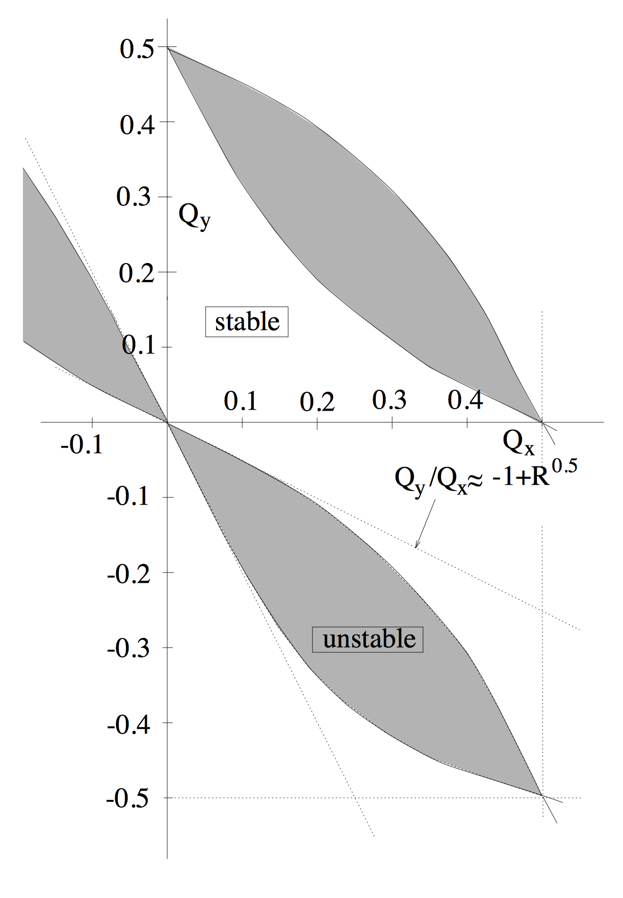
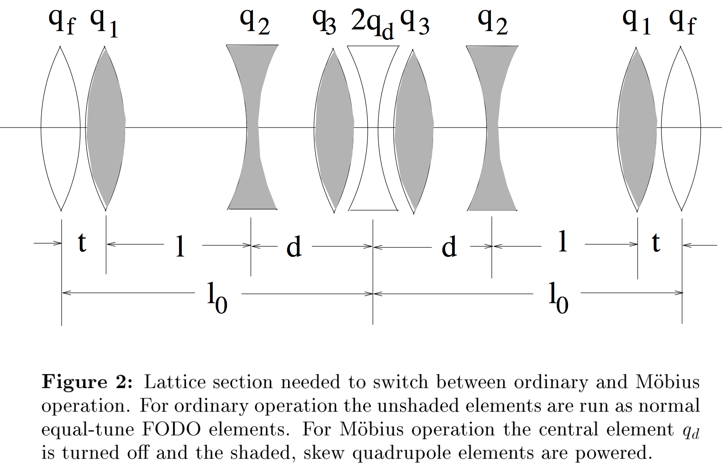
Talman 1993 Mobius Paper
https://www.classe.cornell.edu/public/CBN/1993/Mobius.ps
Synchrotron
Stability
Diagram
Shaded = Skew quadrupole

Slide 34
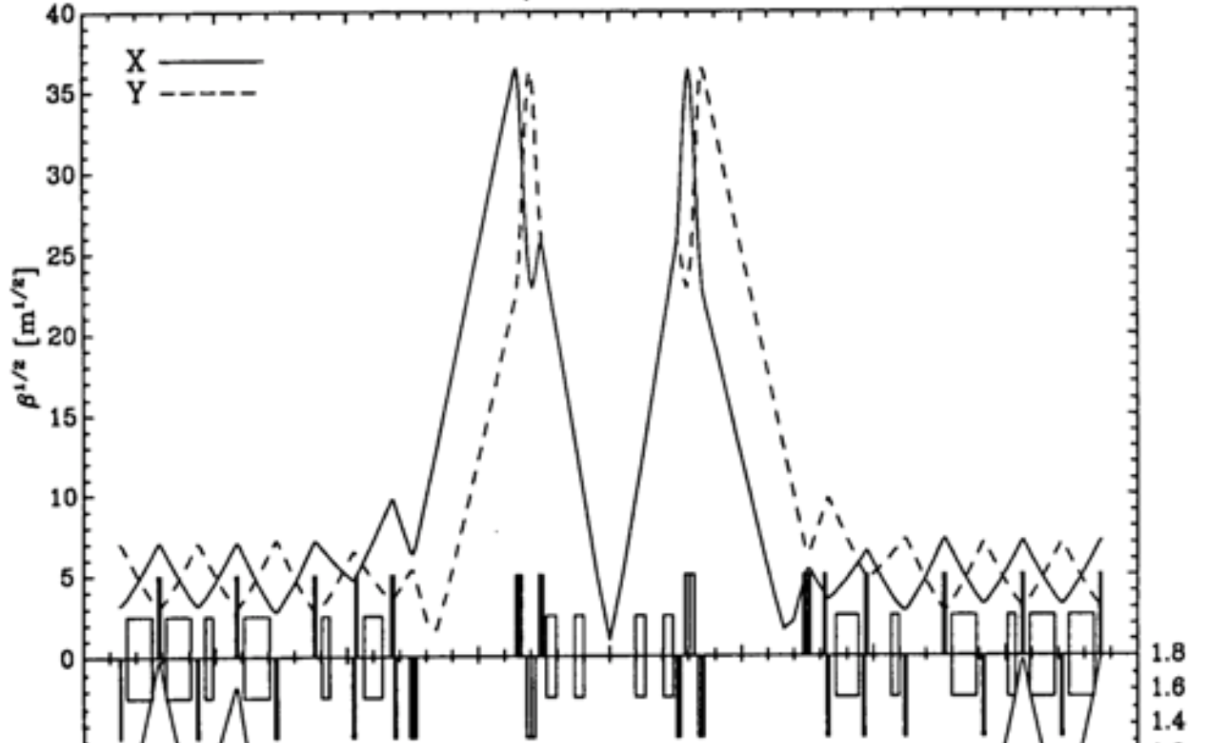
Low-beta Insertions: intro
We have one final “dipole-free” insertion to discuss
  (In practice it may well not be dipole free)
Low beta insertions are fundamentally quads that focus into special long drift spaces
  To this point we have avoided overfocusing
  Low beta insertions are intentionally overfocused to create a minimum beam size (or waist) in a drift
RHIC low-beta
insertion

Slide 35
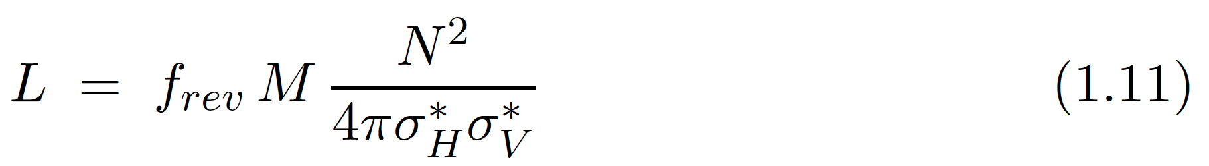
Low-beta Insertions: Uses
Low-beta is most famously used to maximize collider luminosity by minimizing beam size at interaction point
Also used to maximize beam divergence
  Minimizes emittance growth from interactions with materials, e.g. ion stripping foils or diagnostic screens
x’
thin foil scattering adds
noise to particle angles x’
x’
x
x
low β
α=0

Slide 36
Low-beta Insertions
Recall homework about β evolution and phase advance in a drift
where β* is the minimum value of β and s is the
s-coordinate distance from this minimum
β must be quite large at the quadrupoles surrounding the low-beta insertion to create a small β*

Slide 37
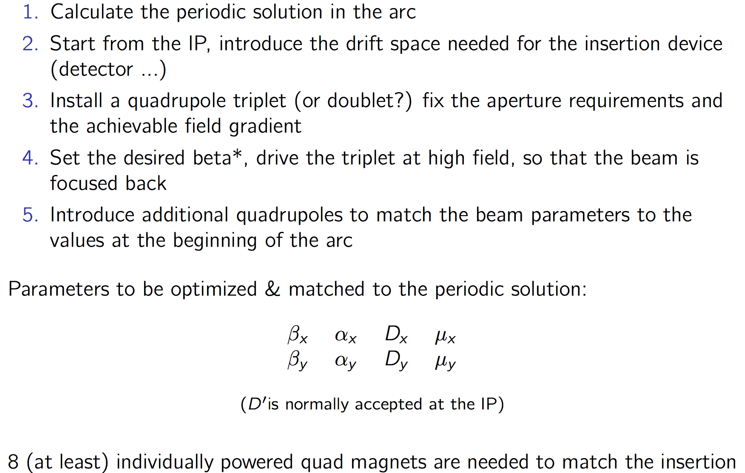
Low-beta Insertion guidelines
Use a code (e.g. madx)
to optimize and match!
Slide from D. Pellegrini

Slide 38
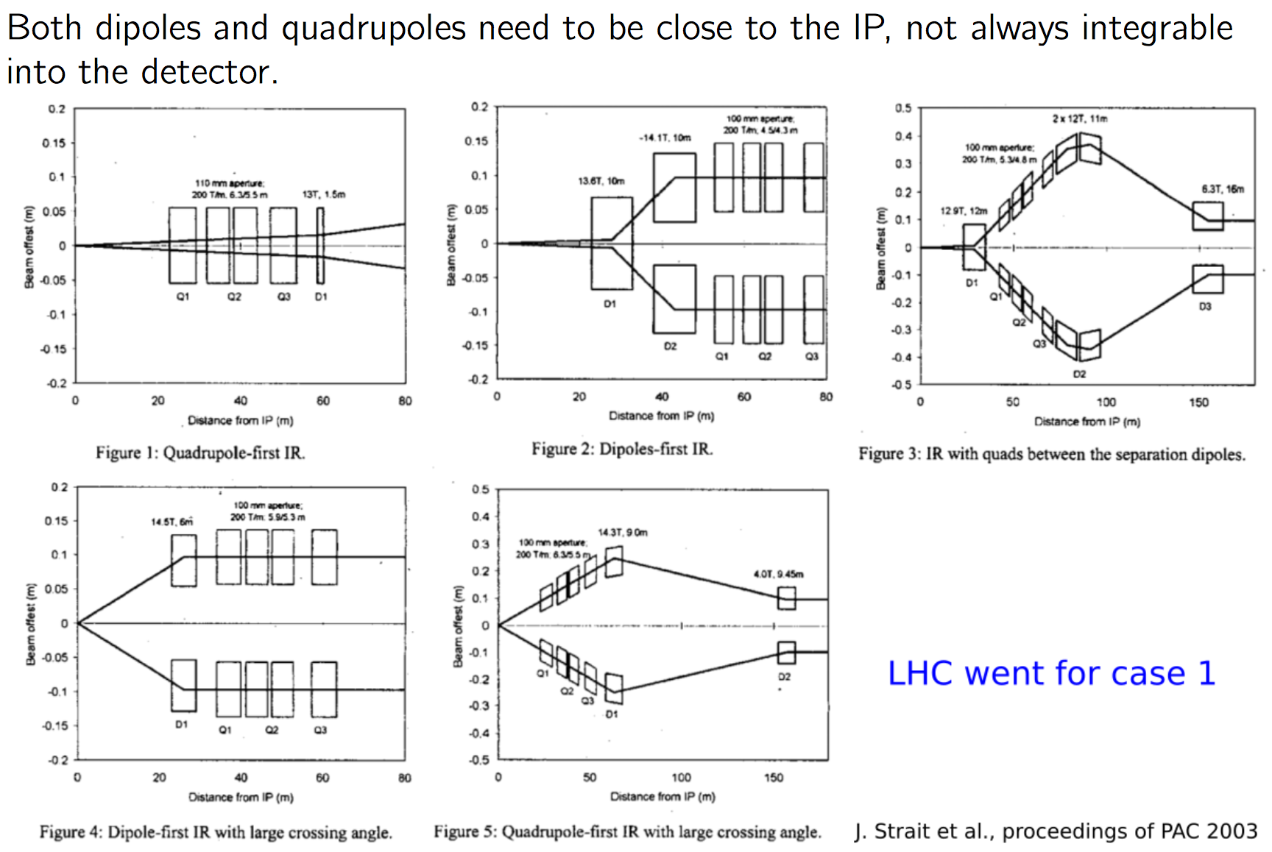
Combining Beam Separation and Low Beta Quads
LHC
RHIC
Slide from D. Pellegrini

Slide 39
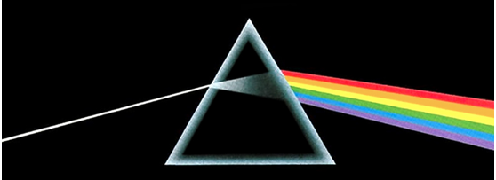
Dispersion Review
Review and reformulation of Tuesday PM material (a long time ago)
Dispersion is defined as the change in particle position with fractional momentum offset
  Dispersion originates from momentum dependence of dipole bends
  Equivalent to separation of optical wavelengths in prism
White light with many frequencies
(momenta) enters, all with same initial trajectories (x,x’)
Different positions
due to different bend angles of different wavelengths (frequencies, momenta) of incoming light

Slide 40
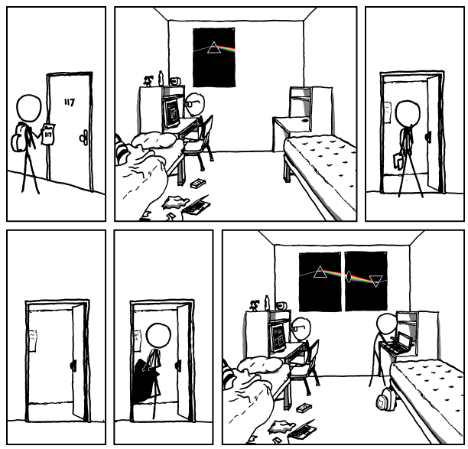
(xkcd interlude)

Slide 41
(xkcd interlude)
http://www.xkcd.org/964/
This is known in accelerator lattice design language as a “double bend achromat”

Slide 42
Dispersion
Add explicit momentum dependence to equation of motion
  Perturb our zero-dispersion solution to find
  The trajectory has two parts:

Slide 43
(Dispersion Review)
Substituting and noting dispersion is periodic,
  If we take we can solve this in a clever way
  Solving gives

Slide 44
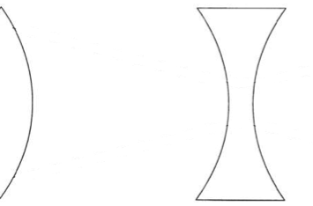



FODO with dipoles
cell
A periodic lattice without dipoles has no intrinsic dispersion
Consider FODO with long dipoles and thin quadrupoles
  Each dipole has total length so each cell is of length
  Assume a large accelerator with many FODO cells so

Slide 45
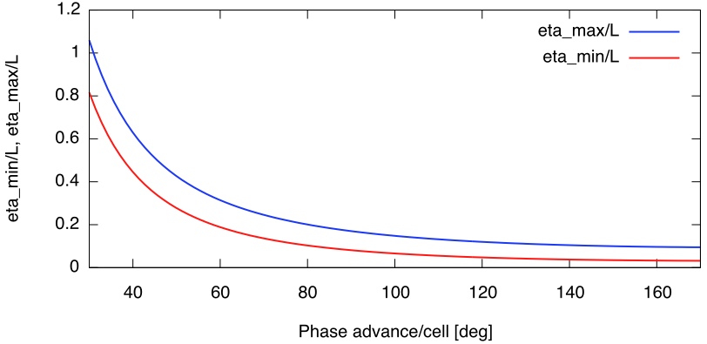
FODO with dipoles
Like before, this choice of periodicity gives us
Changing periodicity to defocusing quad centers gives

Slide 46
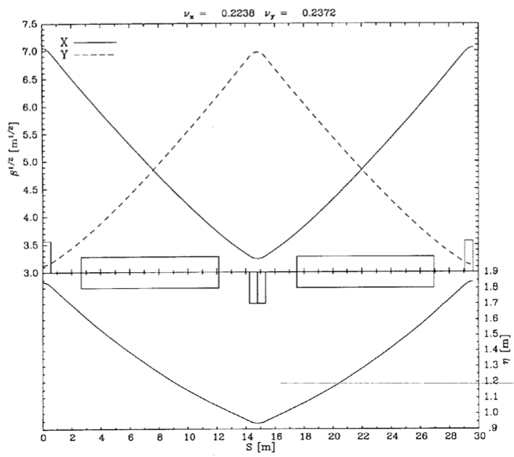
RHIC FODO Cell
Horizontal
Vertical
half quadrupole
half quadrupole
dipole
dipole
quadrupole
Horizontal dispersion

Slide 47
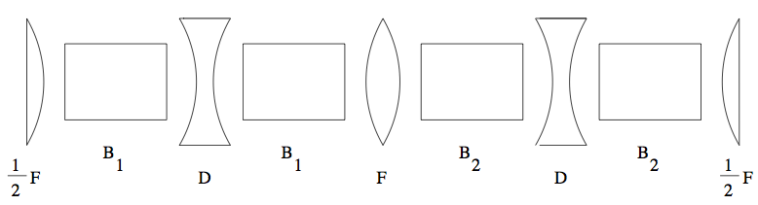
Dispersion suppressors
The FODO dispersion solution is non-zero everywhere
  But in straight sections we often want
    e.g. to keep beam small in wigglers/undulators in a light source
  We can “match” between these two conditions with with a dispersion suppressor, a non-periodic set of magnets that transforms FODO to zero.
  Consider two FODO cells with different total bend angles
    Same quadrupole focusing to not disturb much
    We want this to match to
    at ends to simplify periodic matrix

Slide 48
Dispersion suppressors
Zero dispersion area
slope η’=0
FODO peak dispersion,
slope η’=0

Slide 49
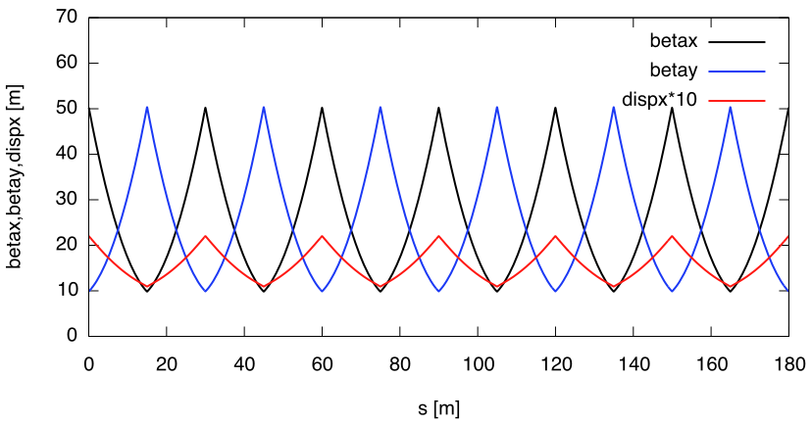
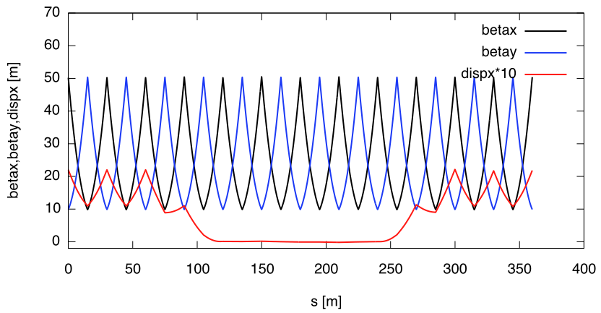
FODO Cell Dispersion and Suppressor
Dispersion-free Insertion

Slide 50
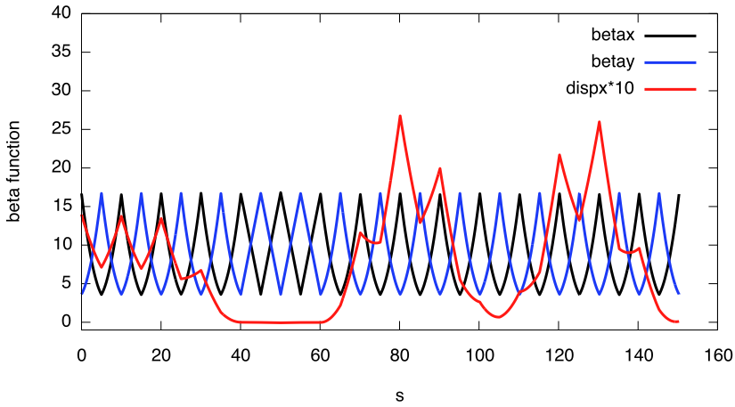
Mismatched Dispersion
What does mismatched dispersion look like?
  For example, this is what happens when the second dispersion suppressor is eliminated and the dipole-free FODO cells run right up against the FODO cells with dipoles
Dispersion
Mismatch –
not periodic!
Dispersion-free Insertion

Slide 51
RHIC Lattice Revisited
quadrupoles
dipoles
Missing dipole dispersion suppressor
low-beta insertion
low-beta insertion
Horizontal
Vertical
matching
FODO
Note modular design, including low-beta insertions
  Used for experimental collisions
  Minimum beam size σ (with zero dispersion)
    maximize luminosity
  Large σ, beam size in “low beta quadrupoles”
  Other facilities also have longitudinal bunch compressors (this afternoon)

