Slide 1
International Accelerator School 2023
Superconducting Science and Technology for Particle Accelerators
Linear Optics 1 (1h): Concepts
Todd Satogata (Jefferson Lab and Old Dominion University)
satogata@jlab.org
https://indico.lightsource.ca/event/6/timetable/#20230712
Additional material/courses: http://www.toddsatogata.net/
Happy Birthday to Willis Lamb (1955 Nobel), Buckminster Fuller, and the Australian Aboriginal Flag!
Happy Etch-a-Sketch Day (July 12 1960), New Conversations Day, and Paper Bag Day!

Slide 2
Outline
Quick refresher from yesterday’s lectures
  Relativity, rigidity, phase space, 1D transport
Thin quadrupoles
Strong focusing
Periodic linear beam transport
Hill’s equation and Twiss/Courant-Snyder revisited
Invariants, emittances (normalized and geometric)
General linear beam transport (parameterization)
Twiss parameter propagation
FODO cell analysis, stability and examples
Periodic triplet optics

Slide 3
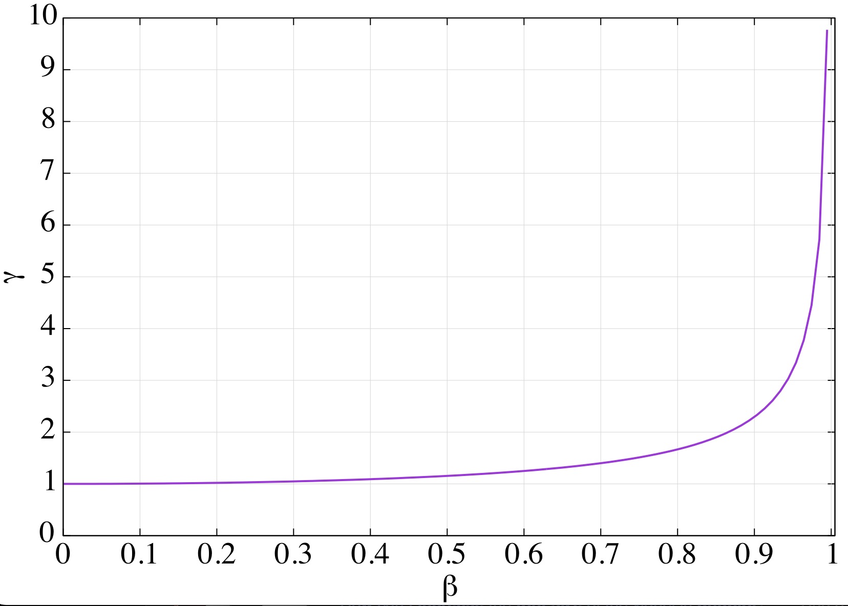
Review: Convenient Relativity Relations
Total energy
Momentum
Differential relations are fun to derive, hold for all γ
In “ultra” relativistic limit β≈1
  Usually must be careful below γ≈5 or U≈5 mc²
    For high energy electrons this is only U≈2.5 MeV
  Many accelerator physics phenomena scale with γ^{k} or (βγ)^{k}
are relativistic or C-S/Twiss parameters: context!

Slide 4
Rigidity: Bending Radius vs Momentum
Accelerator (magnets, geometry)
Beam
This is such a useful expression in accelerator physics that it has its own name: rigidity
Ratio of momentum to charge
  How hard (or easy) is a particle to deflect?
  Often expressed in [T-m] (easy to calculate B)
  Be careful when q≠e!!
A possibly useful expression
Notes:
Perpendicular B!
Add q[e] (or Z) to last equation
Be careful; very low-energy people may define rigidity relative to KE rather than p
RHIC: dAu tradeoff

Slide 5
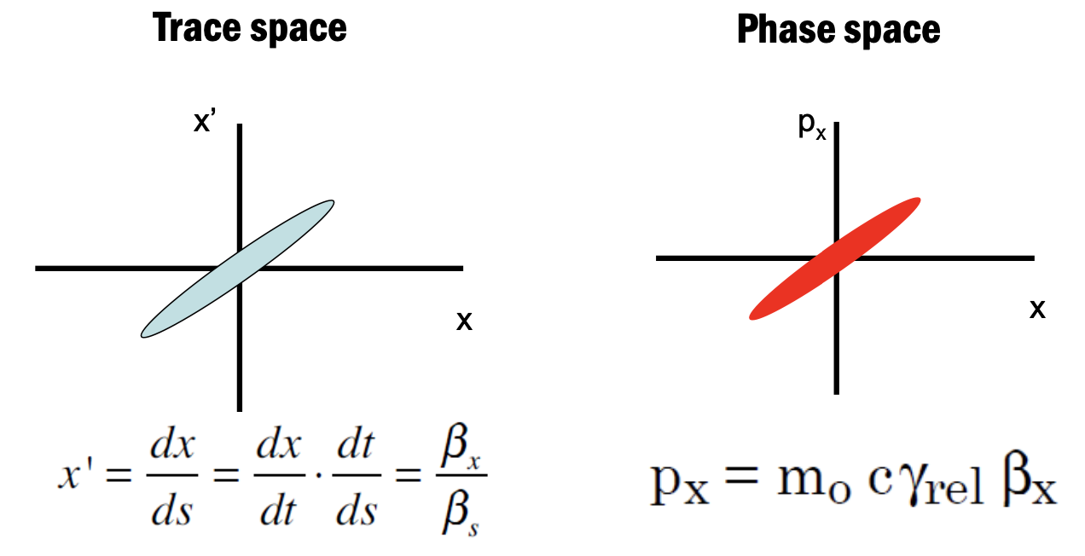
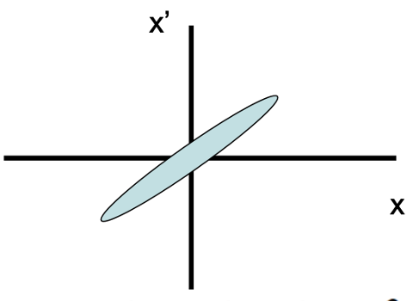
“Review”: Phase Space (as commonly used)
Yesterday
Phase
space
Paraxial approximation
Always check simulation code/course coordinate systems

Slide 6
“Review”: (1D) Transport Matrix
is a second-order differential equation
  Linear solutions “transport” (x,x’) initial conditions
  Coordinates are properties of particles/beam
  M is defined by the accelerator lattice
  Chain/multiply lattices together for different elements
x: transverse position
x’: transverse angle, “velocity”

Slide 7
Thin Quadrupole Transport Matrix
Focusing
Quadrupole
Defocusing
Quadrupole
Quadrupoles are often treated as “thin”
  Focal length is much longer than magnet length
Then we can use the thin-lens approximation
  where f=1/(kL) is the quadrupole focal length
Thin quadrupole approximation

Slide 8
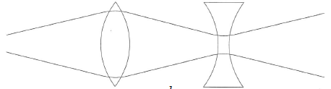
Matrix Example: Strong Focusing
Consider a doublet of thin quadrupoles separated by drift L
  There is net focusing given by this alternating gradient system
  A fundamental point of optics, and of accelerator strong focusing
Thin quadrupole
matrices

Slide 9
Strong Focusing: Another View
  For this to be focusing, x’ must have opposite sign of x where these are coordinates of transformation of incoming paraxial ray
  Equal strength doublet is net focusing under condition that each lens’ focal length is greater than distance between them

Slide 10
1D Periodic Transport Matrix
Periodic focusing systems are extremely useful
  (not just in accelerators: solid state, quantum, ...)
Examples:
  Rings (synchrotrons, betatrons): periodic once per “turn”
    Often “superperiodic”, more than once per turn
  Repeated lattices (FODO and other “cells”)
We need periodic focusing to keep beams stable
  Quadrupoles fortunately provide a linear restoring force
    Alternating focusing/defocusing provides net focusing
  Expect equations of motion to be like simple harmonic oscillators

Slide 11
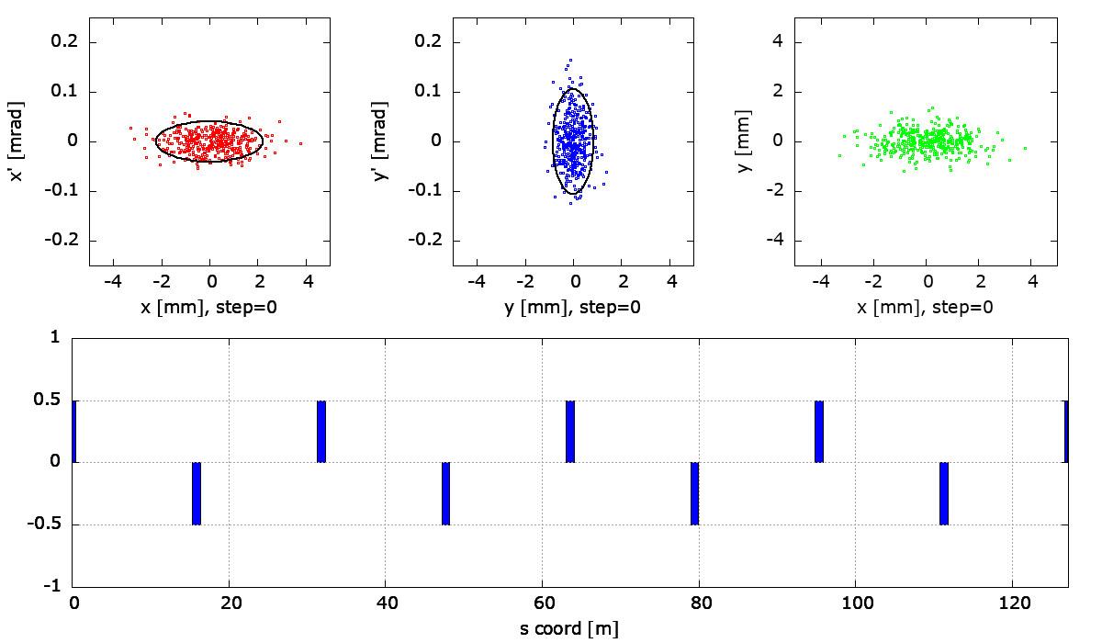
1D Periodic Transport: Drifts and Quads (FODO)
Quadrupoles: phase space angle shear
Drifts: phase space position shear
  Dipoles: position shear with a little bit of rotation

Slide 12
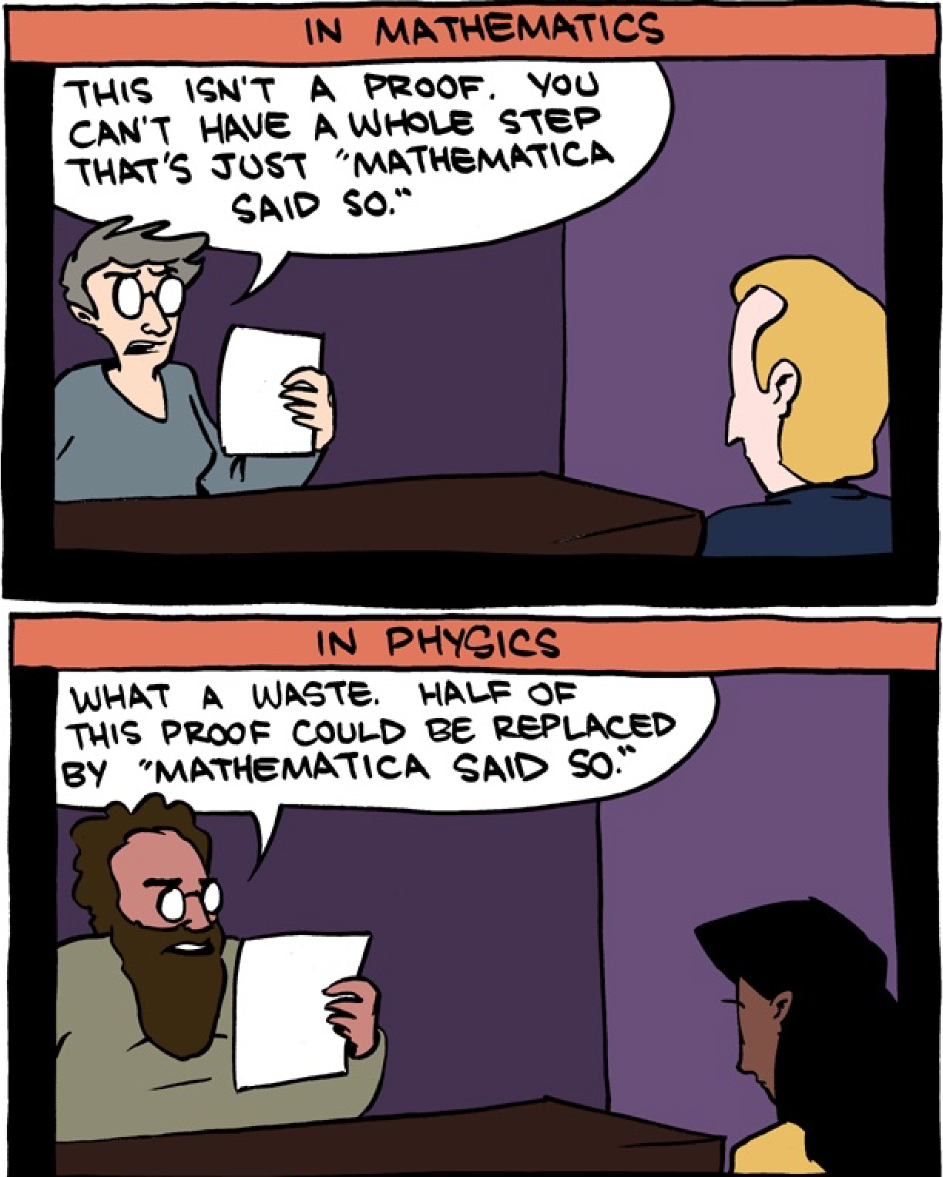
Warning: Professoral Egoistic Indulgence
Differential Equations Ahead
The following illuminates a connection between 2nd order linear differential equations and matrices that your lecturer finds beautiful so you will suffer through it

Slide 13
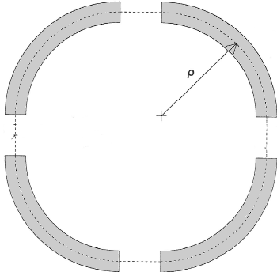
Math: Hill’s Equation
Quadrupole equations of motion: linear restoring force
  What happens when we let the focusing K vary with s?
  Also assume K is periodic in s with some periodicity C
  This periodicity can be one revolution around the
  accelerator or as small as one repeated “cell”
  of the layout
  The simple harmonic oscillator equation with a
  periodically varying spring constant K(s) is
  known as Hill’s Equation

Slide 14
Hill’s Equation Solution Ansatz
Solution is a quasi-periodic harmonic oscillator
  where w(s) is periodic in C but the phase Ψ(s) is not!!
  Substitute this educated guess (“ansatz”) to find
  For and to be independent of , coefficients of the sin and cos terms must vanish identically

Slide 15
Courant-Snyder Parameters
Notice that in both equations so we can scale this out and define a new set of functions, Courant-Snyder Parameters or Twiss Parameters

Slide 16
Towards The Matrix Solution
What is the matrix for this Hill’s Equation solution?
Take a derivative with respect to s to get
Now we can solve for A and B in terms of initial conditions
And take advantage of the periodicity of to find

Slide 17
Hill’s Equation Matrix Solution
We can write this down in a matrix form where
is the betatron phase advance through one period C

Slide 18
Parameterization of Periodic Transport
Describes 1D single particle and centroid linear motion over period C
Twiss parameters
are periodic in C, but depend on s position within the periodic system
is independent of s
  the betatron phase advance of this periodic system
Determinant of matrix M is 1! (Liouville)
Equivalent to a rotation and some scaling
M can be written down in a beautiful and deep way
Matrix DeMoivre
Lie
algebras
(NB: Two transverse dimensions x,y are assumed decoupled here)

Slide 19
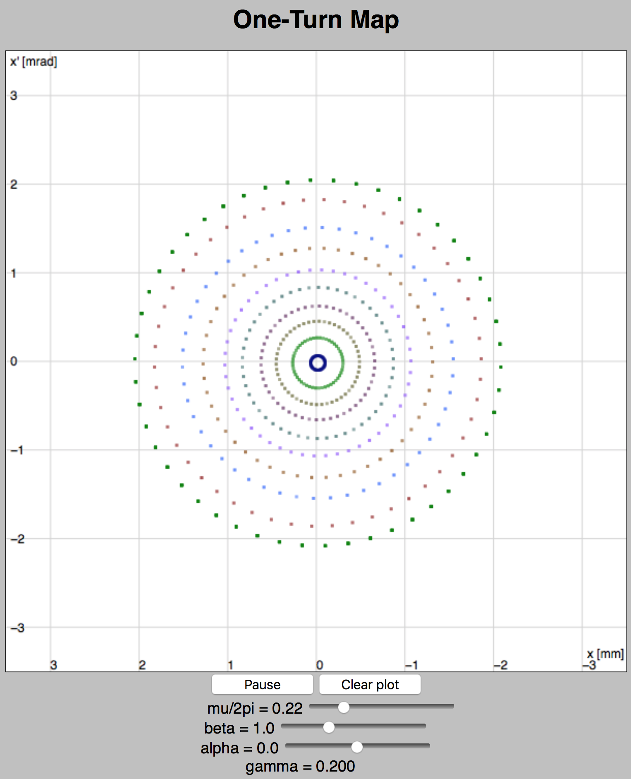
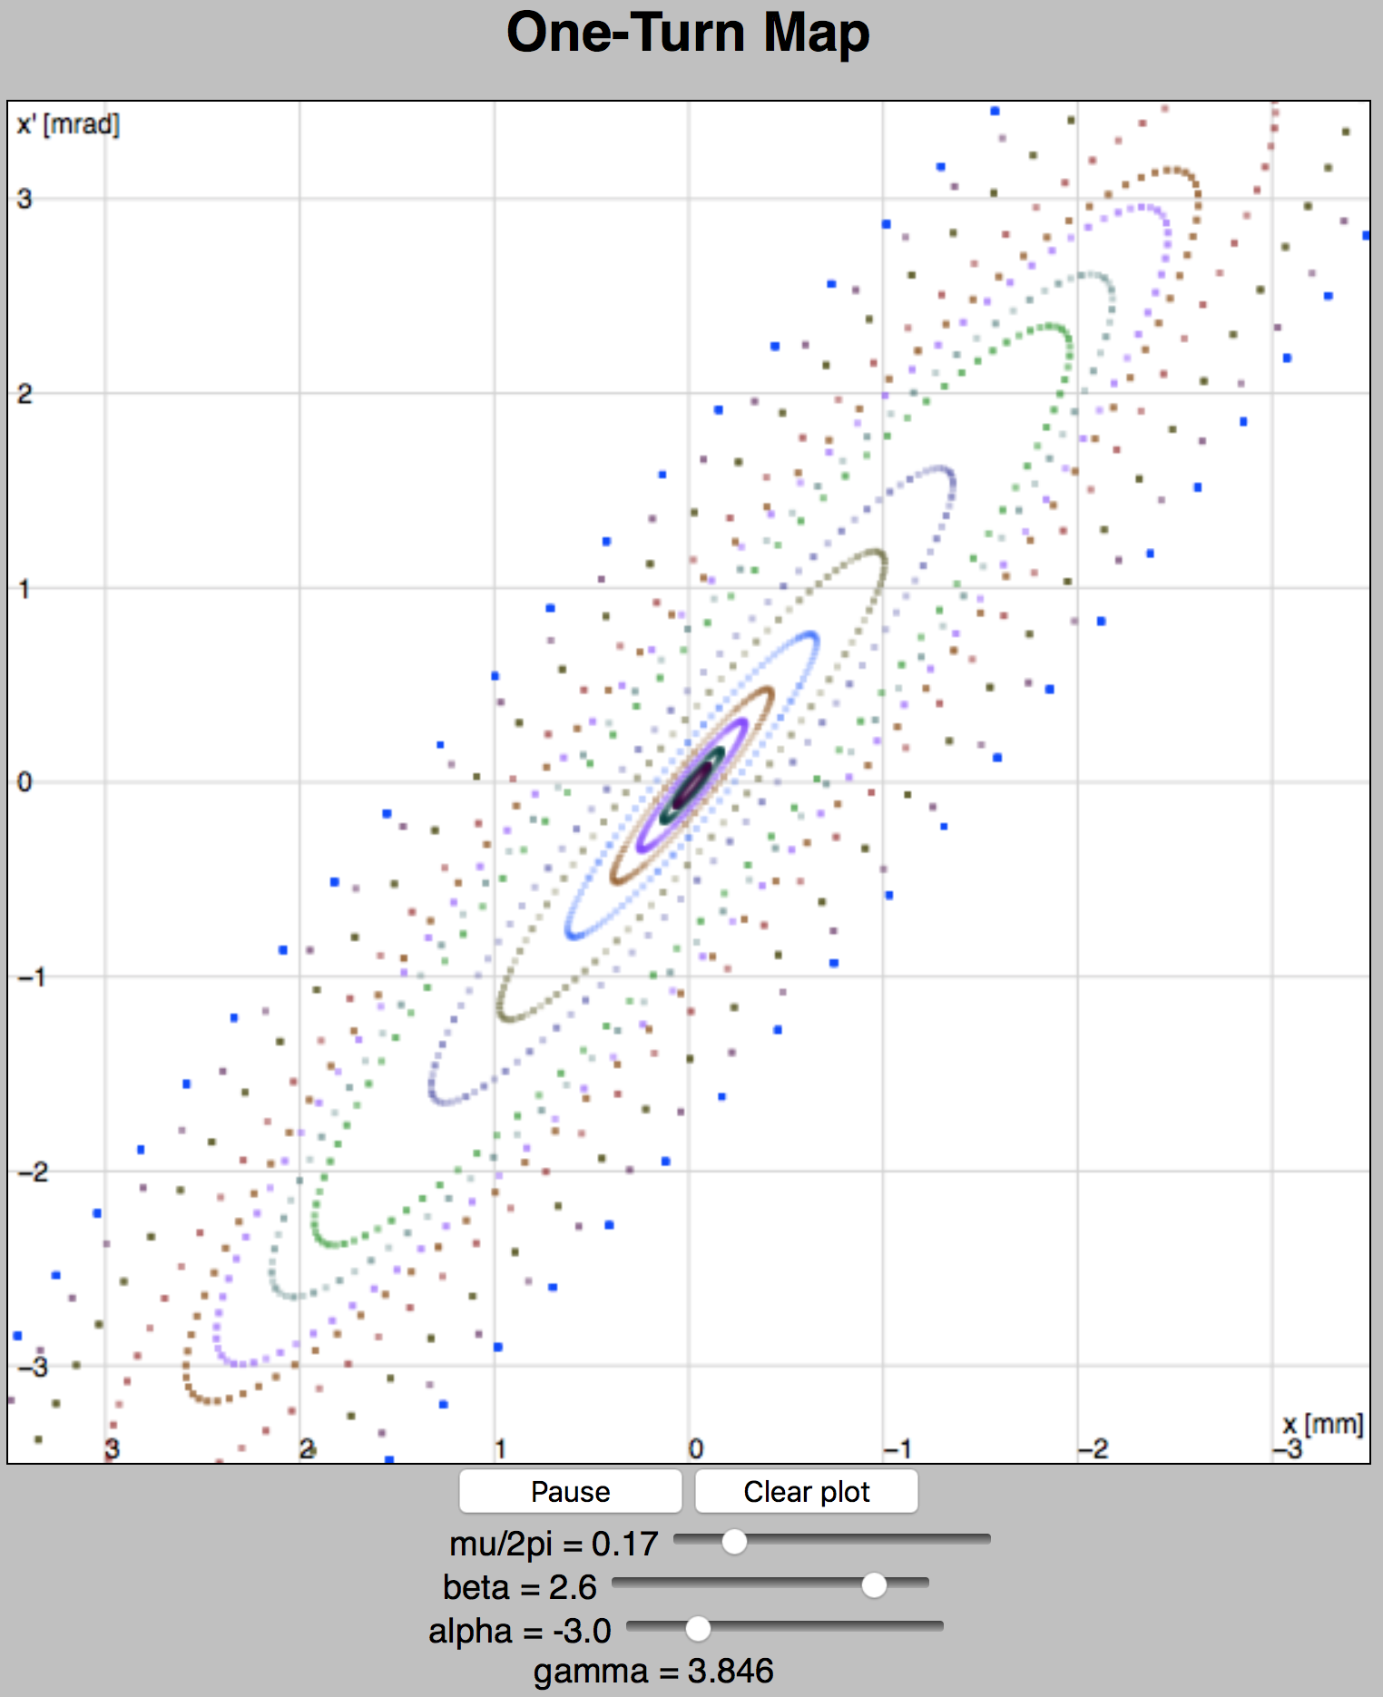
One Turn (or One Period) Map
http://www.toddsatogata.net/2019-USPAS/OneTurnMap.html

Slide 20


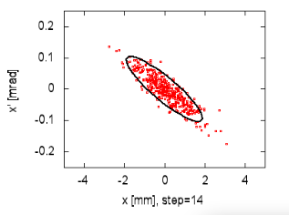
Invariants and Ellipses
We assumed A was constant, an invariant of the motion
  A can be expressed in terms of initial coordinates to find
  This is known as the Courant-Snyder invariant: for all s,
  Similar to total energy of a simple harmonic oscillator
  looks like an elliptical area in phase space
  Our matrices look like scaled rotations (ellipses) in phase space
s=s₀
s=s₀+C
s=s₀+2C
s=s₀+3C

Slide 21



Emittance
The area of the ellipse inscribed by any given particle in phase space as it travels through our accelerator is called the emittance : it is constant and given by
  Emittance is often quoted as the area of the ellipse that would contain a certain fraction of all (Gaussian) beam particles
  e.g. RMS emittance contains 39% of 2D beam particles
  Related to RMS beam size
  Yes, this RMS beam size depends on s!
  RMS emittance convention is fairly standard
  for electron rings, with units of mm-mrad

Slide 22






Adiabatic Damping and Normalized Emittance
But constant-energy assumption is violated when we accelerate!
  When we accelerate, invariant emittance is not invariant!
  We are defining areas in phase space
  The definition of x doesn’t change as we accelerate
  But does since changes!
  scales with relativistic beta, gamma:
  This has the effect of compressing x’ phase space by
  Normalized emittance is the invariant in this case
    unnormalized emittance goes down as we accelerate
    This is called adiabatic damping, important in, e.g., linacs

Slide 23
Floquet Transformation
All these one-turn (or one-period) maps are points around concentric ellipses
There must be a transformation that separates out the ellipse parameters and the circular rotation
This is called the Floquet Transformation

Slide 24
Normalized Phase Space
If we define new coordinates then
and motion is just circles with the trivial solution

Slide 25
Back to General Physical Solution
Particle position motion scales like
For ellipse aspect ratio

Slide 26
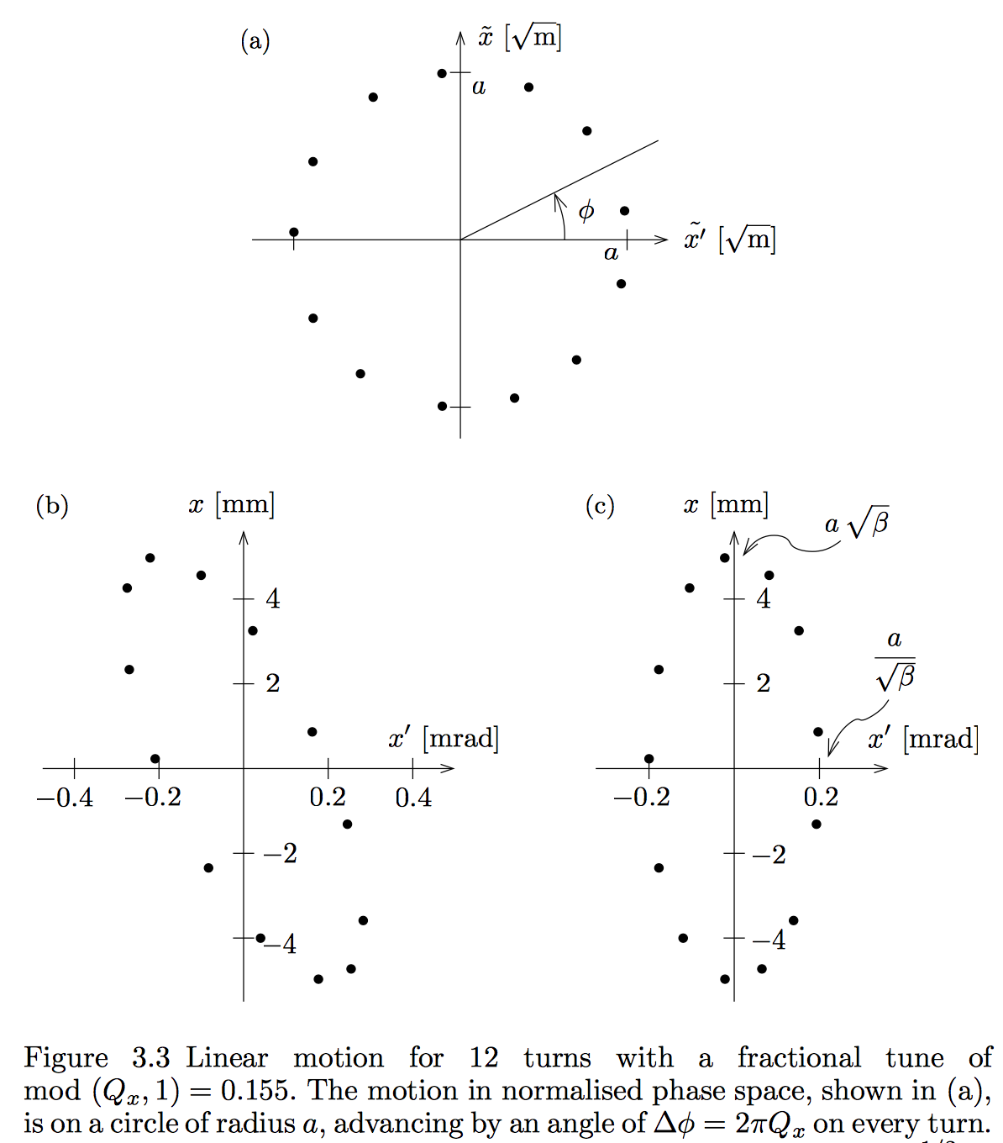

Slide 27
General Linear Beam Transport
The normalized phase space transformation gives us a clever path to general linear beam transport
  From one location (s₁) to another (s₂)
  Rotation is just a portion of the phase advance, not the full tune
  Floquet transformations can use different Twiss Parameters (reminder: they depend on s coordinate!)

Slide 28
General Linear Transport Matrix
We can parameterize a general non-periodic transport matrix from s₁ to s₂ using lattice parameters and
This does not have a pretty form like the periodic matrix
  However both can be expressed as
  where the C and S terms are cosine-like and sine-like; the second row is the s-derivative of the first row!
  A common use of this matrix is the m₁₂ term:
Effect of angle kick
on downstream position

Slide 29
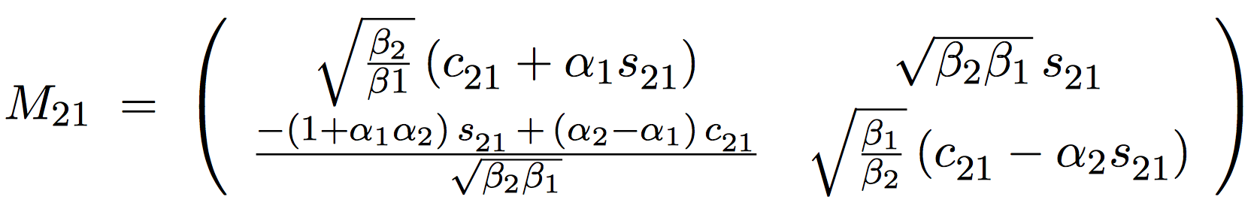
General Linear Transport Matrix
So we have a very general form from all this math:
  with
  This is how one can parameterize uncoupled x or y transport from one location s₁ to another location s₂ where the Twiss parameters of those locations and their relative phase advance is known
    Such as from a table from a modeling code like madx
  Most modeling codes can also output matrix elements between specific locations at starts or ends of magnets

Slide 30
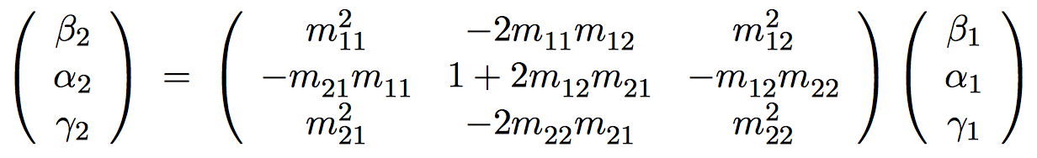
Twiss Parameter Propagation
Labeling the transport matrix elements as m₁₂ etc:
then we (okay, you) can show
and the phase advance between two locations is
also related to the transport matrix elements and
initial Twiss parameters by

Slide 31
Review

Slide 32
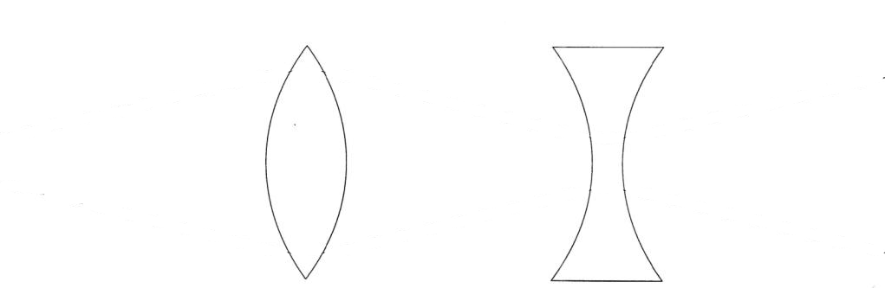
Lattice Optics: FODO Lives!
(Be very careful in comparisons to other sources!)
cell
Most accelerator lattices are designed in modular ways
  Design and operational clarity, separation of functions
One of the most common modules is a FODO module
  Alternating focusing and defocusing “strong” quadrupoles
  Spaces between are combinations of drifts and dipoles
  Strong quadrupoles dominate the focusing
  Periodicity is one FODO “cell” so we’ll investigate that motion
  Horizontal beam size largest at centers of focusing quads
  Vertical beam size largest at centers of defocusing quads

Slide 33
Periodic Example: FODO Cell Phase Advance
cell
Select periodicity between centers of focusing quads
  A natural periodicity if we want to calculate maximum β(s)
  only has real solutions (stability) if

Slide 34
Periodic Example: FODO Cell Beta Max/Min
cell
What is the maximum beta function, ?
  A natural periodicity if we want to calculate maximum β(s)
  Follow a similar strategy reversing F/D quadrupoles to find the minimum β(s) within a FODO cell (center of D quad)

Slide 35
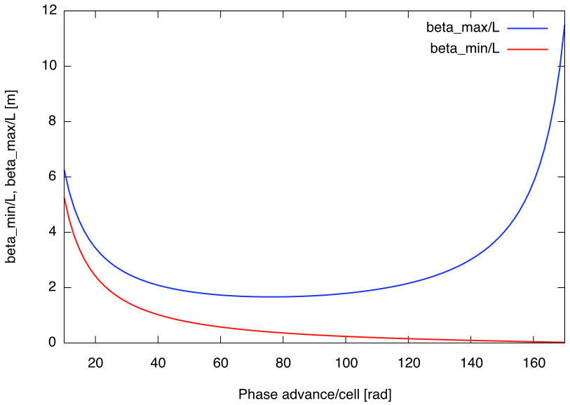

FODO Betatron Functions vs Phase Advance
Here there be dragons
Generally want /L small
Strong focusing
Smaller magnets
Less expensive accelerator
[deg]

Slide 36
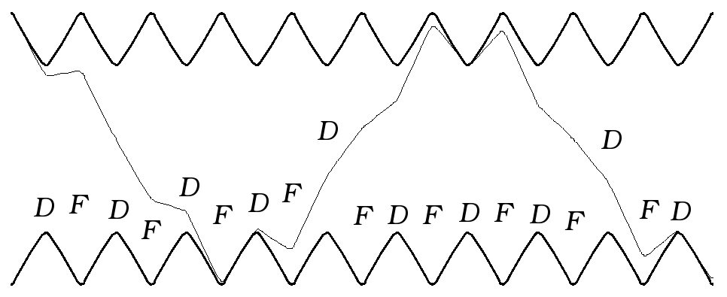
FODO Beta Function, Betatron Motion
Betatron motion
trajectory
design trajectory
This is a picture of a FODO lattice, showing contours of since the particle motion goes like
  This also shows a particle oscillating through the lattice
  Note that provides an “envelope” for particle oscillations
    is sometimes called the envelope function for the lattice
  Min beta is at defocusing quads, max beta is at focusing quads
  6.5 periodic FODO cells per betatron oscillation

Slide 37
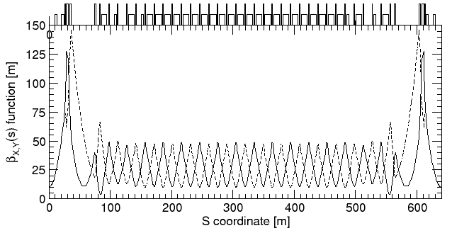
Example: RHIC FODO Lattice
quadrupoles
dipoles
low-beta insertion
low-beta insertion
Horizontal
Vertical
matching
FODO
1/6 of one of two RHIC synchrotron rings, injection lattice
  FODO cell length is about L=30 m
  Phase advance per FODO cell is about
☺

Slide 38
Stability Diagrams
Designers often want or need to change the focusing of the two transverse planes in a FODO structure
  What happens if the focusing/defocusing strengths differ?
  Recalculate the M matrix and use dimensionless quantities
  then take the trace for stability conditions to find
cell

Slide 39
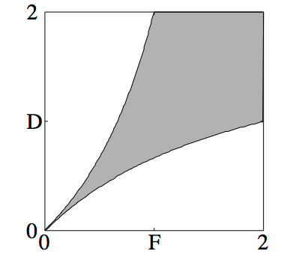
Stability Diagrams II
  For stability, we must have
  Using , stability limits are where
  These translate to a FODO “necktie” stability diagram

Slide 40
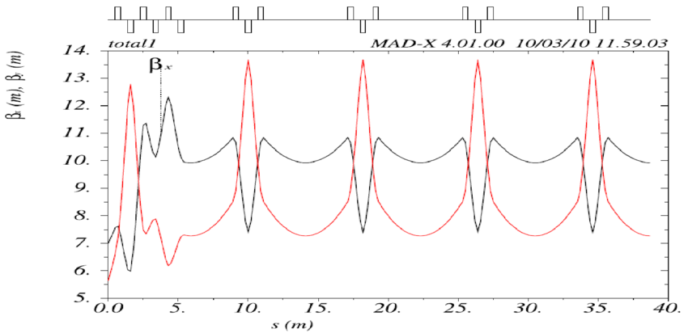
Triplet Optics: Extra Straight Space
cell
half quad!
half quad!
From R. Chehab et al., “The CLIC Positron Capture and Acceleration in the Injector Linac”, 2010.

Slide 41
Triplet Optics: Extra Straight Space
cell
long drift
full double strength quad!
More this
afternoon
symmetric beta
antisymmetric alpha
From R. Chehab et al., “The CLIC Positron Capture and Acceleration in the Injector Linac”, 2010.

Slide 42
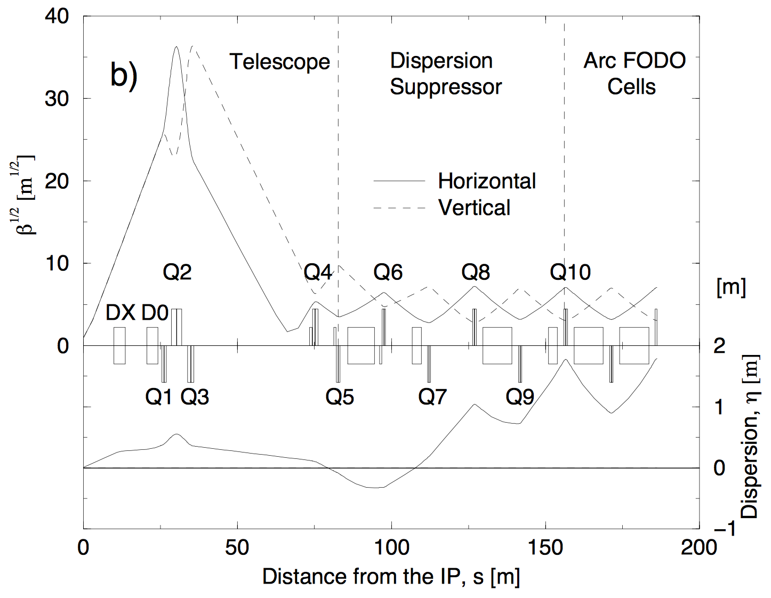
Continuous Twiss Parameter Plot: RHIC IR

