Slide 1
International Accelerator School 2023
Superconducting Science and Technology for Particle Accelerators
Linear Optics 3: Magnets
Todd Satogata (Jefferson Lab and Old Dominion University)
satogata@jlab.org
https://indico.lightsource.ca/event/6/timetable/#20230712
Happy Birthday to Patrick Stewart, Harrison Ford, and Live Aid!
Happy Embrace Your Geekiness Day!

Slide 2
Overview
Review: Maxwell
  Parameterizing fields in accelerator magnets
  Symmetries, comments about magnet construction
Relating currents and fields
  Equipotentials and contours, dipoles and quadrupoles
  Thin magnet kicks and that ubiquitous rigidity
  Complications: hysteresis, end fields
More details about dipoles
  Sector and rectangular bends; edge focusing
Intro to superconducting magnets
  RHIC, LHC, EIC, and beyond
Notes:
Maybe comments about magnet measurements in complications section? Along with lead and return ends

Slide 3
Other References
Magnet design and a construction is a specialized field all its own
  Electric, Magnetic, Electromagnetic modeling
    2D, 3D, static vs dynamic
  Materials science
    Conductors, superconductors, ferrites, superferrites
  Measurements and mapping
    e.g. g-2 experiment: 1 PPM field uniformity, 14m SC dipole
Entire USPAS courses have been given on just superconducting magnet design
  http://www.bnl.gov/magnets/staff/gupta/scmag-course/
    (Ramesh Gupta and Animesh Jain, BNL)

Slide 4
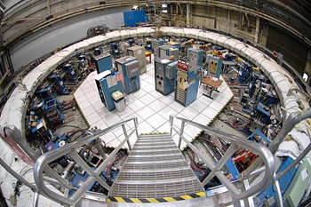

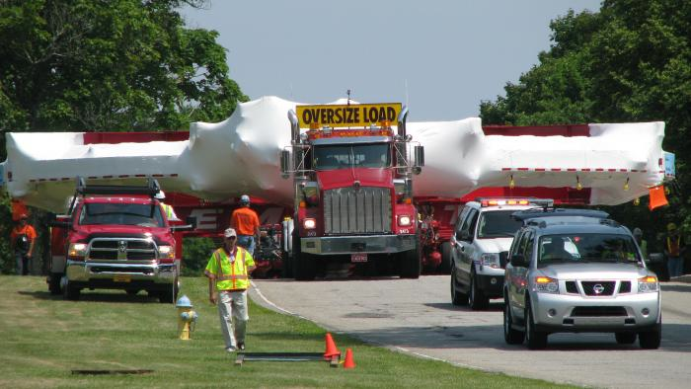
g-2 magnet
At Brookhaven
Magnet moved from Brookhaven to Fermilab in 2013
  17 tons, 44m circumference, 18 cm gap
  35 days, over 3200 miles
  http://muon-g-2.fnal.gov/bigmove/
At Fermilab
On the move

Slide 5
EM/Maxwell Review I
Relativistic Lorentz force
  For large γ common in accelerators, transverse magnetic fields are much more effective for changing particle momenta
  Can mostly separate E (RF, septa) and B (DC magnets)
    Some exceptions, e.g. plasma wakefields, betatrons, RFQ
Easiest/simplest: magnets with constant B field
  Constant-strength optics
    Most varying B field accelerator magnets change field so slowly that E fields are negligible
    Consistent with constant (or slow-changing) field assumptions
Notes:
Most important things like Ampere’s law
Concentrate on DC transverse magnets (ignore E fields)

Slide 6
EM/Maxwell Review II
Maxwell’s Equations for and magnetization are
A magnetic vector potential exists
Transverse 2D (B_{z}=H_{z}=0), paraxial approx (p_{x,y}<<p₀)
Away from magnet coils ( )
  Simple homogeneous differential equations for fields
Notes:
Waldo mentioned curl B=0 yesterday as conservative force, Hamiltonian mechanics

Slide 7
Parameterizing Solutions
What are solutions to these equations?
  Constant field:
    Dipole fields, usually either only B_{x} or B_{y}
    360 degree (2π) rotational “symmetry”
  First order field:
    Maxwell reduces 4 vars to 2: B_{s}=B_{xx}=-B_{yy} and B_{n}=B_{xy}=B_{yx}
    Quadrupole fields, either normal B_{n} or skew B_{s}
    180 degree (π) rotational symmetry
    90 degree rotation interchanges normal/skew
  Higher order…

Slide 8
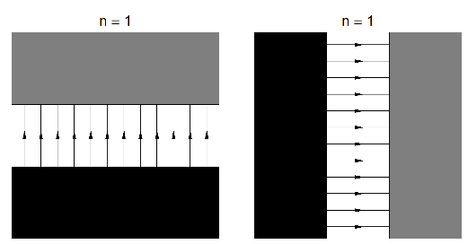
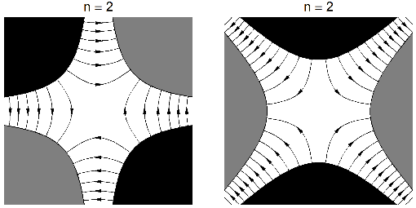
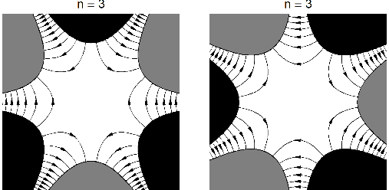
Visualizing Fields I
Dipole and “skew” dipole
Quad and skew quad
Sextupole and skew sextupole

Slide 9
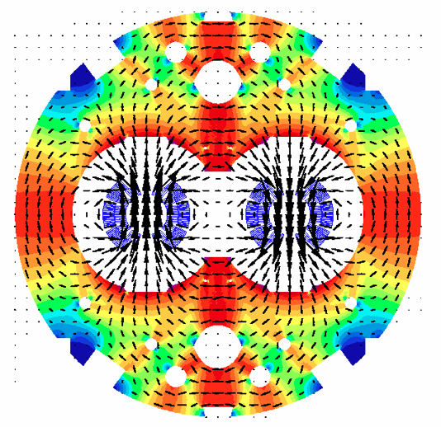
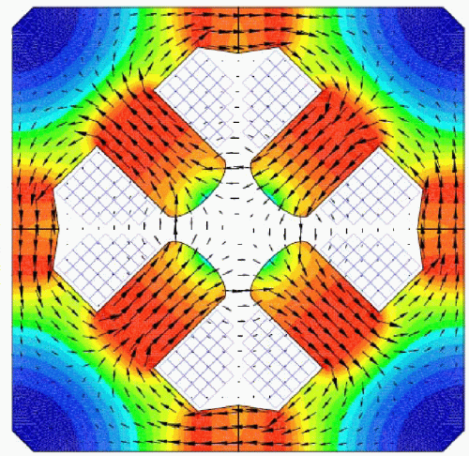
Visualizing Dipole and Quadrupole Fields II
LEP quadrupole field
LHC dipole
field
LHC dipole: B_{y} gives horizontal bending
LEP quadrupole: B_{y} on x axis, B_{x} on y axis
  Horizontal focusing=vertical defocusing or vice-versa
  No coupling between horizontal/vertical motion
    Note the nice “harmonic” field symmetries

Slide 10

General Multipole Field Expansions
Rotational symmetries, cylindrical coordinates
  Power series in radius r with angular harmonics in θ
  Need “reference radius” a (to get units right)
  (b_{n},a_{n}) are called (normal,skew) multipole coefficients
  We can also write this succinctly using de Moivre as
European
vs American!
Notes:
(bn, an) are unitless!
Cauchy-Riemann conditions, analytic expansion In Bx-iBy

Slide 11
(But Do These Equations Solve Maxwell?)
Yes ☺ Convert Maxwell’s eqns to cylindrical coords
  Aligning r along the x-axis it’s easy enough to see
  In general it’s (much, much) more tedious but it works

Slide 12
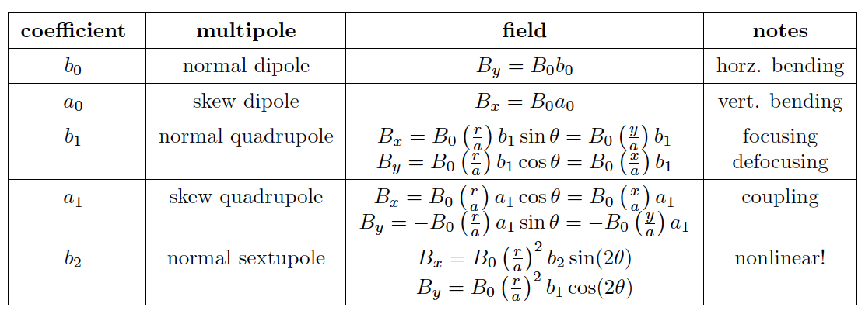
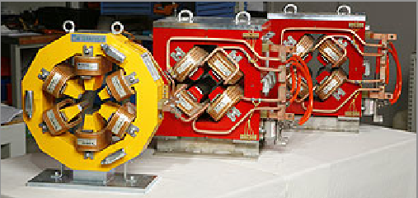
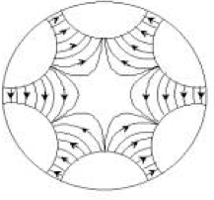
Multipoles
European
vs American!
(b,a)_{n} “unit” is 10⁻⁴ (natural scale) (b,a)_{n} (US) = (b,a)_{n+1} (European)!
S
N
N
S
S
Elettra magnets
N
Notes:
Higher order multipole specs as a black art, dynamic aperture
Be very careful to define your multipole conventions or read the documentation

Slide 13
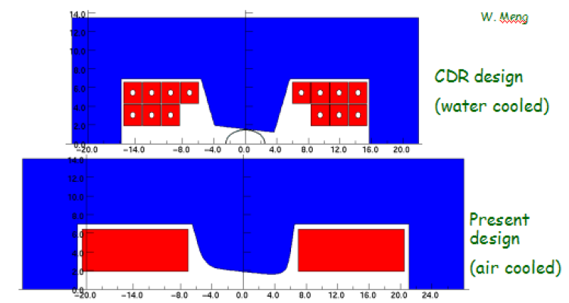
Multipole Symmetries
Dipole has 2π rotation symmetry (or π upon current reversal)
Quad has π rotation symmetry (or π/2 upon current reversal)
k-pole has 2π/k rotation symmetry upon current reversal
We try to enforce symmetries in design/construction
  Limits permissible magnet errors
  Higher order fields that obey main field symmetry are called allowed multipoles
RCMS half-dipole laminations
(W. Meng, BNL)
“H style dipoles”
(include focusing
as well as bending)

Slide 14
Multipole Symmetries II
So a dipole (n=0, 2 poles) has allowed multipoles:
  Sextupole (n=2, 6 poles), Decapole (n=4, 10 poles)...
A quadrupole (n=1, 4 poles) has allowed multipoles:
  Dodecapole (n=5, 12 poles), Twenty-pole (n=9, 20 poles)…
General allowed multipoles: (2k+1)(n+1)-1
  Or, more conceptually, (3,5,7,…) times number of poles
Other multipoles are forbidden by symmetries
  Smaller than allowed multipoles, but no magnets are perfect
    Large measured forbidden multipoles mean fabrication or fundamental design problems!
Better magnet pole face quality with punched laminations
Dynamics are usually dominated by lower-order multipoles

Slide 15
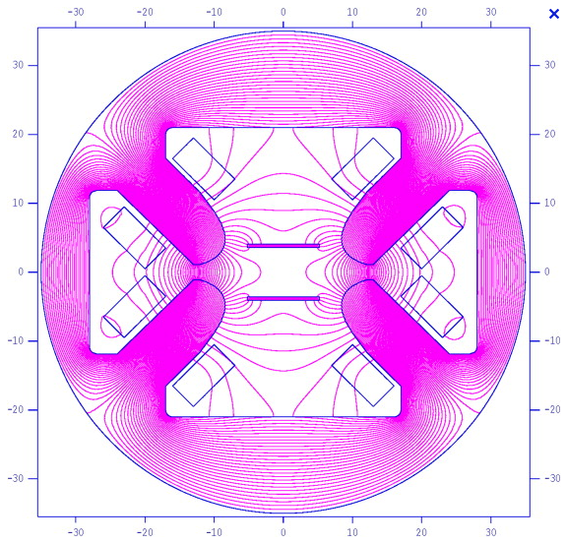
Equipotentials and Contours
Field-defining Iron
(high permeability)
Current carrying
conductors (coils)
Z. Guo et al, NIM:A 691,
pp. 97-108, 1 Nov 2012. A novel structure of multipole field
magnets and their applications in uniformizing beam spot at target
y position [mm]
Field lines perpendicular
to iron surface
x position [mm]

Slide 16
Equipotentials and Contours
Let’s get around to designing some magnets
  Conductors on outside, field on inside
  Use high-permeability iron to shape fields: iron-dominated
    Pole faces are very nearly equipotentials
    We work with a magnetostatic scalar potential Ψ
    B, H field lines are perpendicular to equipotential lines of Ψ
    This comes from integrating our B field expansion.
    Let’s look at normal multipoles G_{n} and pole faces…

Slide 17
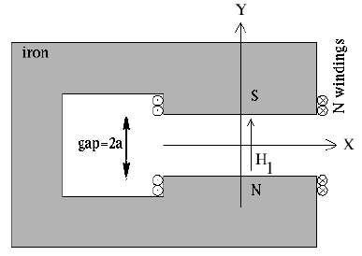
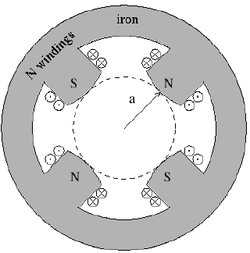
Equipotentials and Contours II
For general G_{n} normal multipoles (i.e. for b_{n})
Dipole (n=0):
  Normal dipole pole faces are y=constant
Quadrupole (n=1):
  Normal quadrupole pole faces are xy=constant (hyperbolic)
So what conductors and currents
are needed to generate these fields?

Slide 18
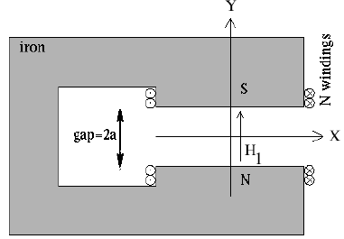
Dipole Field/Current
Use Ampere’s law to
calculate field in gap
  N “turns” of conductor
  around each pole
  Each turn of conductor
  carries current I
Field integral is through N-S poles and (highly permeable) iron (including return path)
NI is in “Amp-turns”, μ₀~1.257 cm-G/A
  So a=2cm, B=600G requires NI~955 Amp-turns
(C-style dipole)

Slide 19
Wait, What’s That Δx’ Equation?
Field, length: Properties of magnet
Rigidity: property of beam (really p/q!)
This is the angular transverse kick from a thin hard-edge dipole, like a dipole corrector
  Really a change in p_{x} but paraxial approximation applies
  The B in (Bρ) is not necessarily the main dipole B
  The ρ in (Bρ) is not necessarily the ring circumference/2π
  And neither is related to this particular dipole kick!

Slide 20
Quadrupole Field/Current
Use Ampere’s law again
  Easiest to do with magnetic
  potential Ψ, encloses 2NI
Quadrupole strengths are expressed as transverse gradients
(NB: Be careful, ‘ has different meaning in B’, B’’, B’’’…)
Notes:
Apologize about confusion about interpretation of primes (sometimes d/ds, sometimes d/dx)

Slide 21
Quadrupole Transport Matrix
Paraxial equations of motion for constant quadrupole field
Integrating over a magnet of length L gives (exactly)
Focusing
Quadrupole
Defocusing
Quadrupole

Slide 22
Thin Quadrupole Transport Matrix
Focusing
Quadrupole
Defocusing
Quadrupole
Quadrupoles are often “thin”
  Focal length is much longer than magnet length
Then we can use the thin-lens approximation
  where f=1/(kL) is the quadrupole focal length
Thin quadrupole approximation

Slide 23
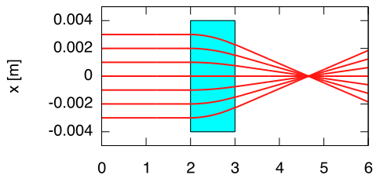
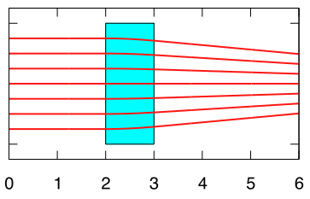
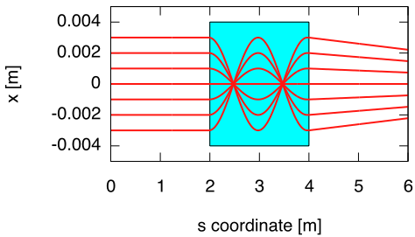
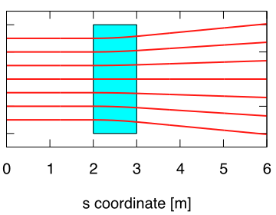
Picturing Drift and Quadrupole Motion
KL=0.5 m⁻¹, f=2m
KL=0.1 m⁻¹, f=20m
KL=20 m⁻¹, f=0.05m
KL=-0.1 m⁻¹, f=-20m

Slide 24
Picturing Drift and Quadrupole Motion
KL=0.5 m⁻¹, f=2m
KL=0.1 m⁻¹, f=20m
KL=20 m⁻¹, f=0.05m
KL=-0.1 m⁻¹, f=-20m
Thin Quadrupole Approximations

Slide 25
Higher Orders
We can follow the full expansion for 2(n+1)-pole:
For the sextupole (n=2) we find the nonlinear field as
Now define a strength as an n^{th} derivative
(NB: Be careful, ‘ has different meaning in B’, B’’, B’’’…)

Slide 26
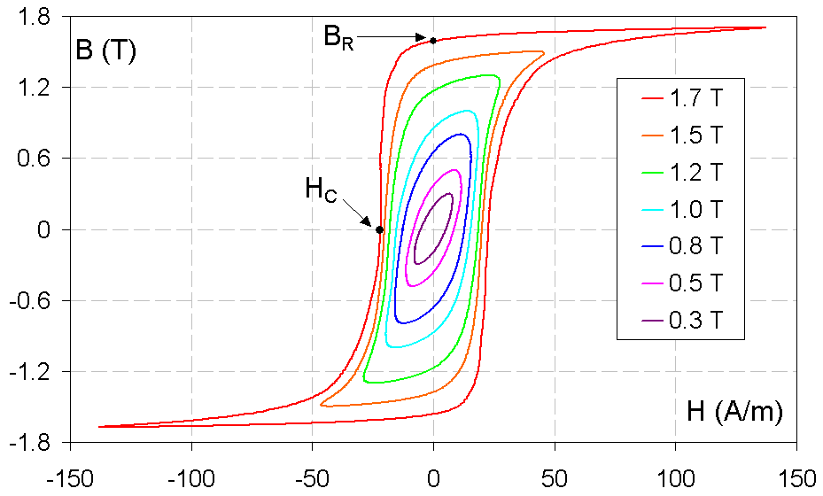
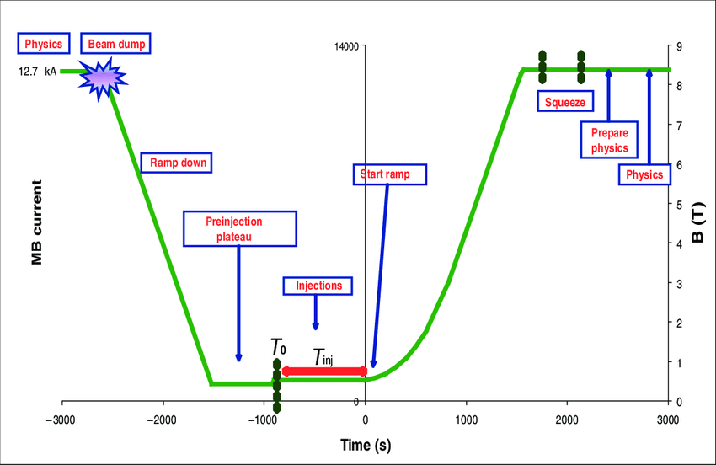
Hysteresis
Magnets with variable current carry “memory”
  Hysteresis is quite important in iron-dominated magnets
Usually try to run magnets “on hysteresis”
  e.g. always on one side of hysteresis loop
  Large spread at large field (1+ T): saturation
  Degaussing
B_{R}: Remanence
H_{C}: Coercive field
LHC
magnet
cycle

Slide 27
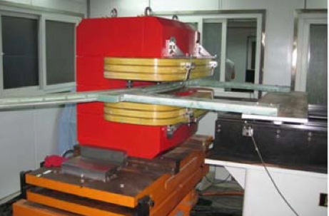
End Fields
Magnets are not infinitely long: ends are important!
  Conductors: where coils usually come in and turn around
  Longitudinal symmetries break down
  Sharp corners on iron are first areas to saturate
  Usually a concern over distances of ±1-2 times magnet gap
    A big deal for short, large-aperture magnets; ends dominate!
Solution: simulate… a lot
  Test prototypes too
  Quadratic end chamfer eases
  sextupoles from ends (first
  allowed harmonic of dipole)
More on dipole end focusing…
PEFP prototype magnet (Korea)
9 cm gap,1.4m long

Slide 28


Dipoles, Sector and Rectangular Bends
Sector bend (sbend)
  Beam design entry/exit angles are perpendicular to end faces
  Simpler to conceptualize, but harder to build
Rectangular bend (rbend)
  Beam design entry/exit angles are half of bend angle
  Easier to build, but must include effects of edge focusing

Slide 29
Sector Bend Transport Matrix
The dipole “rotation” that we see in phase space movies
Has all the “right” behaviors
  But what about rectangular bends?

Slide 30
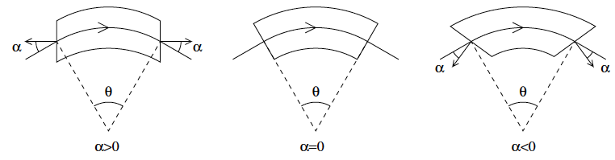
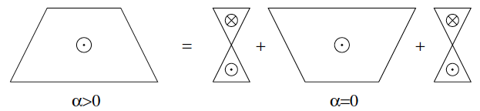
Dipole End Angles
We treat general case of symmetric dipole end angles
  Superposition: looks like wedges on end of sector dipole
  Rectangular bends are a special case

Slide 31
Kick from a Thin Wedge
The edge focusing calculation requires the kick from a thin wedge
  What is L? (distance in wedge)
  Here ρ is the curvature for a particle of this momentum!!

Slide 32
Dipole Matrix with Ends
The matrix of a dipole with thick ends is then
  Rectangular bend is special case where α=θ/2

Slide 33
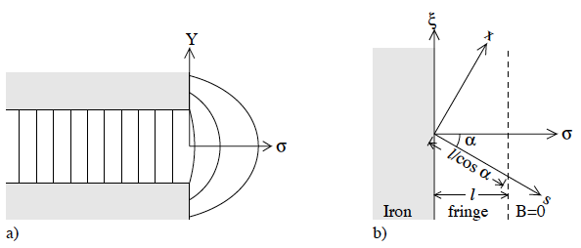
(End Fields)
Overhead
view, α>0
Side view
N
S
Field lines go from –y to +y for a positively charged particle
  B_{x} <0 for y>0; B_{x}>0 for y<0
    Net focusing!
  Field goes like sin(α)
    get cos(α) from integral length

Slide 34
Other Familiar Dipoles
Weaker, cheaper dipoles can be made by conforming coils to a beam-pipe (no iron)
Relatively inexpensive, but not very precise
  Field quality on the order of percent

Slide 35
Normal vs Superconducting Magnets
LEP quadrupole magnet (NC)
LHC dipole magnets (SC)
  Note high field strengths (red) where flux lines are densely packed together

Slide 36
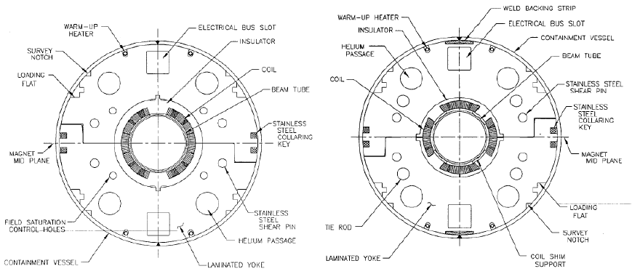
RHIC Dipole/Quadrupole Cross Sections
RHIC cos(θ)-style superconducting magnets and yokes
NbTi in Cu stabilizer, iron yokes, saturation holes
Full field design strength is up to 20 MPa (3 kpsi)
4.5 K, 3.45 Tesla

Slide 37
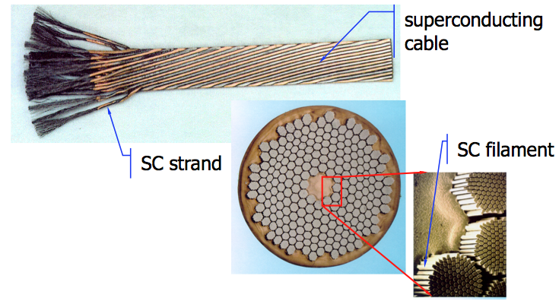
Rutherford Cable
Superconducting cables: NbTi in Cu matrix
  Single 5 μm filament at 6T carries ~50 mA of current
  Strand has 5-10k filaments, or carries 250-500 A
  Magnet currents are often 5-10 kA: 10-40 strands in cable
    Balance of stresses, compactable to stable high density

Slide 38
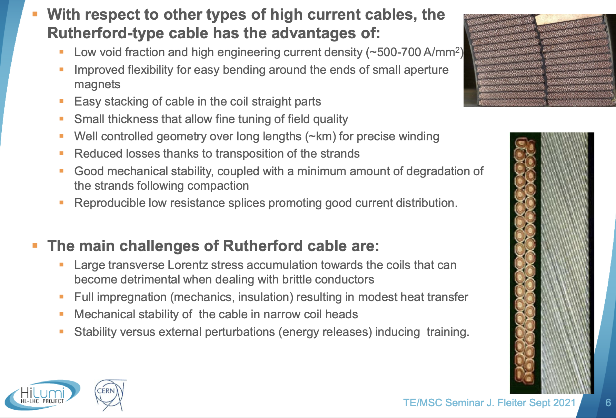
Jerome Fleitner CERN seminar 2021

Slide 39
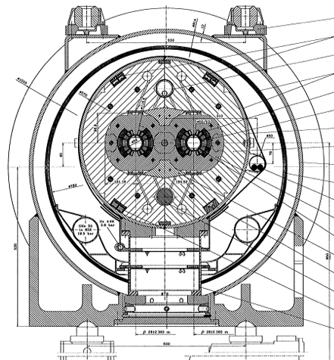
Superconducting Dipole Magnet Comparison
6.8 T, 50 mm
4T, 90mm
LHC
8.36T, 56mm
4.7T, 75 mm
3.4T, 80mm

Slide 40
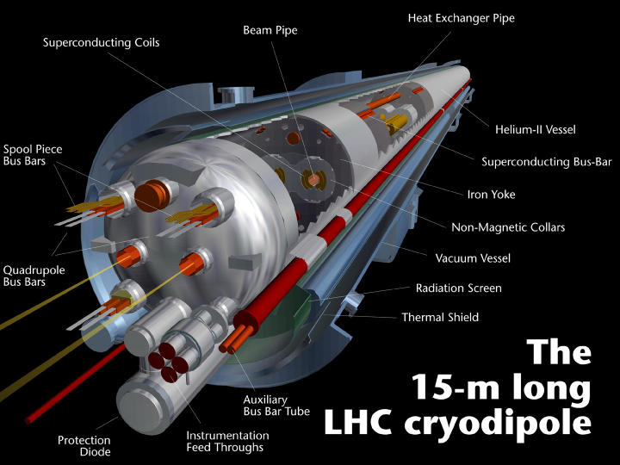
LHC cryostat
1.9 K, 8.36 T
(~5 T achieved)

Slide 41
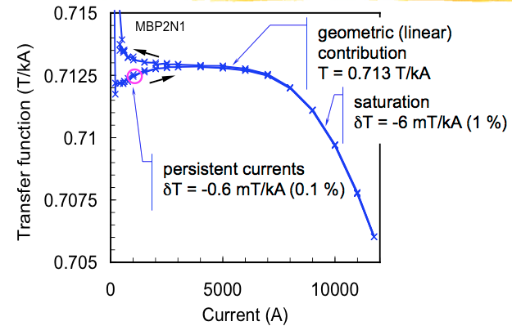
Superconducting Magnet Transfer Function
Transfer function: relationship between current/field
  Persistent currents: surface currents during magnet ramping
Luca Bottura, CERN

Slide 42
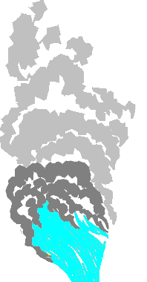
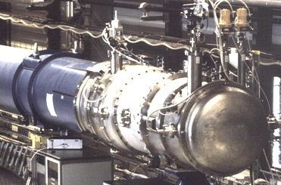

Quenching
the most likely cause of death for a superconducting magnet
Magnetic stored energy
LHC dipole
Martin Wilson, JUAS Feb 2006

Slide 43
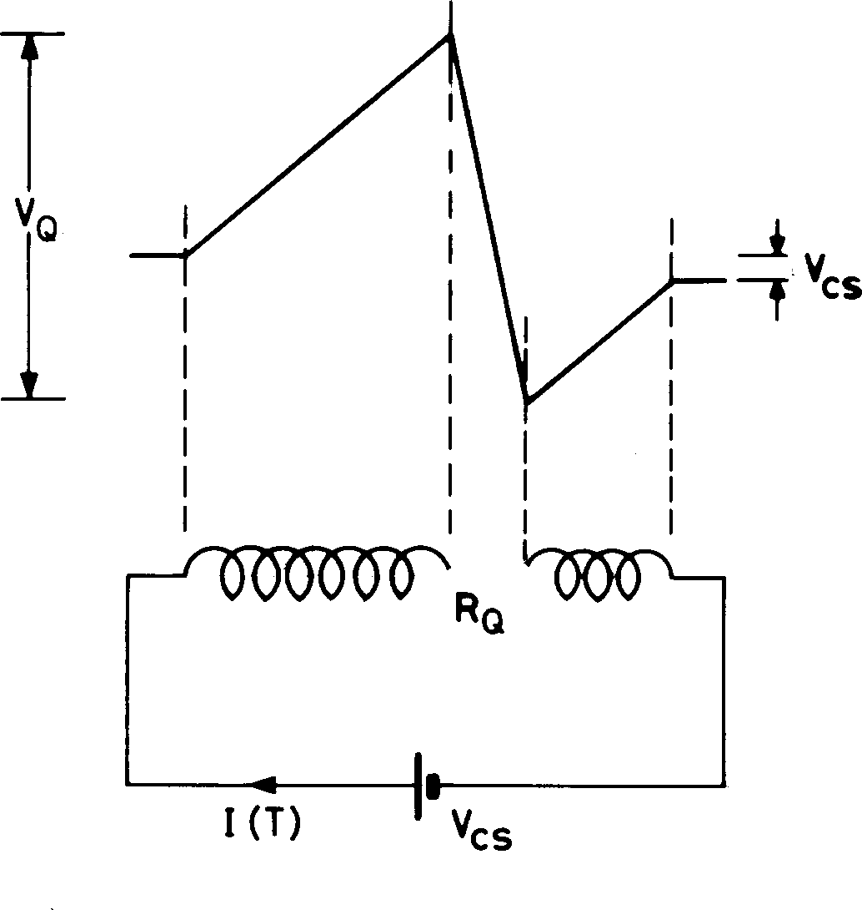
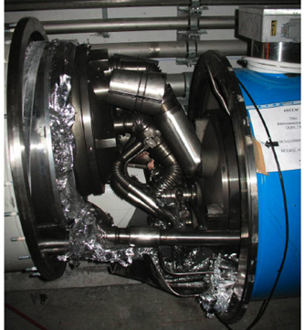
Quench Process
Resistive region starts somewhere in the winding at a point: A problem!
  Cable/insulation slipping
  Inter-cable short; insulation failure
Grows by thermal conduction
Stored energy ½LI² of the magnet is dissipated as heat
Greatest integrated heat dissipation is at localized point where the quench starts
Internal voltages much greater than terminal voltage (= V_{cs} current supply)
  Can profoundly damage magnet
  Quench protection is important!
Martin Wilson, JUAS Feb 2006

Slide 44
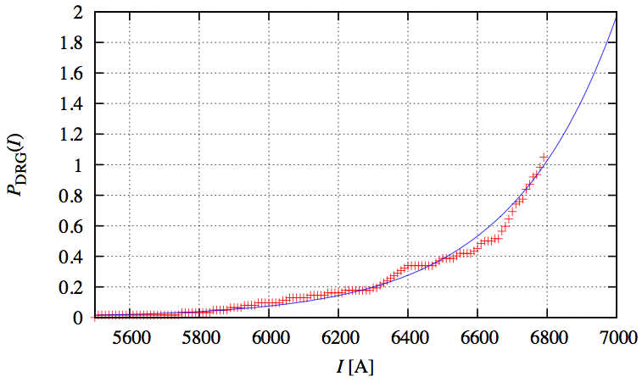
Quench Training
Intentionally raising current until magnet quenches
  Later quenches presumably occur at higher currents
    Compacts conductors in cables, settles in stable position
  Sometimes necessary to achieve operating current
RHIC main dipole quench training model
Blue: exponential fit
Red: quench training data (62 quenches)
“Energy Upgrade as Regards Quench Performance”, W.W. MacKay and S. Tepikian

Slide 45
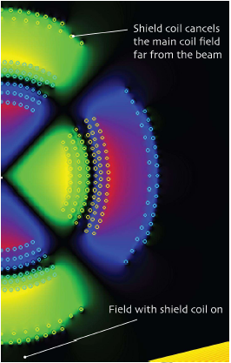
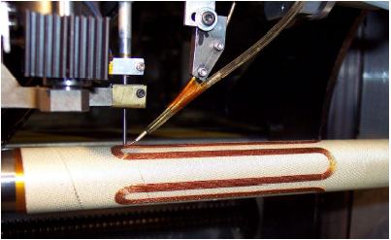
Direct-Wind Superconducting Magnets (BNL)
6T Iron-free (superconducting)
Solid state coolers (no Helium)
Field containment (LC magnet)
“Direct-wind” construction
World’s first “direct wind” coil machine at BNL
Linear Collider magnet

Slide 46
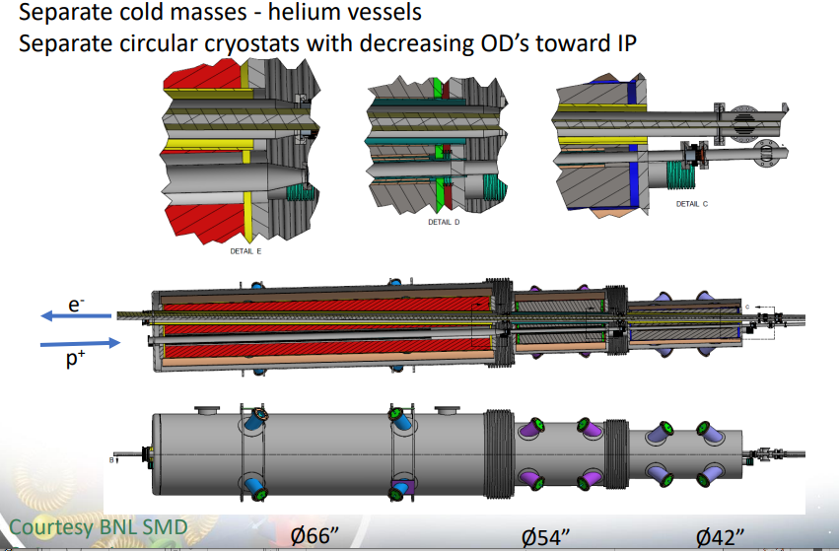
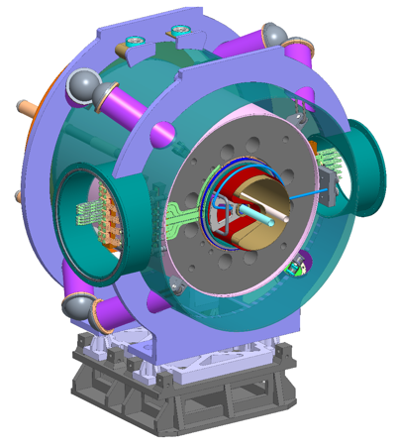
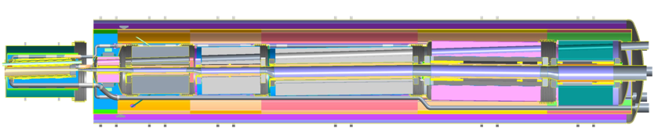
EIC IR Superconducting Magnets
More from A. Seryi next week
Multiple function spectrometer
magnet at the forward hadron
side
Forward superconducting magnet integration

Slide 47
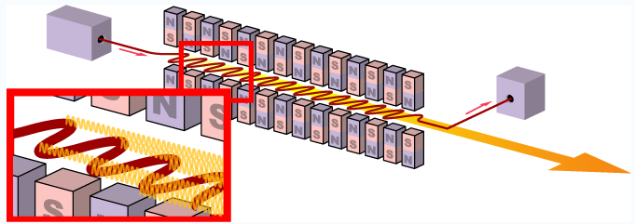
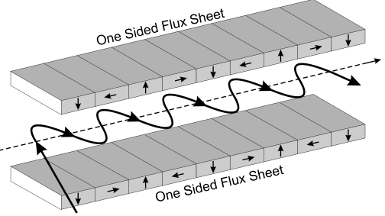
FELs: Wigglers and Undulators
Used to produce synchrotron radiation for FELs
  Often rare earth permanent magnets in Halbach arrays
  Adjust magnetic field intensity by moving array up/down
  Undulators: produce nm wavelength FEL light from ~cm magnetic periods (γ² leverage in undulator equation)
    Narrow band high spectral intensity
  Wigglers: higher energy, lower flux, more like dipole synchrotron radiation
    LCLS/LCLS-II: 100+m long undulator groups!

Slide 48
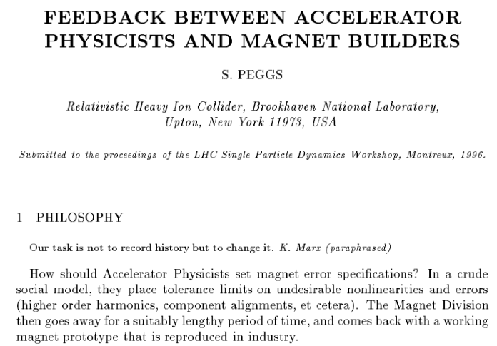
Feedback to Magnet Builders
http://www.agsrhichome.bnl.gov/AP/ap_notes/RHIC_AP_80.pdf

