Slide 1
Our Project Pitch: Project Name
Spokes person name
On behalf of other collaborators names
IAS, July 2023

Slide 2
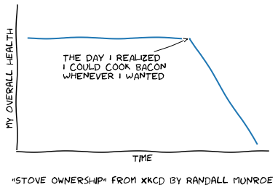
Motivation for Project
Key points and images to explain your great idea
What is the big idea!
What is the science or engineering challenge you are trying to address, why do you want to carry out your idea?
Decide on an audience, e.g. the general public, lab management, thesis supervisor, politician or a colleague or collaboration.
What are the science or engineering you want to do, e.g. study the Higgs boson, set a world record or create a medical application.

Slide 3
Challenges for project
what are the parameters that you need to achieve and why?
What particle type and energy do you want to achieve?
What are the existing systems that can produce these parameters?

Slide 4

Solution to realise big idea
Solutions: using basic calculations, show some possible solutions to your challenges.
What are the physics and engineering principles that govern your idea?
Calculate for example your magnetic or electric field you require.
$$E=mc^{2}$$

Slide 5
Outcomes from our Big Idea
what will your idea lead to?
When your idea succeeds, what will it lead to?
New knowledge, better medical treatment, cheaper operations, more stable operations, other new discoveries.

