Slide 1
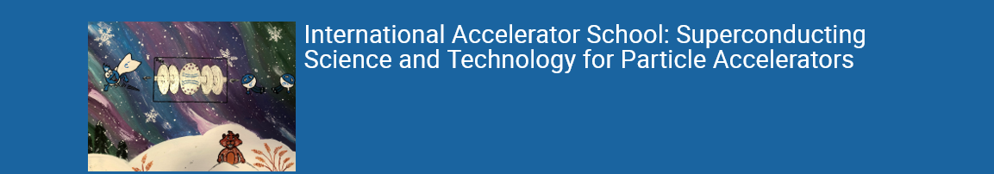
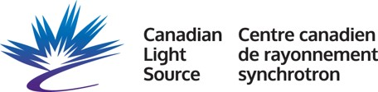


Superconducting Magnets 2
GianLuca Sabbi
Lawrence Berkeley National Laboratory
IAS 2023
July 16-17, 2023

Slide 2


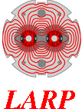
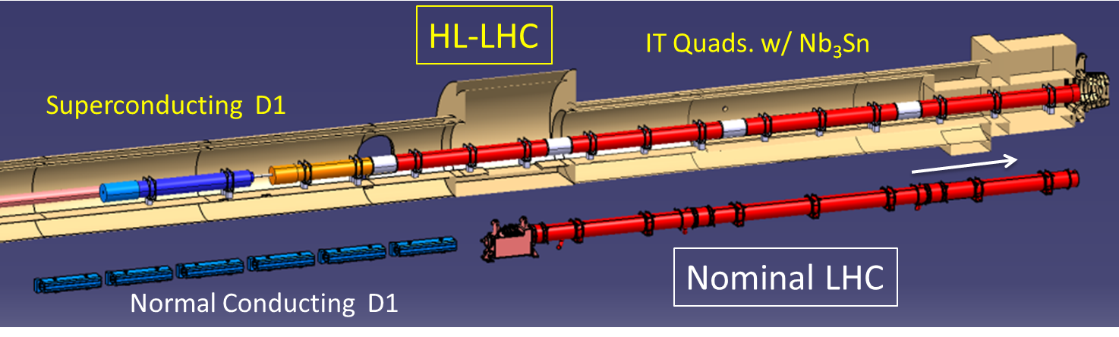
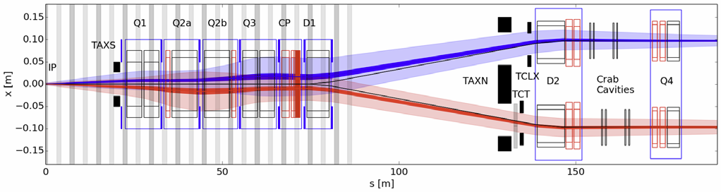
Next HEP collider: HL-LHC
Goal: 10x integrated luminosity enabled by new IR magnets
first application of Nb₃Sn technology in a high energy collider

Slide 3
IR Quadrupole Parameter Optimization
Nb₃Sn technology enables HL-LHC luminosity target

Slide 4
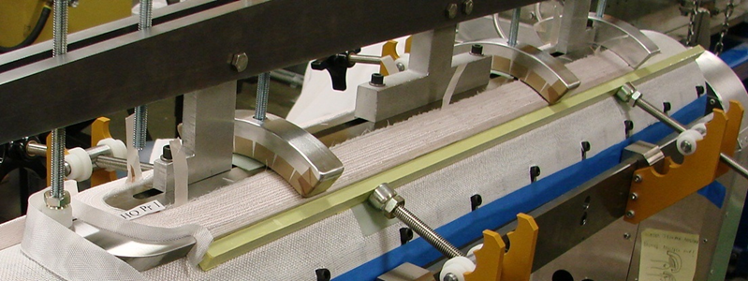
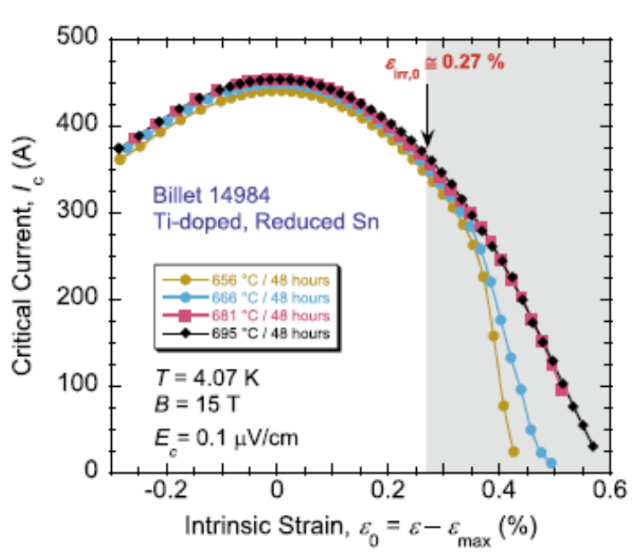
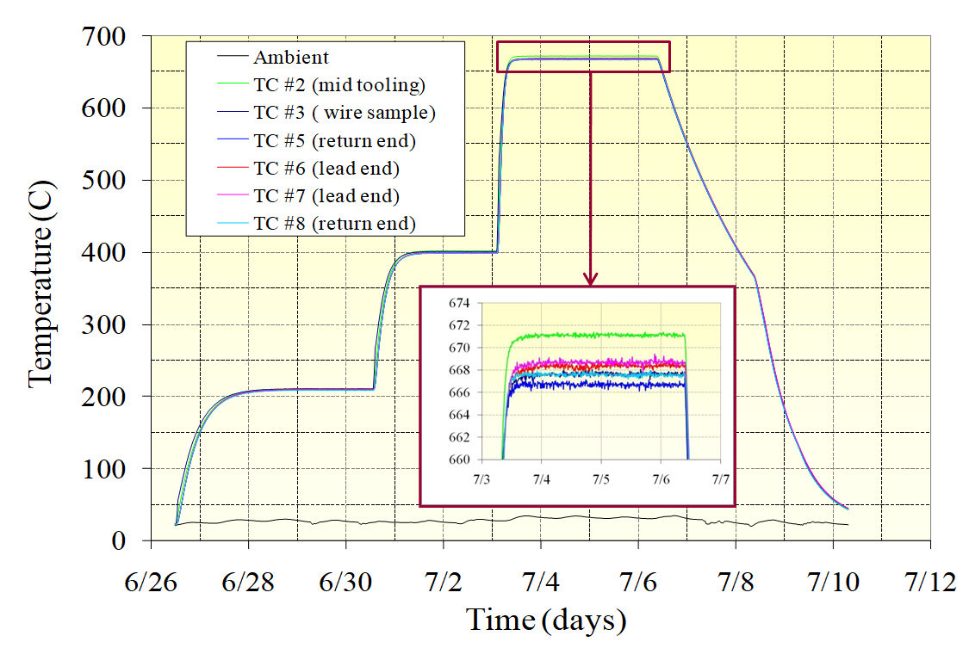
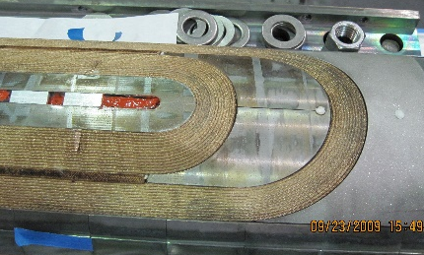
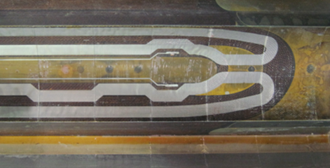
Nb₃Sn Technology
Brittle material:
Severe damage in cabling/winding
React coils after winding
New coil materials (insulation, parts)
Winding
Reaction
Cheggour
Sci Rep 9 (2019)
Sensitivity to stress/strain:
Epoxy impregnation
New mechanical designs
Post-reaction
Epoxy-impregnation

Slide 5
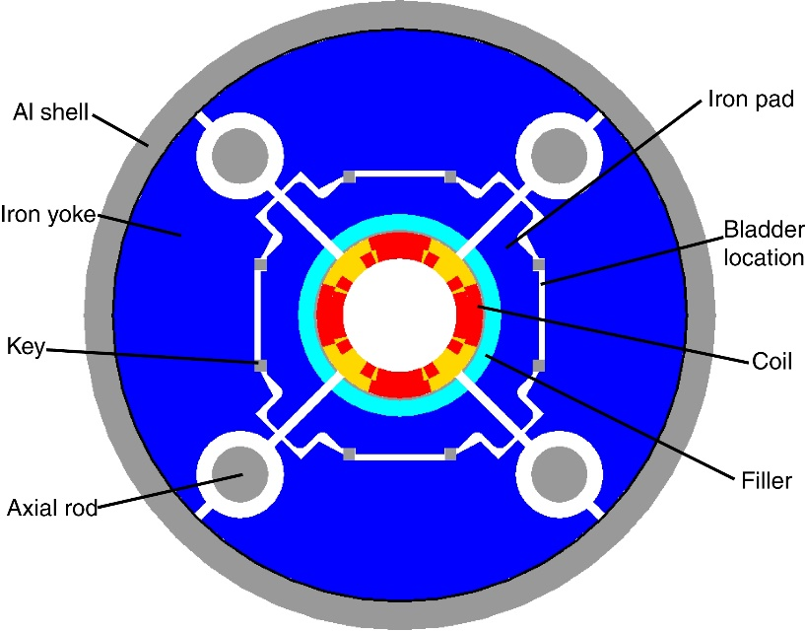
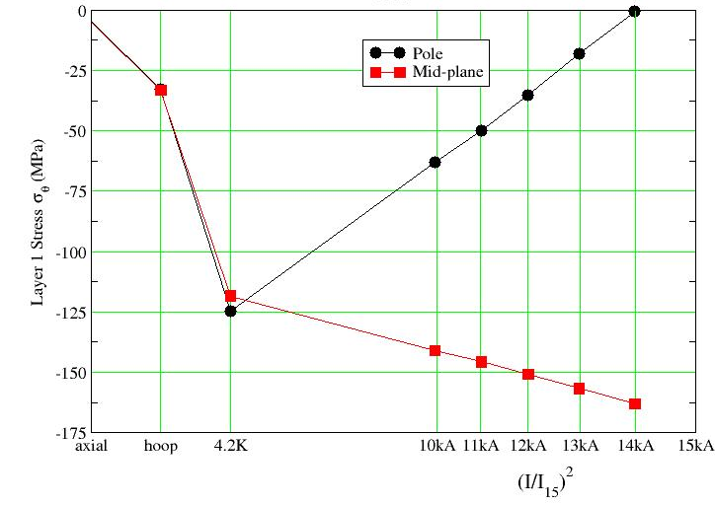
Aluminum-shell based support structure
Mechanical design of Nb₃Sn magnets needs to satisfy stringent constraints
  Full support without exceeding stress limits (150-200 MPa cold)
Selected structure is based on aluminum shell over iron yoke, preloaded with pressurized bladders and interference keys
  Minimize and precisely control warm pre-load
  Increase to full pre-load during cool-down, avoiding overshoot
S. Caspi, P. Ferracin et al.

Slide 6
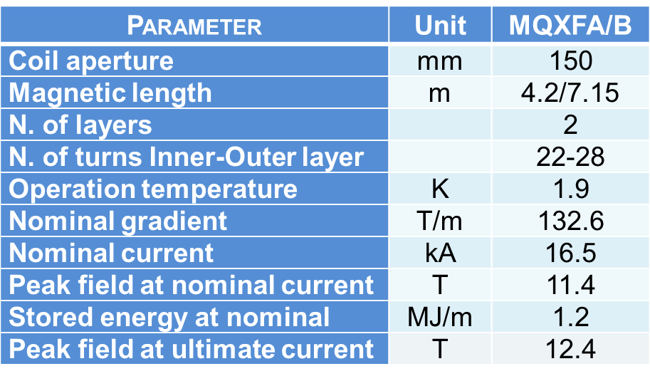
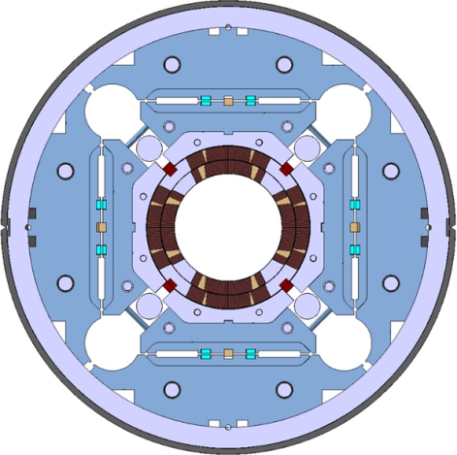
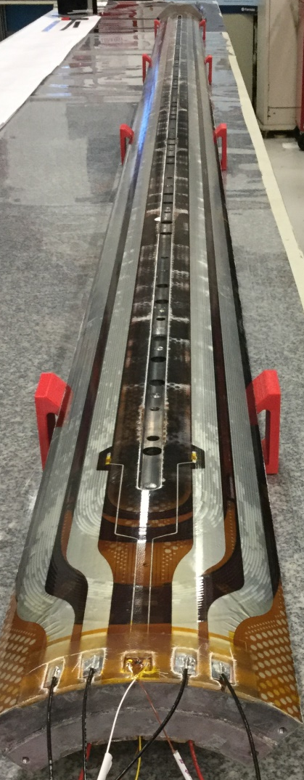
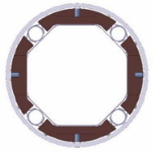
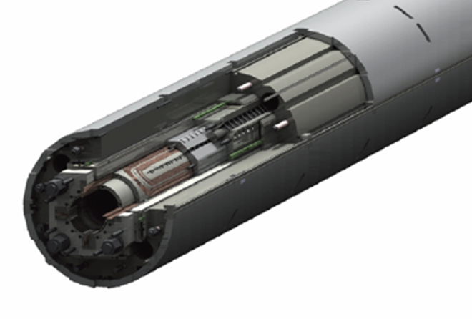
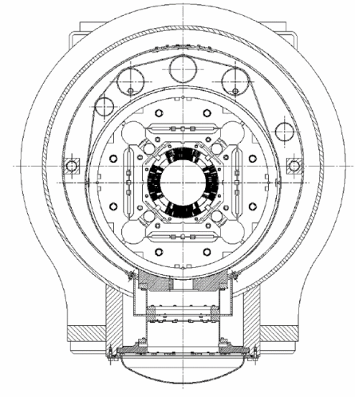
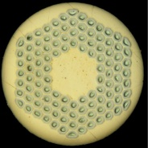


HL-LHC IR Quad production is underway
4 m long
Nb₃Sn
coil
Cross-section of cold mass and cryostat
Beam screen w/tungsten absorbers
Nb₃Sn strand
Common design for US (Q1/Q3) and CERN (Q2a/b) Quadrupoles except for different length (4.2+4.2 m vs 7.15 m)

Slide 7
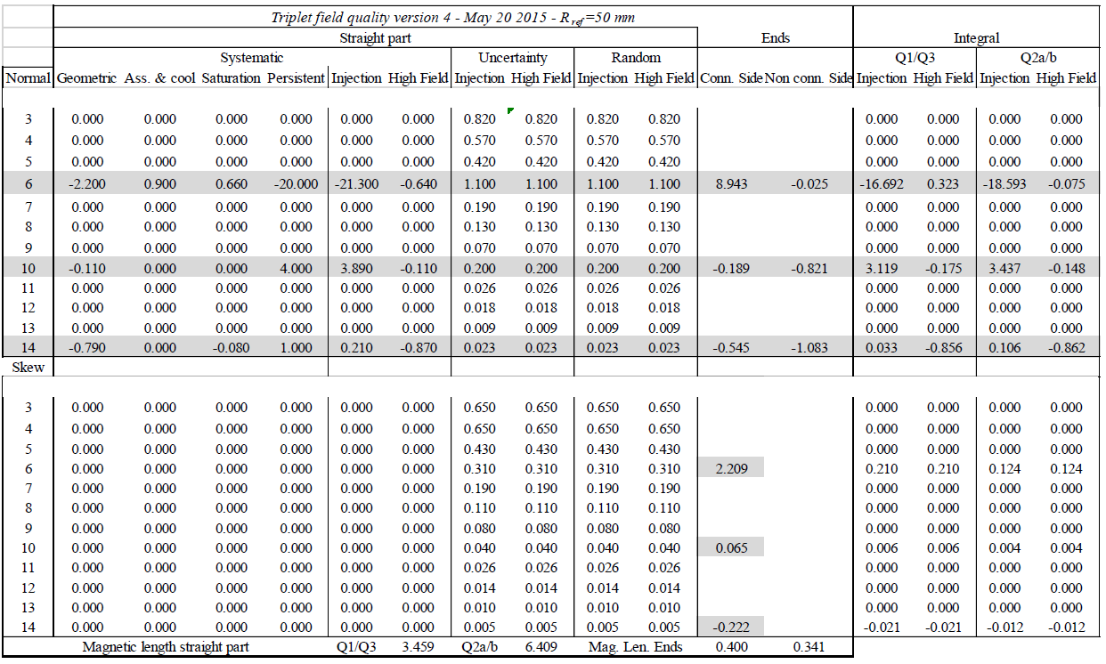
Field Quality Table
Reference: Hi Lumi LHC Work Package 3 - Magnets for Insertion Regions https://espace.cern.ch/HiLumi/WP3/SitePages/Home.aspx

Slide 8
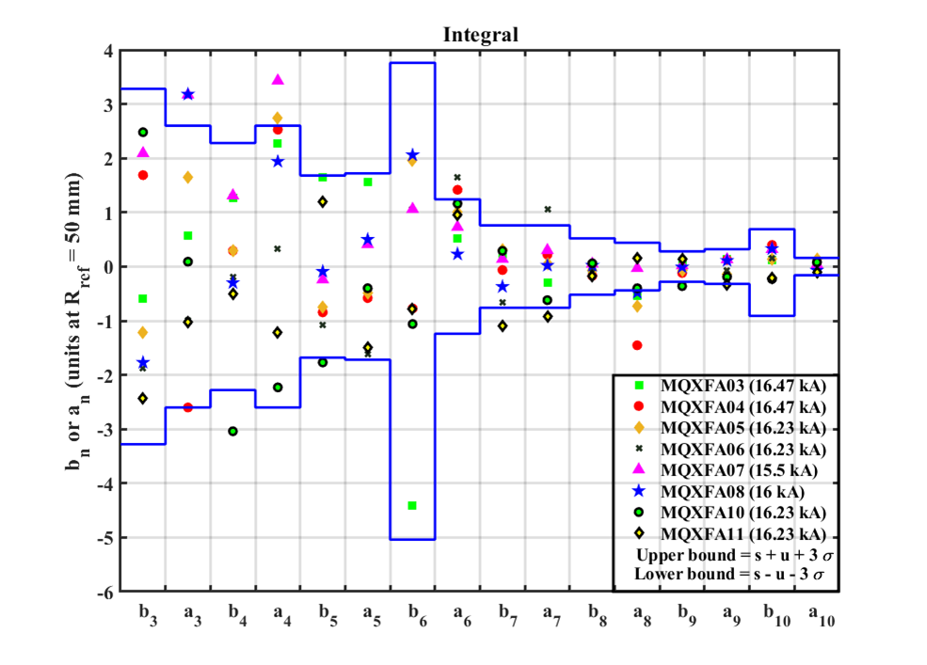
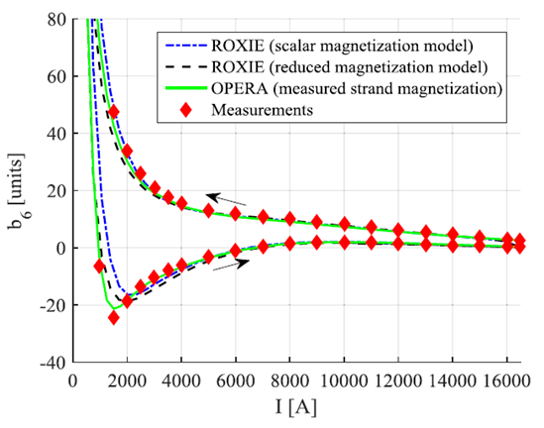
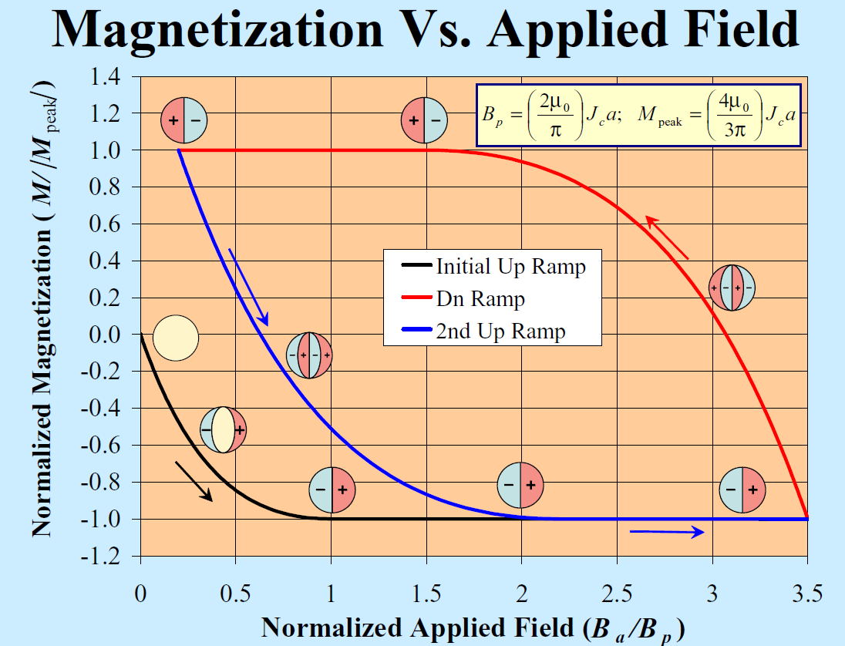
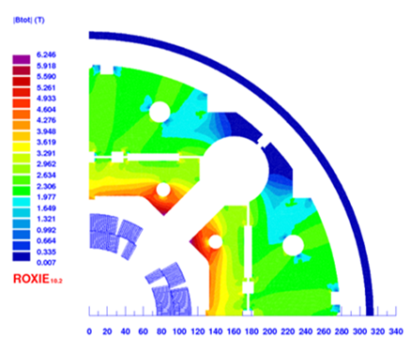
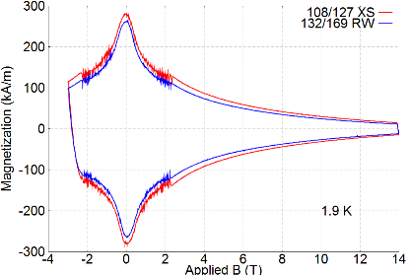
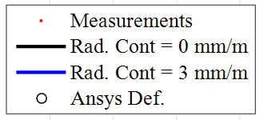
Field Error Measurements and Analysis
Conductor Magnetization
Integrated Harmonics
at nominal field
Iron saturation
Magnetization measurement
S. Izquierdo Bermudez, X. Wang, A. Ben Yahia,
M. Sumption et al.
USPAS 2006 - A. Jan, BNL

Slide 9
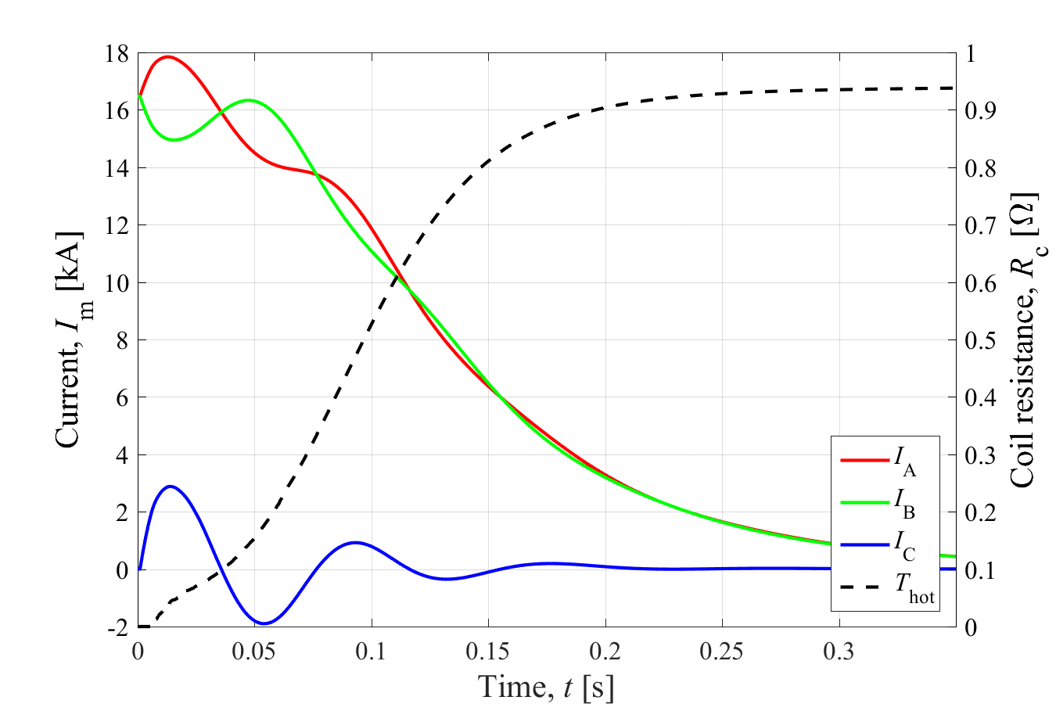
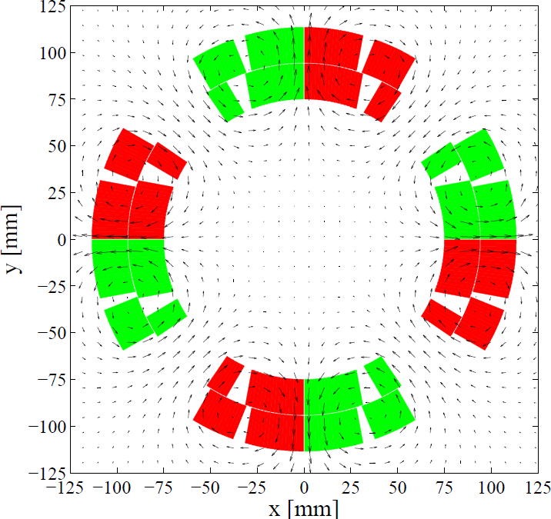
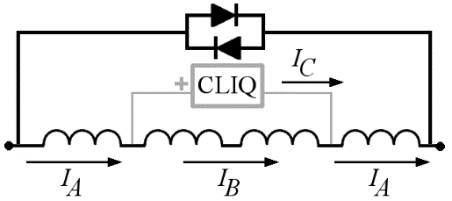
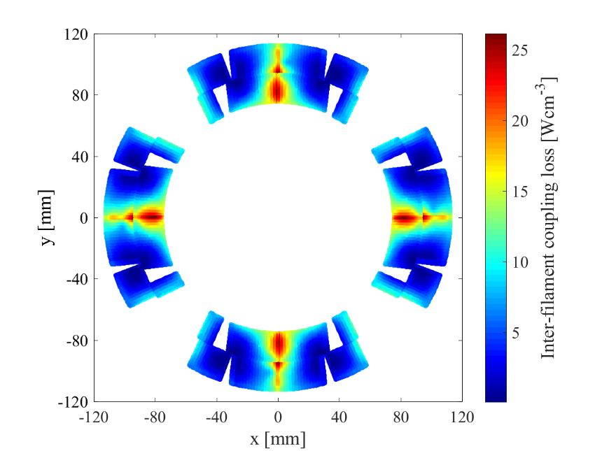
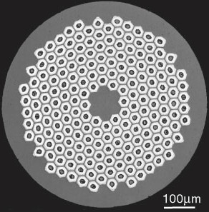
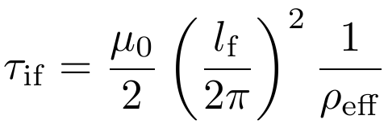
Quench Protection with CLIQ
E. Ravaioli, CERN
Power is deposited by inter-filament coupling currents induced by the rapid current oscillations

Slide 10

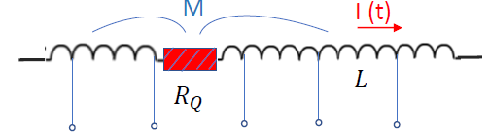
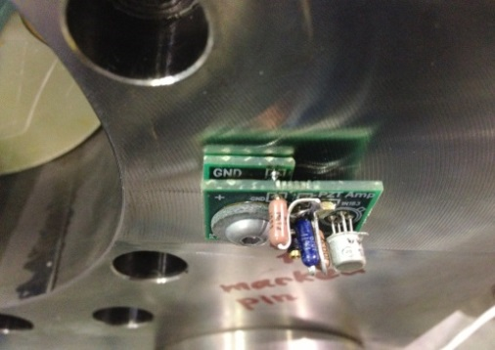
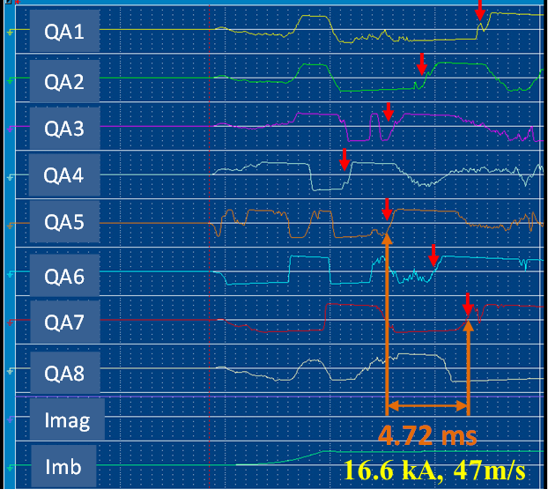
Test Instrumentation
New diagnostics are being developed to complement the traditional approach based on voltage taps
Ultrasonic transducer
Acoustic sensor
Quench antenna
M. Marchevsky, USPAS 2022

Slide 11
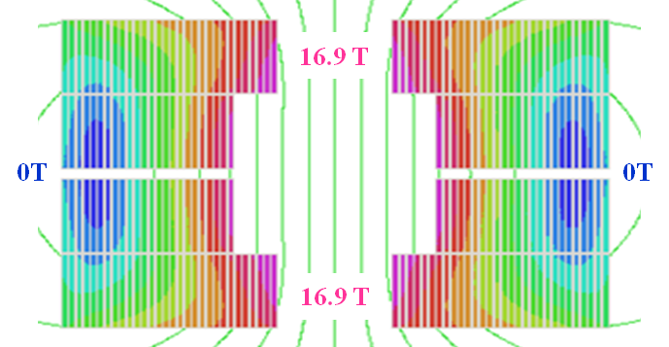

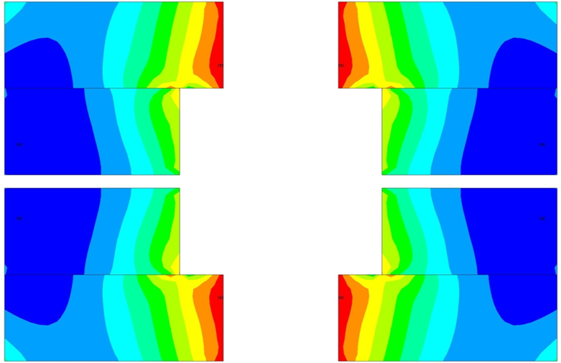
Block-coil High Field Dipole Design
HD2 Design:
High Je (no spacers/structure in coil)
  Efficient design for small aperture
Only two co-wound layers/pole
  Optimize performance and cost
Concentrates stress in low-field region
Internal bore support (vs. Roman arch)
Flared ends (vs. saddle ends)
Magnetic Field @ B₀ = 16 T
EM force
Bore structural support
Coil Stress @ B₀ = 16 T
Winding
Pole
0 MPa
200 MPa (0T)
190
MPa
190
MPa
36 mm
Central support tube
(tested with/without)
200 MPa (0T)
0 MPa

Slide 12
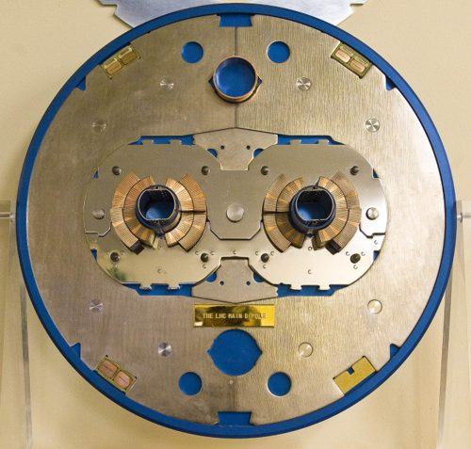
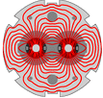
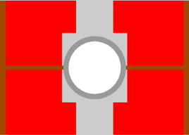
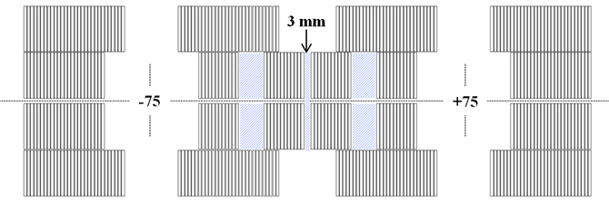
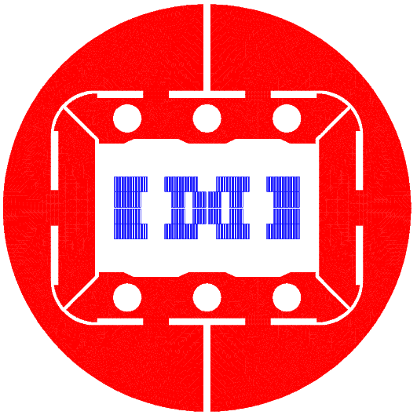

Twin-Aperture Collider Dipoles
Horizontal layout has good magnetic and mechanical efficiency
Asymmetric coil design for smaller spacing between apertures
Short sample performance | I_{ss} |  | B₁^{ss}
Temperature | 4.5K | 1.9K | 4.5K | 1.9K
Single aperture (HD2) | 18.0 | 20.1 | 15.52 | 17.15
Double aperture (2HD) | 17.8 | 19.7 | 15.49 | 17.12

Slide 13
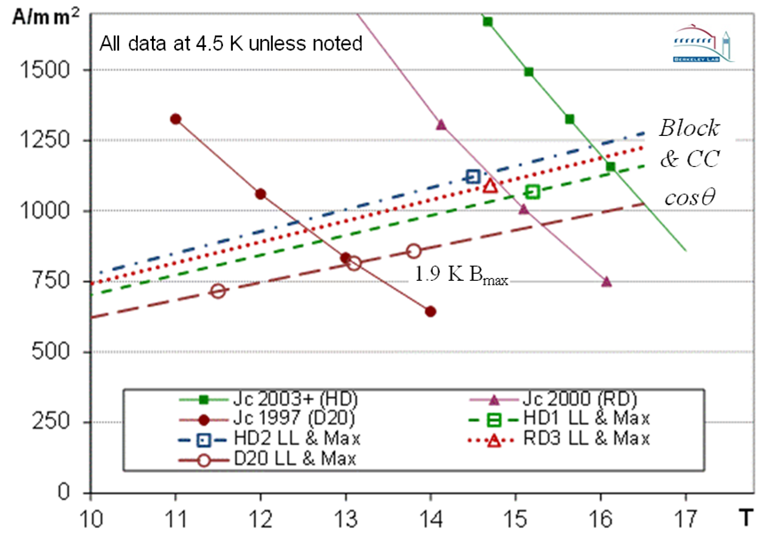
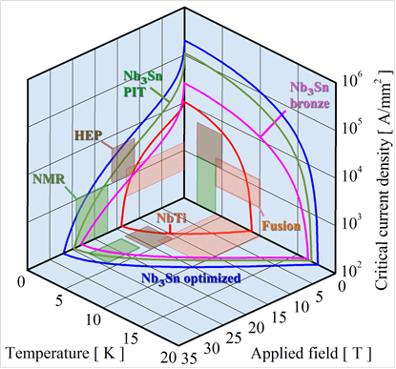
Past improvements of Nb₃Sn J_{c}
Bore field to peak field ratios:
  D20 : 0.98
  HD2: 0.95
  HD1: 1.06
  RD3: 0.99
HEP conductor development program resulted in +3T field potential (4.5K)
Achieved performance consistent with improvements in conductor properties
Optimal design choices driven by accelerator requirements and production cost

Slide 14


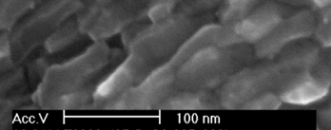
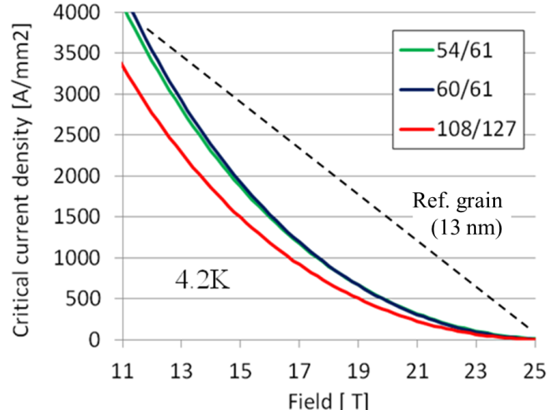
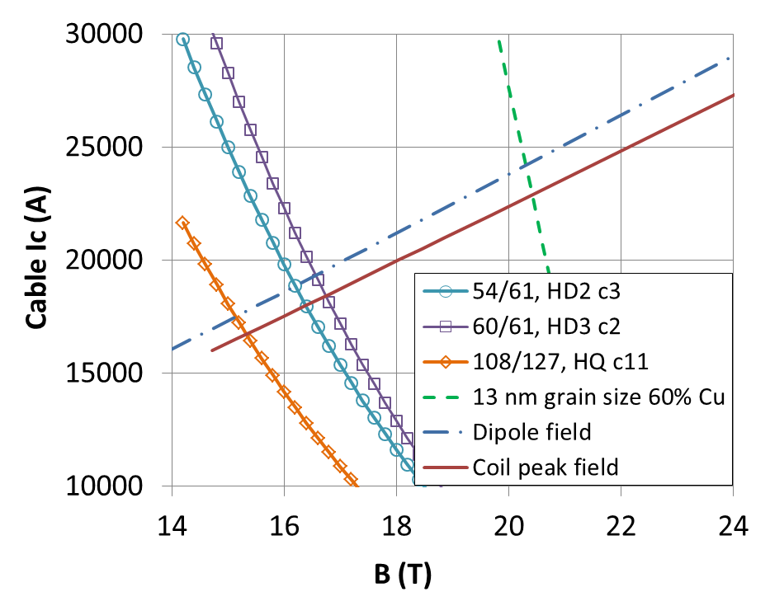
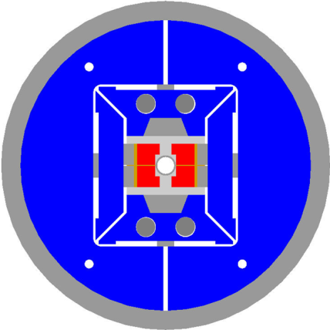
Potential for further improvements
Principle: increase of Nb₃Sn pinning force at high field through grain refinement
Promising results in short samples (X. Xu et al, Appl. Phys. Lett. 104 082602):
J_{c}(12 T, 4.2K): from
3.5 kA/mm² @ 100+ nm (e.g. best HD2 wire) to
9.6 kA/mm² @ ~35 nm
Extrapolation to HD2 & 13 nm grain size (G. Sabbi et al., IEEE-TAS 25 (3) 4001407):
B₀>19T
@ 4.5K
HD2 cross-section

Slide 15
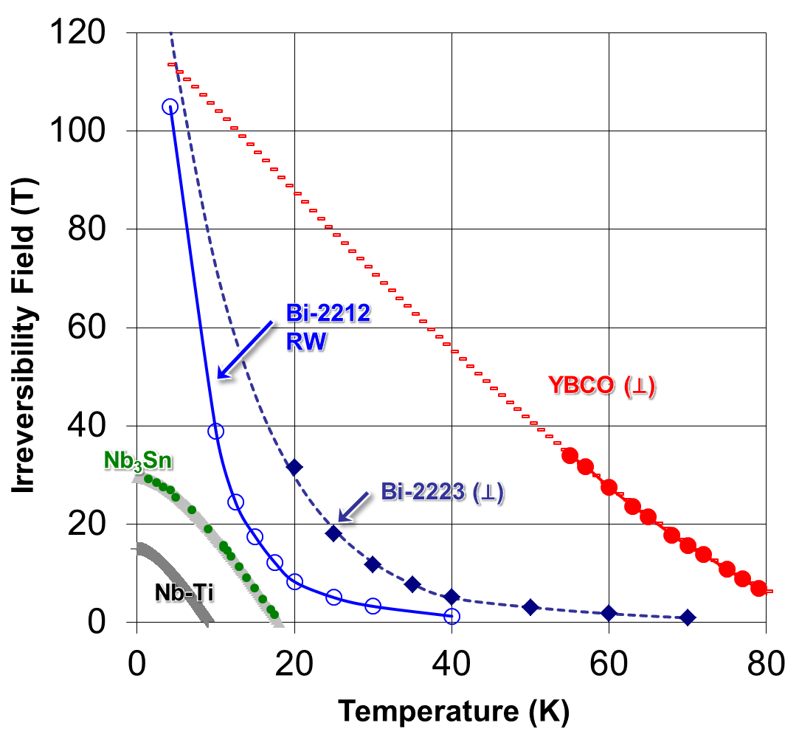
High Temperature Superconductors (HTS)
Technology foundation:
Conductor properties
Fabrication methods
Design concepts, tools
Bi-2212
YBCO
Performance demonstration in simple configurations
Full qualification in
accelerator configurations
In-depth analysis & optimization
Conductor properties
Fabrication technology
Material characterization
Modeling and diagnostics
Nb₃Sn
NbTi
System integration

Slide 16



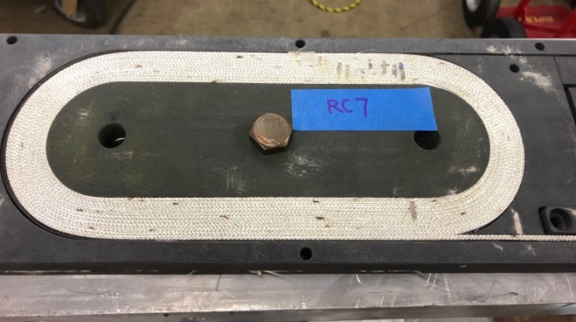



Accelerator-type coils with Bi-2212
Significant J_{c} improvements with new high pressure heat treatment and powers
RC-06 results (0.8 mm strand, 17-strand Rutherford cable, 2-layer, 6-turn/layer):
  J_{e} - 1365 A/mm² at 15 T (2xFCC spec); 1000 A/mm² at 27 T (1.3 GHz NMR)
Two larger 11-turn coils (RC7-8) generated 4.5 T field in a shell-based structure
Zhang et al. SuST, 31 (2018) 105009
Jiang et al., IEEE TAS, 29 (2019), 6400405
Shen et al., arXiv preprint arXiv:1808.02864
2x6 turn coil
2x11 turn coil

Slide 17


REBCO tapes: the high field frontier
REBCO tapes provide by far the best current densities at the highest field
Enabling impressive progress in hybrid LTS/HTS superconducting solenoids
  Highest field all superconducting user facility (32 T) – 12/2017
  All-SC test achieves highest magnetic field on record (45.5 T) – 2/2019
  First commercial 1.2 GHz NMR (28.2T) system by Bruker – 8/2019
D. Larbalestier, NHMFL
M. Bird, NHMFL

Slide 18








Key technology: high current HS cables
Goal: develop multi-kA HTS cables with low degradation from cabling, bending and stress, and low AC losses
REBCO is strongly preferred to Bi-2212 in large systems due to lower projected cost and avoiding the challenging reaction
ITER CICC
(Nb₃Sn)
REBCO
tape
Twisted stack
Conductor on Round Core (CORC)
Robel cable

Slide 19



Cable-in-groove
Concept: place individual turns in grooved formers
Goals:
  More flexibility in the winding pattern, cable design, and coil grading
  Internal structure to protect the conductor from force accumulation
Issues to be addressed for application to high field magnets
  Magnetic: engineering current density, quench propagation
  Mechanical: pre-load transfer, or capability to operate without pre-load
  Tooling/processes for reaction and impregnation; reliable insulation
  Field quality: tolerances for cable insertion, module assembly/alignment
Cosθ
Racetrack
Helical Winding

Slide 20



CORC Wires in Helical Windings
Basic concept: superposition of tilted solenoids to generate a dipole field (Meyer, NIM 1970)
Windings can be further modulated to generate higher order multipoles and control the field in curved or tapered geometries
Two-layer dipole: 1.2 T at 4.2 K
Four-layer dipole: 2.9 T at 4.2 K
X. Wang et al. SuST (2018) 075002

Slide 21




Accelerator-type coils for ECR sources
solenoid
gas
ions
Ion current scales as square of microwave frequency
Confinement field scales linearly with frequency
sextupole

Slide 22





45-56 GHz ECR magnets with Nb₃Sn
Very favorable performance (current) scaling with square of frequency/field
Main challenge is the sextupole coil fabrication and mechanical support
Requires lower current (<1-2 kA) than typical in large accelerator applications
  Single wire or small Rutherford cable – but both require many layers
Shell based structure is directly applicable with additional challenges
  Asymmetric force distribution and sextupole-solenoid integration
45 GHz Design by IMP and LBNL
Single wire
(baseline)
6-strand mini-cable
(alternative)
Conductor options
Magnetic and mechanical design
Energy extraction vs. CLIQ

Slide 23





Medical applications: compact cyclotrons
Strong reduction of cyclotron size and weight at higher field (1/B³)
  Of particular benefit for installations in medical facilities
Significant progress in compact (synchro)cyclotrons for proton therapy
  Up to 7 T with NbTi and 9 T with Nb₃Sn
Higher field is possible from a magnet perspective, but there are challenges in beam physics and system integration
  Potential opportunities in carbon therapy
Consider potential benefits from “high field” technology in specific sub-systems: gantries, cryogenics, flux return coils etc.

Slide 24
Concluding Remarks
Superconducting Accelerator Magnets are a very broad subject combining different disciplines from material science to magnetics, mechanical engineering, cryogenics, power electronics and related instrumentation and diagnostics
Solid technological basis and exciting developments with many technical challenges, both near term and long term
Progress in high field magnets requires a convergence of technical feasibility, performance benefits for the application and critical mass to support the R&D
Several new technologies are reaching maturity, offering opportunities for new application

