Slide 1
KEKB experience with crab cavities
20230717
Yoshiyuki Morita
KEK

Slide 2
KEKB experience with crab cavities
KEKB accelerator and crab crossing
RF system
Crab cavity commissioning
Crab cavity operation

Slide 3
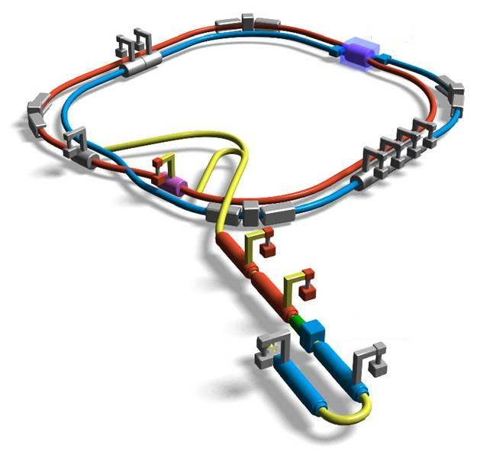
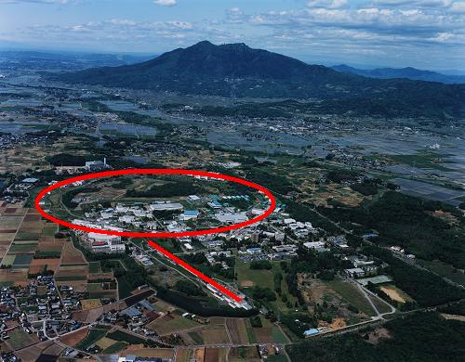
He Refrigerator
KEKB
LER Crab cavity
BELLE
IP
Double ring e+e- collider
8 SC cavities
LER: e+ 3.5 GeV 1.7A
HER: e- 8.0 GeV 1.4A
Cross. Angle: 22 mrad
HER
HER Crab cavity
LER
ARES cavities
ARES cavities
Beam-beam simulation predicted
luminosity can be increased by a factor of 2 or more with crab crossing
KEKB applied the single crab cavity scheme
Crab cavity location
~1 km away from the IP
He refrigerator (8 kW@4.4K) for 8 SC cavities
HP RF stations re-used for crab cavities
e+ Linac
e- Linac

Slide 4
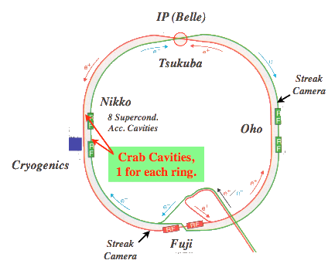
Single crab cavity scheme
Typical parameters
 | LER | HER
Beam energy (GeV) | 3.5 | 8.0
Beam current (A) | 1.7 | 1.25
RF frequency (MHz) | 508.887
Crossing angle (mrad) | ±11
β_{x,IP} (cm) | 80 | 80
β_{x,crab} (m) | 80 | 170
Kick voltage (MV) | 0.9 | 1.45
Loaded Q | 2.0 x 10⁵ | 1.6 x 10⁵
RF power (kW) | 23 | 90

Slide 5
RF system
High power station
Low level control
Interlock

Slide 6
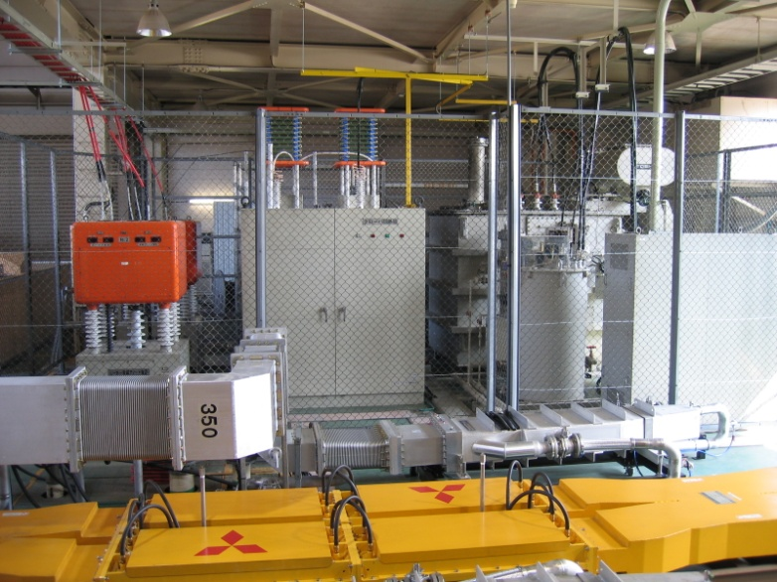
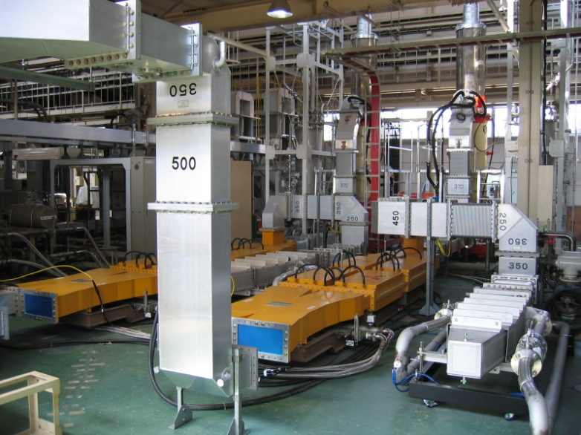
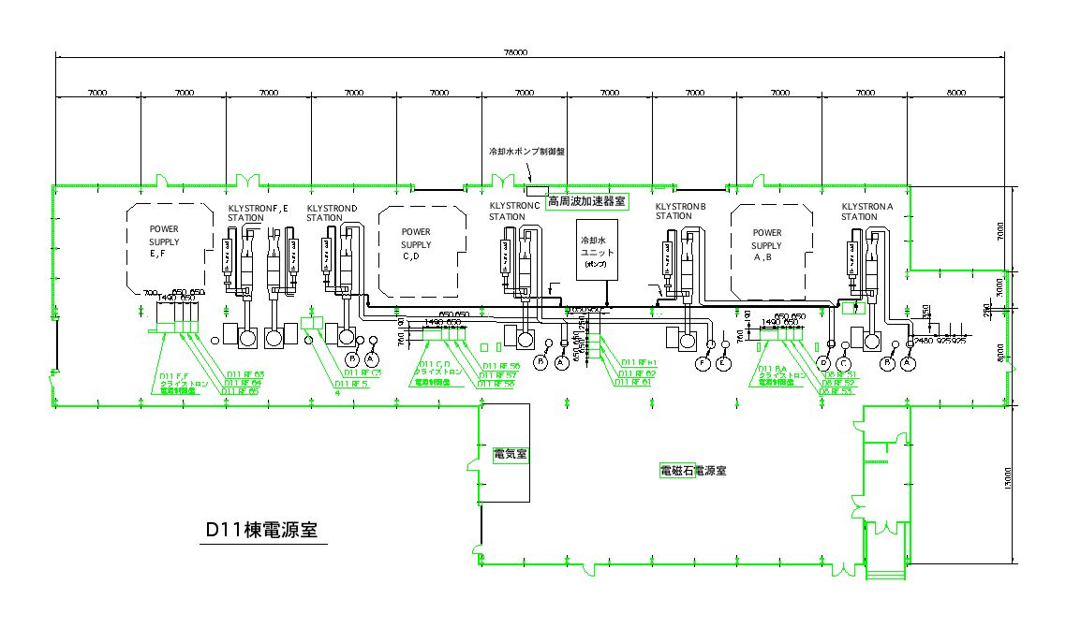
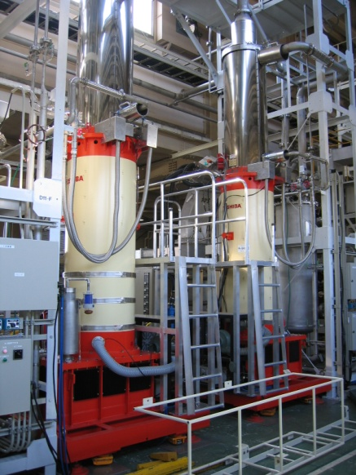
High power RF system
Power supply
Two RF stations for crab cavities
Four existing RF high power stations for SC accelerating cavities
Two RF stations for two crab cavities.
Two re-used klystrons.
One power supply to drive two klystrons.
Similar to the SC accelerating cavity stations.
Toshiba klystron

Slide 7
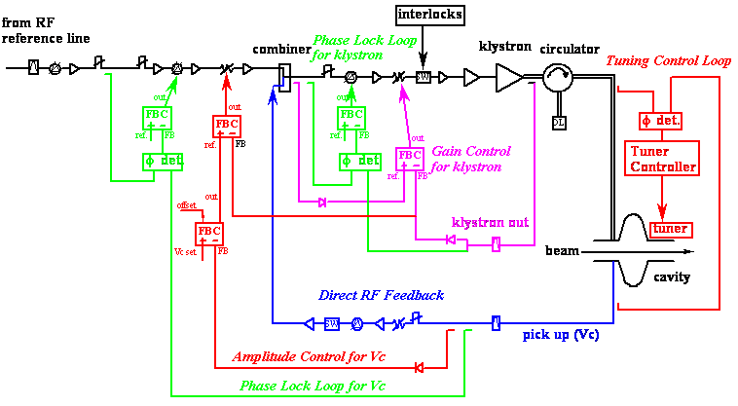
Low level RF system
K. Akai et al, EPAC98, p. 1749.
Mostly similar to the low level system for the SC accelerating cavities.
Conventional amplitude and phase feedback loops to control the cavity voltage and the klystron output power.

Slide 8
Crab cavity I/L system
IL system is important to protect the hardware
Breakdown detector judges
whether P_{kly}, V_{C} and φ_{crab} are normal, or not.
If not, Crab RF is switched off.
This is the most frequent cause of Crab RF trip.
Breakdown detector
RF output from pickup probes
Several pickup probes are attached for monitoring
the transmit power and the RF output at
coaxial beam pipe.
Vacuum pressure
Temperature
Crab RF Off
Beam abort
Arc sensor
Whenever Crab RF is switched off,
the beam is aborted immediately.
He pressure/level
Flow rate of cooling water

Slide 9
Cavity conditioning
Coupler conditioning before cooldown
Up to 200 kW SW
Cool down
2K/H for ~1 week
Frequency tuner setting
3 days
Cavity conditioning
~1W
HER crab up to 1.7 MV
LER crab up to 1.6 MV

Slide 10
Cavity tuning with beams
Search for the field center in the cavity (beam-induced power)
Search for the crabbing phase and calibration of the crabbing voltage (closed orbit distortion)
Phase stability
Tuner mechanism problem of LER crab cavity
Tuner phase stability
Crab phase stability

Slide 11
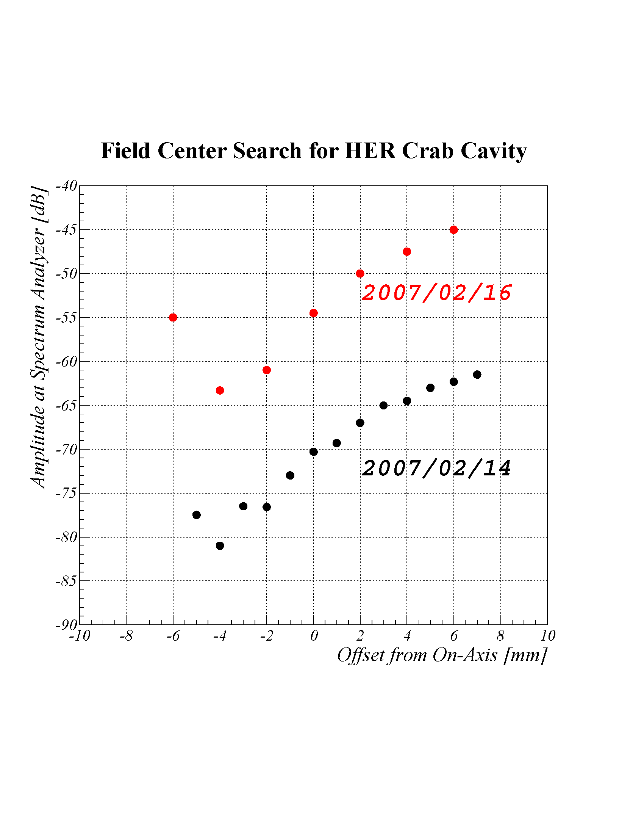
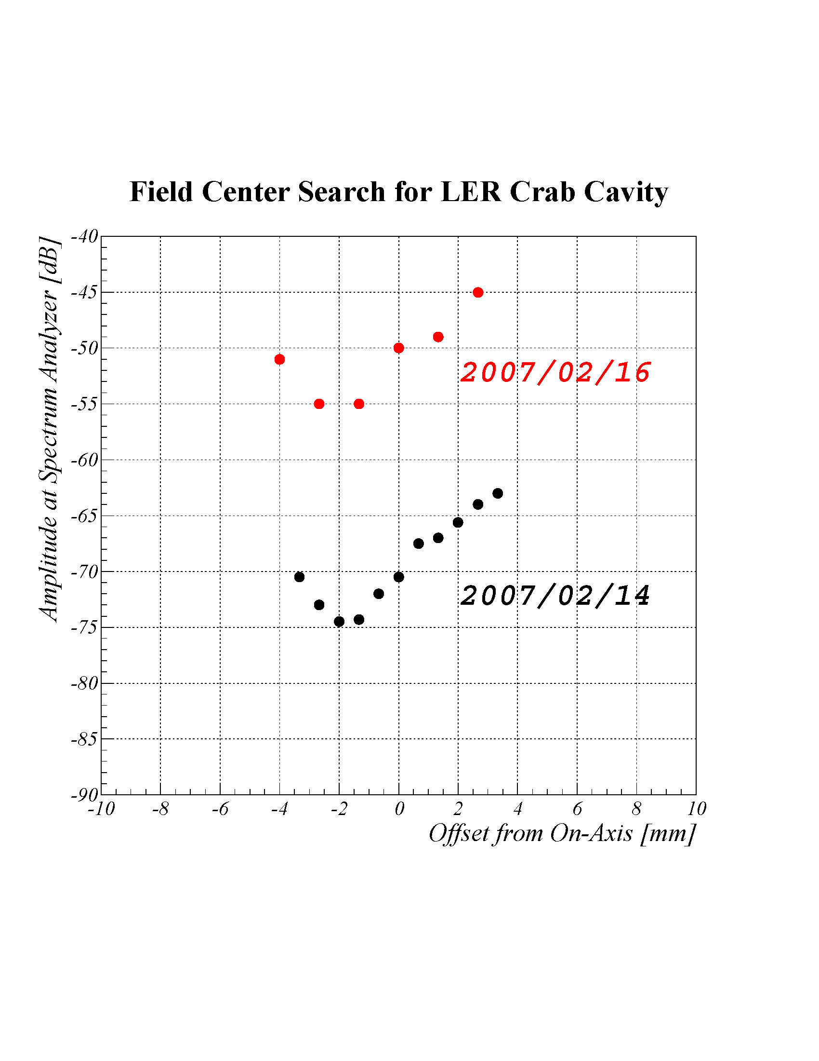
Search for field center in crab cavity
A local bump orbit was set with the crab cavity detuned
HER
LER
5kHz
5kHz
40kHz
40kHz
Inner
Outer
Inner
Outer
Field center search by measuring beam-induced crabbing mode
Crab cavities detuned by 5 kHz and 40 kHz.
Field centers given at the minimum induced voltage

Slide 12
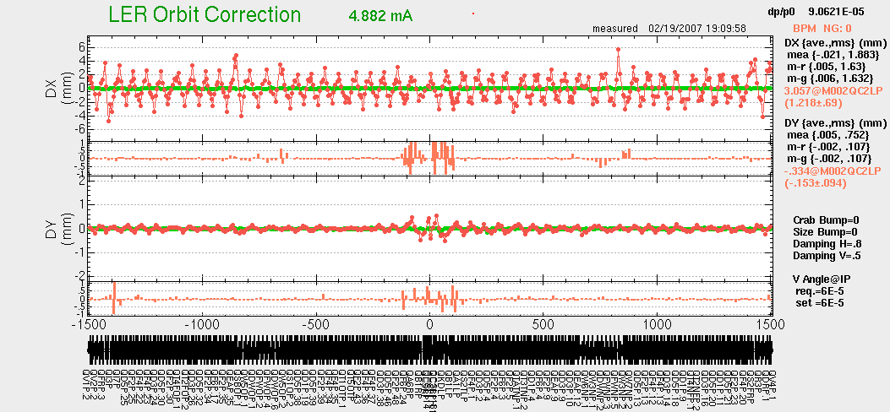
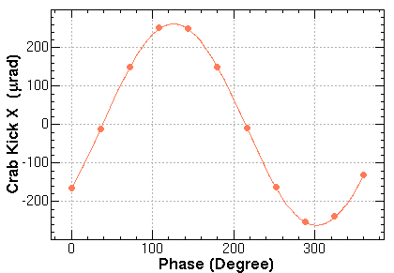
Search for the crabbing phase
Crab cavity
Horizontal orbit distortion by crab kick
Crabbing phase determined at the minimum crab kick
Vc set: 1.0MV
Vc calibrated from this orbit distortion: 0.987MV

Slide 13
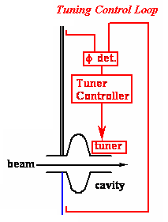
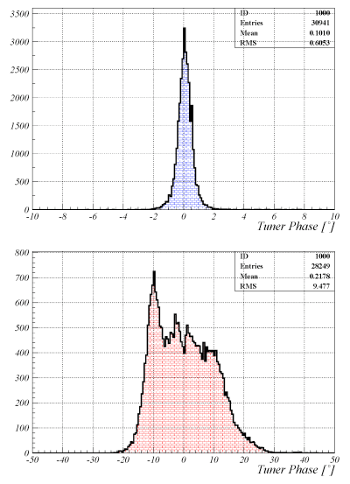
Tuner phase control
Distribution of tuner phase for Vc > 0.3 MV
HER
+/-1 deg.
The HER frequency tuner is well controlled.
Tuning phase stays within +/- 1 deg.
The LER frequency tuner mechanism has a large backlash.
Tuning phase fluctuates about +/- 15 deg.
LER
+/-15 deg.

Slide 14
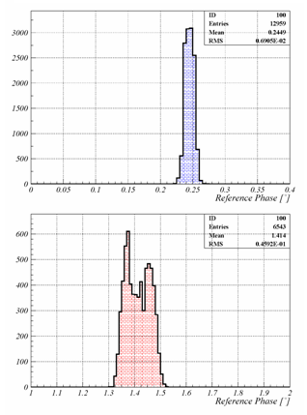
Crab phase control
HER
0.01 deg.
Low level feed back loops well stabilize the cavity voltage and phase.
Phase distributes within
0.01 deg. in the HER crab cavity,
0.05 deg. in the LER crab cavity.
LER
0.05 deg.

Slide 15
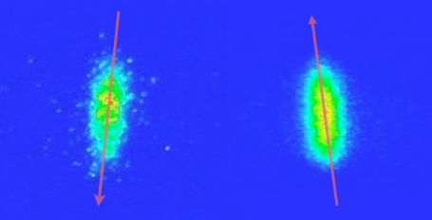
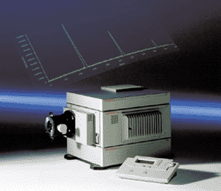
Observation with Streak Cameras
Bunch rotations were observed by two streak cameras
LER
HER
HER
Longitudinal direction
LER
Inside the ring
Horizontal direction
Outside the ring
Beam bunches really tilted

Slide 16
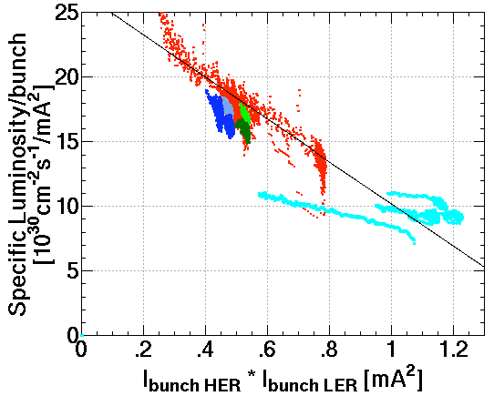
Collision tuning at low current
Lsp=L/(Ib₊Ib₋N_{bunch})
Crab crossing
β=80,84 cm
With crab crossing, specific luminosity / bunch was improved more than the geometrical gain
The vertical beam-beam parameter ξ became 0.088
It was 0.055 before the crab crossing
Still lower than the prediction
Simulation
Crab crossing
β=68~100 cm
Before Crab crossing
ξ=0.055
Remember that the crab crossing improves the luminosity reduction due to the geometrical overlap loss and also increase the beam-beam parameter

Slide 17
High current trial
First trial with crab crossing was not successful
Vacuum pressure increased
Cavity trip rate increased
Warm up to 80K for evacuation
Crab crossing suspended
Cavities detuned and scrubbing
Currents increased
LER:1.4A
HER:1.2A
Warm up to 300K
Second trial with crab crossing
Stable vacuum pressure with crab crossing
Currents increased
LER:1.3A
HER:0.7A
Current increase with crab cavities detuned
LER:1.7A
HER:1.35A

Slide 18
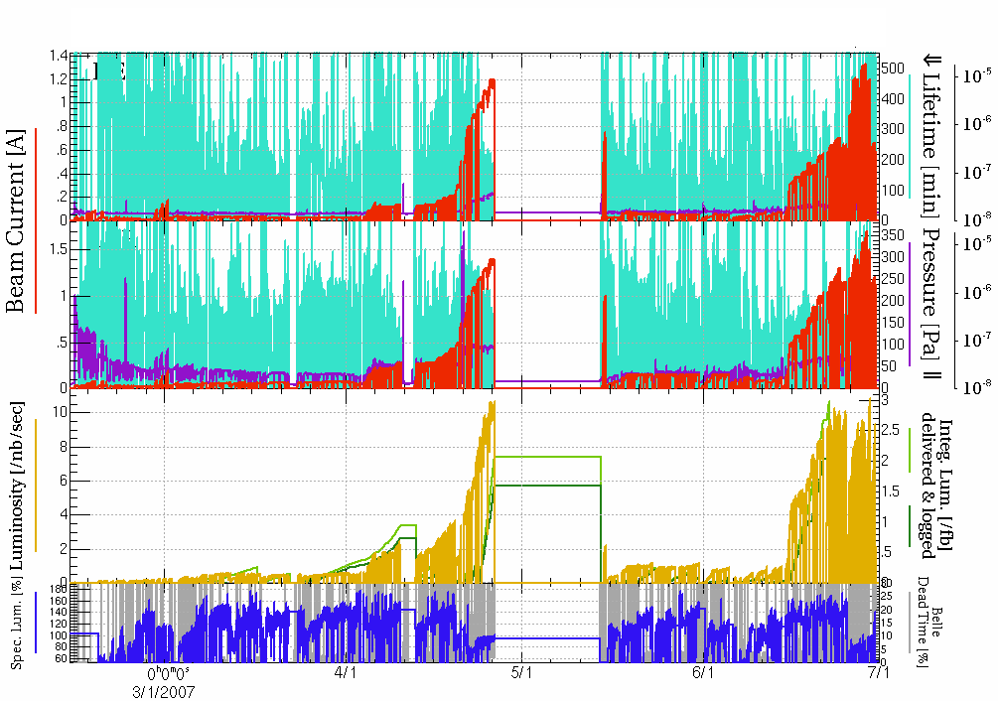
Overview of the crab commissioning (1st period)
1st trial
300K
2nd trial
HER
crab crossing tuning at low currents
crab crossing tuning at low currents
0.7A (crab ON)
1.2A(detuned)
1.35A(detuned)
LER
3/17
Vc degraded
to 1 MV
High trip rate
1.3A (crab ON)
1.4A(detuned)
1.7A(detuned)
2/19 First crabbed beam
2/21 First crab collision
Warm-up to 80 K
Warm-up to 80 K
Warm-up to 300 K
Conditioning
1st high current trial
2nd high current trial
Crab detuned
Crab detuned

Slide 19
Number of trips per cavity from Mar. 1 to Jun. 30
 | LER | HER
Mar. | 58 | 43
Apr. | 55 | 21
May | 13 | 16
June | 12 | 32
Total | 137 | 112
Rate | 1.56 | 1.27
Green line: maintenance day
Machine maintenance in a day shift
Conditioning of crab cavities
Black line: warm-up
First two: up to 80K for one day
Third: up to 300K for about three weeks

Slide 20
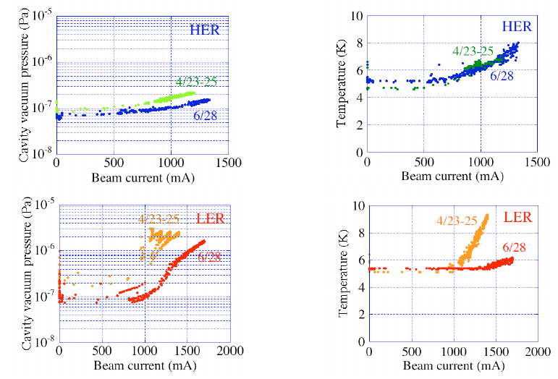
Improvements of vacuum pressure after warm-up
Vacuum pressure in each cavity improved after vacuum scrubbing and warmup to 300K
Reinforcement of cooling power was done for the LER inner conductor

Slide 21
Achieved parameters and problems during commissioning
Achieved parameters
LER voltage drop
LER Tuner problem
Phase stability
Voltage oscillation at high current crabbing beams

Slide 22
Achieved parameters
 | LER | HER
Beam current (Crabbing) (mA) | 1620 | 850
Beam current (Crab detuned) (mA) | 1700 | 1350
Maximum crabbing voltage (MV) | 1.6→1.3→1.1 | 1.8
Operating crab voltage (MV) | 0.8～0.95 | 1.3~1.48
Ferrite HOM damper load(kW) | 12 | 12
Tuner phase (deg.) | ±13 | ±1
Tuner phase w/o piezo (deg.) | ±15 | ±3
Crab phase (deg.) | ±0.1 | ±0.1
Trip rate | 1.6 | 1.3

Slide 23
Crabbing voltage
HER crab cavity
Maintained high crabbing voltage around 1.45 MV
Sometimes raised up to 1.7MV to search the best crabbing angle
LER Crab cavity
Degraded from 1.6 to 1.3 MV shortly after the startup
Further degraded to 1.0 MV after a heavy quench on Mar. 17, 2007
Slight recovery to 1.1 MV after warm-up to 80 K
Crabbing angle kept at 11 mrad by increasing the beta function from 40 to 80 m

Slide 24
Frequency tuner problems
The LER tuner has large backlash behavior
Tuner phase fluctuates +/- 15 deg.
Piezo actuator broke down
Frequency tuner operates w/o piezo actuator
Tuner phase fluctuation increased +/-2 deg.
LLRF still well controls crabbing phase even with large tuner phase fluctuation

Slide 25
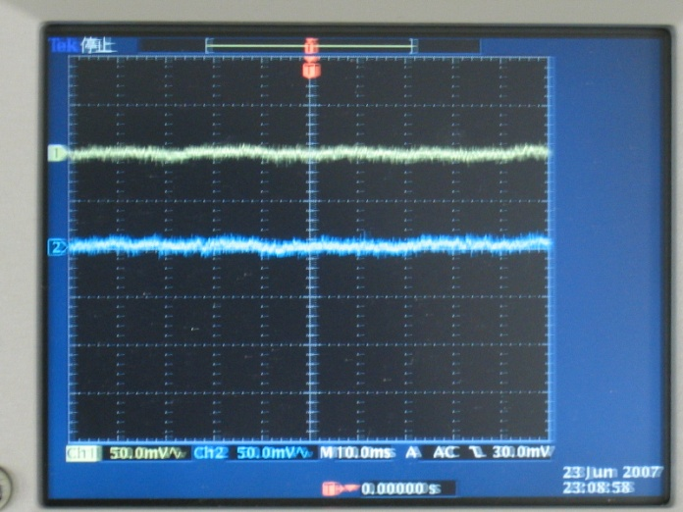
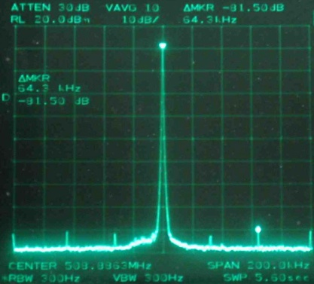
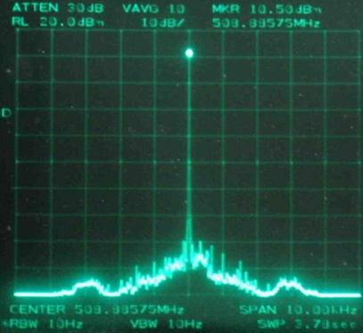
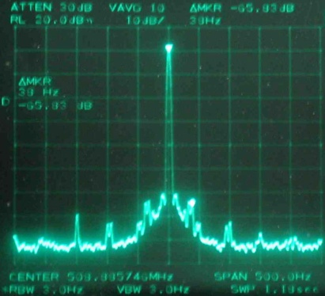
Phase stability
Spectrum of pick up signal was analyzed and consistent with phase detector data.
Phase fluctuation faster than 1 kHz is less than ± 0.01°, and slow fluctuation from ten to several hundreds of hertz is about ± 0.1°.
They are much less than the allowed phase error obtained from the beam-beam simulations for the crabbing beams in KEKB.
K. Akai
According to b-b simulation by Ohmi-san, allowed phase error
for N-turn correlation is 0.1×√N (degree).
LER crab phase
± 1 deg
HER crab phase
Span 200 kHz
Sideband peaks at 32kHz and 64kHz.
Span 10 kHz
Span 500 Hz
Sideband peaks
at 32, 37, 46, 50, 100 Hz.
Phase detector signal. Beam current was 385mA (HER) and 600 mA (LER).
Spectrum around the crabbing mode measured at a pick up port of the LER crab cavity. Beam current was between 450 and 600 mA.

Slide 26
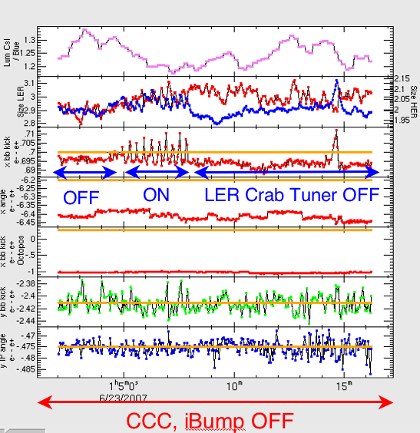
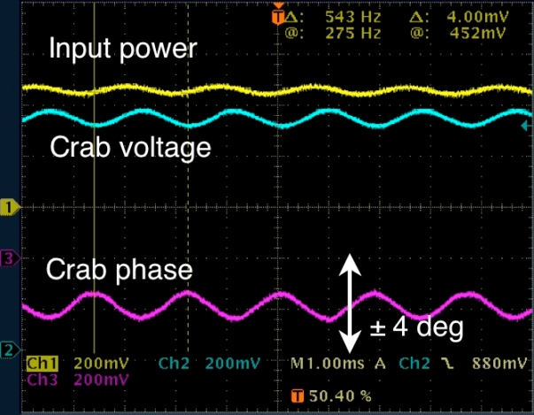
K. Akai
Oscillation of high-current crabbing beams
A large-amplitude oscillation was observed in high-current crab-crossing operation in June.
It caused unstable collision, short beam life time and luminosity degradation.
Crab amplitude and phase were modulated at 540 Hz. Horizontal oscillation of beams was also observed at the same frequency.
None of the beam orbit feedback systems is responsible, since their time constants are 1 to 20 sec, much slower than the oscillation.
The oscillation occurred when the LER tuning phase migrated to the positive side. This gave us a hint to understand the phenomena.
Beam-beam kick is shaken.

Slide 27
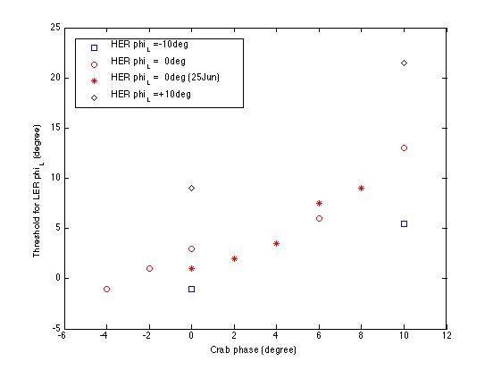
A remedy for the oscillation was found
K. Akai
Observations at a machine study
The oscillation occurred only with high-current colliding beams: it never occurred with a single beam, even at a high current.
Both beams oscillates coherently.
The threshold for the oscillation is dependent on the crab phase and tuning phase (see left).
Cause and remedy
We concluded that the oscillation is caused by beam loading on crab cavities together with beam-beam force at the IP.
We found that it can be avoided by shifting the crabbing phase by +10° and controlling the tuning offset angle appropriately.
HER tuning offset:
φtun (HER)
oscillation
occurs
φtun (HER) = +10°
LER tuning offset (degree)
φtun (HER) = 0°
φtun (HER) = -10°
stable
Both crab phase (degree)
Dependence on the crab phase and tuning phase.
Beam current was 1150 mA (LER) and 620 mA (HER).
Tuning offset +5º (HER), -8º (LER)
Crab phase: +10º (HER/LER)

Slide 28
Crab cavity operation
Brief history
Trip rate
Breakdown of piezo actuator
Cavity voltage
Degradation
Voltage scanning
Voltage oscillation and its remedy
Beam-induced RF spectrum
HOM loads
Need for higher voltage
Effort to cool down below 4K

Slide 29
Brief history
month/year | comments
Jan/2007 | Crab cavities were installed into KEKB.
Feb/2007 | Beam commissioning started with “Crab ON”.
Mar/2007 | Cavity voltage of LER Crab dropped suddenly.
Jun/2007 | Piezo actuator of LER Crab broke down for the first time. Oscillation was observed at high beam current with crabbing collision.
Oct/2007 | Physics run started with “Crab ON”.
May/2008 | Cavity voltage of LER Crab was recovered slightly.
Oct/2008 | Lower temperature operation was tried to recover cavity voltage of LER Crab.
Mar/2009 | Lower temperature operation was retried.
Oct/2009 | Oscillation was observed again, regardless of setting tuning phase offset and crab phase.
Dec/2009 | Beam current with “Crab ON” achieved 1250mA for HER and 1700mA for LER.

Slide 30
RF trip of crab cavity
Period 1 : Feb/2007~Jun/2007
Period 2 : Oct/2007~Dec/2007
Period 3 : Feb/208~Jun/2008
Period 4 : Oct/2008~Dec/2008
Period 5 : Apr/2009~Jun/2009
Period 6 : Oct/2009~Dec/2009
2.8/day
0.4/day
0.8/day
0.1/day
558days
HER : 1.3/day
LER : 0.5/day
Total average

Slide 31
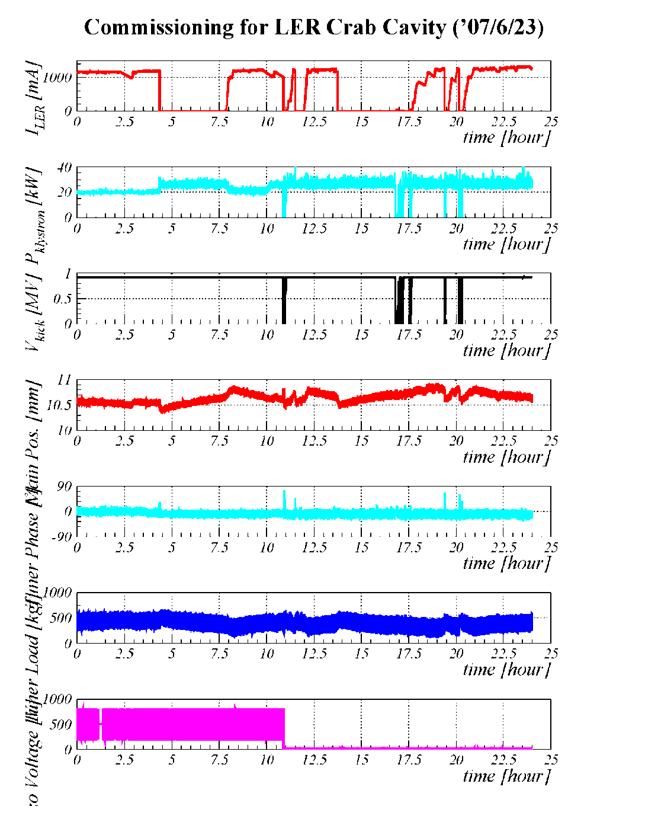
Piezo actuator breakdown
Date | Cavity | Comment
Jun/9/2007 | LER | At RF recovery
Jun/23/2007 | LER | At beam abort with RF trip
Oct/1/2007 | HER | At RF recovery
Oct/4/2007 | HER | At RF trip
Oct/16/2007 | LER | At RF recovery
Oct/15/2008 | HER | At RF trip
May/15/2009 | LER | At beam abort with RF trip
Jun/11/2009 | HER | At beam abort with RF trip
Oct/25/2009 | LER | At beam abort with RF trip
I_{LER}
P_{Kly}
V_{kick}
Main
Position
φ_{Tuner}
Load
Crab cavities have been operated
without Piezo actuator
during most of beam commissioning.
Low level feedback system can control
Crab cavity without Piezo.
breakdown@10:53
V_{Piezo}

Slide 32
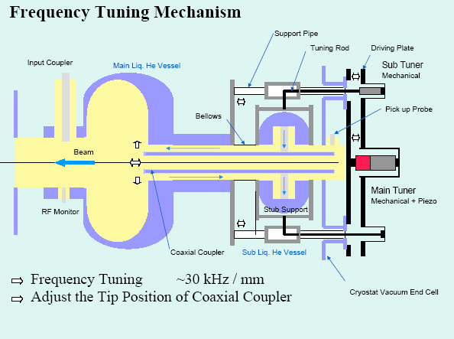
Frequency tuning

Slide 33
Cavity voltage drop of LER Crab
Cavity voltage of LER Crab was better than HER at horizontal test.
But, after installation to beam line, it dropped gradually.
And, it dropped suddenly from 1.3 to 1.0MV in Mar/17/2007.
Date | Cavity voltage [MV] | Comment
Dec/2006 | 1.9 | Horizontal test
Feb/19/2007 | 1.5 | At the beginning of beam commissioning
Feb/22/2007 | 1.3 | Maintenance day
Mar/17/2007 | 1.0 | Suddenly dropped
Mar/23/2007 | 1.1 | After thermal cycle
May/22/2008 | 1.2 | Slightly recovered
Jun/30/2008 | 1.3 | After pulse conditioning
Dec/18/2009 | 1.3 | No recovery afterwards

Slide 34
Crab voltage scanning
Date | LER [MV] | HER [MV]
Feb/29/2008 | 0.83 → 0.88 | 1.37 → 1.41
Mar/4/2008 | 0.88 → 0.88 | 1.37 → 1.38
Apr/5/2008 | 0.83 → 0.84 | 1.38 → 1.39
Apr/15/2008 | 0.84 → 0.85 | 1.39 → 1.40
Apr/25/2008 | 0.83 → 0.83 | –
Jun/4/2008 | 0.83 → 0.85 | 1.45 → 1.46
Jun/18/2008 | 0.83 → 0.83 | –
Oct/26/2008 | 0.85 → 0.83 | 1.37 → 1.34
Nov/22/2008 | 0.83 → 0.81 | 1.50 → 1.48
Dec/18/2008 | 0.81 → 0.84 | –
Apr/26/2009 | 0.85 → 0.83 | 1.35 → 1.32
May/20/2009 | 0.83 → 0.85 | 1.32 → 1.33
Jun/6/2009 | 0.85 → 0.86 | 1.33 → 1.37
Jun/18/2009 | 0.95 → 0.98 | 1.50 → 1.55
Nov/2/2009 | 0.87 → 0.90 | 1.29 → 1.34
Dec/12/2009 | 0.95 → 0.97 | 1.40 → 1.45
Voltage scanning is sometimes carried out
as part of beam tuning for higher luminosity.
During this operation, RF trip of Crab cavity
occurs frequently.
Very careful operation is necessary!
When Crab RF is switched off, RF conditioning
is sometimes done at local control room.
Max. operation voltage

Slide 35
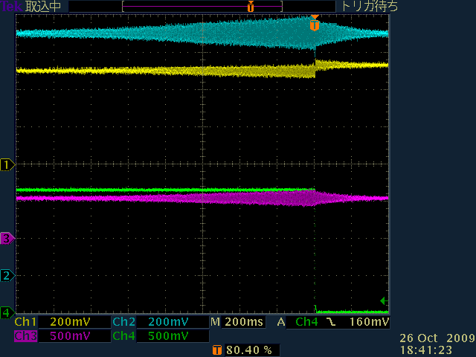
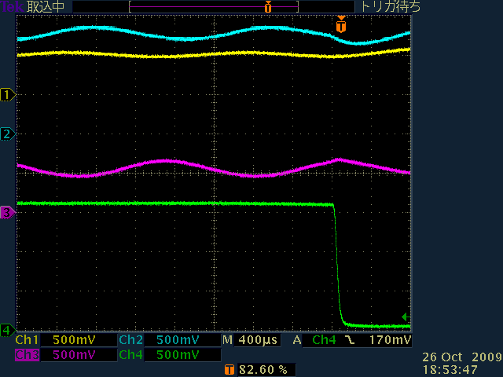
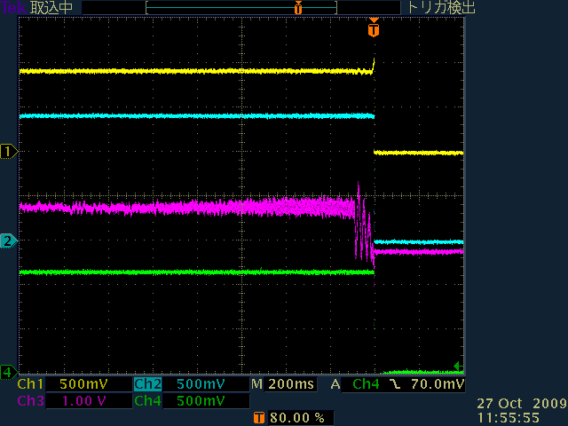
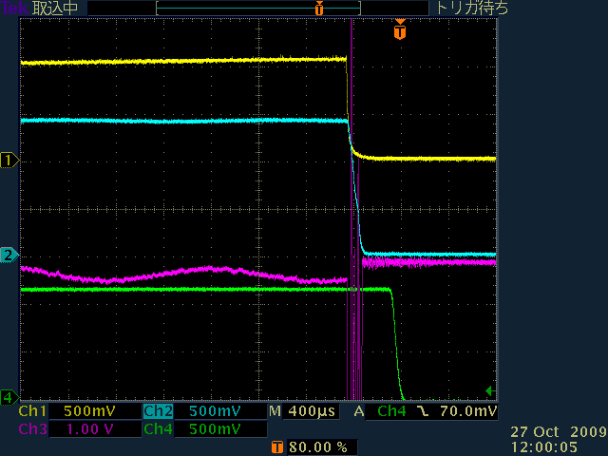
Oscillation at high beam current with “crab on”
Oscillation occurred again in autumn/2009,
regardless of setting same values as previous.
V_{C}
P_{klystron}
540Hz
I_{beam current}
φ_{Crab}
LER Crab
Tuning phase offset : +15°(HER)
–10°(LER)
crab phase : ~+19°(HER/LER)
Oscillation is suppressed again!
HER Crab

Slide 36
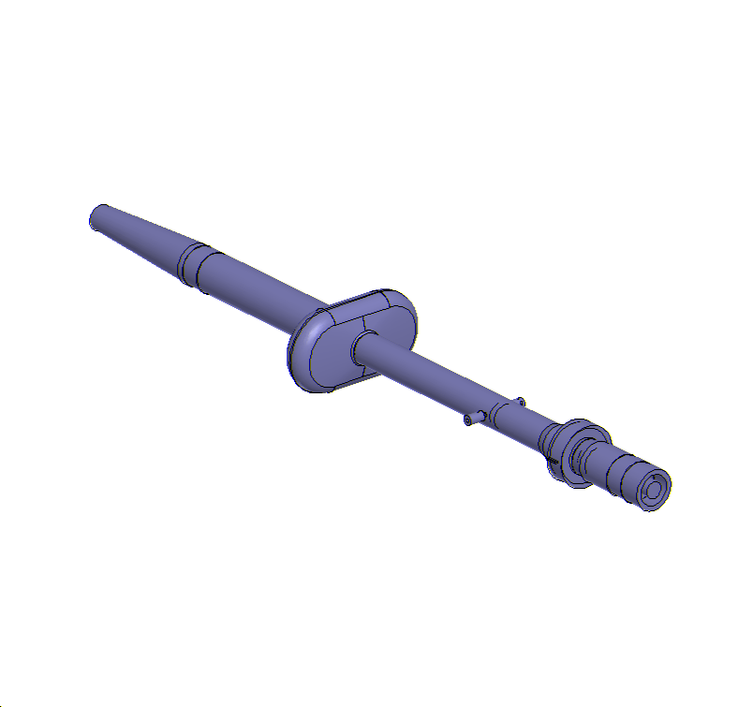
Beam-Induced RF spectrum
Crab cavity has several RF ports to measure beam-induced RF spectrum.
They are pick-up antennae.
Four antennae are set on the coaxial coupler.
Those antennae are suitable to measure HOM signals.
Four antennae are set on the beam pipe.
Those antennae are suitable to measure the beam spectrum
LBP HOM Damper
Large Beam Pipe
Cavity Cell
Coaxial Coupler
HOM4 port
Stub Support
Notch Filter
HOM3 port
Coaxial
HOM Damper
Crab Cavity
RF4 port
Pickup antenna
Beam
RF3 port

Slide 37
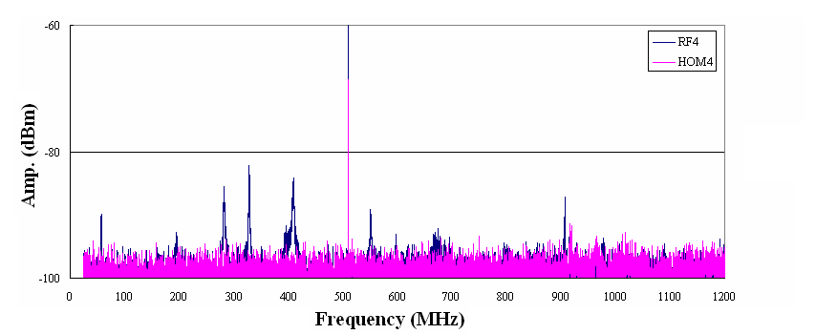
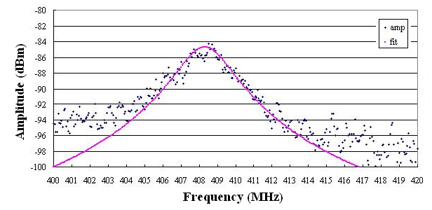
Single bunch operation at a machine study
Single bunch operation is suitable to measure beam-induced RF modes since its beam spectrum is flat with a revolution interval (100 kHz)
6/21 LER: 0.86MV,0.48mA
Freq(MHz) Mode
56 co-TEM 1/4λ
195 co-TEM 7/4λ
282 co-TEM 9/4λ
327 co-TEM 11/4λ
395 co-TEM 13/4λ
408 TM110, LOM
550 co-TEM 19/4λ
672 TM310
696 TM310
907 TM111
979 TM130
LOM, TM110
Co-TEM11/4
Co-TEM7/4
Co-TEM13/4
Co-TEM1/4
Co-TEM9/4
Co-TEM
TM310
TM111
TM130
Consistent
f0: 408.3
Q: 140
Measured at horizontal test
(@ room temperature)
Mainly observe beam spectrum.
LOM
f₀: 408.3 MHz
Q: 140
The most dangerous mode, TM110 (accelerating mode) is heavily damped.
Mainly observe beam-induced RF modes.

Slide 38
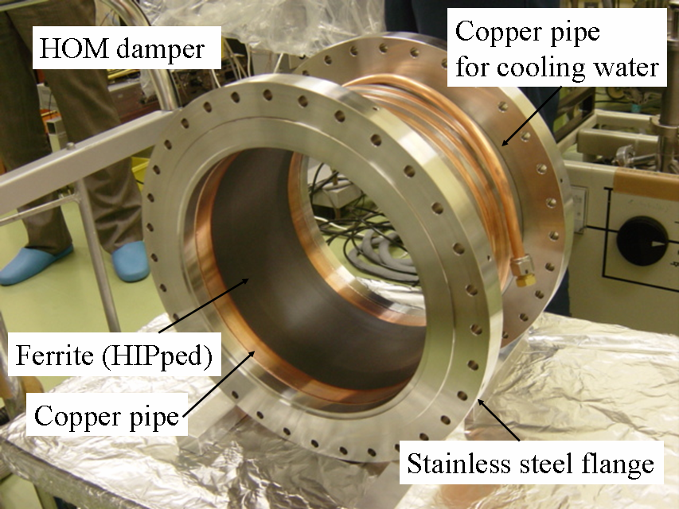
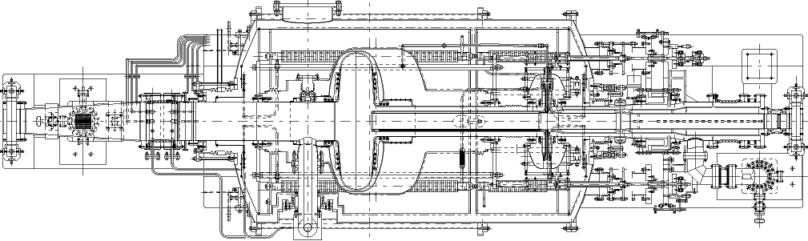
HOM dampers
Ferrite dampers
Beam pipe damper (LBP damper)
Coaxial damper (Coax damper)
Ferrite: 240mmφ x 100mm x 4mm
SiC damper
LER crab module has a SiC damper
SiC: 150mmφ x 240 mm x 10 mm
LER crab cavity module
SiC damper, 150φ
Ferrite damper, 240φ

Slide 39
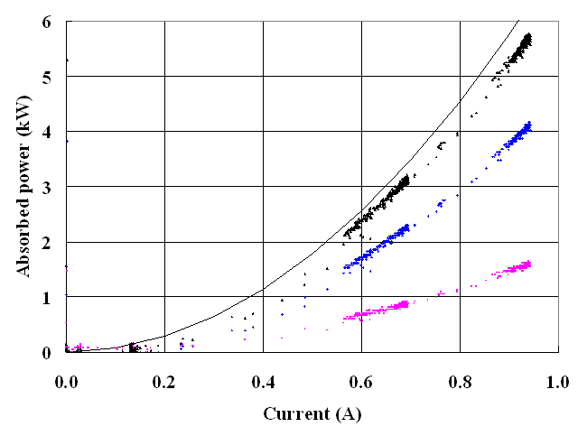
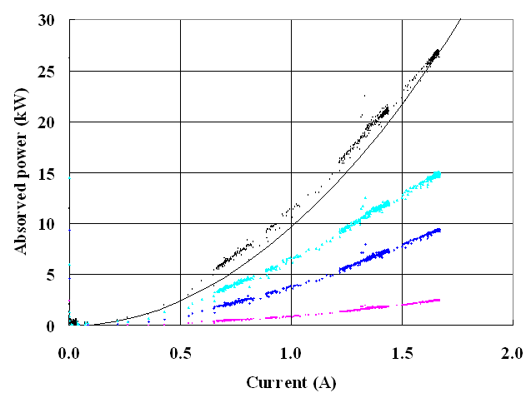
Typical HOM powers in the beam operation
HER
Absorbed HOM power:
4.1 kW (LBP) + 1.6 kW (coax) @ 0.95 A
Coax/LBP=0.4 for 3.06-sp, 1585 bunches
Calculation well reproduces total HOM power
Total
LBP
coax
LER
Absorbed HOM power:
9.4 kW (LBP) + 2.4 kW (coax) @ 1.62 A
Coax/LBP=0.25(LER) for 3.06-sp, 1585 bunches
SiC damper contributes for HOM power absorption.
Calculation well reproduces total HOM power
Total
SiC
LBP
coax

Slide 40
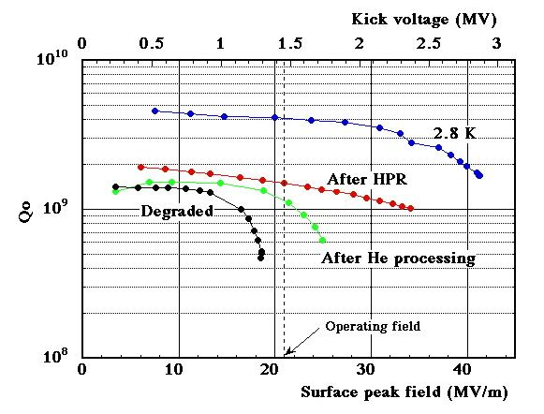
Need for higher Vc
Large beta function at crab cavity may cause beam loss.
Physical aperture is ~100 mm.
Higher Vc is required for low beta function
Low temperature operation below 4K may improve the Vc limit
Cavity performance at lower temperature
Vertical Cold Test (prototype cavity)

Slide 41
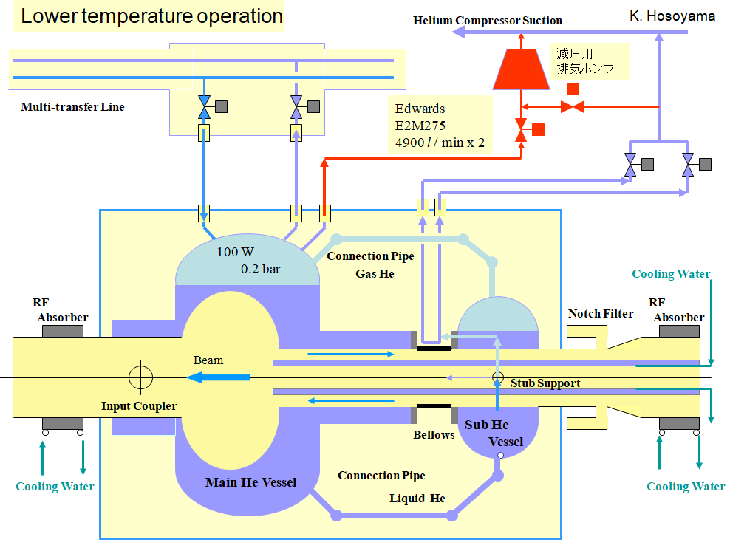
Lower temperature operation

Slide 42
Lower temperature operation
P_{Kly}
Lower temperature operation below 4K was tried.
The first trial was done in autumn/2008.
It failed due to unexpected oil reduction
of the pumping system.
The second trial was done in spring/2009.
Lower temperature operation was successful!
The operation was stable around 3.6K.
But, performance of LER Crab cavity
was not recovered.
V_{kick}
He Temp.
He Level
He press.
at cavity
He press.
at pump

Slide 43
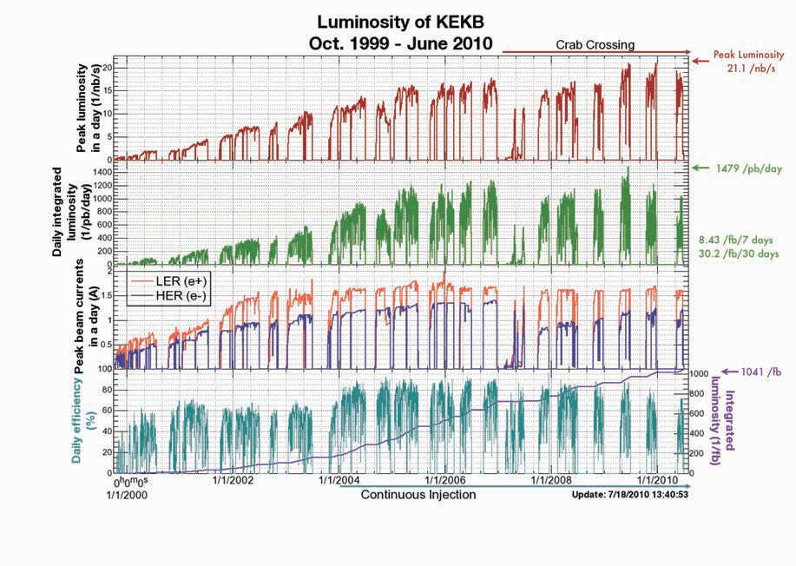
KEKB operation

Slide 44
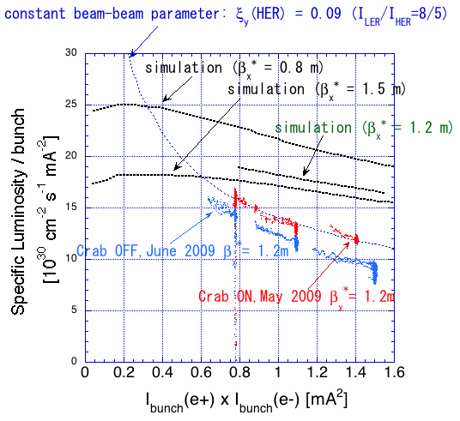
Specific luminosity increase
Funakoshi
Specific luminosity increase with crab crossing: 20 %
More than geometrical reduction factor, 11%
Beam-beam parameter:0.09
Improved from 0.057 w/o crab crossing
Still lower then the prediction

Slide 45
Achieved parameters
 | LER | HER
Max. Beam current (mA) | 1700 | 1238
Crab voltage (MV) | 0.81~0.98 | 1.32~1.55
# of total trips | 263 | 710
Average trip rate (in the last one year) | 0.5(0.1) | 1.3(0.8)
Max. HOM power (kW) | 2.5+12.4+13.0+12.2 (Coax+LBP+SiC1+SiC2) | 3.0+6.9 (Coax+LBP)
Another SiC damper added in 2009
HER LBP damper absorbed 9.9 kW at 1350A when crab detuned

