Slide 1
SC cavity design and production
IAS2023
20230716
Yoshiyuki Morita
KEK

Slide 2
SC cavity design and production
Crab cavity design for KEKB
Crab cavity production and assembly
High power tests

Slide 3
Requirements for KEKB Crab cavity
Original two crab scheme
  Two crab cavities in one ring
High kick voltage: 1.4MV
Heavily damped cavity
  Q of FM~100
Superconducting cavity designed for KEKB
  Operating frequency: 509 MHz
  Operating temperature: 4.4K
  Using the existing cryogenic system and HP stations
 | LER | HER
Beam energy (GeV) | 3.5 | 8.0
RF frequency (MHz) | 508.887
Crossing angle (mrad) | ±11
βx,IP (m) | 0.33 | 0.33
βx,Crab (m) | 20 | 100
Kick voltage (MV) | 1.41 | 1.44

Slide 4
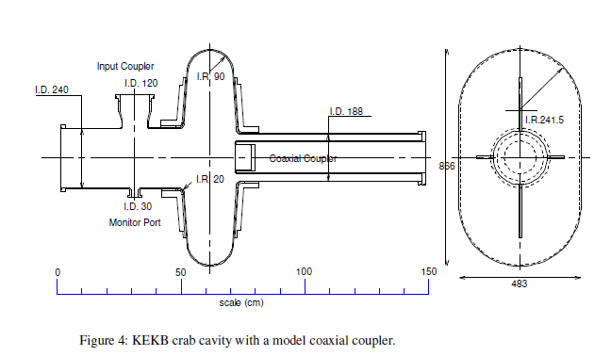
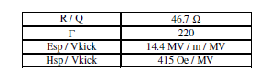
Cell type
Pill box type
  Squashed cell
    866mm x 483mm
    Separate SOM above 650 MHz
  Coaxial coupler
    OD: 130 mm, ID: 100 mm
    BP diameter: 188 mm
    Damp FM, SOM, HOMs
    fc of TE11: 600MHz
  Beam pipe
    Diameter: 240 mm
Frequency: 509 MHｚ

Slide 5
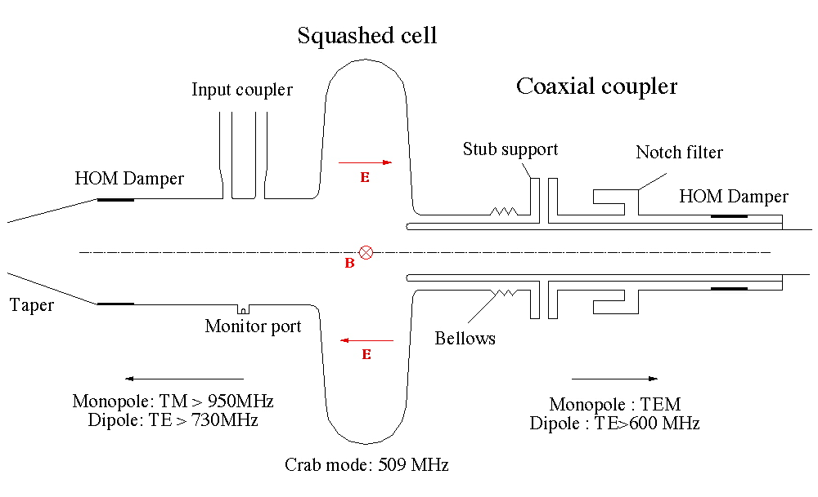
Conceptual design for KEKB
K. Akai
Unique characteristics
Coaxial Coupler
Squashed Cell
High Field
  Vkick=1.4 MV
  Esp=21 MV/m
(RF Absorber)
Crab Mode: TM210-like mode (R/Q:46)
Squashed cell: SOM, 682 MHz > fc of TE11, 600 MHz
Coaxial coupler
Notch filter: TEM-coupled Crab mode rejection when misaligned
Stub support: support for inner conductor and channel for he cooling
Bellows: coaxial coupler alignment
HOM damper: RF absorber

Slide 6
R&D
1994 1/3-scale models
1996 Full-scale prototype cavities
  To establish fabrication method for the squashed cell structure
  To establish surface treatments for high fields
  Fabricated a model coaxial coupler to study its effect on the cavity performance and multipacting in the coaxial structure

Slide 7
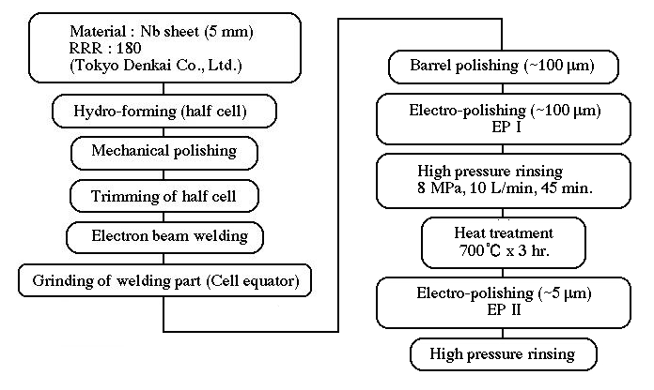
Fabrication and surface treatments
Intensively studied using prototype cavities

Slide 8
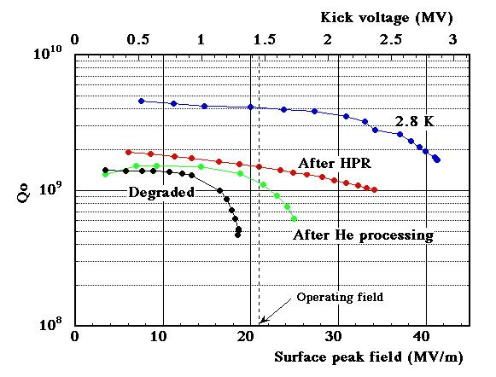
Vertical Cold Test (prototype cavity)
The prototype cavity reached the required kick voltage of 1.4 MV
Degraded by micro-particles
He processing tried
Performance recovered by HPR
Low Temperature operation tried, ~3MV reached

Slide 9
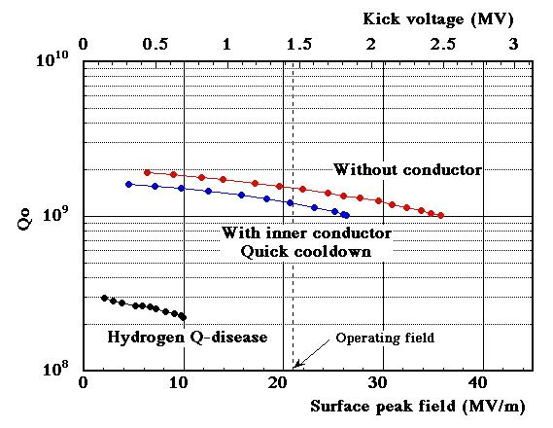
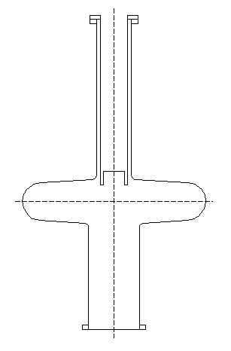
Vertical Cold Test (with a model coupler)
Effect of coupler tested with a short model coaxial coupler.
Multipacting occurred at low fields, but it was processed in an hour.
Hydrogen Q-disease occurred.
It could be avoided by quick cooling.
Required voltage achieved with the coaxial coupler
Model coupler

Slide 10
Fabrication of KEKB crab cavities
Established fabrication method and surface treatments of the cavity cell
Investigated effects of the inner conductor of the coaxial coupler
Required voltage reached
Confirmed performance recovery by HPR
After the R&D, we started fabrication of two crab cavity modules in 2005

Slide 11
Milestone of Crab Cavity for KEKB
After the R&D, we started fabrication of two crab cavity modules in 2005
2005
Jan. Start the Fabrication of 2 Crab Cavities
Dec. RF Test of Crab Cavity HER in Ver. Cryostat V_{kick} = 1.9 MV
2006
Jan. RF Test of Crab Cavity LER in Ver. Cryostat V_{kick} = 2.7 MV
Feb. Cool-down Test of Prototype Cryo-module
Feb. Start the Assembling of Cryo-module for Crab Cavity HER
Mar. Insertion Failure of Coaxial Coupler
Apr. Improved the Insertion Tool
Finished the Assembling Crab HER
May. Cool-down & High Power Test at Test Stand V_{kick} = 1.65 MV
July Dismantle the Cryo-module
Improved RF Contact of Coaxial Coupler and Bellows
Aug. Reassemble the Cryo-module
Sep. Cool-down and High Power Test of Crab HER at Test Stand V_{kick} = 1.8 MV
Oct. Assembling the Cryo-module for Crab LER
Nov. Cool-down and High Power Test of Crab LER at Test Stand V_{kick} = 1.93 MV
2007
Jan. 8,11 Installation of Crab Cavities for HER and LER into KEKB Ring
Jan.29,31 Start the Cool-down of Crab Cavities for HER and LER
Feb. 9,10 Start of RF Aging V_{kick} = 1.7 and 1.43 MV for HER and LER
Feb. 19 Crab Kick

Slide 12
Fabrication Procedure of Crab Cavity
Crab Cavity Cell
Beam Pipe & Flange
MHI
Kobe
Nb Sheet
Tokyo Denkai
5 mm t RRR = 180
Nb Sheet
Half Cell Hydro-forming
Rolle
Mechanical Polishing & Trimming
Electron Beam Welding
Grinding of Welding Part
Cell Equator
KEK
Tsukuba
Barrel Polishing
~ 100 μm
EP 2
~ 5 μm
Electro-Polishing
Electro-Polishing
EP 1
~ 100 μm
High Pressure Water Rinsing
Nomura
Plating
Kanuma
80 bar. 60 min.
High Pressure Water Rinsing
Assembling for Cold Test
Kinzoku
Giken
Mito
Annealing
700 ºC x 3 hr
Cold Test in Vertical Cryo.

Slide 13
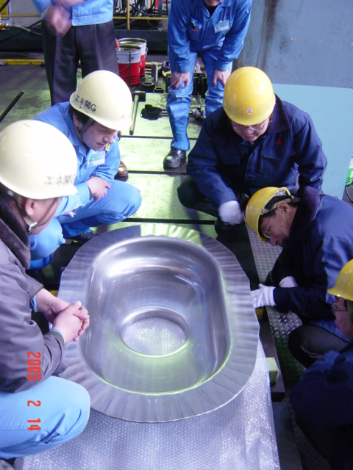
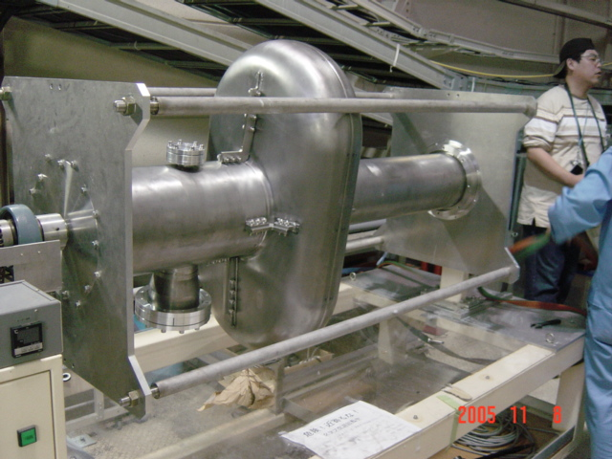
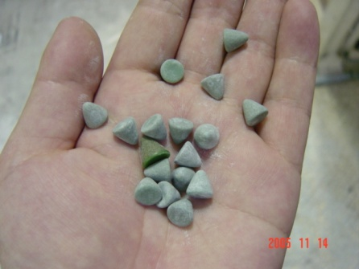
Forming and Barrel Polishing
Forming of 4 Half-Cells for Crab Cavity for LER and HER
Barrel Polishing
Polishing Time 312 Hr
Average ~100μm
Equator ~150μm

Slide 14
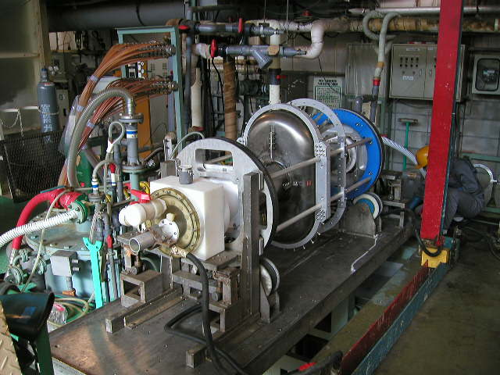
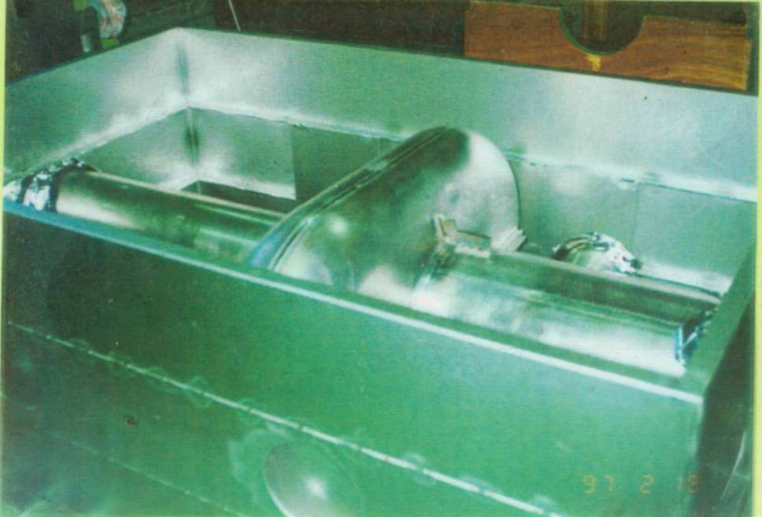
Electro Polishing & Annealing
Electro Polishing at Nomura Plating Ltd.
Rotation speed: 1RPM
Cathode: Aluminum pipe
EP 1 ~ 100 μm
EP 2 ~ 5 μm
Annealing at 700ºC for 3 hours
at Kinzoku Giken Ltd.

Slide 15
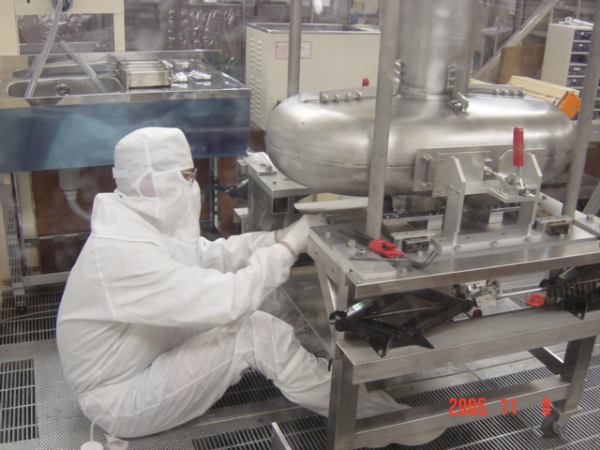
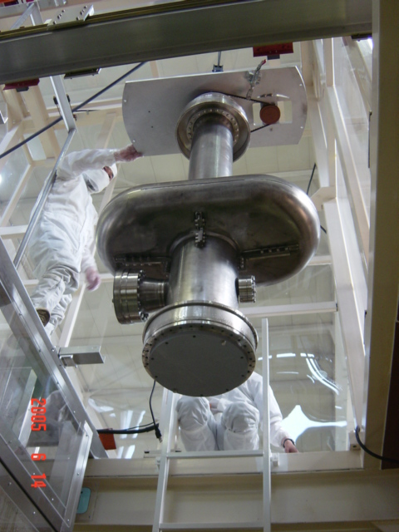
High Pressure Rinsing and Assembling for RF Cold Test
Set Flanges of Beam Pipes and Ports
in Class 100 Clean Room
Nozzle
High Pressure Water Rinsing
by 80 bar Ultra-Pure water
Rotation & Up-Down Motion

Slide 16
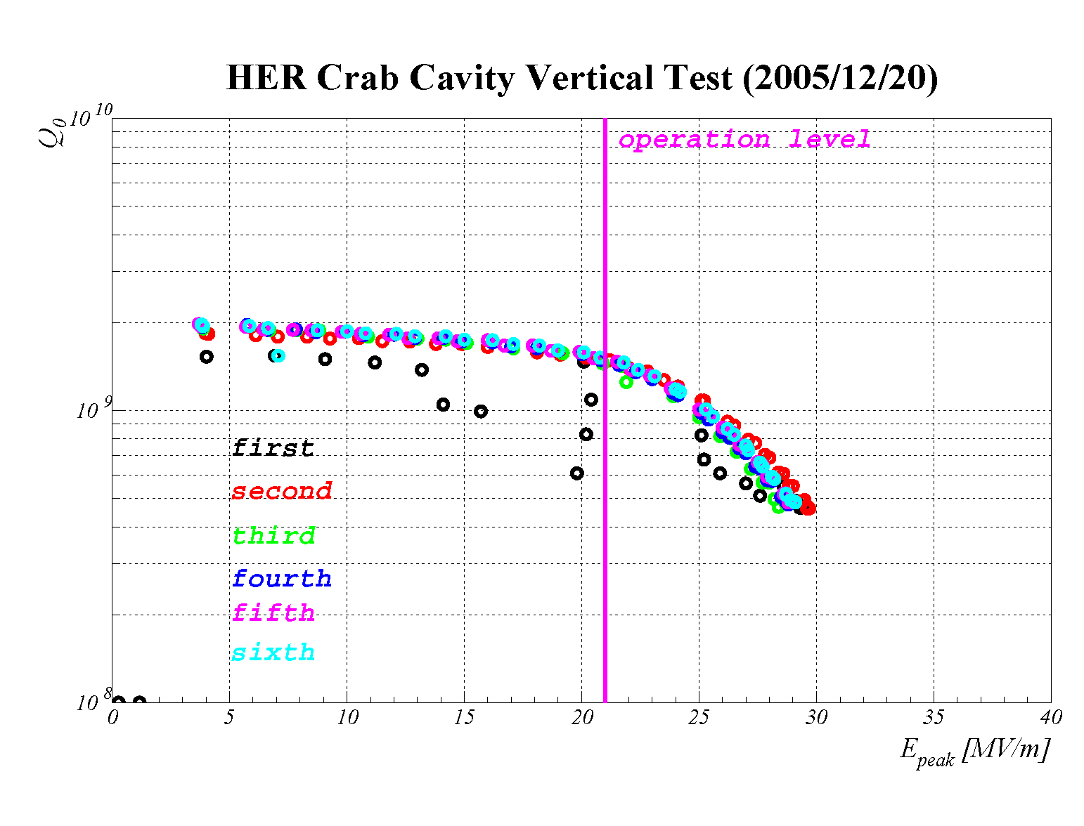
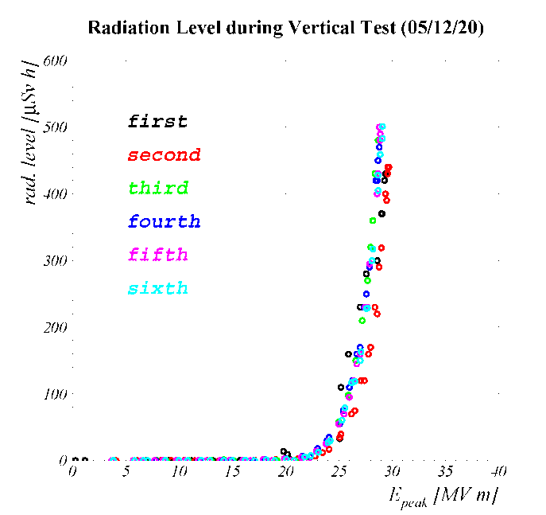
Cold test results of HER crab

Slide 17
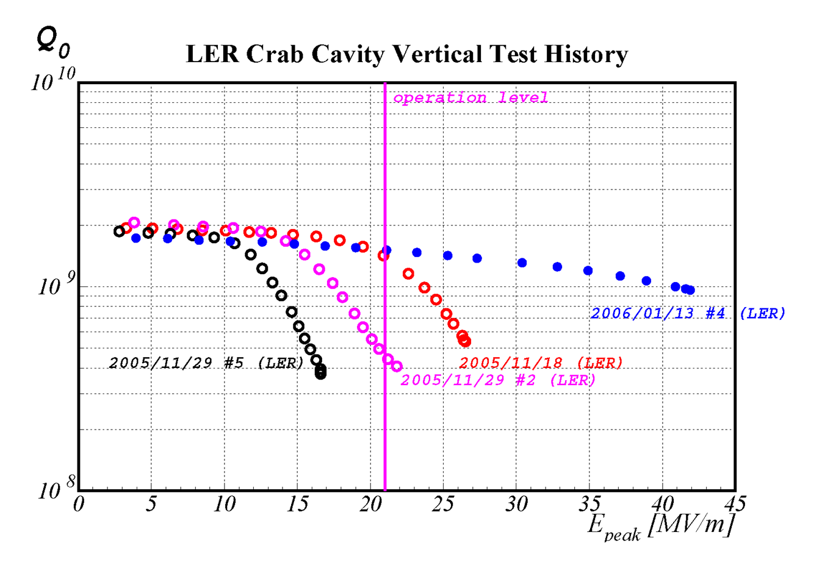
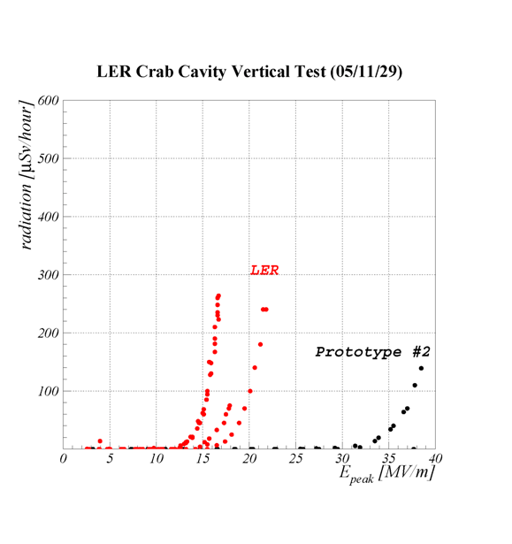
Cold test results of LER crab
EP once again

Slide 18
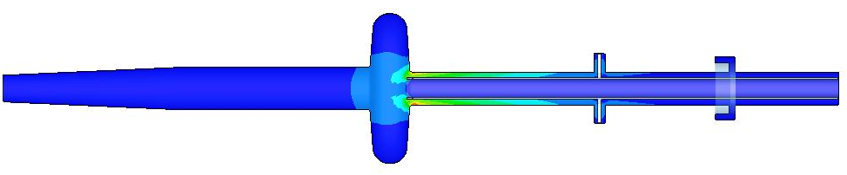
Coaxial coupler design
Parasitic modes in the coaxial coupler
Tip cutting
Tapered
TE-1/4λ mode
f = 595 MHz
R/Q = 5.3 Ω
Q = 10⁶
Stop band splitting
¼ wave length
Coaxial coupler has parasitic modes.
The most dangerous mode is the TE-1/4λ mode.
High R/Q (5.3Ω) and frequency lower f than cut-off.
Can not propagate to HOM damper.
This mode remains with high Q factor and gives high impedance.
Three modifications were applied to extract this mode.
Tapered coupler design for lower cut-off.
Tip cutting design for raising f of TE-1/4λ mode.
TE stop band splitting of notch filter.

Slide 19
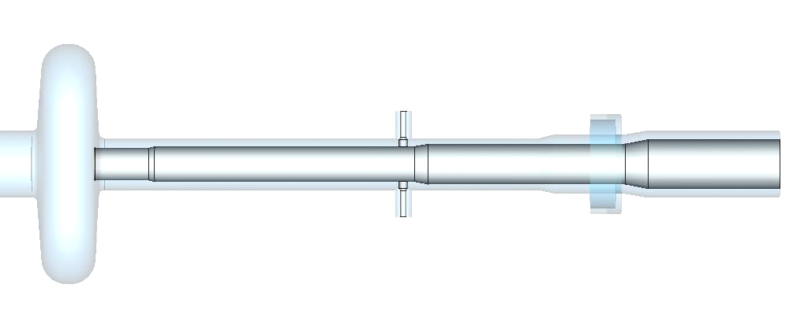
Tapered coaxial coupler design
Coaxial coupler has several tapered sections
Decrease cut-off frequency (fc) for TE-mode propagation
Tip cutting at the tip of the inner conductor, fc=620 MHz
R106/74
fc=530 MHz
R94/60
fc=620 MHz
R94/65
fc=600 MHz
R94/74
fc=568 MHz
R120/90
fc=454 MHz
Stub support
Notch filter
HOM damper

Slide 20
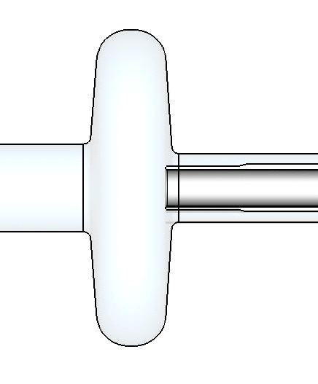
Tip cutting design
To raise the frequency of TE-1/4λ mode, outer diameter of the inner conductor is adjusted to 120 mm, which gives the cut-off of 620 MHz.
This modification makes TE-1/4λ mode above 600 MHz and lower R/Q.
120 mm
200 mm

Slide 21
Effect of tip cutting design
Δf, Δf/ΔL, Qext and R/Q
Frequency shift of the crab mode
Tuning parameter Δf/ΔL
External Q factor of the TM110 mode (LOM)
R/Q of TE-1/4λ mode
The coupler has to be inserted 5 mm into the cavity
to compensate frequency shift of crab mode.
 | Δf(crab) | Δf/ΔL | Qext(LOM) | R/Q(TE-1/4l)
No cutting |  | 30 kHz/mm | 69 | 5.2 Ω
Tip cutting | -145kHz | 30 kHz/mm | 58 | 2.1 Ω

Slide 22
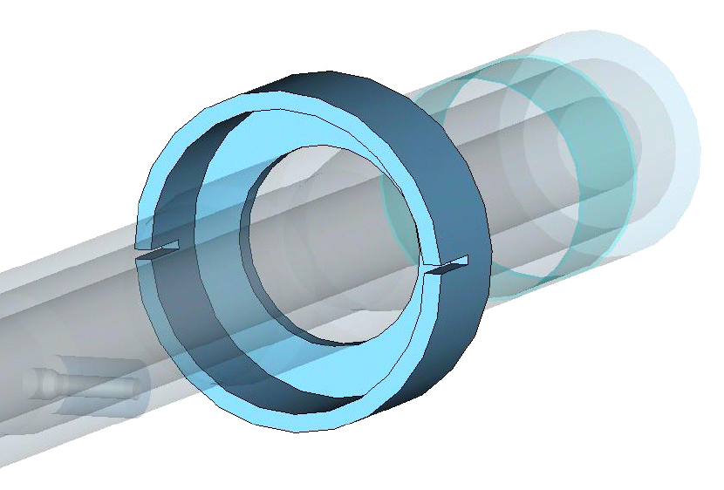
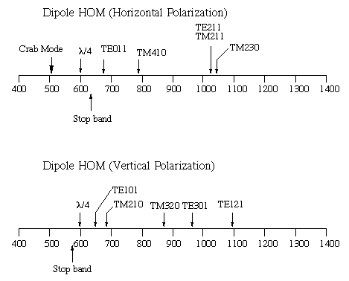
Stop band splitting design of the notch filter
Previous design has a stop band at 630 MHz for TE mode. This band is close to the TE-1/4λ mode.
A stop band splitting notch filter is designed. It has partitions in the mid-plane to separate stop bands for horizontally polarized TE mode (650 MHz) and vertically polarized one (570 MHz).
Partitions
Stop band (H-V splitting)
TEM | 509 MHz
TE(H) | 650 MHz
TE(V) | 570 MHz
Frequency (MHz)
Frequency (MHz)

Slide 23
Rotation of notch filter
Partitions
Mode | 0 deg. | 45 deg. | 90 deg.
l/4-H | 5.24 | 5.32 | 5.36
l/4-V | 4.98 | 5.30 | 5.17
TE101 | 10.3 | 10.1 | 10.8
Rotation of notch filter further decreases the Q factor of the horizontal TE1/4 mode. The Q factor of the TE101 cavity mode does not vary until it hits the stop band of the notch filter at the 90 degrees. The vertical TE1/4 mode has no significant variation. We set the rotation at 60 degrees.
R/Q of these tree modes are almost the same against the rotation.

Slide 24
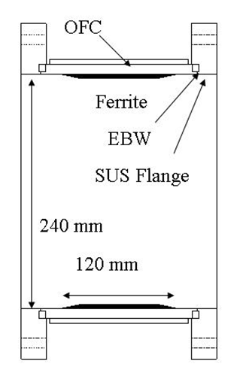
Ferrite HOM damper
RF absorber
Ferrite material
HIP (Hot Isostatic Press) method
  1500 atm, 900℃ for 5h
Size: 240mm^{φ} x 120 mm x 4mm^{t}

Slide 25
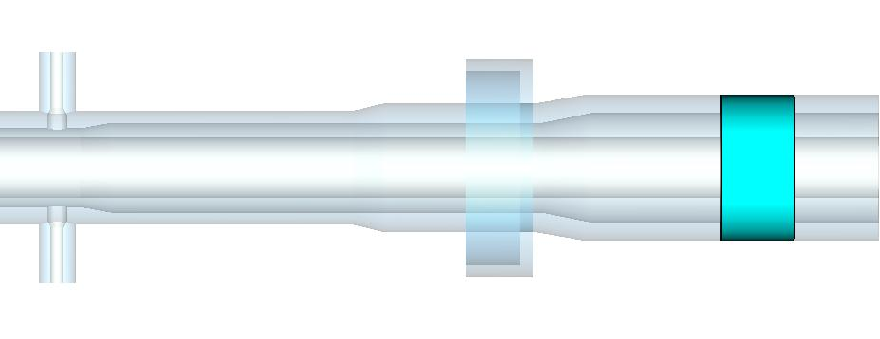
HOM damper position
S
HOM damper
Ferrite RF absorber
Size: 240φ x 120 mm
Position of the damper was optimized for the minimum Q factor of LOM.
Q factor of the TM110 mode (LOM) as a function of damper position.

Slide 26
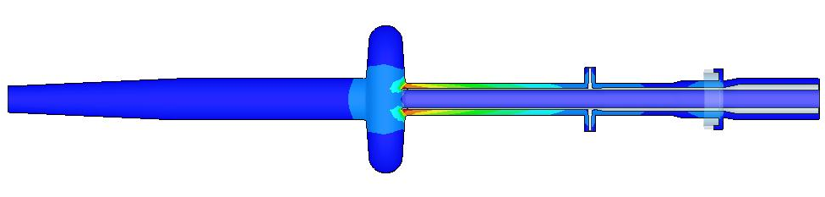
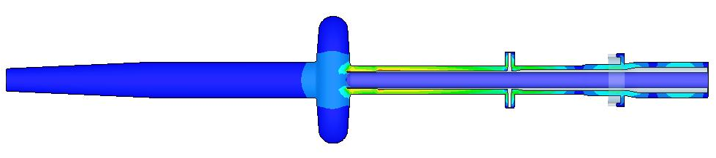
Comparison of TE-1/4λ mode damping
Straight type + previous notch filter
Tapered type + stop band splitting notch
Chosen for KEKB CC
With tip cutting
Type | f | R/Q(MWS) | Q(HFSS)
Straight | 595 MHz | 5.7 Ω | 10⁶
Tapered | 602 MHz | 5.2 Ω | 5800
Tapered + tip cutting | 607 MHz | 2.1 Ω | 2700

Slide 27
Conceptual Design of Cryostat for KEKB Crab Cavity
Top View
Input coupler
Magnetic Shield （ Jacket Type ）
Frequency Tuning
by Adjusting Distance
RF Absorber
RF Absorber
Stub Support
~ 18 kW
~ 8 kW
I.D. 240
Coaxial Coupler
I.D.100
Main He Vessel
Crab Mode Reject Notch Filter
Bellows
Monitor Port
80 K LN2 Radiation Shield
Sub Liq. He Vesse
Jacket-type Helium vessel for the large cavity cell
Jacket type sub-Helium vessel for the stub support to provide cooling of the inner conductor
Large size bellows (188φ） connects both jackets for alignment of the coaxial coupler and frequency tuning

Slide 28
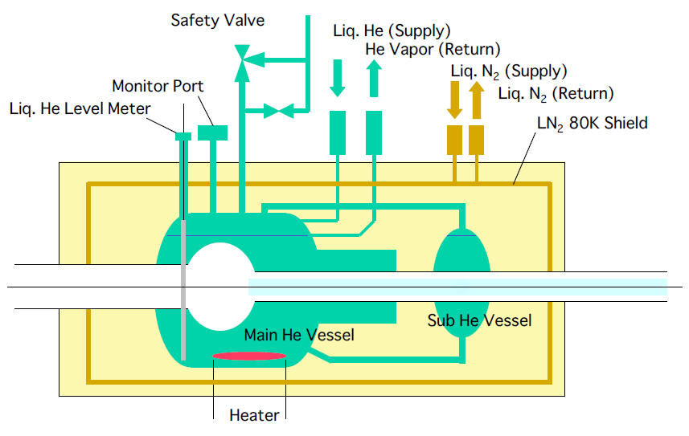
Cell cooling scheme

Slide 29
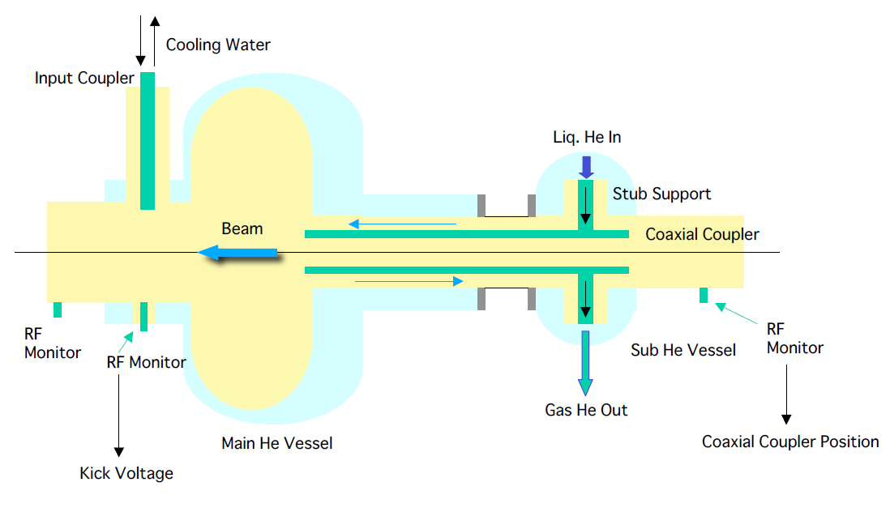
Coaxial coupler cooling scheme

Slide 30
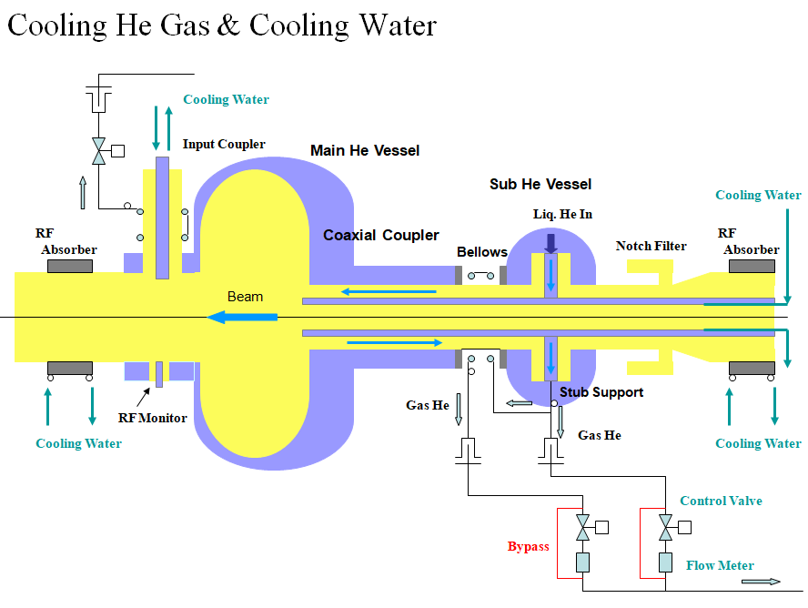
He gas and water cooling

Slide 31
Crab Cavity & Coaxial Coupler in Cryo-module
Support Rod
Jacket Type Main He vessel
SUS316L
Jacket Type Sub He vessel
Support Pipe
Tuning Rod
Input Coupler
Notch Filter
Crab Cavity Cell
RF Absorber
Coaxial Coupler (Nb)
Extract TM₀₁₀, TE₁₁₁ Mode
Frequency Tuning
Stub Support
Bellows

Slide 32
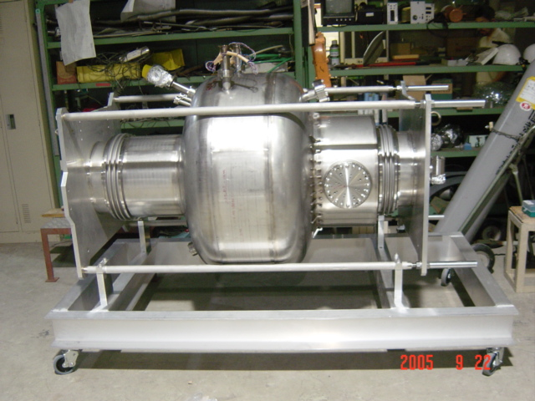
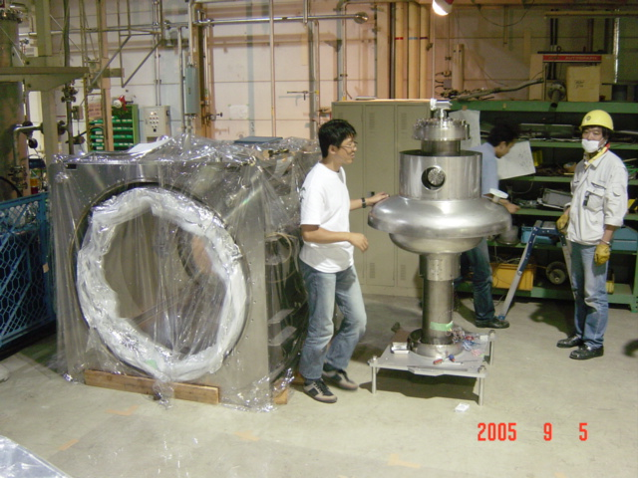
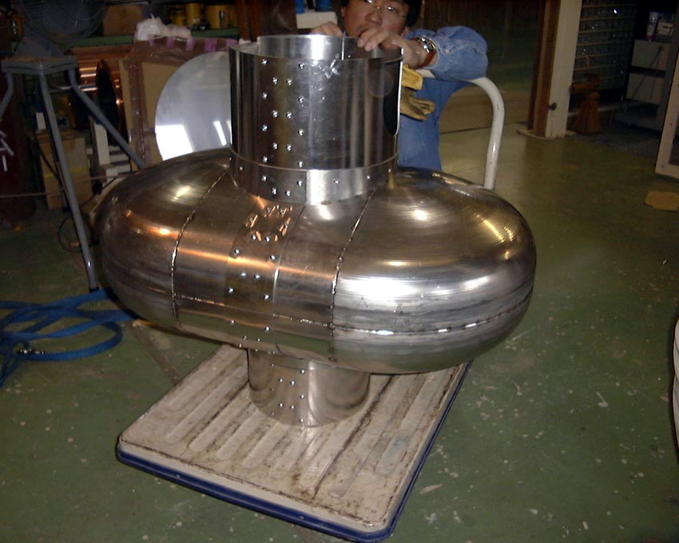
Jacket Type Helium Vessel Prototype
Large Beam Pipe
Input Coupler Port
Jacket Type Helium Vessel
Jacket Type Magnetic Shield
Permalloy 3t

Slide 33
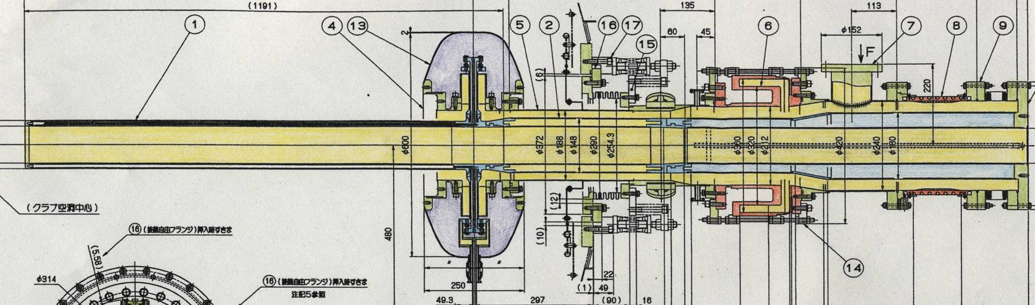
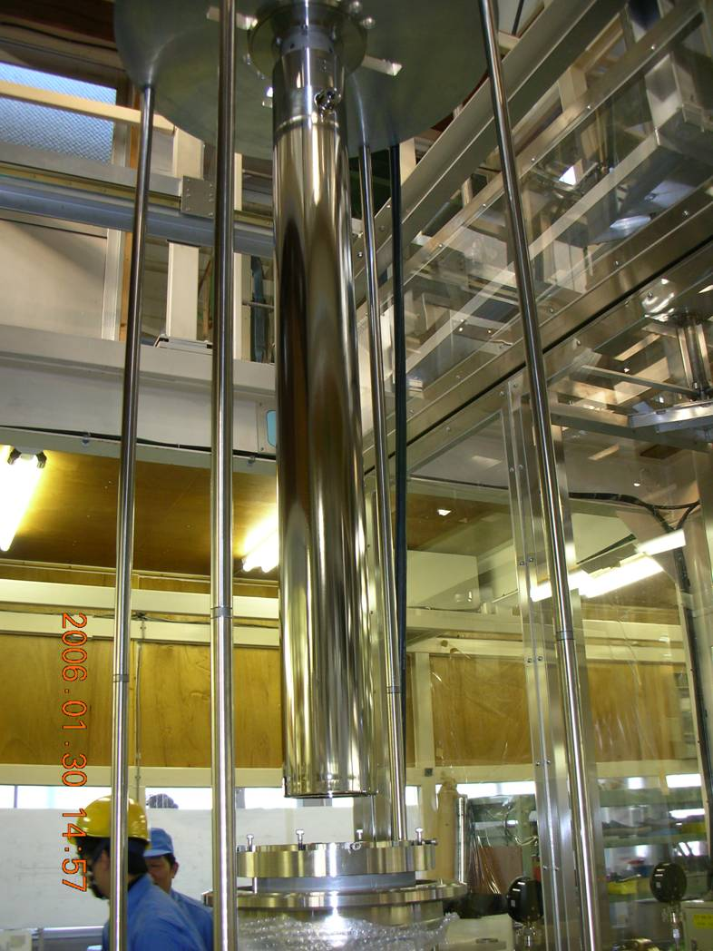
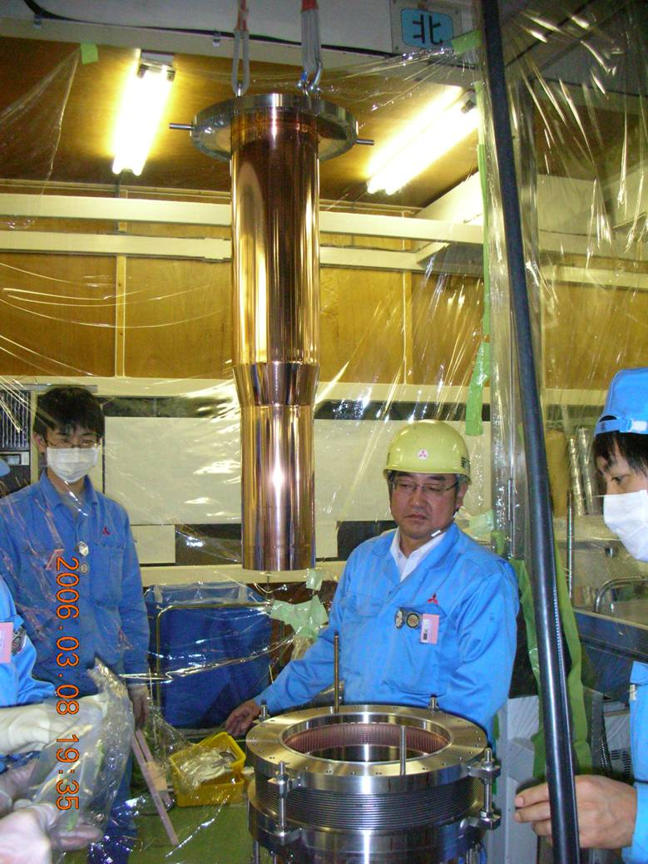
Coaxial coupler assembly
Structure detail
Temporary Mechanical Support
for Assembling
Nb-Coaxial Coupler
Notch Filter
RF Absorber
Cooled by Liq. Helium
Stub Support
B
A
Joint Part
Inner conductor consists of three parts
1 Niobium coupler
2 SS joint conductor
3 SS inner conductor
Nb-Coaxial Coupler
Cooled by Liq. Helium
Copper-plated SS Inner Conductor
Cooled by Water

Slide 34
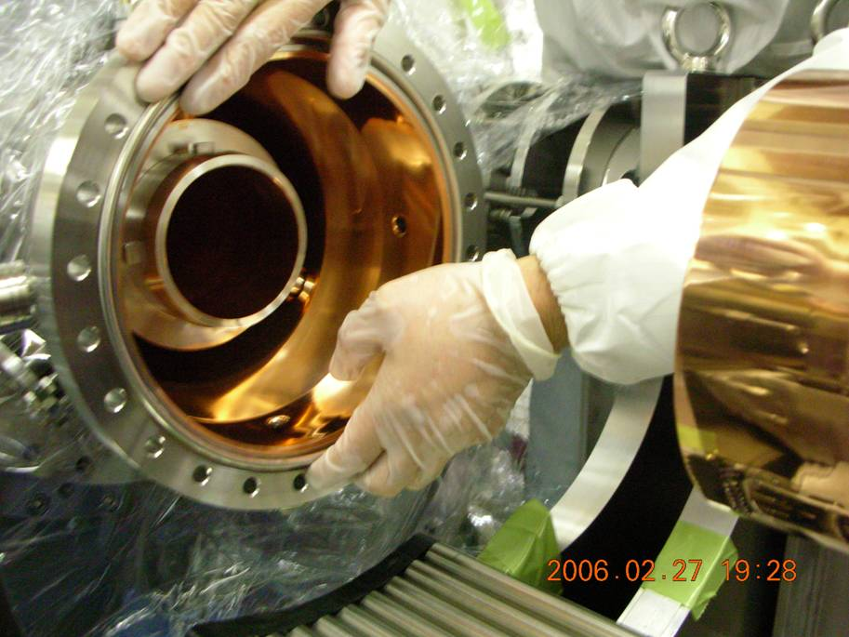
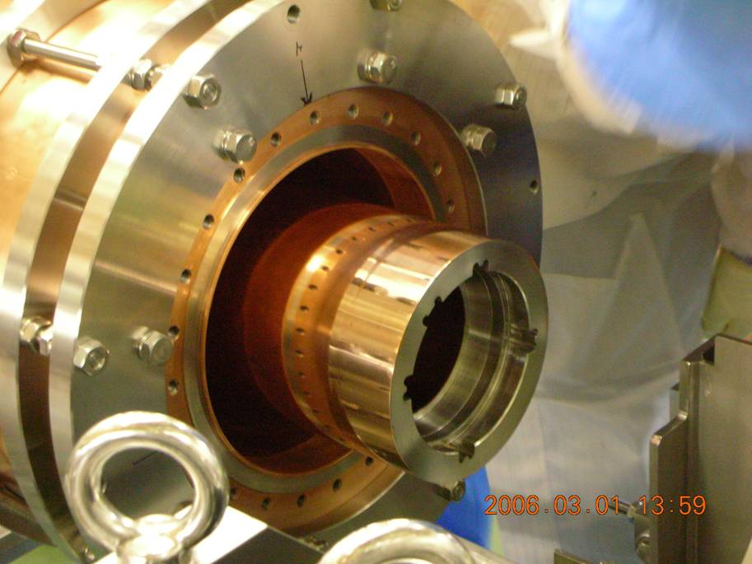
Assembling of Coaxial Coupler
Crab Cavity (Cryostat) Side
Notch Filter Side
Bayonet Type Connection
Step 1 Insert
Step 2 Rotate Clockwise 30 degree

Slide 35
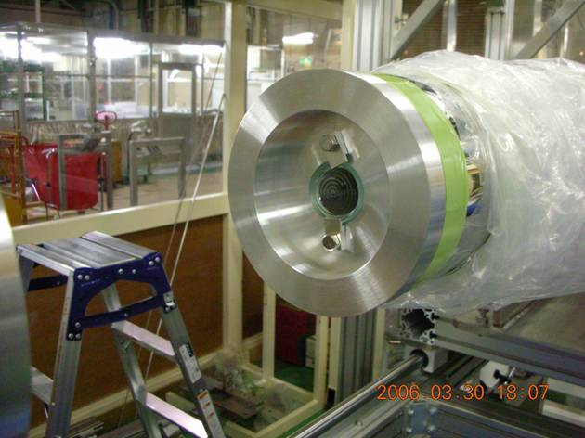
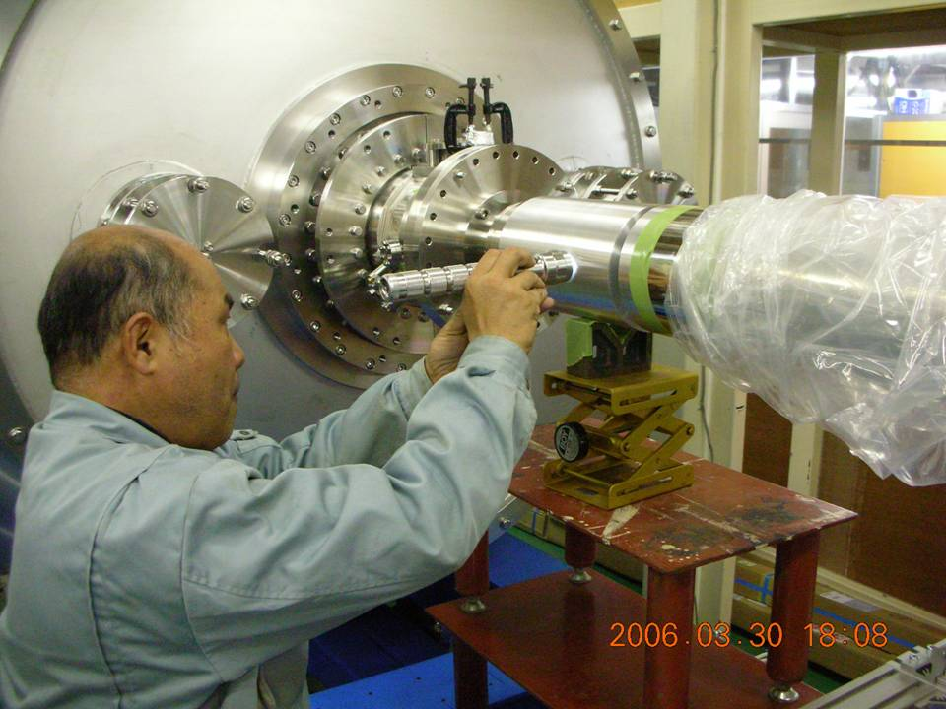
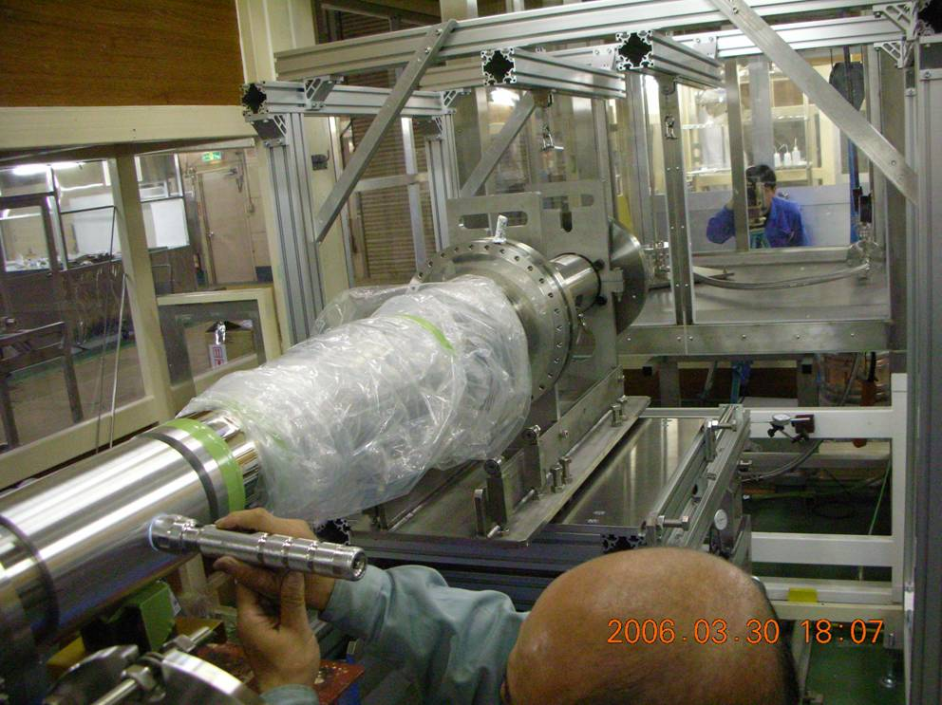
Alignment of Coaxial Coupler
Decide the axis of the coaxial coupler
set in the cryostat by using transit.
Align the axis of the coaxial coupler
which will be connected to the coaxial
coupler of cryostat side.

Slide 36
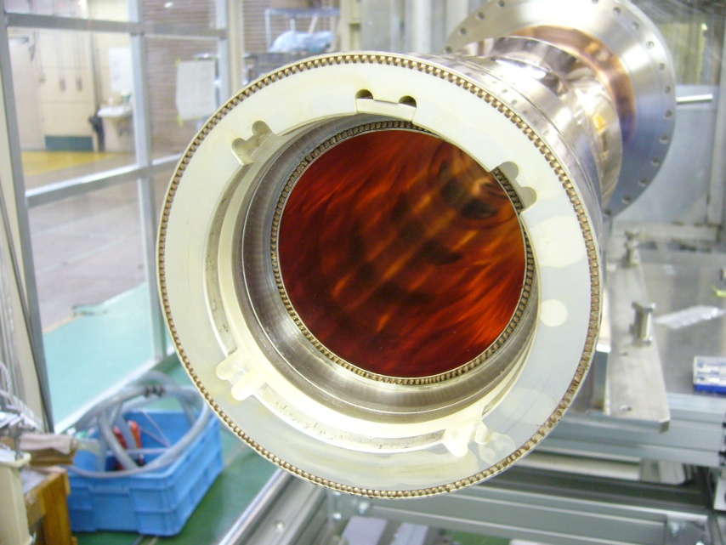
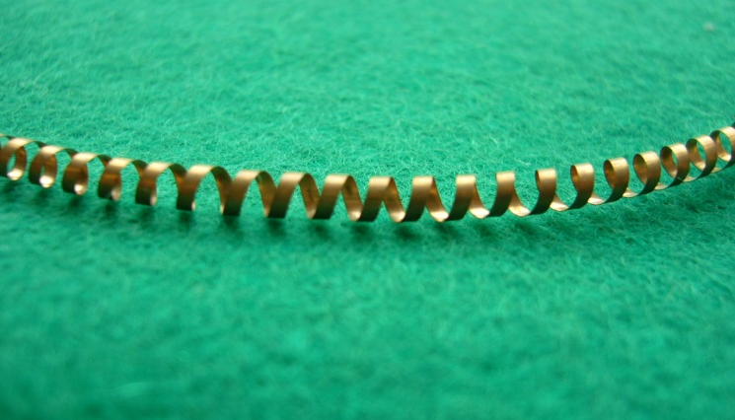
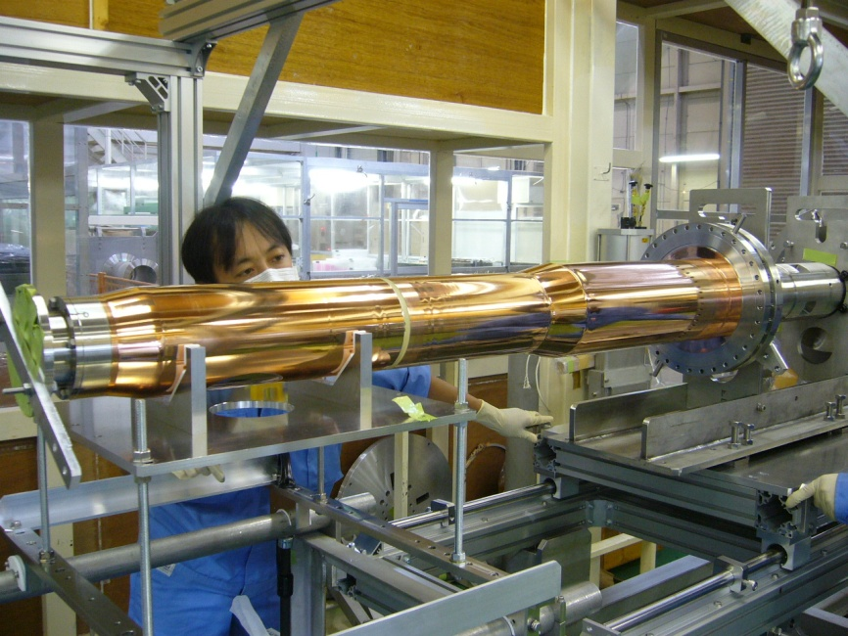
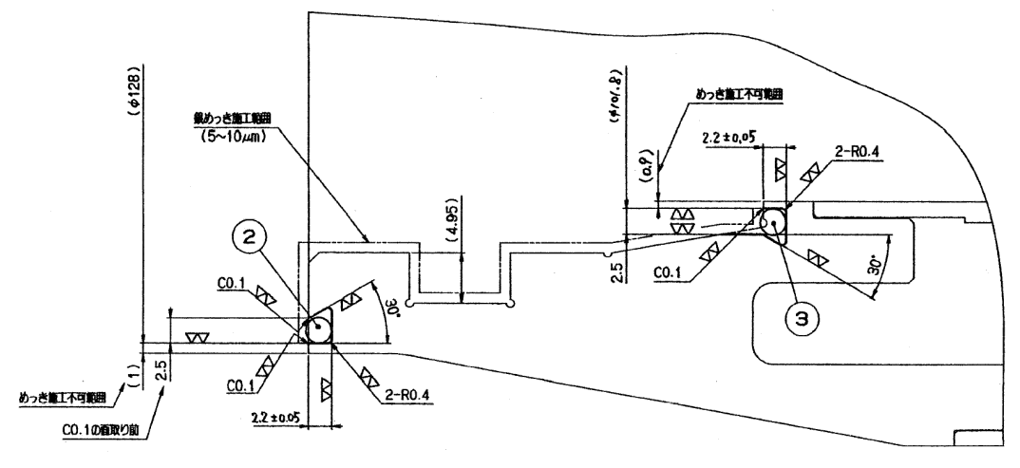
RF Contact
In the joint parts, RF contacts were attached for good electric contact
Type： Spiral
Material： BeCu
Spring Constant： 14kg/φ94mm（0.5kg/cm）

Slide 37
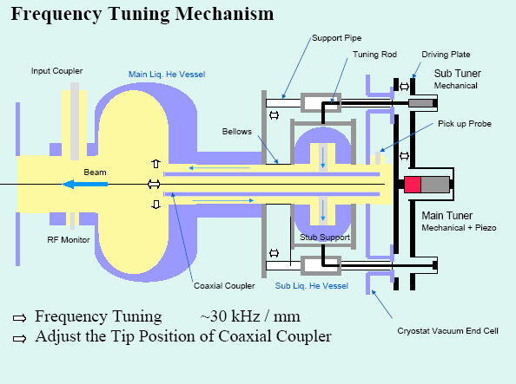
Frequency tuner
Frequency tuner tunes the cavity by the insertion of inner conductor (30kHz/mm)
It consists of main and sub tuners
The main tuner (motor jack and piezo) drive the inner conductor
The sub tuner adjusts its alignment

Slide 38
Frequency Tuner
Support Bolt
Add Expansion Rods!
Base Plate
Driving Plate
Main Tuner
Sub Tuner
Test Stand for Frequency Tuner
Frequency Tuner of Crab Cavity for HER

Slide 39
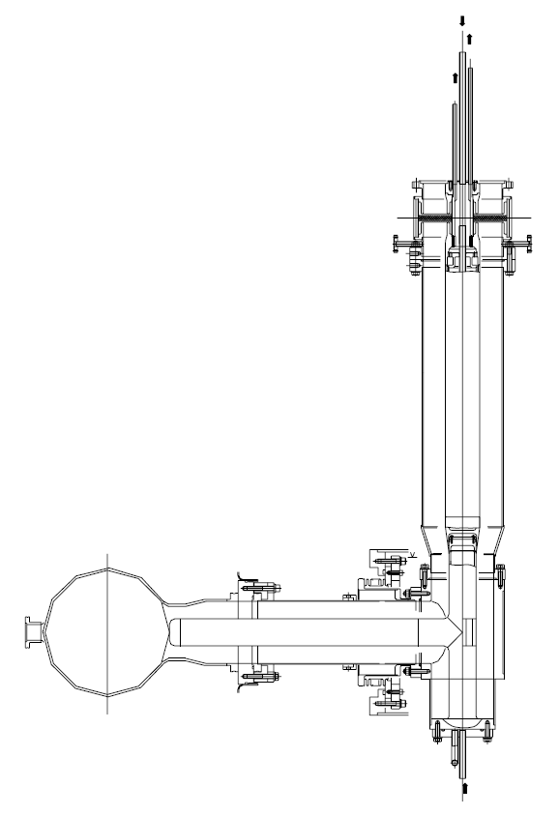
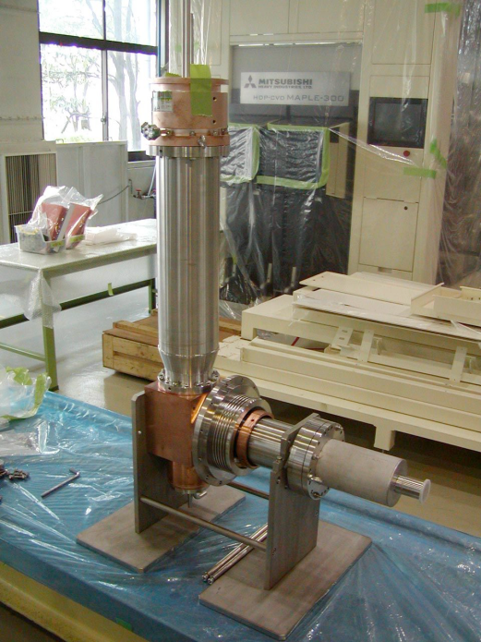
High power coupler
Horizontal insertion
T-Stub structure
  VSWR:1.15 at 509 MHz
Ceramic RF window
Water cooled inner conductor
Monitor ports
  Electron collection probe
  View port for arc sensor
  Vacuum gauge port
Conditioning
  Up to 250kW (TW) before installation
  Up to 200 kW (SW) before cool-down
    Up to 150 kW for LER crab
Typical RF power
  25 kW for LER crab at 0.9 MV
  75 kW for HER crab at 1.5 MV

Slide 40
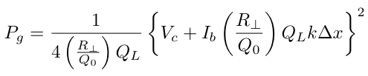
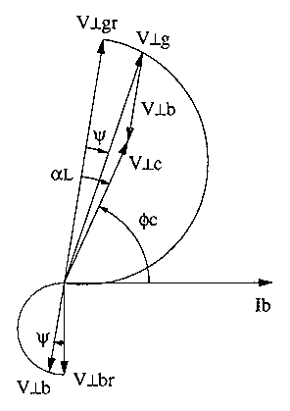

Loaded-Q factor
K. Akai et al, EPAC96, p. 2118.
Generator power
Choice of Q_{L} is important
Maximum Pg~100kW
Fluctuation ΔPg~10kW
Beam-induced crabbing voltage when the beam shifts Δx
Required power to maintain the crabbing voltage.
Beam induced voltage (0.2MV for Ib=2 A, QL=2x105, dx=1 mm)
Not to be sensitive to beam orbit change.
Q_{L}=1-2 x 10⁵ is a good choice.
Q_{L}=1.6x10⁵ (HER)
Q_{L}=2.0x10⁵ (LER)
Phaser diagram for the crabbing mode

Slide 41

High power tests
Mt. Tsukuba
Crab cavity module

Slide 42
High power test
Adjustment of the resonant frequency
Alignment of the coaxial coupler
Optimization of the tuner feedback system
Conditioning of the cavity
Qo measurement
Static loss measurement of the cryostat

Slide 43


High Power Test Stand
Conducted in a pit of a high power test stand
Installed in the pit
He Transfer tubes connected

Slide 44


Cool-down and frequency adjustment of HER crab
Cool-down rate: 2 K/h
1 week
Operating frequency
200 KHz
Frequency shift during cool-down
400 kHz
To the operating frequency,
Cell deformation
100 kHz
Coaxial coupler insertion
100 KHz
400 KHz

Slide 45

Conditioning status of HER crab
1.4 MV
1.8 MV
Degraded
Hi power conditioning
The crabbing voltage increased
1.4 MV reached
Slightly degraded
due to vacuum pressure increase
Warm-up to 85 K and cool-down for evacuation
High poer conditioning again
1.8 MV reached
Warm-up and cool-down
Outgas (H2,CO..)
85 K

Slide 46

Conditioning status of LER crab
1.93 MV
Hi power conditioning
1.93 MV reached

Slide 47


Qo measurement
Horizontal test: 1.8 MV
Q0 of the cavity measured
Conducted by a heat load measurement method of the cryostat
Consistent with the vertical test results
Operation: 1.4 MV
Horizontal test: 1.93 MV
Operation :0.8 MV
Designed: 1.44 MV

Slide 48

Tuner phase
Tuner phase stability
  HER crab: +/-3 deg.
  LER crab: +/-15 deg.
HER tuner operates smoothly
LER tuner has a large backlash
  Two peaks observed
  LLRF compensates this tuner backlash and control the crabbing phase precisely at the beam operation

Slide 49

Two crab cavities installed in KEKB, one for each ring in January 2007
HER (8 GeV electrons)
LER (3.5 GeV positrons)

