Slide 1
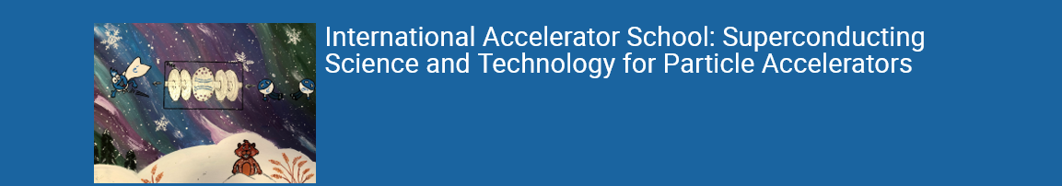



Superconducting Magnets 1
GianLuca Sabbi
Lawrence Berkeley National Laboratory
IAS 2023
July 16-17, 2023

Slide 2
Introduction
Superconducting Accelerator Magnet development is a very broad subject combining different disciplines from material science to magnetics, mechanical engineering, cryogenics, power electronics and related instrumentation and diagnostics
This short overview will focus on those aspects that are of more direct relevance to accelerator design, and less on magnet engineering details
Reference to more extensive courses and literature are provided (next slide)
We will also try to minimize overlap with other classes at the IAS:
  Basics of Superconductivity
    Type II Superconductors: critical fields and flux pinning
  Accelerator Physics Primer
    Field errors and their effect on the beam
  Linear Optics – Magnets
    Magnetic Design: Coil and iron yoke contributions, End fields
    Quench process
  Cryostat Technology for Accelerators

Slide 3
References
US Courses:
USPAS 2015: Superconducting Magnets for Particle Accelerators (P. Ferracin, S. Prestemon, E. Todesco) https://indico.cern.ch/event/440690/?view=nicecompact
USPAS 2022: Superconducting Accelerator Magnets (P. Ferracin, S. M. Marchevsky, Prestemon, E. Todesco) https://conferences.lbl.gov/event/979/
CERN Courses:
John Adams Institute Accelerator Courses: Magnet Design (A. Milanese): https://indico.cern.ch/event/1101643
Masterclass - Design of superconducting magnets for particle accelerators (E. Todesco) https://indico.cern.ch/category/12408/
CERN Summer Student Lectures 2023: Accelerator Technology Challenges – Magnet Design (S. Izquierdo Bermudez) https://indico.cern.ch/event/1254879/
Upcoming! (November 2023): CAS School on Normal and Superconducting Magnets, St. Polten, Austria, https://indico.cern.ch/event/1227234/
Books: from classics to more recent publications
Martin N. Wilson, "Superconducting Magnets“ (1983)
Fred M. Asner, "High Field Superconducting Magnets“ (1999)
K.-H. Mess, P. Schmuser, S. Wolff, “Superconducting accelerator magnets” (1996)
S. Russenschuck, “Field computation for accelerator magnets” (2010)
D. Schoerling and A. V. Zlobin, “ Nb₃Sn Accelerator Magnets” (2019)

Slide 4
Presentation Outline
Part 1: fundamentals of superconducting accelerator magnet design
Superconducting Accelerator Magnet Overview
Practical Superconductors for Accelerator Magnets
Wire and Cable Design
Magnetic Design, margin and training
Coil forces and stress
Quench Protection
Part 2: advanced technologies and applications
Recent progress in superconducting accelerator magnet development
  Selected topics and highlights in magnet design and fabrication
Special Accelerator magnets
Benefits of accelerator magnet development to broader applications in science, medicine and industry

Slide 5
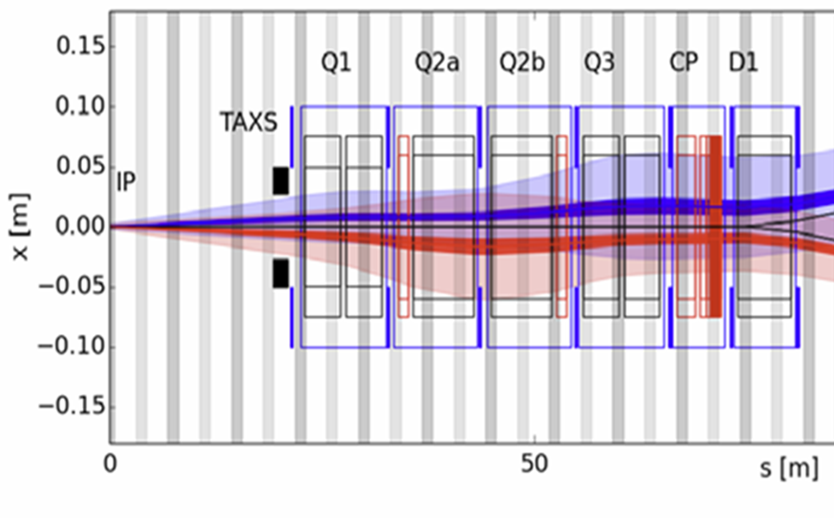
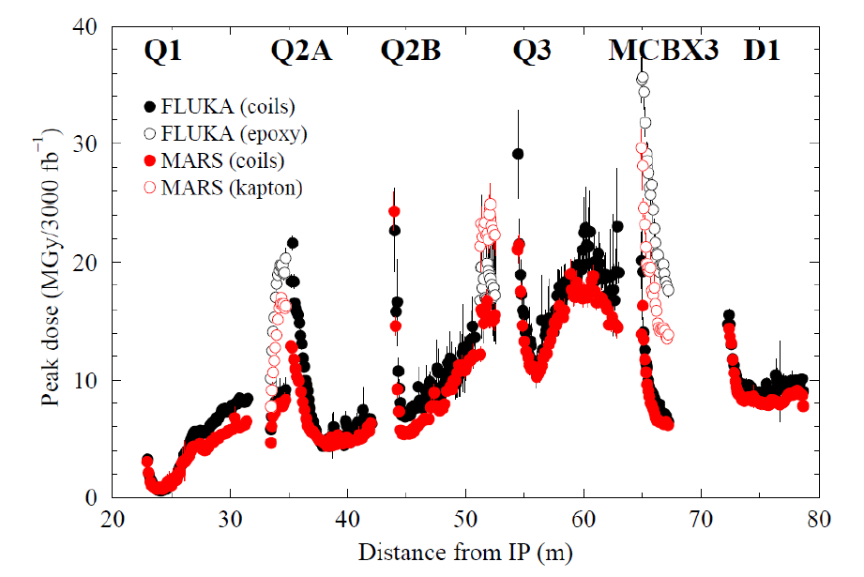
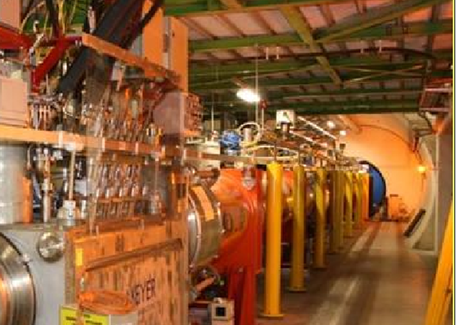
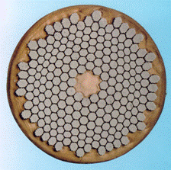
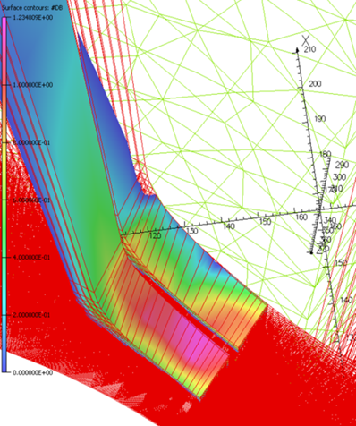
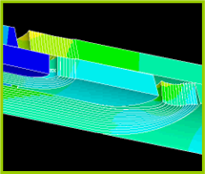
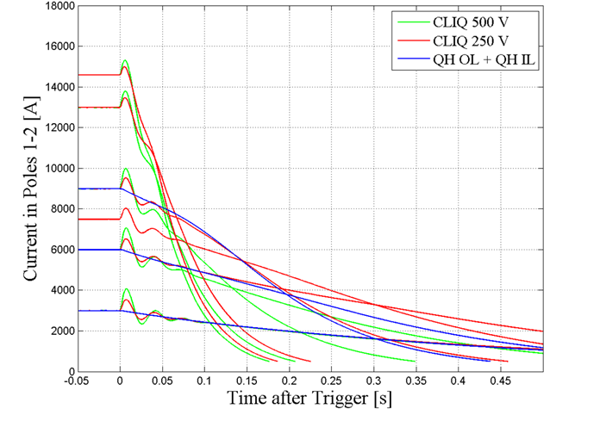
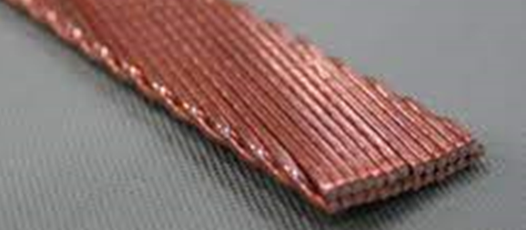
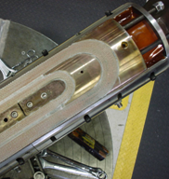
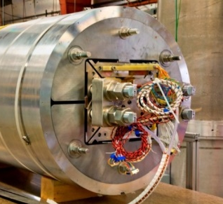
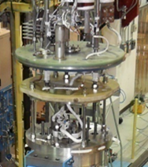
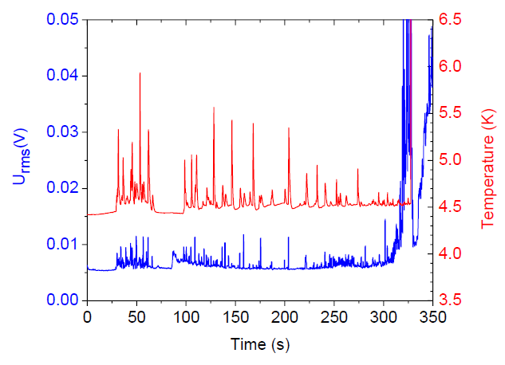
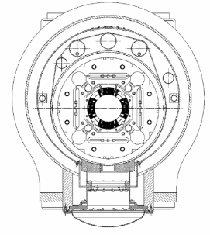
Accelerator Magnet Development Overview
Accelerator Requirements and Constraints
Aperture and Field (integral)
Dynamic Aperture
Radiation Dose and Heating
Space, Infrastructure, Transport
Conceptual Design and Analysis
Material properties
Wire and cable
Magnetic Analysis
Mechanical Analysis
Quench Protection
Engineering Design, Fabrication, Testing and Integration
Coil Fabrication
Structure and Assembly
Cryogenic Testing
Instrumentation
Cryostat Design

Slide 6
Practical Superconductors: Critical Surface
Operating space of practical
Low-Temperature Superconductors (LTS)
for magnet applications
Niobium-Titanium (NbTi)
Ductile alloy
Upper critical field (B_{C2}): ~15T
Critical Temperature (T_{c}): ~10K
Used in most projects to date
Niobium-Tin (Nb₃Sn)
Brittle and strain sensitive
Upper critical field (B_{C2}): ~28T
Critical Temperature (T_{c}): ~18K
In production for HL-LHC
High Temperature Superconductors
MgB2, Bi-2212, YBCO
Great potential with significant technology challenges

Slide 7
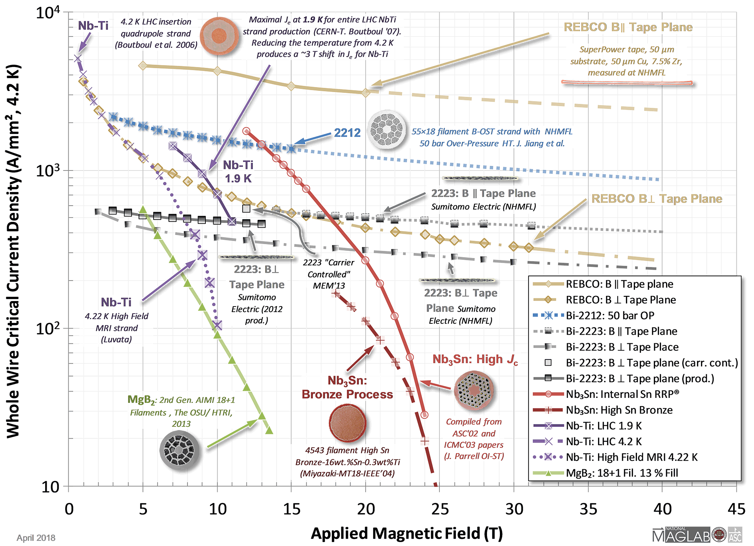
Conductor Properties and Design Space
Credit: Peter Lee
Applied Superconductivity
Center, FSU/NHMFL
1kA/mm²

Slide 8
Conductor Technologies
Material | NbTi | Nb₃Sn (Nb₃Al) | Bi-2212 | YBCO
Max Field | 10-11 T | 16-17 T | Stress limited | Stress limited
Reaction | Ductile | ~675⁰C in Air/Vacuum | ~890⁰C in O₂ (±2⁰C) | None
Wire axial compression | N/A | Reversible | Irreversible? | Reversible
Transverse stress | N/A | < 200 MPa | 60 MPa? | > 150 MPa
Insulation | All | S/E Glass | Ceramic | All
Construction | G-10, stainless... | Bronze/Titanium, Stainless | Super alloy | All
Quench propagation | >20m/s | ~20 m/s | ~0.05 m/s? (4.2 K, 8 T) | ~0.01 m/s? (4.2 K, self-field)

Slide 9
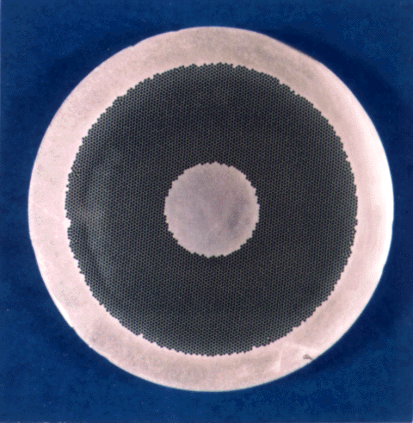
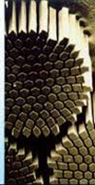
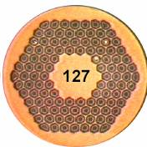
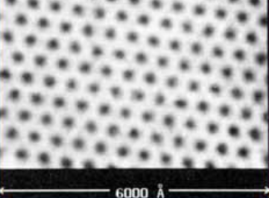
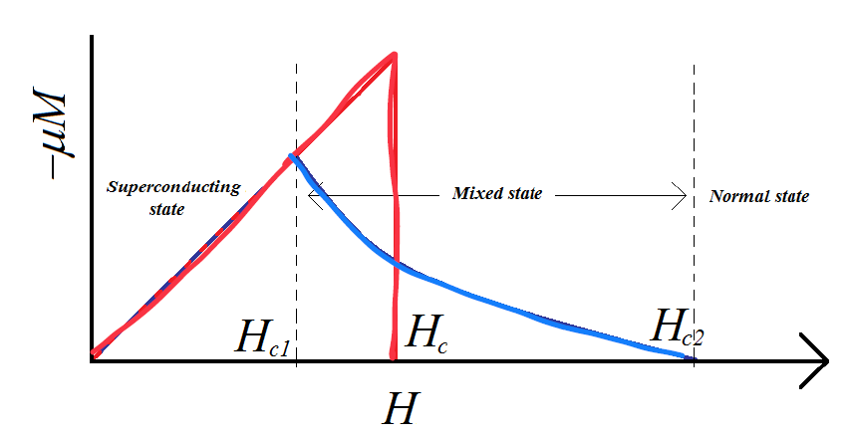
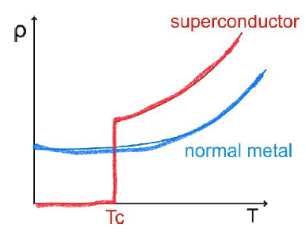
Superconducting Wire Architecture
The basic building block of an accelerator magnet is the superconducting wire
Typical diameters in the range of 0.5-1.5 mm and continuous uniform lengths of 1-20 km
Designed as a matrix of thin superconducting filaments embedded in pure copper
NbTi (LHC MB)
Nb₃Sn (LARP HQ)
Main drivers of the multi-filamentary wire architecture
Flux pinning
Magnetization effects
Quench Protection
Instabilities due to redistribution of flux vortices (“flux-jumps”) limit the current that can be carried as a unit
Field errors due to internal shielding “persistent” currents proportional to the SC filament diameter
During a quench, the copper matrix (briefly) provides a low resistance path for the magnet current

Slide 10
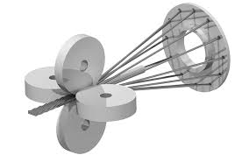
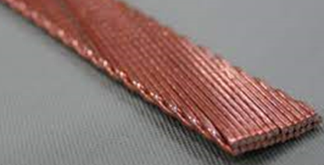
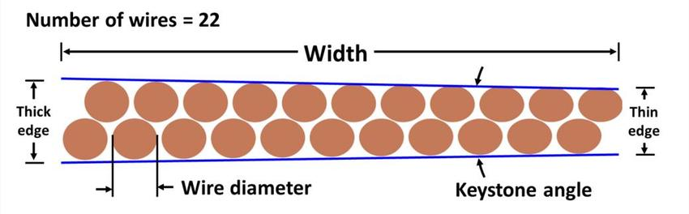
Rutherford Cables
Rutherford cables address several fundamental (and conflicting) magnet requirements:
Provide high current-carrying capability (up to 10-20 kA) to limit magnet inductance and related voltages, in particular during a fast discharge in case of a quench (<1kV)
…while retaining sufficient flexibility and mechanical stability for coil winding
…and high compaction (~90%) with low J_{c} degradation for high coil-pack current densities
…and precise geometry (~10 μm) for accurate coil field quality and stress control
…and control of dynamic effects during a current ramp (strands are twisted and transposed)
They also offer some important practical advantages:
Rectangular (or trapezoidal) shape provides effective management of coil internal forces/stress
Large number of wires (strands) lower the continuous length required in wire production
Capability to achieve a range of conductor characteristics from a given strand design

Slide 11
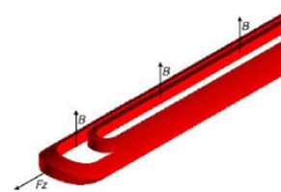
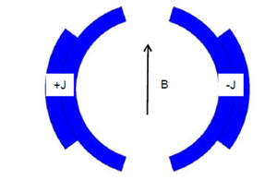
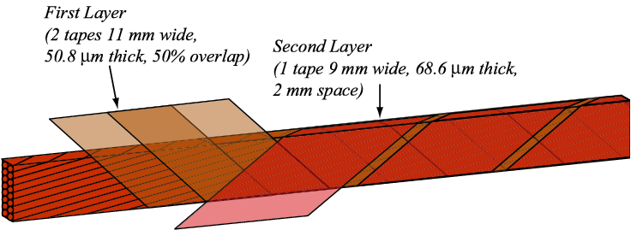
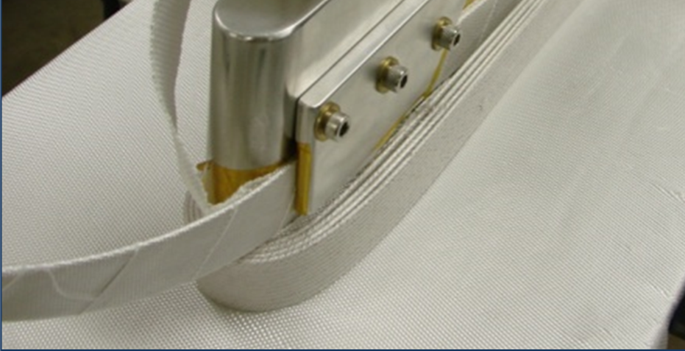
Superconducting Coils
Typical accelerator coils windings have a long (1-15 m) straight section generating a transverse field, and two short end sections to complete each turn and transition to the next one
Electrical insulation is paramount. Each turn is electrically insulated. Additional insulation is placed between coil layers, and around the entire coil to prevent shorts to the structure
Polyimide tape insulation scheme used in LHC magnets (NbTi)
Fiberglass braid/sleeve used in Nb3Sn magnets
Extra tape around pole
Extra sheet
(coil to structure)
The effective current density is averaged across superconductor, copper stabilizer, internal components (wedges and spacers) and electrical insulation
About 2 orders of magnitude higher than can be achieved in normal conducting coils

Slide 12
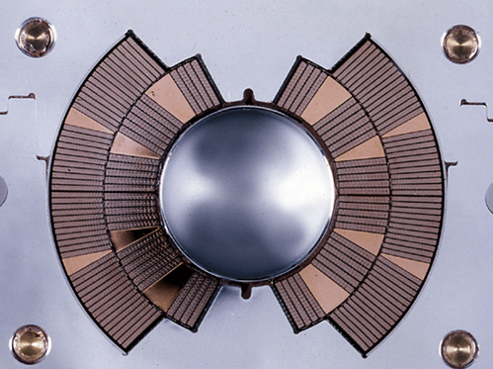
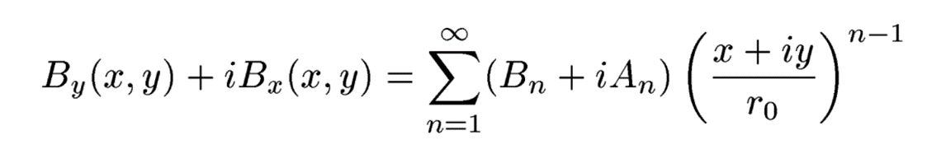
Shell-type coil design
Basic concept: approximate a cos(nθ) current distribution around the aperture
For n=1: j(θ)=j₀cosθ generates a perfect dipole; n=2 generates a quadrupole etc.
In practice, this current distribution is approximated using spacers (wedges) between turns, optimized to reduce deviations from the prescribed field
In the magnet straight section, the 2D field can be expressed as a series of harmonics (already described in the “linear optics – magnets” presentation):

Slide 13
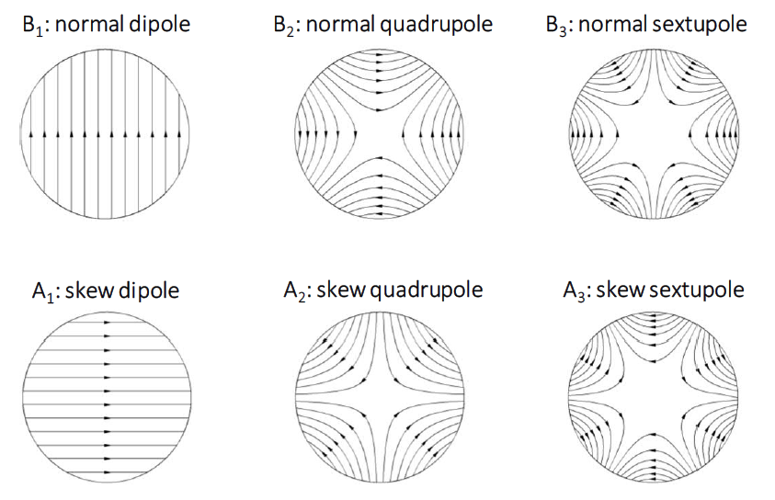
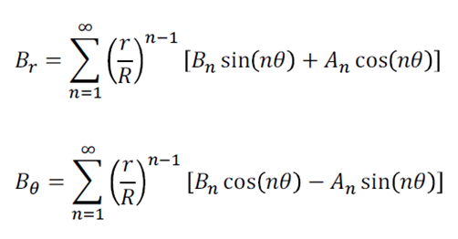
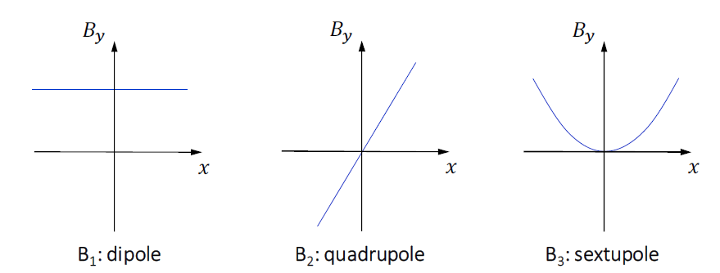
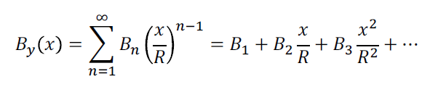
Field Patterns from Harmonic Terms
1. Flux Lines
2. Field profile in the horizontal plane

Slide 14
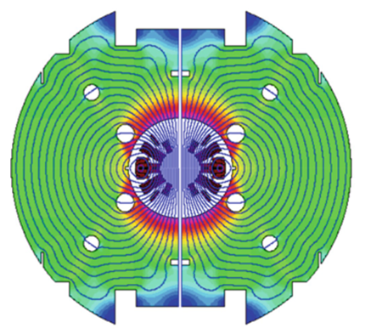
Iron Yoke
The superconducting coil is usually surrounded by an iron yoke made of ferromagnetic steel
The iron yoke performs several essential functions:
Contribute to the field in the aperture. For a circular yoke that is not saturated (<2T) this contribution is linear and can be calculated with the “image currents” method
  If the yoke is saturated (>2T) non-linear field errors are generated as a function of current: need to optimize geometry to minimize or balance these effects
Return the magnetic flux, limiting fringe field and coupling with surrounding elements
  For a dipole, the required iron thickness is ~B/2 times the aperture radius
The yoke is often used as an integral component of the mechanical structure

Slide 15
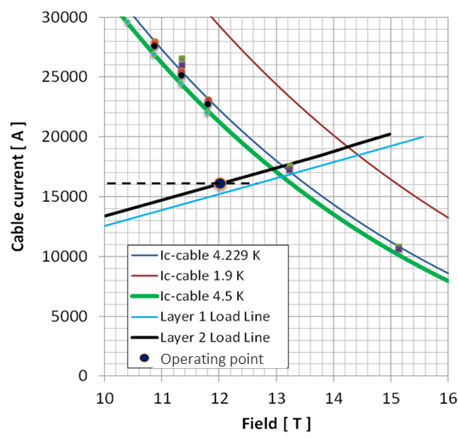
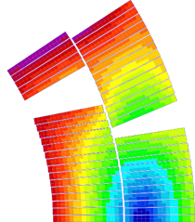
Coil Field and Margin to Quench
In order to maintain its superconducting state, the conductor must operate within the envelope defined by its critical surface
Assuming that the temperature is set by the cryogenic system, as the magnet is energized, current density and field increase along the so-called “load line”
The operating point along the load line is defined as the fraction of the operating current to the critical current, usually below 80-85% to provide sufficient margin
Strand Ic measurements (4.2K)
Critical current scaling (1.9K)
Coil peak field vs. current (layer 1, 2)

Slide 16
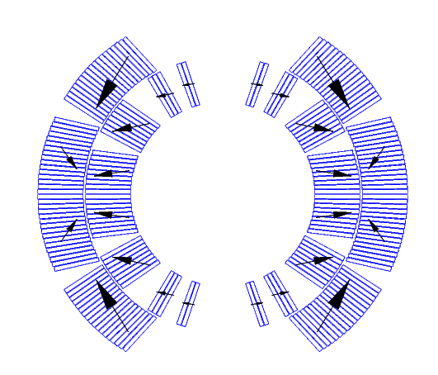
Coil Forces and Stress
The combination of high field and current results in large electromagnetic forces acting on the superconducting coil as the magnet is energized
Accumulated force is of the order of 100s of tons/m pointing outward
  Radial force is linear with aperture and quadratic with field
  Axial force scales with the square of both aperture and field
Corresponding coil stress can reach 100-150 MPa (MN/m²) which can cause insulation damage and conductor degradation
Any slippage under friction will release thermal energy causing a quench
Mechanical design approach: pre-compress the coil before energization
Electromagnetic force pattern in a dipole magnet

Slide 17
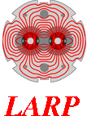
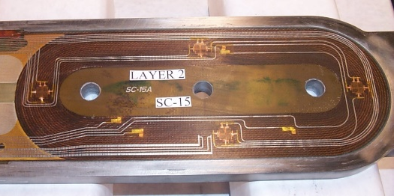
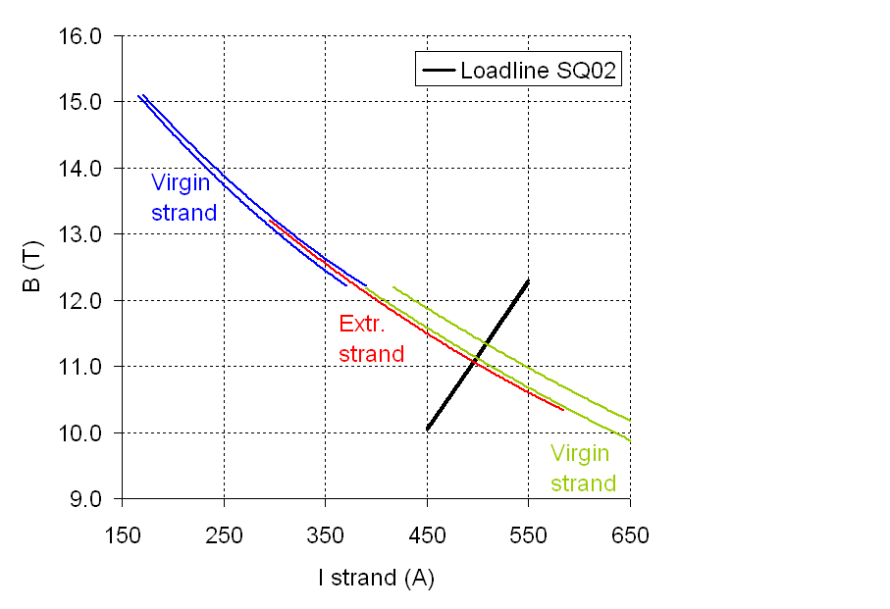
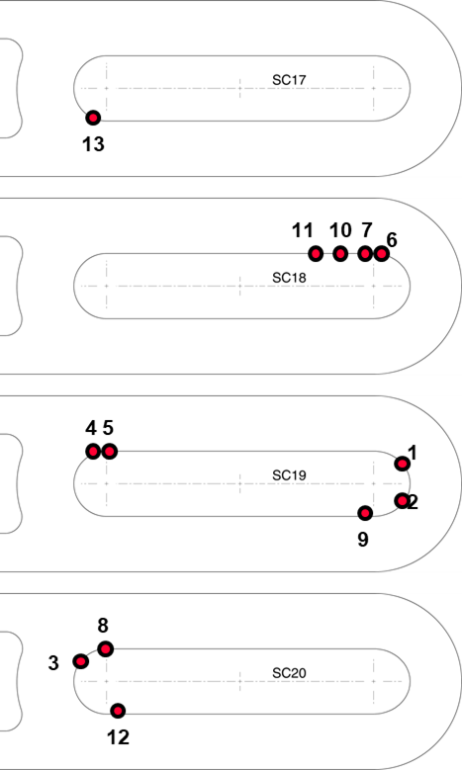
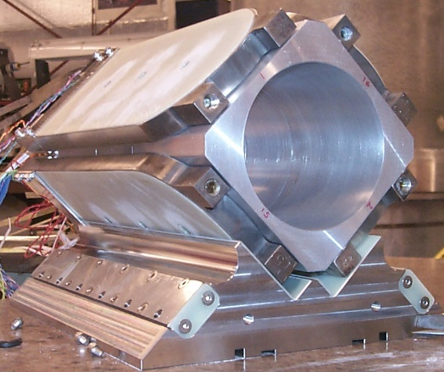
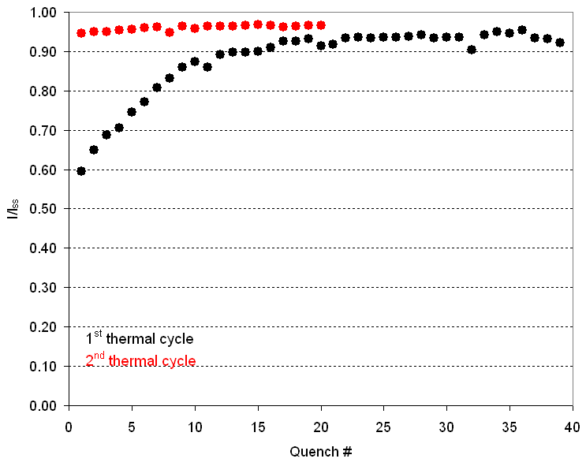
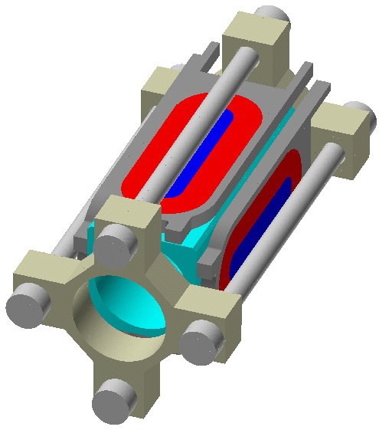
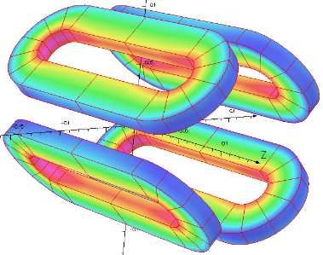
Quench Training: LARP SQ Test
Q1-Q13
P. Ferracin et al., LBNL

Slide 18
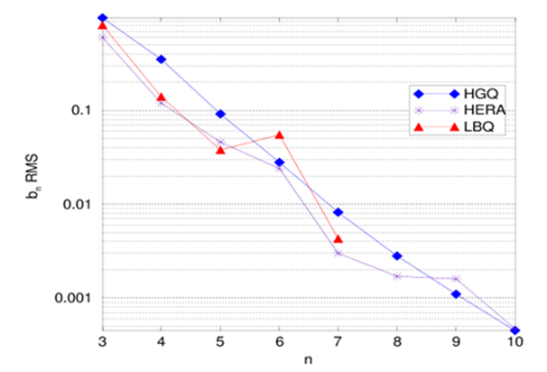
Geometric Field Quality
Design errors:
Caused by deviations from the ideal current distribution
Only a subset of harmonic components are “allowed” by symmetry
Need to balance field quality against complexity (e.g. number of wedges)
Fabrication errors:
Effect of fabrication tolerances can be estimated by Monte Carlo simulations
Conductor positioning within ±50 μm is usually achieved in cosθ magnet production
Larger errors may be expected for first (only) units or other design/fabrication methods

Slide 19
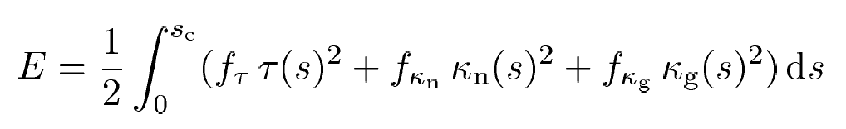
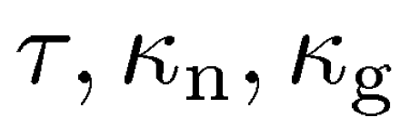
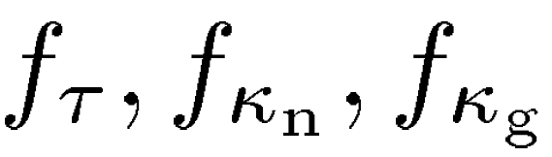


Coil End Optimization: Winding Pattern
End windings often require the bending patterns at the limit of the cable mechanical stability:
Individual strands raising above the cable surface cause potential damage and electrical shorts
If the cable completely loses its shape (“roping”) it may result in loss of the entire unit length
Main objective of the mechanical optimization is minimizing the cable strain energy function:
are the curvatures (torsion, normal and geodesic) to be optimized along the cable length s
are the mechanical properties (flexural rigidities) for the specific cable parameters
J. Cook, ANL; R. Bossert, J. Brandt (FNAL)

Slide 20


Coil End Optimization: Field Quality
Integrated harmonics can be corrected with spacers but total magnet length will increase
For higher order harmonics, need to split blocks
Feedback from AP will provide guidance

Slide 21




Coil End Optimization: Peak Field
Coil field may increase by 10-20% in the ends
Can be offset by reducing or eliminate iron yoke over the ends, but this can affect the mechanical performance and increase the fringe field
Additional margin from increased block spacing or splitting blocks

Slide 22
Quench Protection
A quench occurs when a portion of the coil transitions to the normal conducting state due to local degradation or heat release (conductor motion under forces, radiation etc.)
The magnet stored energy is quickly dissipated in the resistive area, leading to temperature and pressure increase, current variations, resistive/inductive voltage, thermal/EM forces
Natural propagation of the resistive area is generally too slow to distribute the energy over a sufficiently large volume to avoid damage
Therefore, quench propagation needs to be accelerated by heating the coil and/or the magnet has to be quickly discharged into an external dump

Slide 23




Advanced Protection Techniques
More effective protection can broaden the design space in critical areas:
  Reducing the copper fraction from 60% to 40% equals a 50% increase of J_{c}
  Increasing limits on stored energy density leads to more efficient designs
  Limits on the inductance may constrain the cable design to sub-optimal choices, or even eliminate design approaches requiring smaller cables
Balancing quench heater efficiency vs. electrical integrity has proven problematic
The “Coupling Loss Induced Quench” (CLIQ) system developed by CERN is having a transformative impact on design options: take full advantage of this opportunity
CLIQ concept
CLIQ-induced currents
HQ: CLIQ vs Heaters
E. Ravaioli et al., CERN

Slide 24

Summary: Accelerator Magnet Design
Main drivers: address stringent beam physics requirements and minimize cost
Technical requirements:
Aperture
Field quality (geometric, saturation, persistent currents, eddy currents)
Mechanical support
Quench protection
Efficiency/cost requirements:
Limit power consumption – use SC magnets
Minimize conductor & structure cost/size
Powering of many magnets in series
Achieve high operational field
Lifetime under radiation load
Fabrication in (very) Long Lengths
LHC
Selection of magnet layout and accelerator parameters is closely coupled (e.g. optimal coil layout depends on required aperture and field quality)
Magnet R&D goal is to inform the overall accelerator optimization process
  Initial design simplifications for fast feedback on fundamental issues
  But eventually, all accelerator quality issues need to be addressed

