Slide 1
Basic crab cavities
ISA2003
20230716
Yoshiyuki Morita
KEK

Slide 2
Basic crab cavities
Luminosity of the collider accelerators and related topics
RF cavities and parameters
Pill box type crab cavities, mainly developed for KEKB
Compact crab cavities, mainly developed for LHC

Slide 3
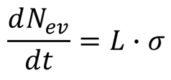
Colliding beams
We consider the luminosity of collider accelerators
Luminosity is one of the most important parameters
Number of physics interactions (events) per second = L x σ
L: Luminosity
σ: Cross section
L has to be increased to obtain high event rate
Particle bunch: N+
Particle bunch: N-
Collision

Slide 4
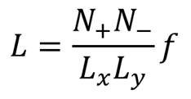
Luminosity
N+
Ly
N-
σ
S
Calculate luminosity
Head on collision
Flat beams with uniform distribution
# of events for a particle with a cross section of σ
# of events for N+ particles
If those collisions occur f times per second
Luminosity for flat beams
Lx
Lz

Slide 5
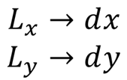
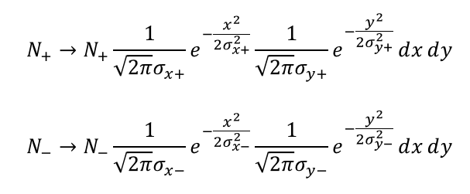
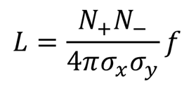
Luminosity
σy
σx
dy
dx
In case of Gaussian distribution we have to modify the previous equation
Same σx, σy for both beams

Slide 6
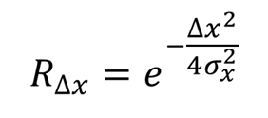
Luminosity
σy
σx
dy
dx
In case of Gaussian distribution
Same σx, σy
But the other beam has offset Δx
Reduction factor

Slide 7
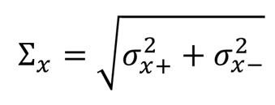
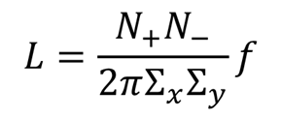
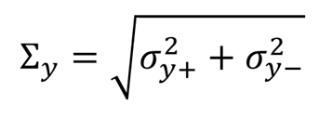
Luminosity
σy
σx
dy
dx
In case of Gaussian distribution
Different σx, σy
Define Σx and Σy

Slide 8
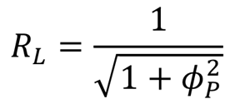
Finite angle crossing
To increase luminosity
Increase beam bunches
When bunches increased parasitic collisions occur
To avoid parasitic collisions
Beam crossing with finite angle: θc
Make beam separation simple
Reduction of luminosity
Geometrical reduction factor R_{L}
May introduce coupling between synchrotorn and betatron oscillations in circular colliders
Parasitic
collision
Interaction
point
Piwinski angle

Slide 9
Crab crossing
Kickback
Kickback
Bunch rotation at the IP
Horizontal kick at the bunch head
Horizontal kick at the bunch tail but opposite direction
No kick at the bunch center
Bunch rotates so that it collides head-on at IP
Crab crossing
Crab cavity kick the bunch with a phase advance of π/2
Another crab cavity kicks back the bunch after IP
Head-on
Crab kick
Crab kick

Slide 10
Required kick voltage
Kick voltage given to the bunch head
L: length from the bunch center
c: speed of light
ΔV: kick voltage
No kick to the bunch center
Same kick voltage to the bunch tail, but opposite direction
Δt=L/c

Slide 11
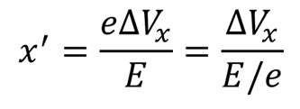
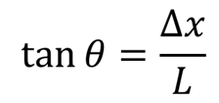
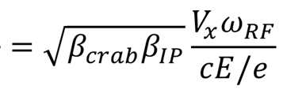
Required kick voltage
Kick angle, x’
Offset at the IP
m12: transfer matrix component of the betatron oscillation
Δφ: phase advance (sinΔφ=1)
Bunch rotation angle at the IP
Half crossing angle
Required kick voltage
X’
eΔVx
E
Δx

Slide 12
Single crab cavity scheme
One crab cavity in the ring
The beam wiggles in the whole ring
Cavity location can be chosen any where in the ring
near the existing cryogenic facility
KEKB applied this scheme
Two crab cavities fabricated and installed in the HER and LER ring
The location is 1 km away from the IP, where a cryogenic facility was operating for the SRF accelerating cavities
Great cost reduction
Crab kick
at IP
Kickback
Wiggling if no kickback

Slide 13
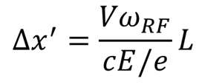
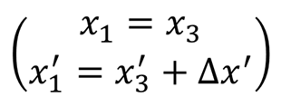
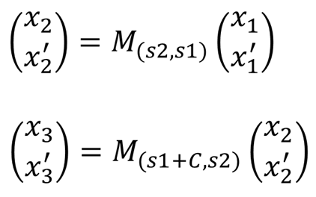
Required kick voltage in single crab scheme
Bunch head
Crab kick
IP
Wiggling in the ring
Coordinate transformation
Bunch rotation angle at IP
Transfer matrix
Phase advance in the ring: ψc~π
Phase advance at the crab: ψ21=π/2

Slide 14
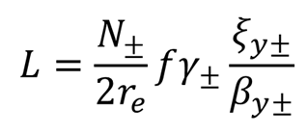
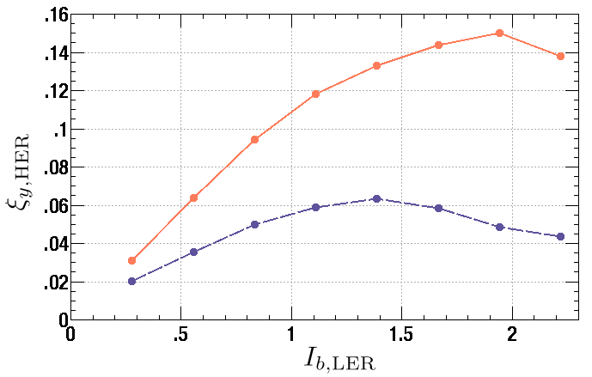
Beam-beam parameter
Beam-beam kick
Electromagnetic force of electrons kicks positrons
Kicking force is approximately proportional to the distance from the center
Tune shift
This force is like a quadrupole magnet
Tune shifts due to this kick
Δμ: ξ parameter
Beam-beam parameter
Beam-beam limit
If we increase N, σ increases
Beam-beam parameter has a limit
Bean-bean limit
Luminosity has a limit
Beam-beam simulation predicted ξ could be increased more than twice in the crab crossing
r_{e}: Classical electron radius
γ: Lorentz factor

Slide 15
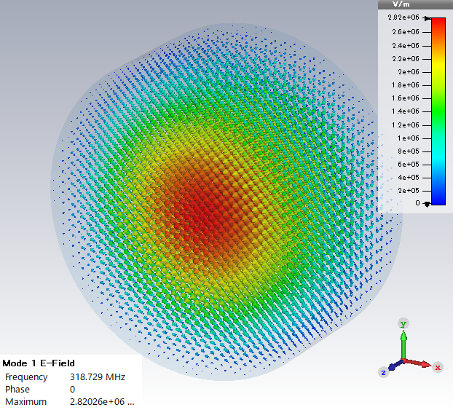
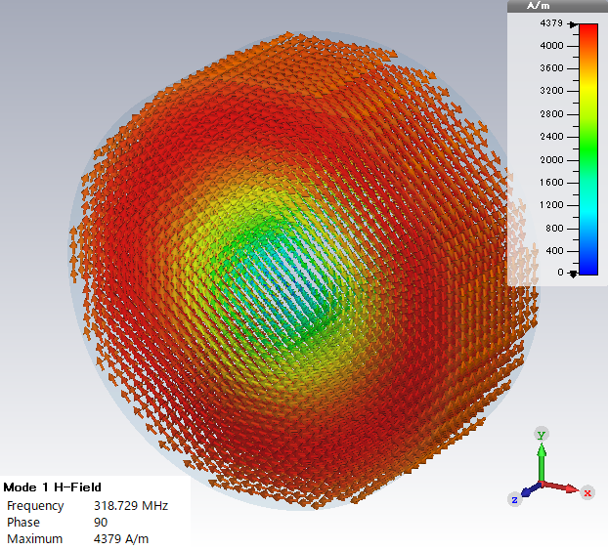
RF cavity
electric field
Particle acceleration longitudinally or transversely
Time varying electric and magnetic fields in a cavity
Resonate with the resonant frequency
Create large electric and magnetic fields
Those fields accelerate charged particles
magnetic field

Slide 16
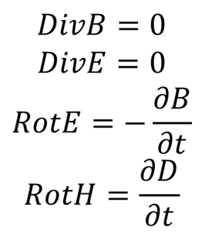
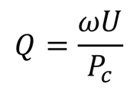
RF cavity
Resonant frequency and electro magnetic fields can be obtained from;
Maxell’s equations
Boundary conditions
Electro-magnetic fields decay in time due to the heating loss on the boundary
The ratio of the loss in one cycle Pc to stored energy U characterizes cavity performance
Quality factor: Q=ωU/Pc

Slide 17
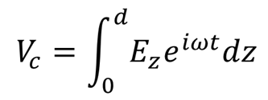
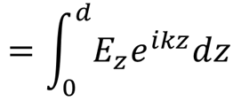
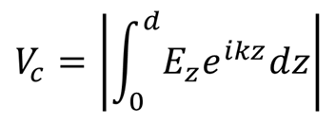
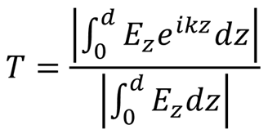
Beam acceleration
Lorentz force
Charged particle with speed of light enters into a cavity
Charged particles obtain acceleration: Lorentz force
We obtain the accelerating voltage when the cavity has longitudinal electric field
Accelerating voltage Vc
The EM fields vary in time
We have to take the travelling time of a particle into account
Transit time factor: T
The ratio of Vc to the maximum voltage

Slide 18
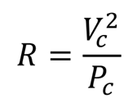
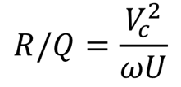
Shunt impedance
Shunt impedance
Important parameter
Ratio of Vc² to Pc
Efficiency of acceleration
In the lumped circuit theory; R=Vc²/Pc/2
R/Q
Another important parameter

Slide 19
Direction of acceleration
Longitudinal acceleration
Beam acceleration
Transverse acceleration
Beam deflection
Whole bunch deflects
Bunch rotation
Bunch head deflects
Bunch tail deflects, but in the opposite direction
Bunch center does not deflect
Crabbing
Deflection
V_{T}
φ
Rotation

Slide 20
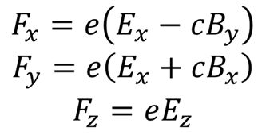
How to kick the beam
Lorentz force
Particle with v=c along z-axis
The force accelerates particles
Z-comp: acceleration
X-comp: horizontal kick
Y-comp: vertical kick
Horizontal kick voltage

Slide 21
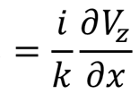
Panofsky-Wenzel theorem
Maxwell’s eq:
V_{x} can be given by E only
Note that the first 2 terms are combined
Its integral vanish at the boundary because Ex=o
V_{x} is given by the gradient of V_{z}
The TE mode does not kick the particle because Ez=0

Slide 22
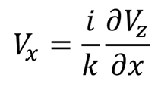
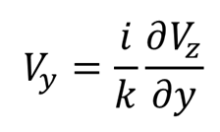
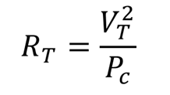
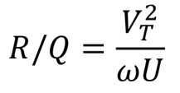
Kick voltage
Kick voltage
Horizontal kick
Vertical kick
Shunt impedance
T stands for x or y
R/Q

Slide 23
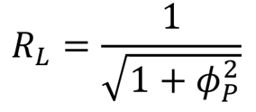
Voltage stability
Δθ
Voltage error: ΔV
Bunch rotation angle error: Δθ
Proportional to V
Geometrical reduction factor

Slide 24
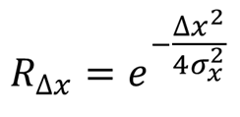
Phase stability
Δx
Phase error of one crab cavity: Δφ
Transverse kick of the bunch center
Proportional to Δφ
Bunch position offset at IP: Δx
Geometrical reduction factor
Absolute phase error of two crab cavities has no geometrical reduction
Both beams have the same offset at IP
Because Δx=0

Slide 25
Cavity type
Pill box
Rectangular cavity
Coaxial cavity

Slide 26
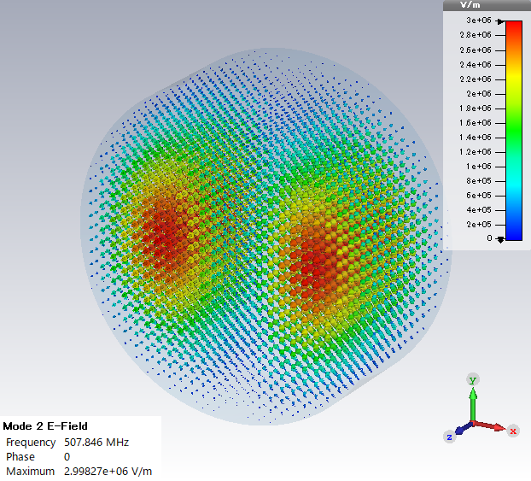
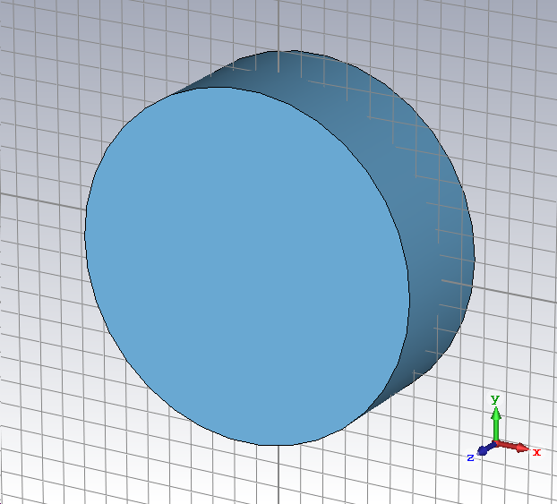
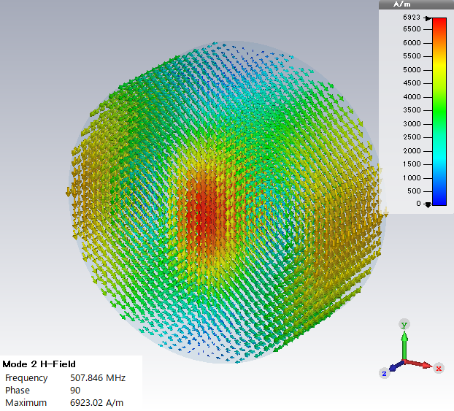
Crab cavity shape
E
Pill box type
TM110 dipole mode
500MHz
E- and H-field
Horizontal kick
R/Q~50
H

Slide 27
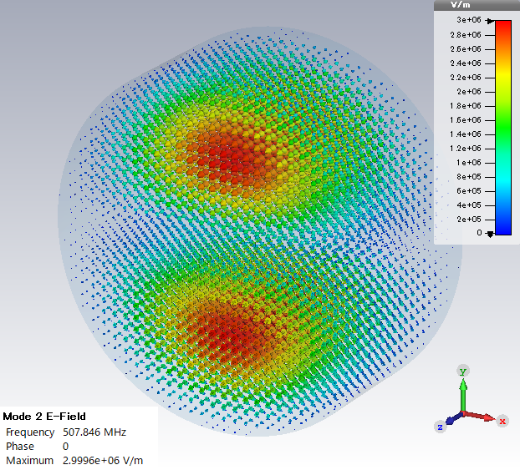
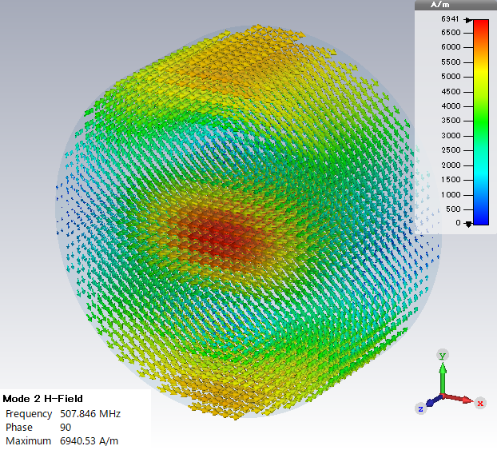
SOM
Same order mode
Unwanted polarization
Vertical kick
Same frequency

Slide 28
LOM
Lowest order mode
Fundamental mode
TM010 monopole mode
Lower frequency: 320 MHz
Accelerating mode
R/Q~100
Need to be heavily damped

Slide 29
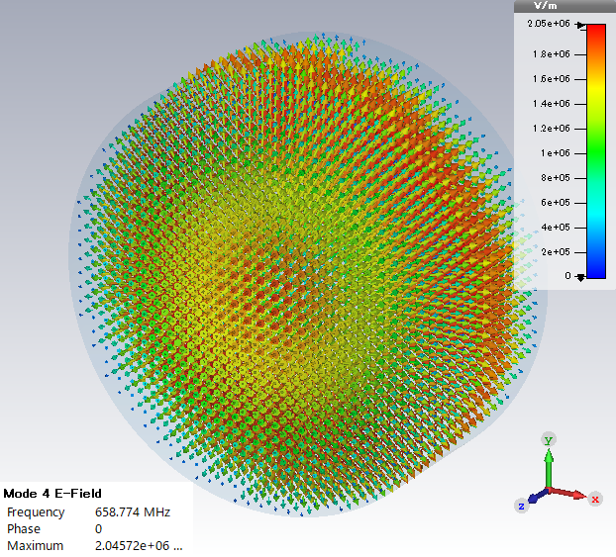
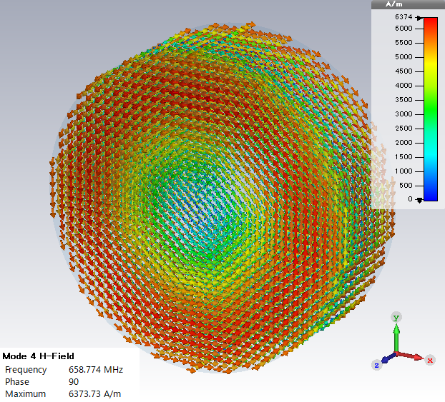
HOM
Higher order mode
TM011 monopole mode
Accelerating mode
Should be heavily dumped

Slide 30
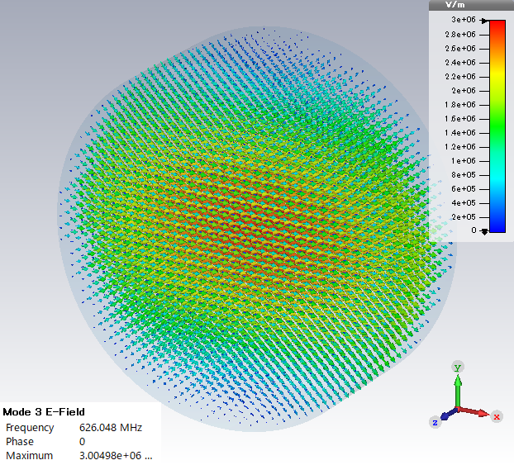
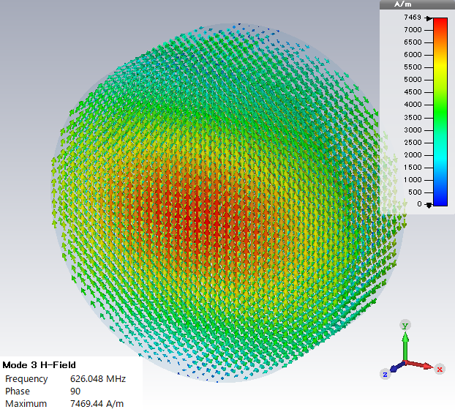
HOM, Crab cavity?
TE111 dipole mode
Crab cavity?
Answer is No!
Magnetic kick cancels electric kick
Remember Panofsky-Wenzel theorem
No kick when Ez=0

Slide 31
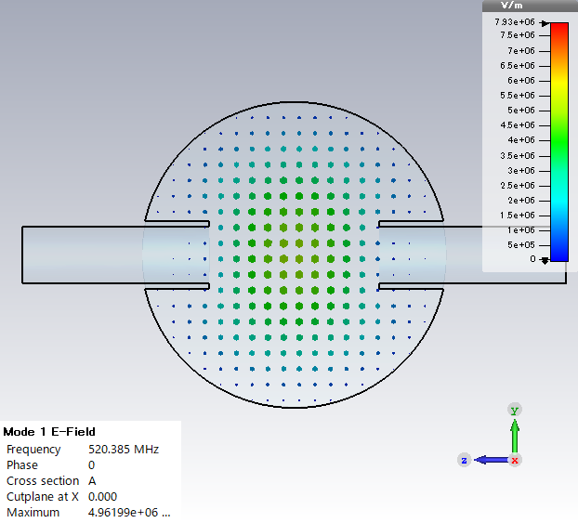
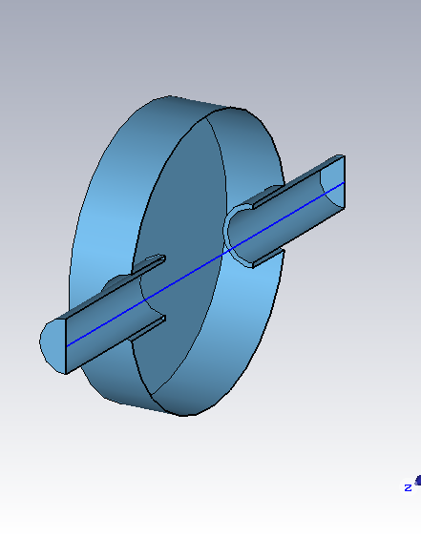
We can design TE-like cavity
TE cavity with beam pipe
Frequency: 500 MHz
If the beam pipes shield the magnetic field
We can obtain a horizontal kick
R/Q~40

Slide 32
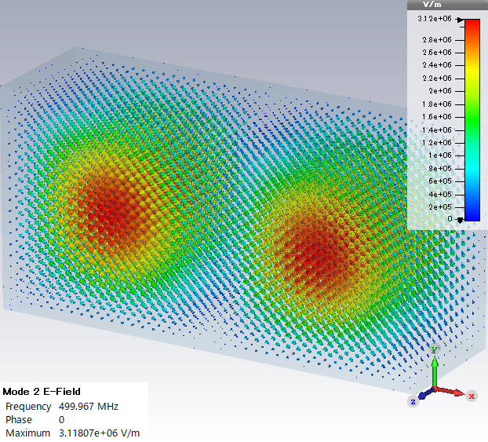
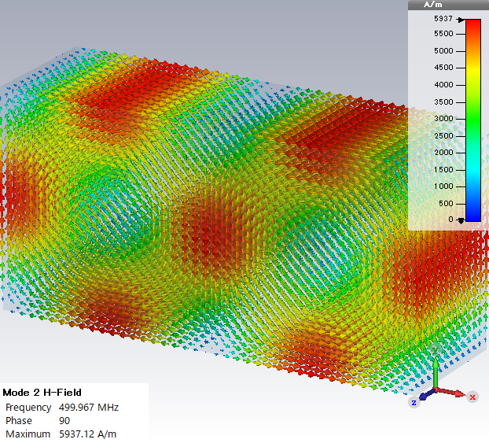
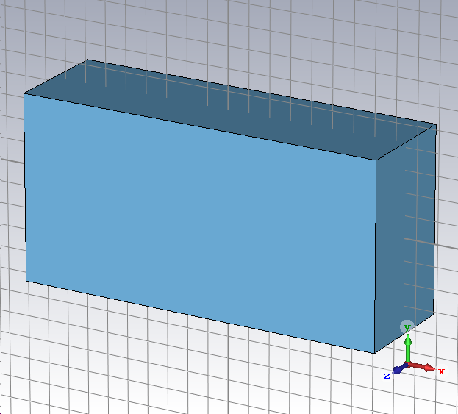
Rectangular cell
Crabbing mode, TM210
500MHz

Slide 33
SOM
TM120
Vertical kicking mode
Higher frequency than the crabbing mode
We can separate vertical kicking mode from horizontal kick mode

Slide 34
Crab cavity cell for KEKB
Required voltage: 1.4MV
Operating temperature: 4.4K
Squashed cell
Crabbing mode
TM210-like mode
509 MHz
Coaxial coupler
For LOM, SOM and HOMs damping

Slide 35
LOM, SOM and HOMs
Coaxial coupler propagates these modes
TEM: No cut-off (monopole)
TE11: fc=600 MHz (dipole)

Slide 36
LOM damping
Lowest order mode
Fundamental mode
Accelerating mode
R/Q~100
LOM can propagate as the TEM mode in the coaxial coupler
Coaxial ferrite RF absorber at the end of this coupler heavily damps this mode
Q~100
TEM mode in the coaxial coupler

Slide 37
SOM damping
Same order mode
Another polarization of crabbing mode
Frequency above 600 MHz by squeezing cavity cell
SOM can propagate as the dipole mode (TE11) in the coaxial coupler
The cut-off frequency is 600 MHz
Above the crabbing mode
Blow the SOM mode
TE mode in the coaxial coupler

Slide 38
HOM damping
Coaxial coupler and coaxial ferrite absorber
Monopole modes
Dipole mode above cut-off
Heavily damp those modes
Notch filter for crabbing mode rejection
Large beam pipe and ferrite RF absorbers
Monopole>900MHz
Dipole>750MHz

Slide 39
Compact crab cavities for LHC
Required for LHC application
Required voltage: 3MV
Frequency: 400 MHz
Operating temperature: 2K
Narrow space between beam pipes
Nominal beam separation: 194 mm
Beam pipe diameter: 84 mm
Can not use pill box type cavities
800MHz cavity clears size problem but the high frequency gives non-linear kick
194 mm

Slide 40
Quarter wave resonator
Compact cavity
Used for low beta beam accelerations
Low frequency application
If you make a 200MHz pill box cavity, its diameter should be 1 m.
Maximum E field exists at the open end of an inner conductor
Deflection by the E-field if the beams pass along the red line
Maximum H field exists at the short end of an inner conductor
Deflection by the H fields if the beams pass along the blue line
E fields also contributes the beam deflection
Beam acceleration
2 or 4 symmetrical configurations avoid acceleration

Slide 41
Four QWR configuration 4RCC
Consists of four QWRs
Use the E and B fields for beam deflection
R/Q～1000
No longitudinal acceleration
Not FM

Slide 42
Crabbing mode
400 MHz
Deflecting by E and H fields
No longitudinal acceleration
R/Q~1000

Slide 43
Fundamental mode
360 MHz
Accelerating mode

Slide 44
1st HOM
445 MHz
Deflecting mode

Slide 45
2nd HOM
446 MHz
Accelerating mode

Slide 46
４RCC（UK)
4-rod crab cavity
ULANC
Cavity size: 143x118 mm²
Cavity length: 500 mm
Peak E field: 32MV/m
Peak B-Field 61 mT
R/Q: 915
FM: 370 MHz
Not fundamental mode

Slide 47
Two QWR configuration DQW
Consists two QWRs
Mainly use the E-field for beam kick
No longitudinal acceleration
FM

Slide 48
Crabbing mode
400 MHz
Deflecting mainly by the E field
No longitudinal acceleration

Slide 49
HOM
410 MHz
Near the crabbing frequency
Well separate after longitudinal length optimization
Accelerating mode

Slide 50
Longitudinal length of the DQW
To obtain larger kick voltage
Deflecting area has to be increased
Optimize longitudinal length~λ/2
R/Q～500
HOM: 457 MHz

Slide 51
Transverse length
Increase of transverse length
Results in shorter inner conductor
160 to 100 mm
Increasing HOM frequency
575 MHz
Well above FM

Slide 52
DQW
Double quarter wave cavity
BNL
Vertical kick
FM
Cavity size: 142x122 mm²
Need slim waist to provide space for the other BP
Cavity length: 384 mm
Peak E field: 43MV/m
Peak B-Field 61 mT
R/Q: 345
HOM: 575 MHz

Slide 53
HOMs
HOMs are well separate from FM
Above 550 MHz
E-Field

Slide 54
HOM damping
HOMs are extracted by couplers
Hook-type coupler
Band stop filter at 400MHz
L-type high pass filter above 570MHz
HPC
HOM
Pickup
HOM
HOM

Slide 55
RFD
RF deflector
Same topology
Evolved from the parallel bar geometry
ODU/JLAB/SLAC
Horizontal kick
FM
Cavity size: 147x147 mm²
Cavity length: 600 mm
Peak E field: 33MV/m
Peak B-Field 56 mT
R/Q: 287
HOM: 580 MHz

Slide 56
Compact CC
400MHz, 3MV | RFD | 4RCC | DQW
Cavity radius (mm) | 147.5 | 143/118 | 142/122
Cavity length (mm) | 597 | 500 | 380
Beam pipe radius (mm) | 42 | 42 | 42
Peak E-field (MV/m) | 33 | 32 | 47
Peak B-field (mT) | 56 | 61 | 71
R/Q (Ω) | 287 | 915 | 318
Nearest mode (MHz) | 584 | 370 | 575
RFD and DQW were chosen for LHC CC

Slide 58
Analytical solution of EM fields
Consider EM fields in a rectangular cavity
Obtain analytical solutions of the TE011 mode
Calculate its kick voltage

Slide 59
Electro-magnetic fields
y
b
x
a
z
d

Slide 60
Integration of analytical solution
Calculate kick voltage for the TE mode in a rectangular cavity
Electromagnetic fields are given
A particle passes at x=a/2, y=b/2
Time factor

Slide 61
Integration of analytical solution
Calculate kick voltage for the TE mode in a rectangular cavity
Real part
Imaginary part

Slide 62
Integration of analytical solution
Calculate kick voltage for the TE mode in a rectangular cavity
Kick voltage
Field integration along beam passage
Real part=0
Imaginary part=0
Kick voltage=0

