Slide 1
Beckhoff EK9000 Device Support
Jeremy Lorelli, SLAC National Accelerator Laboratory

Slide 2
The Ecosystem At LCLS
Very invested in the Beckhoff ecosystem
TwinCAT
PLCs (CX5XXX series)
EL terminals
Wouldn’t it be great if we could use existing EL terminals without needing an ADS IOC or PLC?

Slide 3
EK9000: What is it?
EtherCAT EBus to Modbus TCP/UDP coupler
Allows us to easily talk to E-Bus terminals over Modbus TCP/UDP
PDOs are mapped to the device’s modbus register space
Can still write to CoE parameters
Easy to deploy
Only need a network connection between the device and your IOC
Cheaper & easier than using a PLC or an EtherCAT -> EBus coupler for the same thing

Slide 4
EK9000: Capabilities & Reasons to Use
Can talk to most Beckhoff E-Bus terminals
EL1XXX, EL2XXX, EL3XXX, EL4XXX, EL5XXX, etc.
ES terminals not supported
Does not support the older K-Bus terminals (KLXXXX devices)
Motor terminal support (EL7000 series)
Not a replacement for PLCs
Needs a bit more work and testing on the device-support side
Economical - Saves time & money

Slide 5
EK9000: Capabilities (Cont.)
Modbus TCP/UDP
Simple and flexible
IOCs can be deployed on any system with a network stack
IOC is easy to containerize
Only needs a network bridge with the host
Many proven tools for debugging problems
Ping, traceroute, wireshark, etc.

Slide 6
Example IOC Setup

Slide 7
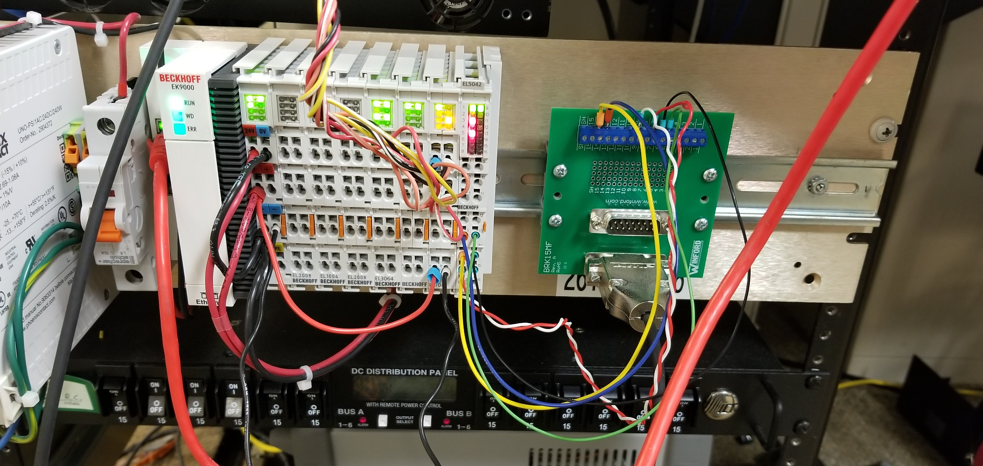
EK9000: Example Rail
EL2008 (8-output bo)
EL1004 (4-input bi)
EL2008 (8-output bo)
EL3064 (4-input ai)

Slide 8
EK9000: Example Rail Setup
ek9000Configure("EK9K1", "127.0.0.1", 502, 5)
# ek9k recordbase type position
ek9000ConfigureTerminal("EK9K1", "BO:1", "EL2008", 1)
ek9000ConfigureTerminal("EK9K1", "BI:1", "EL1004", 2)
ek9000ConfigureTerminal("EK9K1", "BO:2", "EL2008", 3)
ek9000ConfigureTerminal("EK9K1", "AI:1", "EL3064", 4)
# Load your records below here

Slide 9
Example Use Cases
at LCLS

Slide 10
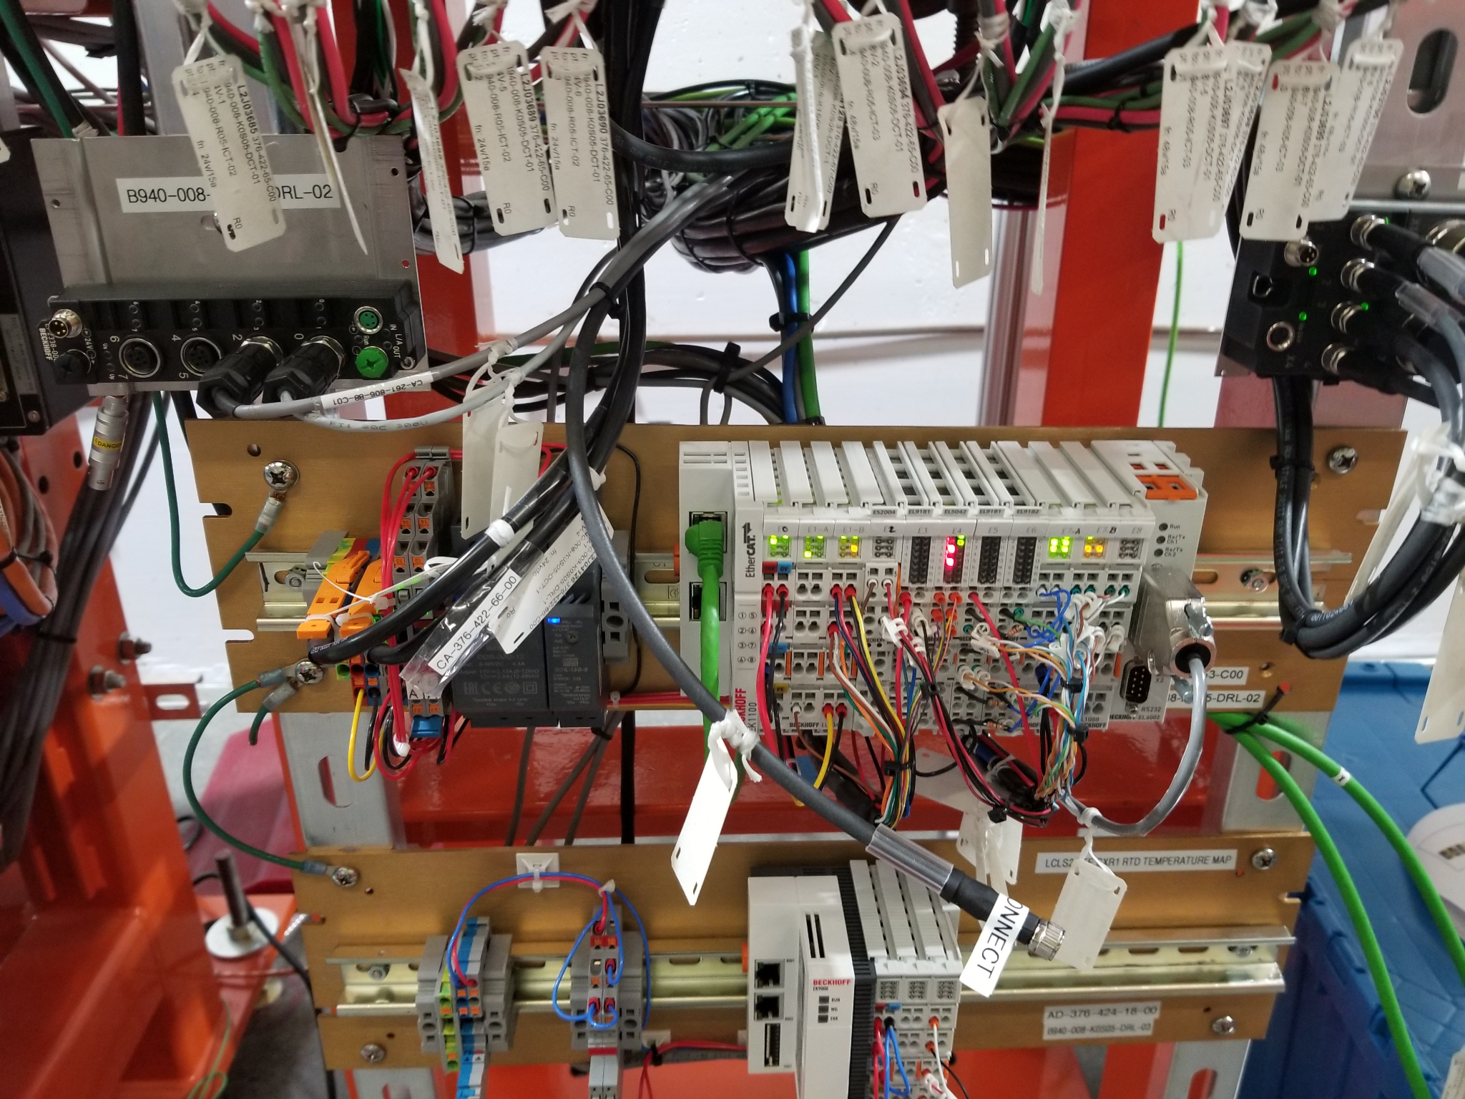
EK9000: Example Use Case #1
Needed to track temperatures on mirrors and granite in the FEE
Already have cat5 cables routed throughout the FEE
Using a PLC would be overkill
Already have EL terminals capable of interfacing with RTDs
Solution: Deploy a couple of ek9000’s!

Slide 11
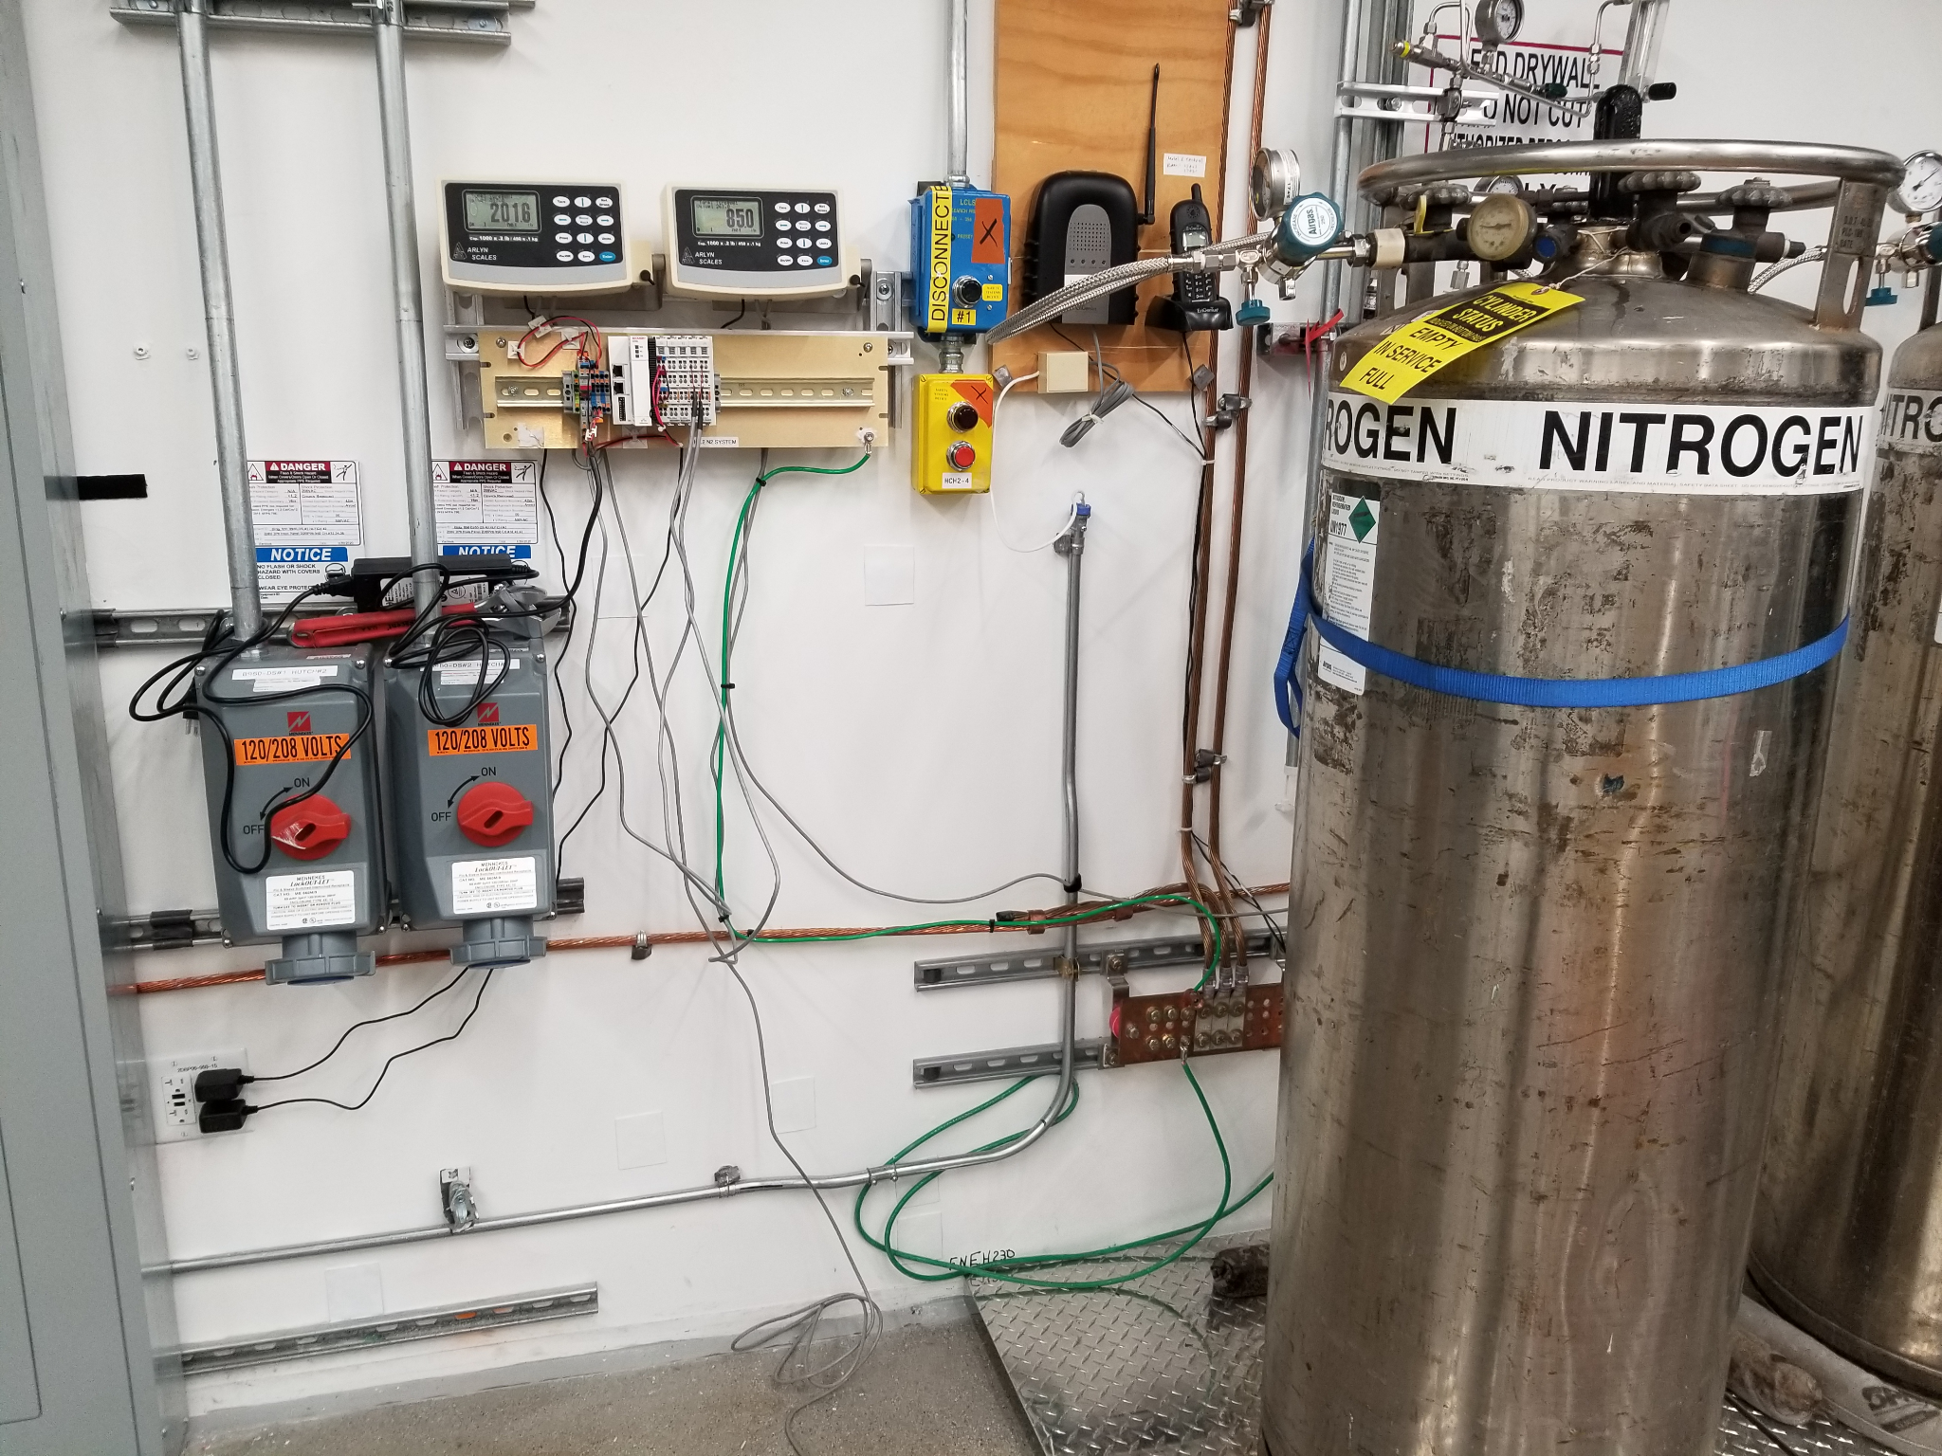
EK9000: Example Use Case #2
Need to track the net weight of two large liquid nitrogen dewars
Located inside the hutch, can’t read the scale during the experiment
Just need something quick + easy to setup/deploy
Solution: Deploy an ek9000 with an analog input terminal

Slide 12
EK9000: Containerization
Lots of talks about containerization this year!
Modbus TCP + CA = Easy IOC to containerize
~42 line dockerfile
Uses docker-compose to run
~3gb image produced (Debian stable + all of the required EPICS modules + object files not cleaned)
More info here: https://github.com/JJL772/ek9000-ioc-docker

Slide 13
Links
https://github.com/slaclab/epics-ek9000
https://github.com/JJL772/ek9000-ioc
https://github.com/JJL772/ek9000-ioc-docker
https://www.beckhoff.com/en-us/products/i-o/ethercat-terminals/ekxxxx-bus-coupler/ek9000.html

Slide 14
Thanks for listening!

